Slide 1
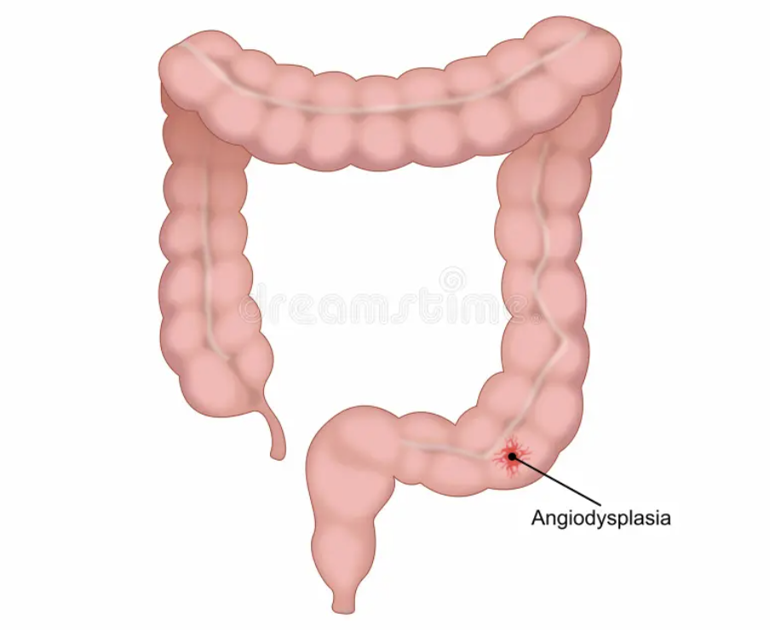
بِسْمِ اللّٰهِ الرَّحْمٰنِ الرَّحِيْمِ
Prof. Zahid Mahmood

Slide 2
Clinical Scenario
Elderly patient presents with unexplained anemia
Intermittent rectal bleeding episodes reported
No obvious source found on examination
What is likely cause and management
Angiodysplasia of intestine

Slide 3
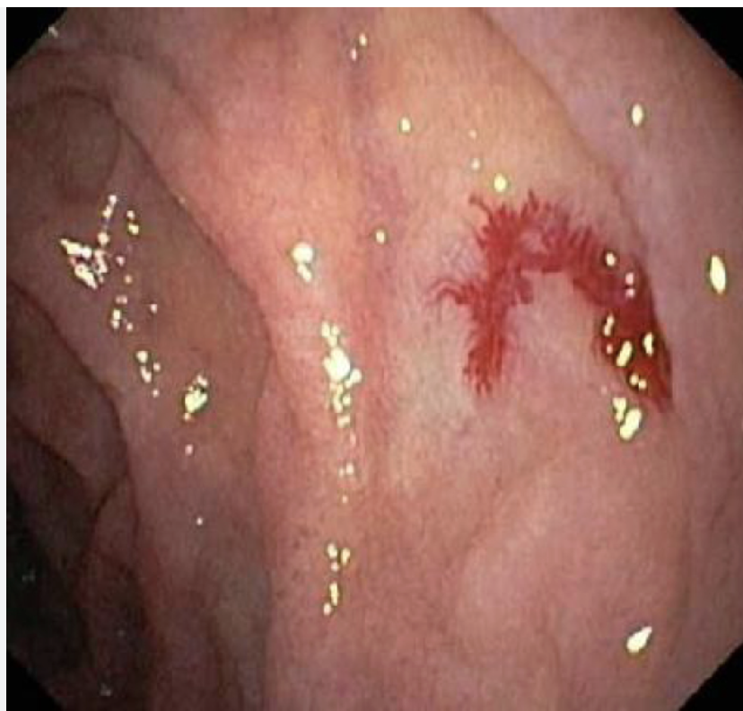

Slide 4
Learning Outcomes
Define angiodysplasia of intestine clearly
Describe clinical features and associations
Explain investigations for diagnosis localization
Outline management of acute bleeding cases

Slide 5
Definition
Angiodysplasia is vascular malformation of bowel
Composed of dilated tortuous submucosal vessels
Commonly affects colon especially right side
Important cause lower gastrointestinal bleeding

Slide 6
Epidemiology
Occurs commonly in elderly above sixty years
Degenerative vascular changes underlying mechanism
Right colon most frequently involved site
Often underdiagnosed cause of bleeding

Slide 7
Pathophysiology
Chronic obstruction of submucosal veins occurs
Leads to dilated fragile vascular channels
Predisposes to intermittent or massive bleeding
Located mainly in right colon segments

Slide 8
Clinical Features
Chronic anemia due occult blood loss
Intermittent painless rectal bleeding episodes
Melena may occur in some patients
Severe bleeding occurs in minority cases

Slide 9
Association
Associated with aortic stenosis condition
Known as Heyde syndrome clinically
May involve acquired bleeding disorders

Slide 10
Colonoscopy Findings
Shows small reddish vascular lesions
Lesions appear raised flat mucosal areas
Usually located in right colon
May need repeated exams for detection

Slide 11
Imaging
CT angiography detects active bleeding site
Shows contrast blush vascular lesion
Requires adequate bleeding rate present
Useful for localization and intervention

Slide 12
Nuclear Scan
Technetium labeled red cell scan used
Detects intermittent slow bleeding sources
Helps localize bleeding not seen elsewhere
Useful when CT angiography negative

Slide 13
Initial Management
Stabilize patient with fluids blood
Assess hemodynamic status immediately
Correct anemia electrolyte imbalance
Stop anticoagulants if clinically indicated

Slide 14
Endoscopic Treatment
Colonoscopy allows visualization of lesion
Cauterization controls bleeding effectively
Argon plasma coagulation useful method
Preferred in stable localized lesions

Slide 15
Interventional Radiology
CT angiography enables embolization therapy
Selective embolization controls bleeding
Minimally invasive alternative to surgery
Useful in high risk patients

Slide 16
Surgical Management
Required in severe uncontrolled bleeding
Segmental resection if site identified
Subtotal colectomy if source unknown
On table colonoscopy helps localization

Slide 17
Viva Points
Elderly anemia think angiodysplasia cause
Right colon most common site
Associated with aortic stenosis syndrome
CT angiography best investigation

Slide 18
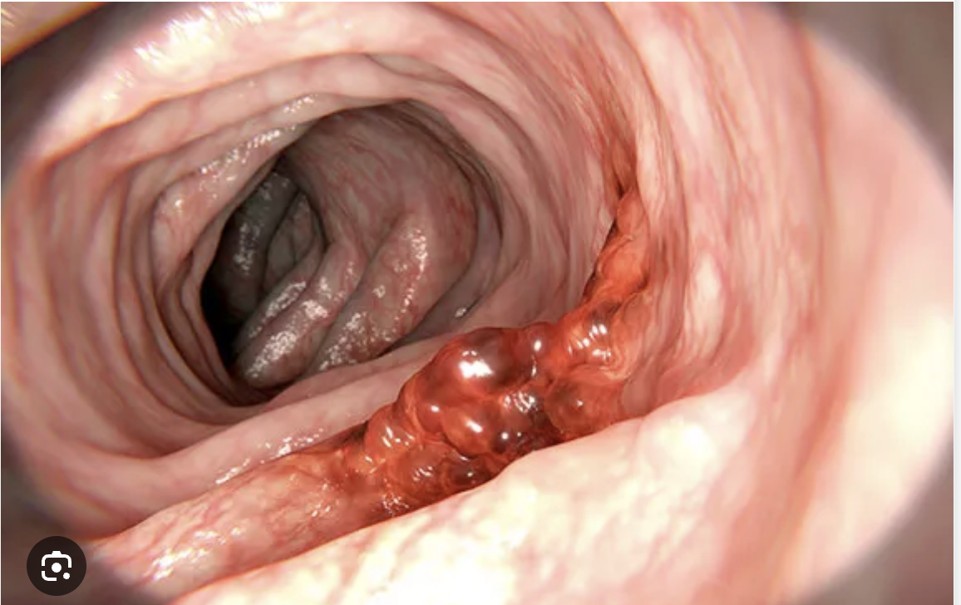
  Colorectal Carcinoma

Slide 19
Learning Outcomes
Define colorectal carcinoma clearly
  Explain adenoma carcinoma sequence
  Stage disease Dukes and TNM
  Plan surgery and adjuvant therapy

Slide 20
Epidemiology
Second leading cancer death cause
  Forty two thousand cases yearly
  Male predominance slight increase
  Peak incidence elderly population

Slide 21
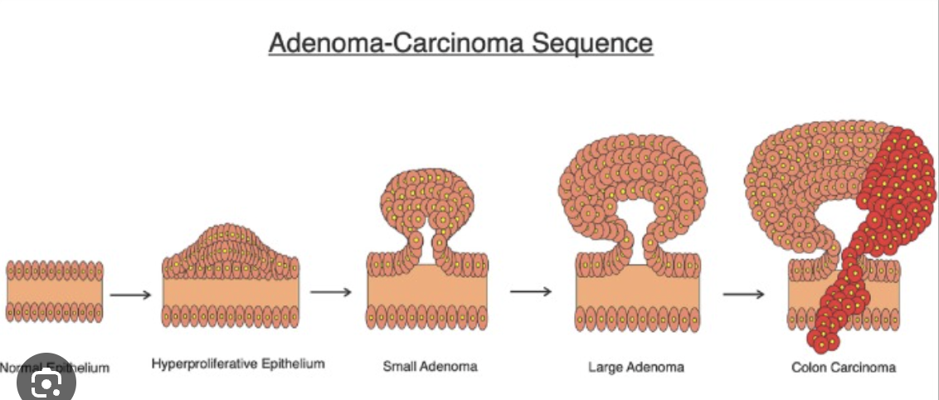
Adenoma-Carcinoma Sequence
Most cancers arise from adenomas
  APC mutation early event
  K-ras mutation intermediate stage
  p53 mutation indicates invasion

Slide 22
Risk Factors
Diet rich red meat increases risk
  Inflammatory bowel disease predisposes malignancy
  Smoking alcohol increase incidence
  Fibre intake protective effect

Slide 23
Hereditary Syndromes
Lynch syndrome DNA mismatch repair defect
  Amsterdam criteria clinical diagnosis
  FAP multiple polyps colon
  Prophylactic colectomy prevents malignancy

Slide 24
Molecular Subtypes
CMS1 microsatellite instability subtype
  CMS2 canonical WNT pathway
  CMS3 metabolic dysregulation tumors
  CMS4 mesenchymal worst prognosis

Slide 25
Pathology
Annular tumors cause obstruction
  Ulcerating lesions cause bleeding
  Rectum commonest site involvement
  Adenocarcinoma most common histology

Slide 26
Spread of Disease
Local invasion adjacent structures
  Lymphatic spread sequential nodal involvement
  Hematogenous spread liver common
  Transcoelomic spread peritoneum ovaries

Slide 27
Dukes Classification
Stage A limited mucosa involvement
  Stage B beyond muscularis propria
  Stage C lymph node involvement
  Stage D distant metastasis present

Slide 28
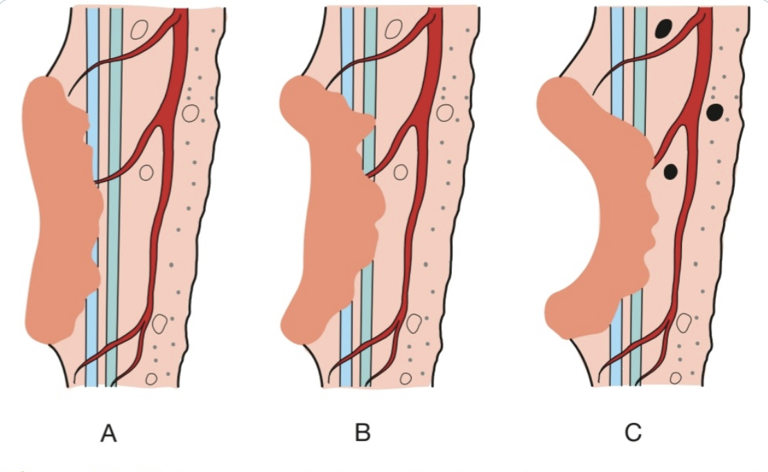

Slide 29
TNM Staging
T1 submucosa T2 muscularis
  T3 beyond muscularis T4 adjacent invasion
  N1 one to three nodes
  N2 four or more nodes

Slide 30
Clinical Features
Left colon altered bowel habit
  Rectal bleeding common symptom
  Right colon anemia mass
  Emergency presentation obstruction perforation

Slide 31
Investigations
Colonoscopy gold standard diagnosis
  Biopsy confirms adenocarcinoma
  CT TAP staging modality
  MRI pelvis rectal cancers

Slide 32
Screening
FIT test screening tool
  Reduces mortality significantly
  Positive test requires colonoscopy
  Early detection improves survival

Slide 33
Right-Sided Surgery
Right hemicolectomy standard procedure
  Includes ileocolic vascular ligation
  Complete mesocolic excision recommended
  Primary anastomosis usually safe

Slide 34
Left-Sided Surgery
Left hemicolectomy sigmoid cancers
  High ligation inferior mesenteric artery
  Primary anastomosis selected patients
  Hartmann procedure emergency setting

Slide 35
Emergency Surgery
Obstruction perforation bleeding emergencies
  Right colon resection safe
  Left colon staged procedures
  Stenting converts emergency elective

Slide 36
Adjuvant Therapy
Stage three requires chemotherapy
  FOLFOX standard regimen used
  Stage two selective chemotherapy
  Targeted therapy metastatic disease

Slide 37
Prognosis
Overall survival fifty eight percent
  Stage A excellent prognosis
  Stage D poor survival
  Early detection improves outcomes

Slide 38
Follow-up
CEA monitoring detects recurrence
  CT scan follow-up surveillance
  Detect liver metastasis early
  Long-term follow-up essential

Slide 39
Complications
Anastomotic leak serious complication
  Wound infection common postoperative issue
  Bowel obstruction late complication
  Liver metastasis disease progression

Slide 40
High Yield Points
APC K-ras p53 sequence
  Rectum most common site
  Dukes C requires chemotherapy
  Stenting avoids emergency surgery

Slide 41
Final Summary
Adenoma carcinoma sequence important
  Early diagnosis improves survival
  Surgery mainstay treatment modality
  Follow-up essential long-term

Slide 42
Clinical Scenario
Patient presents with pruritus bleeding lesions
Irregular pigmentation around anal margin seen
History of HPV or immunosuppression present
What is diagnosis and management approach

Slide 43
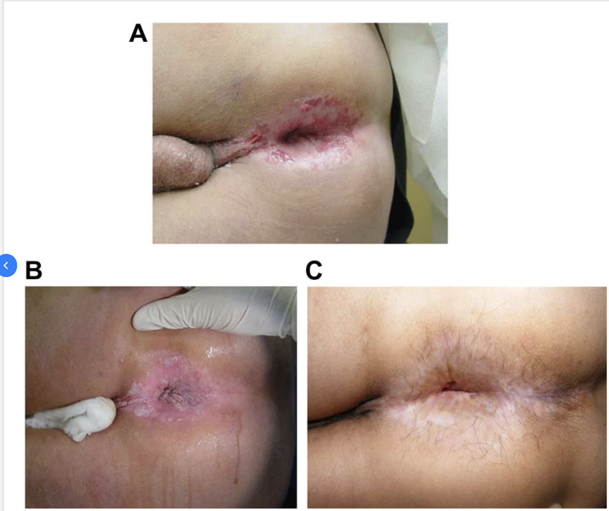

Slide 44
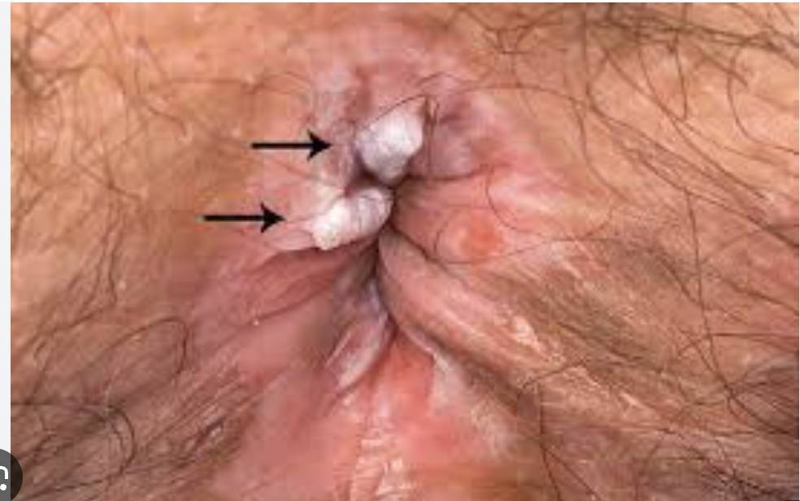

Slide 45
Learning Outcomes
Define anal intraepithelial neoplasia(AIN) clearly
Classify disease based on dysplasia severity
Explain clinical features and risk factors
Outline diagnosis and management strategies

Slide 46
Definition
AIN is dysplasia of anal epithelium
Associated with human papillomavirus infection
Multifocal lesions involving perianal region
Premalignant condition for anal carcinoma

Slide 47
Epidemiology
Prevalence less than one percent population
Increasing incidence in high risk groups
Common in HIV immunocompromised patients
Associated with anogenital intraepithelial neoplasia

Slide 48
Etiology
HPV infection major causative factor
Types sixteen eighteen linked carcinoma risk
Types six eleven cause warts lesions
Immunosuppression increases disease progression

Slide 49
Classification
AIN one mild dysplasia lower third
AIN two moderate dysplasia intermediate thickness
AIN three severe dysplasia full thickness
Similar classification cervical intraepithelial neoplasia

Slide 50
Pathophysiology
HPV induces epithelial dysplastic changes
Loss of keratinocyte maturation occurs
Progression from low to high grade
May lead to invasive carcinoma

Slide 51
Clinical Features
May be asymptomatic detected incidentally
Pruritus pain bleeding discharge symptoms
Lesions raised flat or pigmented
Ulceration suggests invasive malignancy

Slide 52
Examination
White red brown irregular lesions visible
Hyperkeratosis seen high grade lesions
Condylomata associated in many patients
Biopsy essential for confirmation

Slide 53
Diagnosis
Targeted biopsy confirms dysplasia grade
Mapping biopsies assess disease extent
Anoscopy acetic acid highlights lesions
Lugol iodine enhances abnormal areas

Slide 54
Natural History
AIN one two may regress spontaneously
AIN three higher progression risk
Ten percent progress to carcinoma
Immunocompromised higher progression rates

Slide 55
Management
Depends on grade and disease extent
Low grade lesions monitored regularly
High grade requires active treatment
Regular follow up essential

Slide 56
Surgical Management
Local excision for focal disease
Wide excision for extensive disease
Avoid excision causing anal stenosis
Flap graft closure if needed

Slide 57
Medical Management
Topical imiquimod useful regression
Retinoids reduce dysplastic progression
HPV vaccination preventive strategy
Multidisciplinary care improves outcomes

Slide 58
Viva Points
AIN associated with HPV infection
High grade risk carcinoma progression
Biopsy essential for diagnosis
Regular surveillance especially immunocompromised

