Slide 1


Slide 2
Diverticular Disease of the Colon & Meckel’s Diverticulum
بسم الله الرحمن الرحيم
Prof. Zahid Mahmood

Slide 3
Guess Diagnosis
A 72-year-old male from Lahore presents to the emergency department with a 2-day history of worsening left lower abdominal pain, low-grade fever, and absolute constipation. On physical examination, his heart rate is 105 bpm and his temperature is 101°F. There is marked tenderness and a palpable, tender mass in the left iliac fossa. Bowel sounds are sluggish. A CECT scan of the abdomen reveals significant sigmoid wall thickening and a localized 5 cm fluid collection containing gas bubbles within the sigmoid mesentery.

Slide 4
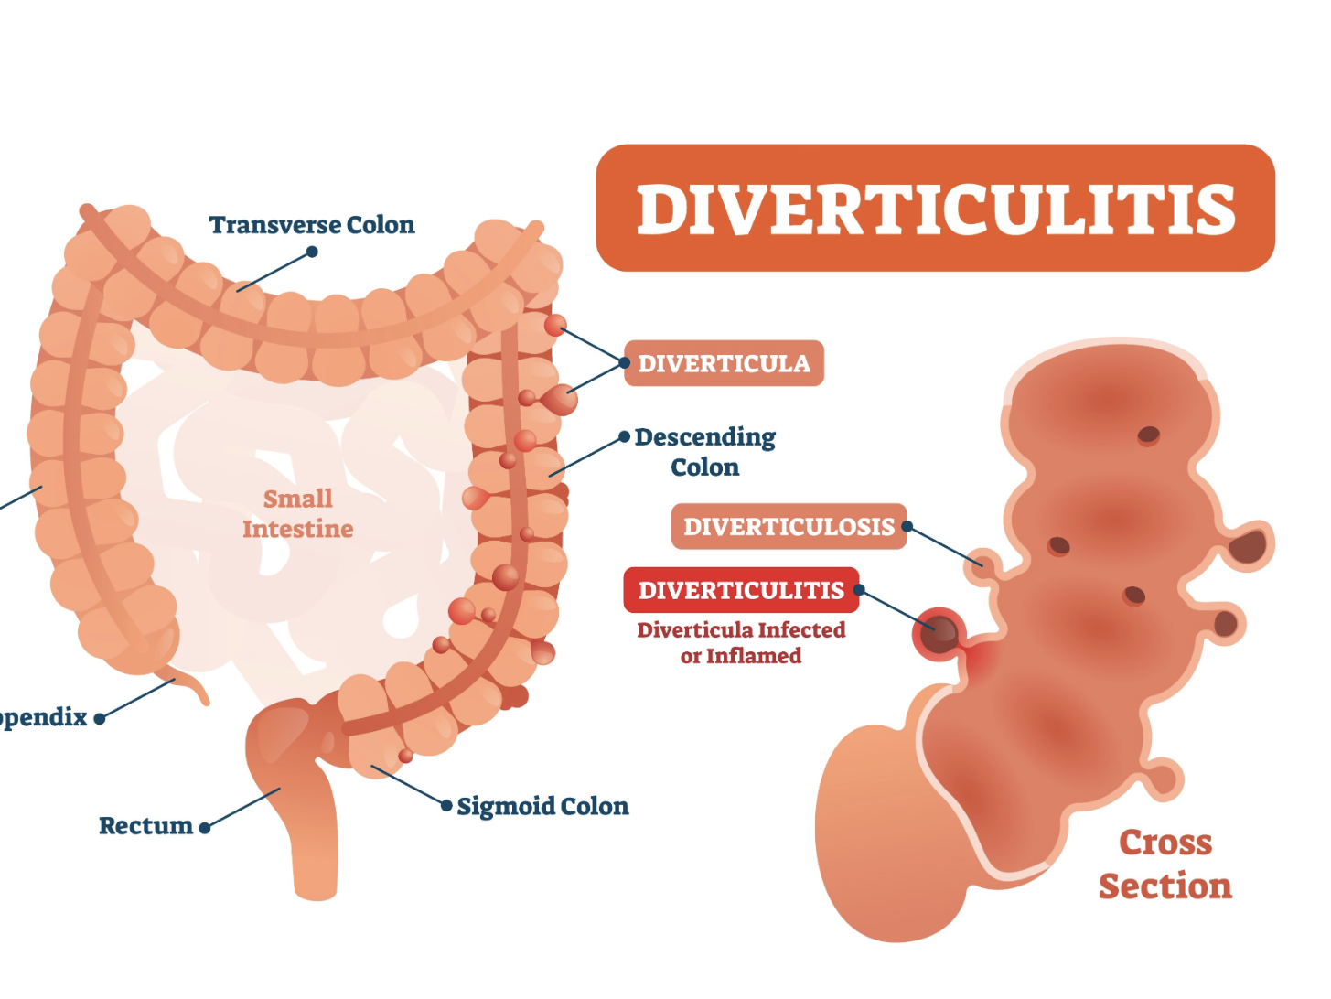

Slide 5
Learning Objectives
Define and classify diverticula (True vs False)
Understand the Rule of 2s for Meckel’s diverticulum
Explain pathophysiology and Hinchey classification
Recognize clinical presentations including left‑sided appendicitis
Outline conservative and surgical management

Slide 6
Definitions
Diverticulum
blind ending pouch arising from hollow viscus
True diverticulum:
contains mucosa, submucosa, muscularis, serosa (e.g., Meckel’s)
False diverticulum:
mucosa and submucosa herniate through muscle layer, sigmoid diverticulosis

Slide 7
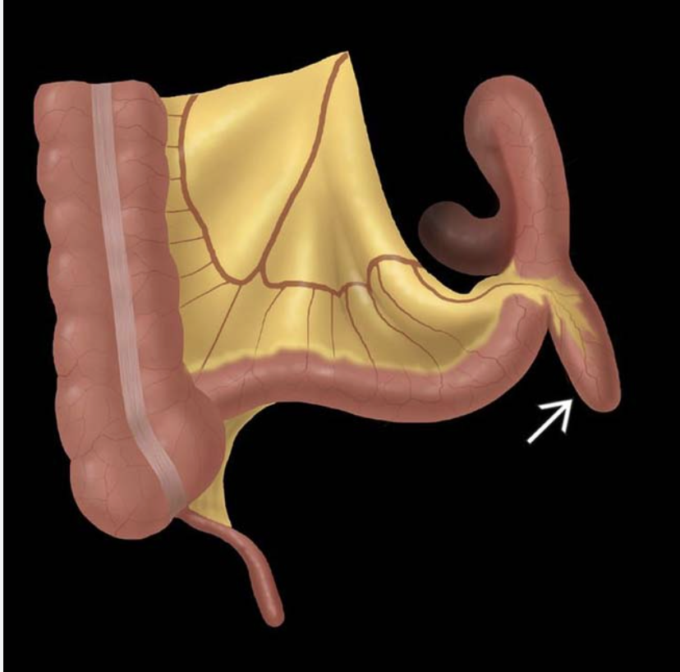
Meckel’s Diverticulum
Facts
persistent Vitello intestinal duct
antimesenteric border of ileum
vitelline artery remnant from SMA
gastric mucosa (common), pancreatic tissue

Slide 8
Rule of 2s
Occurs in 2% population
2 feet proximal to ileocecal valve
2 inches long
2 types ectopic tissue (gastric & pancreatic)
2 times more common in males
Usually presents before age 2

Slide 9
Etiology & Risk Factors
Low fiber diet
Increased intraluminal pressure
Age above 60
Weak points where vasa recta penetrate bowel wall
Connective tissue disorders (Ehlers‑Danlos, Marfan)

Slide 10
Pathophysiology of Diverticulosis
Law of Laplace: P = T / R
Narrow sigmoid colon generates high pressure
Muscle hypertrophy of taenia coli
Fecolith obstruction leads to diverticulitis
Constipation (Chronic )

Slide 11
Clinical Features – Colonic
Often asymptomatic
Chronic left iliac fossa pain
Pain relieved by flatus or defecation
Acute diverticulitis: fever, LIF pain, leukocytosis
Complications: fistula, obstruction, pericolic abscess

Slide 12
Clinical Features – Meckel’s
Painless rectal bleeding in children
Diverticulitis mimicking appendicitis
Intestinal obstruction from intussusception or volvulus

Slide 13
History & Physical Examination
Assess fiber intake and bowel habits
Character of PR bleeding
Fever and tachycardia
Left iliac fossa tenderness
Possible sigmoid mass
Digital rectal exam essential

Slide 14
Important Investigations
CT abdomen pelvis – gold standard
Meckel scan (Tc‑99m pertechnetate)
Erect abdominal X‑ray for perforation
Water soluble contrast enema for fistula

Slide 15
Hinchey Classification
Stage I – Pericolic abscess
Stage II – Pelvic abscess
Stage III – Purulent peritonitis
Stage IV – Fecal peritonitis

Slide 16
Differential Diagnosis
Sigmoid carcinoma
Ischemic colitis
Crohn disease
Appendicitis
Mesenteric adenitis
Ectopic pregnancy

Slide 17
Management
Hinchey I & II → conservative treatment
1
Hinchey III & IV → emergency surgery
2
Asymptomatic diverticulosis → high fiber diet
3

Slide 18
Conservative Management
Bowel rest and hospital admission
IV fluids
Antibiotics: ciprofloxacin + metronidazole
Pain control (avoid morphine)

Slide 19


Slide 20
Emergency Surgical Treatment
Hartmann procedure
Sigmoid resection
Rectal stump closure
End colostomy formation
Primary anastomosis in selected cases

Slide 21
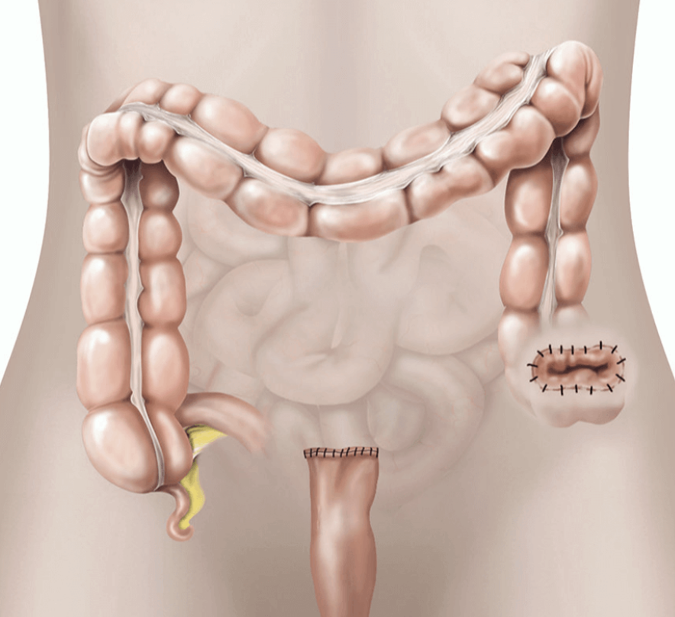
Hartmann procedure

Slide 22
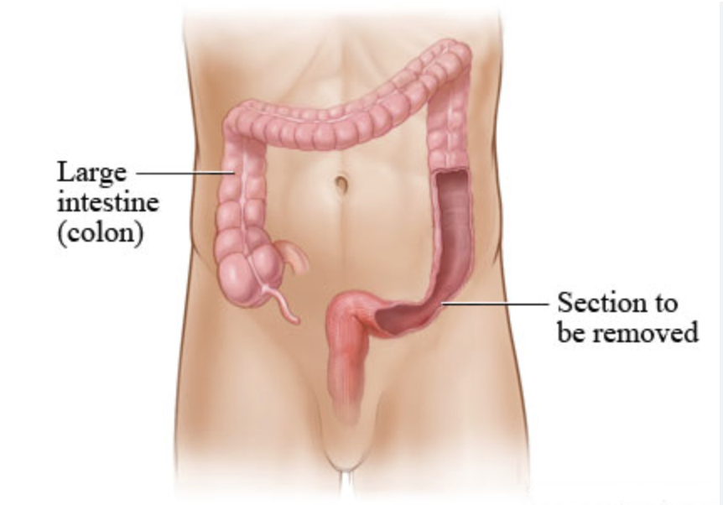
Sigmoid resection

Slide 23
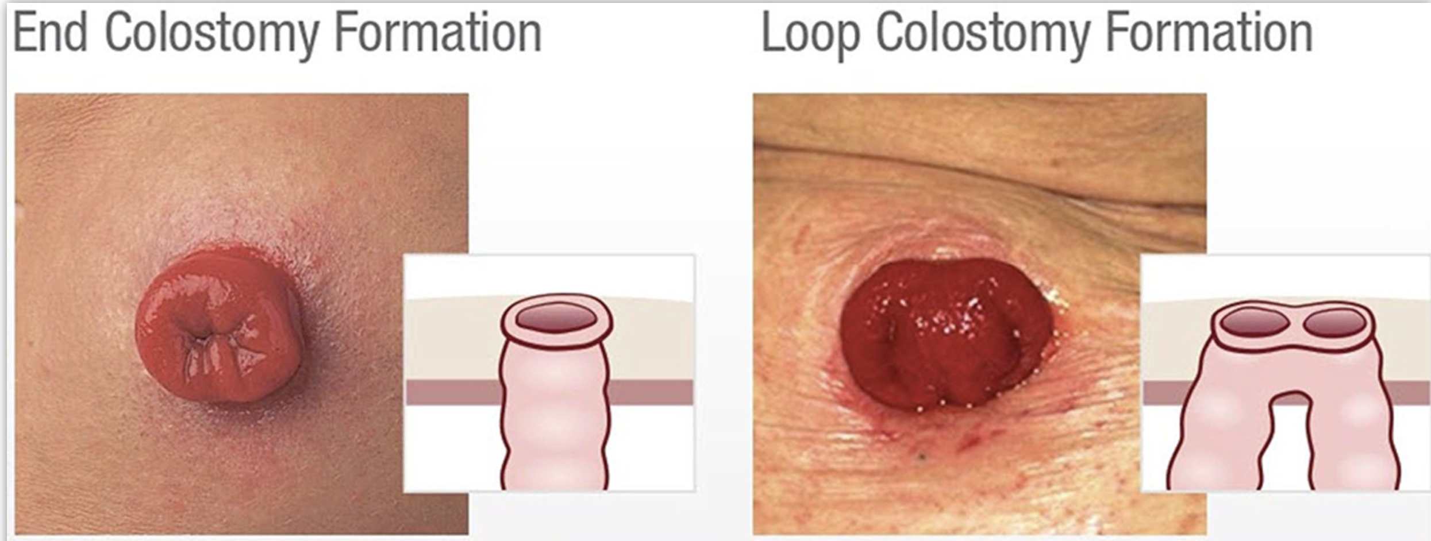
End colostomy formation

Slide 24
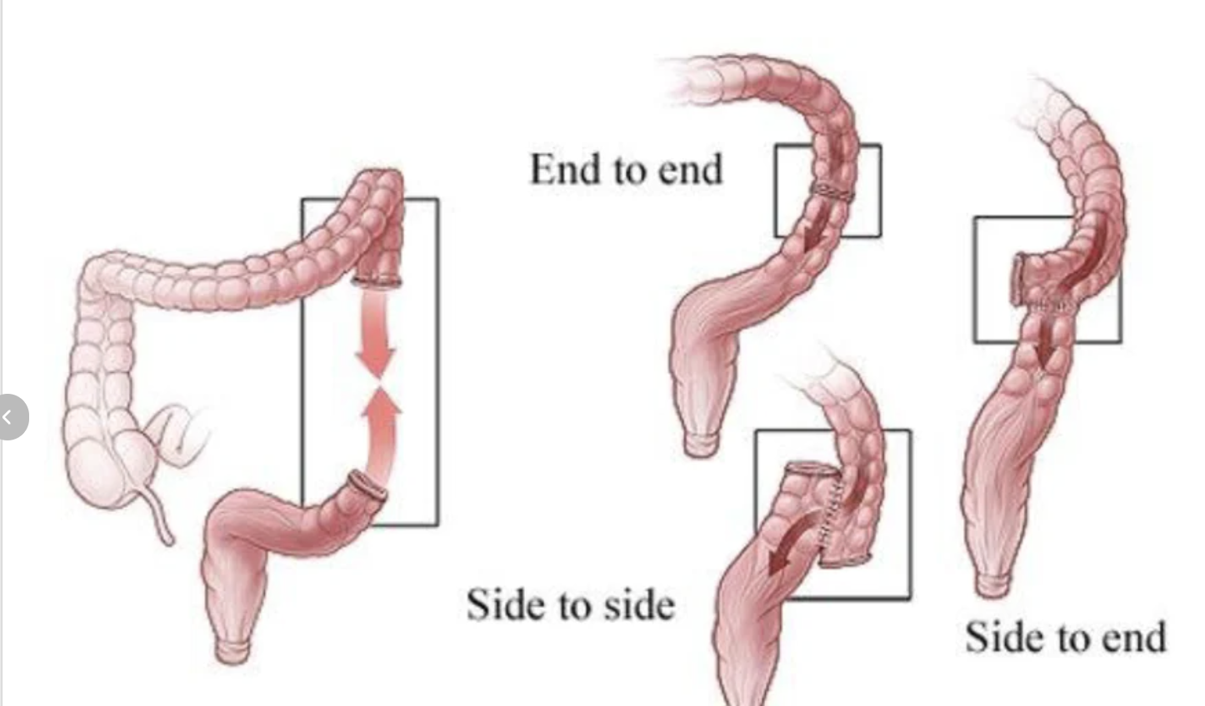
Primary anastomosis in selected cases

Slide 25
Operative Principles
Protect the left ureter
Search distal 2 feet of ileum for Meckel’s if appendix normal
Wedge resection for simple Meckel diverticulitis

Slide 26
Postoperative Care & Complications
Monitor stoma viability
Anastomotic leak
Wound infection
Pelvic abscess
Late: incisional hernia or adhesive obstruction

Slide 27
Sentinel loop: localized ileus on X‑ray
Avoid colonoscopy in acute diverticulitis
Diverticular string sign indicates luminal narrowing

Slide 28
Most common site: sigmoid colon
Most common complication: perforation
Most common ectopic tissue in Meckel: gastric mucosa
Standard treatment for Hinchey IV: Hartmann procedure

Slide 29
Diverticular disease increasingly common
CT scan guides management
Medical treatment for mild disease
Always consider Meckel’s in pediatric GI bleeding

Slide 30
A 72-year-old male presents with sudden onset of profuse, painless rectal bleeding. He is hemodynamically stable. A previous colonoscopy showed extensive diverticulosis. What is the most likely source of his bleeding?
A. Eroded vasa recta at the neck of a diverticulum
B. Inflammation of the mucosal lining
C. Rupture of a pericolic abscess into a vessel
D. Malignant transformation of a diverticulum
E. Associated internal haemorrhoids
Key A

Slide 31
During a clinical viva, a student is asked why the rectum is rarely involved in acquired diverticular disease. The correct anatomical reason is:
A. The rectum has a higher threshold for intraluminal pressure
B. The rectum has a complete longitudinal muscle coat
C. The vasa recta do not penetrate the rectal wall
D. The rectum contains more elastic fibers than the sigmoid
E. The rectal lumen is too narrow for herniation
Key B

Slide 32
A 60-year-old female with a known history of sigmoid diverticulitis presents with recurrent UTIs and complains of "bubbles" in her urine. Which investigation is most likely to confirm the suspected complication?
A. Mid-stream urine culture
B. Diagnostic Laparoscopy
C. CECT Abdomen and Pelvis
D. Rigid Proctoscopy
E. Intravenous Urogram (IVU)
Key C

Slide 33
A patient undergoes an emergency laparotomy for perforated diverticulitis. Intraoperatively, the surgeon finds gross faecal contamination and a ruptured sigmoid colon. According to the Hinchey classification, this is:
A. Grade I
B. Grade II
C. Grade III
D. Grade IV
E. Grade V
Key D

Slide 34
In the management of a Hinchey Grade II pelvic abscess that is 5cm in diameter, what is the treatment of choice in a stable patient?
A. Immediate Hartmann's procedure
B. Sigmoid resection with primary anastomosis
C. Long-term oral antibiotics only
D. Ultrasound or CT-guided percutaneous drainage
E. Emergency loop ileostomy
Key D

Slide 35
A 50-year-old man is recovering from his first episode of uncomplicated acute diverticulitis treated with IV antibiotics. When should he be scheduled for a colonoscopy to exclude malignancy?
A. Immediately before discharge
B. Within 48 hours of admission
C. After 6 weeks of resolution
D. After 6 months of resolution
E. Only if symptoms recur
Key C

Slide 36
What is the primary goal of the "Hartmann’s Procedure" in the emergency setting?
A. To allow for immediate bowel continuity
B. To control peritoneal infection and minimize risk in a septic patient
C. To prevent the formation of a stoma
D. To treat right-sided diverticular disease
E. To avoid the need for general anesthesia
Key B

Slide 37
A 68-year-old patient with right-sided abdominal pain is found to have diverticular disease. In which geographical region is this presentation most common?
A. Northern Europe
B. North America
C. Sub-Saharan Africa
D. South East Asia
E. Australia
Key D

Slide 38
Which of the following is considered a "True" diverticulum?
A. Sigmoid diverticulum
B. Jejunal diverticulum
C. Meckel’s diverticulum
D. Zenker’s diverticulum
E. Duodenal diverticulum
Key C

Slide 39
A 45-year-old male presents with LIF pain and fever. CT shows sigmoid wall thickening and fat stranding but no abscess or free air. He is immunocompetent with no systemic sepsis. What is the modern management trend for this patient?
A. Immediate sigmoidectomy
B. Selective use of antibiotics or conservative observation
C. Emergency barium enema
D. Life-long low fiber diet
E. Immediate diagnostic laparoscopy
Key B

