Slide 1
Liver Mass Pathology : A Diagnostic Dilemma
Department of Surgery
Lahore Medical & Dental College
Ghurki Trust Teaching Hospital

Slide 2
Biodata
Mubeen Bibi
26Y/Female
Married
Resident of Manchanabad, Bahwalnagar.
Housemaid by Profession in Lahore.
Admitted on 3rd Feb 2026 through OPD.

Slide 3
Presenting Complaint
Pain & Swelling in Right Upper Quadrant of Abdomen for 6months

Slide 4
History of Present Illness
Patient was in usual state of health 6months back.
She developed Pain in Right Upper Quadrant of Abdomen
Pain was Gradual in onset, Progressively Increased, intermittent and Dull.
Severity index 4/10 (Moderate)
Radiating to Epigastrium & Left Hypochondrium.

Slide 5
History of Present Illness
Aggravating by taking Food , While doing Any Excessive Movements & Deep Breaths.
No Relieving Factor.
Also, Complaints of Swelling in Right Upper Quadrant of abdomen which increased gradually in size from last 6months.
Swelling was initially soft and progressively become hard.

Slide 6
History of Present illness
It was associated with fever which was undocumented.
Occurs in evening
Associated with Rigors & Chills
No history of any Night sweats , Weight loss or Cough.
No history of nausea, vomiting, loose stools, constipation, any change in stool color or dark urine.

Slide 7
History of Present Illness
No History of itching, Yellowish discoloration of Skin or eyes.
No recent Travel History
No Pets at home, But history of contact with pets present at places where she works.

Slide 8
Past Medical & Surgical History:
Insignificant

Slide 9
Family History:
No family history of such illness.

Slide 10
Socioeconomic & Personal History
Belongs to a lower socioeconomic class.
Lives in rural area but works as Housemaid.
Poor hygiene practices.
Nonsmoker
No history of any drug abuse.

Slide 11
Summary
A young female housemaid by profession with history of pet's contact presented with chronic right hypochondriac pain and progressively enlarging Abdominal mass with intermittent fever.

Slide 12
General Physical Examination
A young female.
Moderately built and nourished.
Conscious , Oriented to time, place and person.
No pallor, icterus , cyanosis, clubbing, koilonychias, lymphadenopathy, edema.
No scratch marks.
No sign of chronic liver disease (e.g: spider navi, palmar erythema).

Slide 13
Vitals Signs
Blood Pressure : 120/80 mmHg
Pulse : 75/beats per minute
SpO2 : 97% @ Room Air
R/R : 18/breaths per minute
Temperature : Afebrile

Slide 14
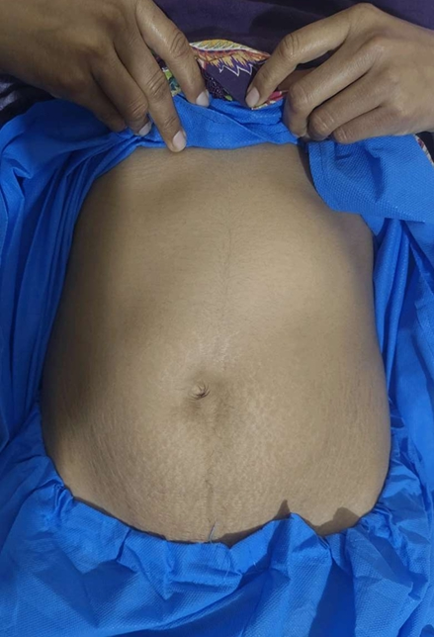
Abdominal Examination
Inspection :
  Abdomen appears mildly distended in the right hypochondrium.
  Overlying skin is normal with no scars, sinuses or dilated veins.
  No visible pulsations.

Slide 15
Abdominal Examination:
Palpation:
  Abdomen is soft nontender with no guarding or rigidity.
  Liver is enlarged (22cm) with irregular margins.
  Multiple cystic masses palpable over the liver surface.
  Masses are firm to cystic in consistency.
  Spleen and kidneys not palpable
  No evidence of Ascites
Auscultation :
  Bowel sounds audible
  No hepatic bruit.

Slide 16
Other systemic Examination
Respiratory System :
  Normal Vesicular Breathing
  No added sounds.
Cardiovascular system :
  S1 & S2 audible
  No murmurs
CNS :
  GCS 15/15 Intact.

Slide 17
Differential Diagnosis
Chronic Cholelithiasis with Distended Gallbladder.
Mucocele / Empyema of Gallbladder.
Liver Abscess
Hyadit Cysts

Slide 18
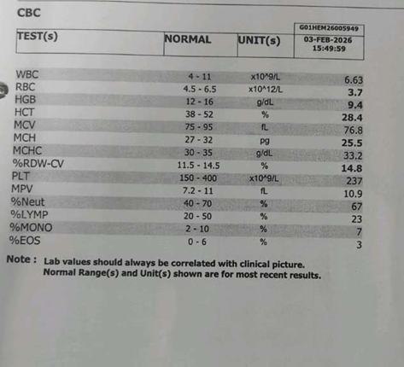
Investigations :
Complete Blood Count:

Slide 19
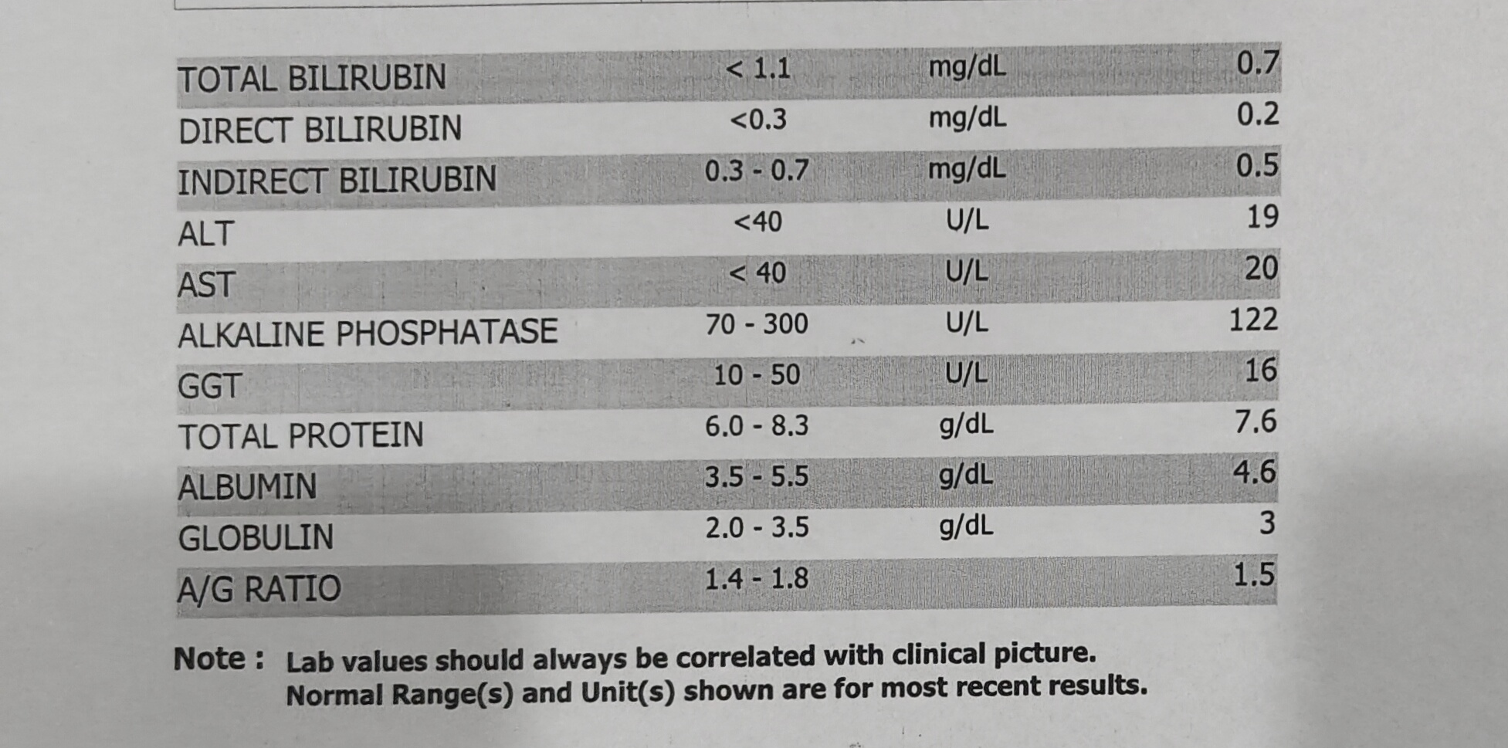
Investigation :
Liver Function Test :

Slide 20
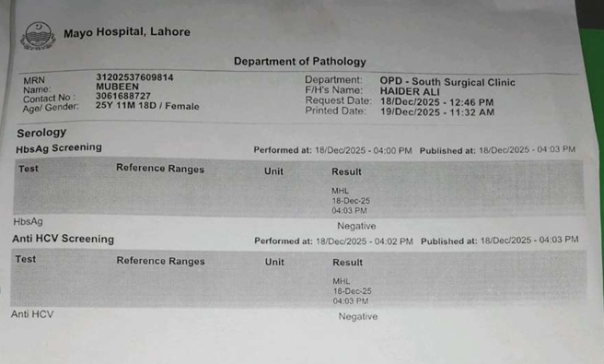
Investigation :
Viral Markers :

Slide 21
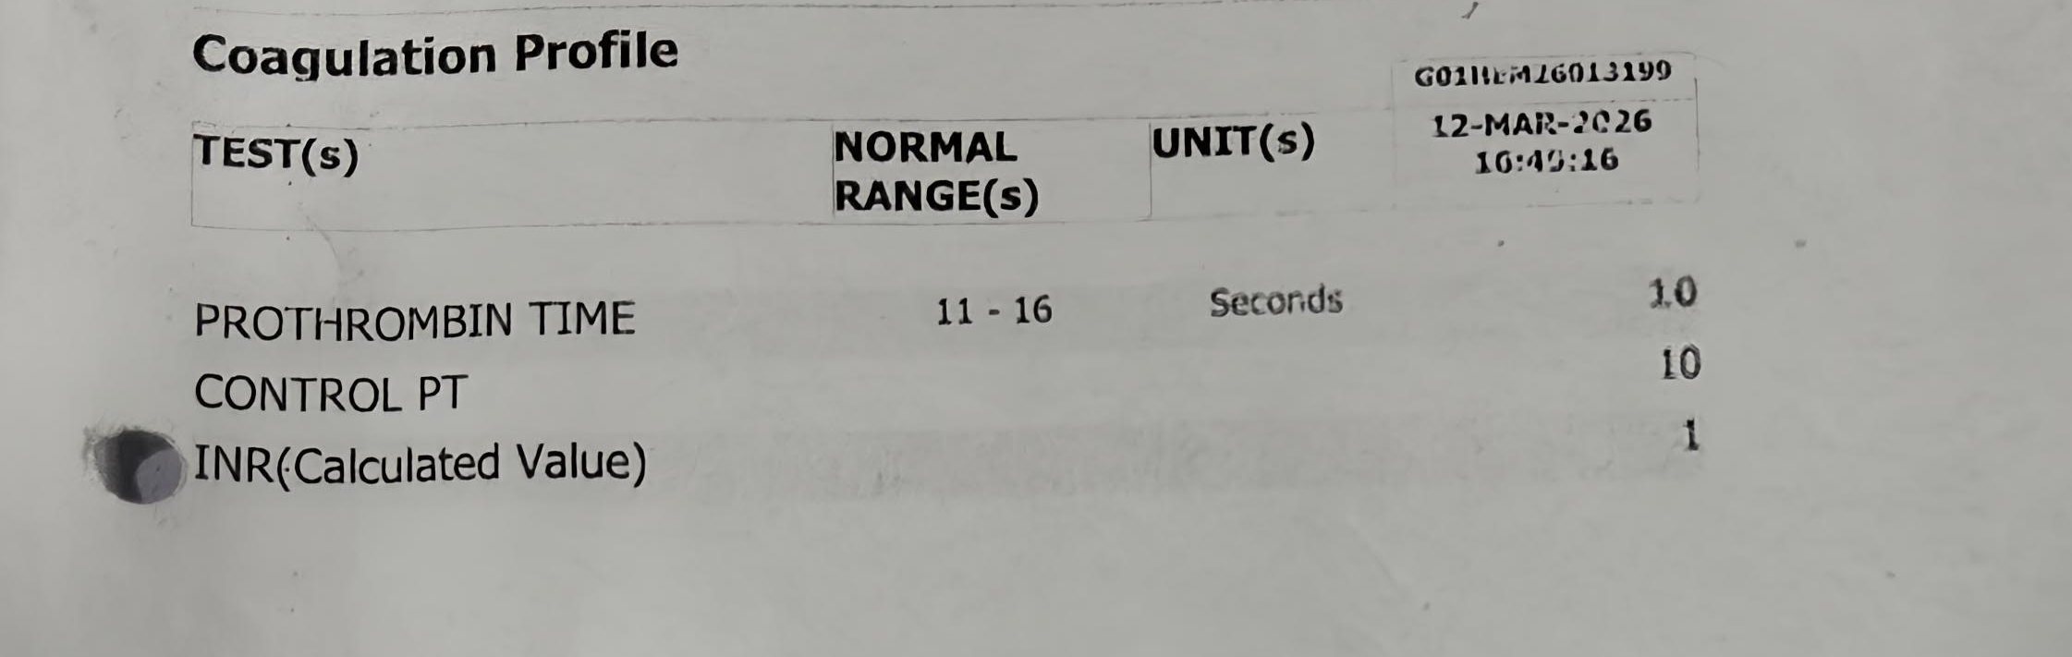
Investigation :
Coagulation Profile :

Slide 22
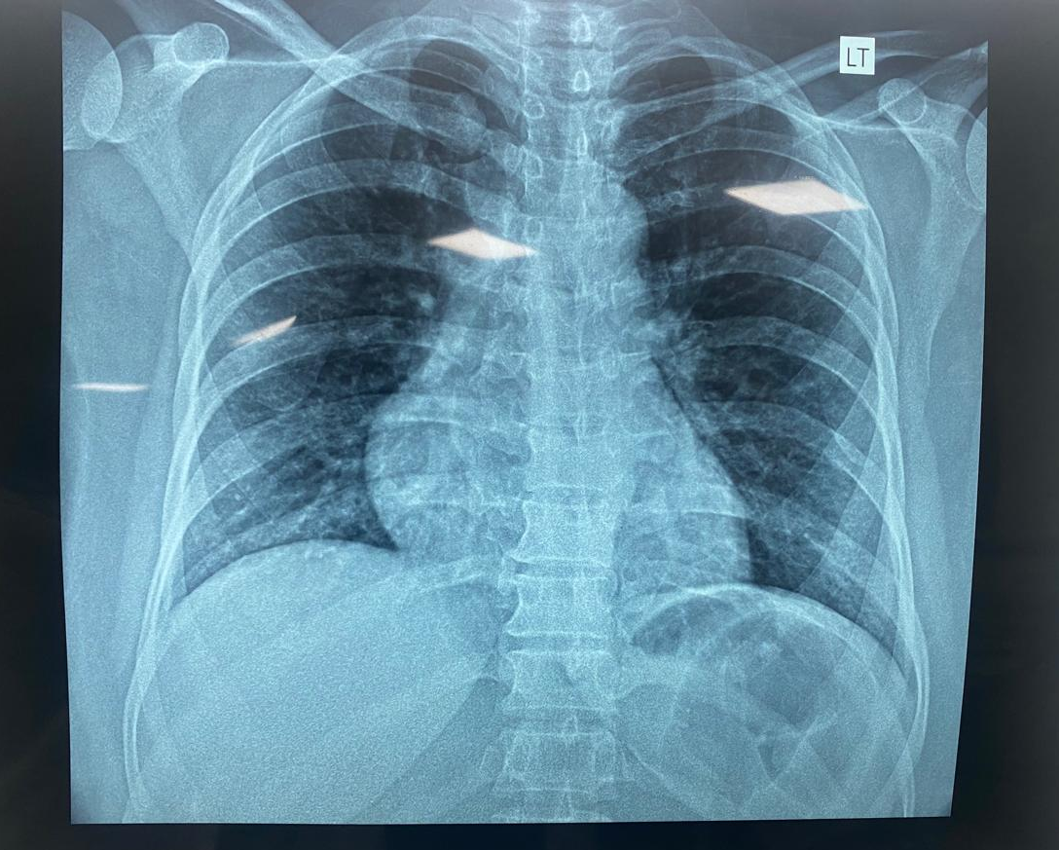
Investigation :
Chest Xray :

Slide 23
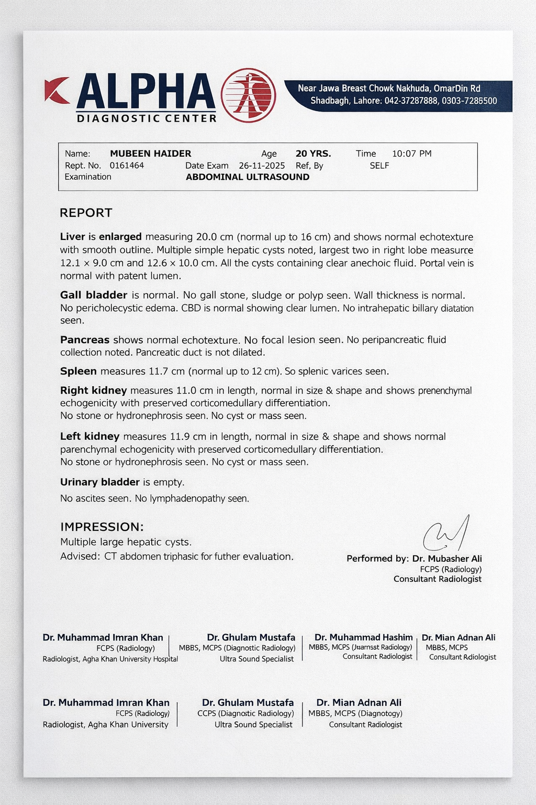
Investigation :
Ultrasound Abdomen :

Slide 24
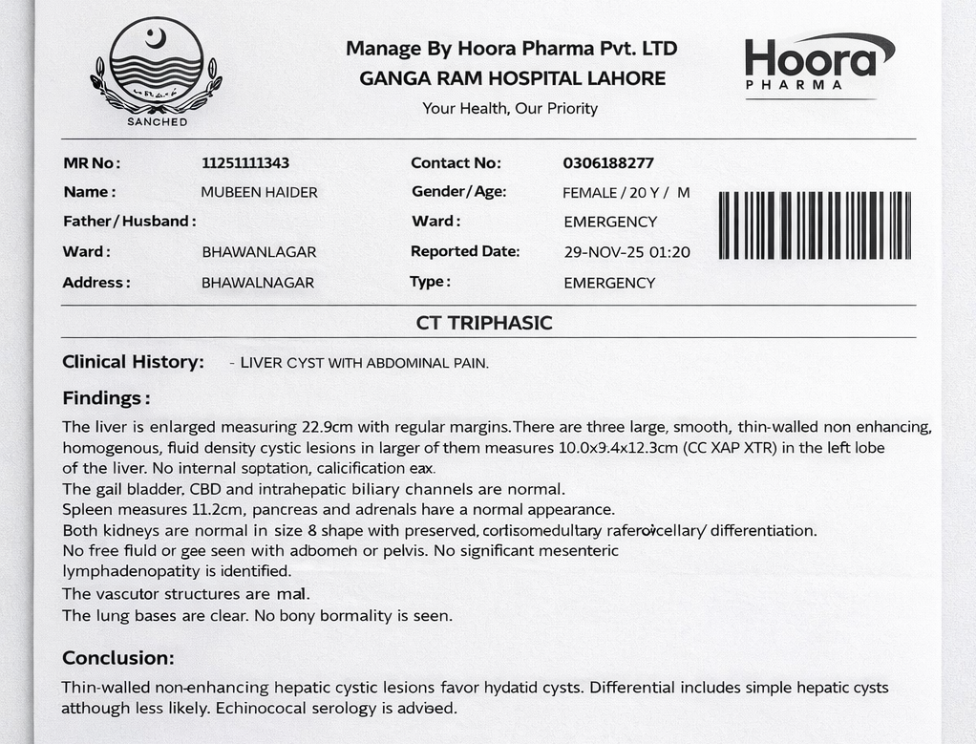
Investigation :
CT Abdomen Triphasic:

Slide 25
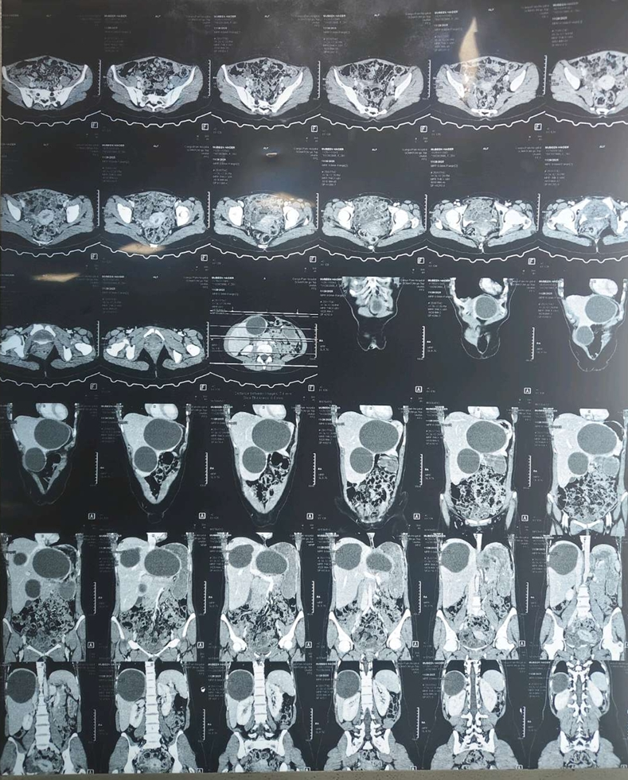
Investigation :

Slide 26
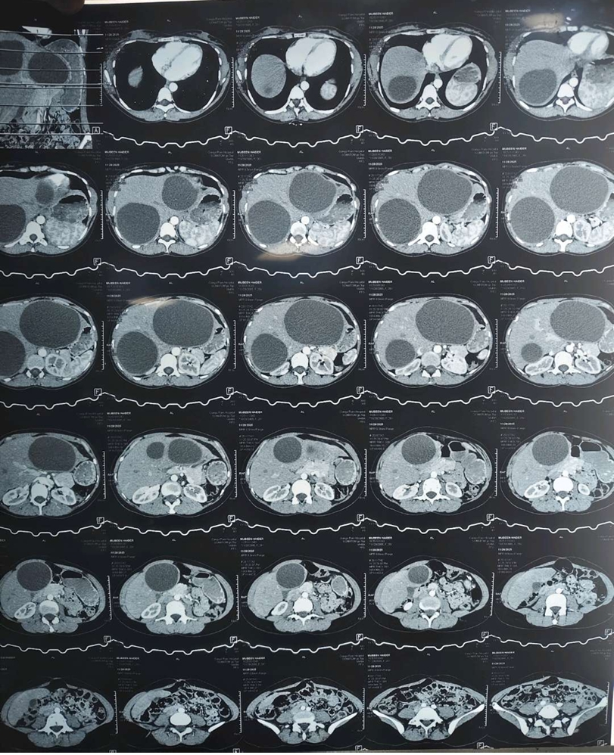

Slide 27
Definitive Diagnosis :
Hyadit Cysts in Liver

Slide 28
Management
Medical :
  Antiparasitic medications (Tab Albendazole) given
Surgical :
  Total Cystectomy (Excision of Cysts) was done.

Slide 29
Excision of Cysts :
Under Aseptic measures.
Midline Incision given.
Liver is Adequately Exposed.
  Intra operative Findings : 2Hyadit Cysts in Right Lobe of liver Measuring 6x6cm & 12x10cm in Anterior Segment
  1 cyst in Left Lobe Measuring 14x12cm.
Hyadit Cysts sites identified and Surrounded with Gauze Packs soaked with Hypertonic Saline

Slide 30
Procedure :
Needle inserted carefully in the cysts.
Cysts fluid aspirated.
Hypertonic saline solution injected In the cysts ( WAITED FOR 15MINS TO PROTOSLICES )
Small incision on cysts wall made.
Suctioning of cysts contents done.
Germinal membrane removed.
Residual cavity wall are sutured.
Drain placed.
Abdominal wall closed in reverse order.
ASD done.

Slide 31
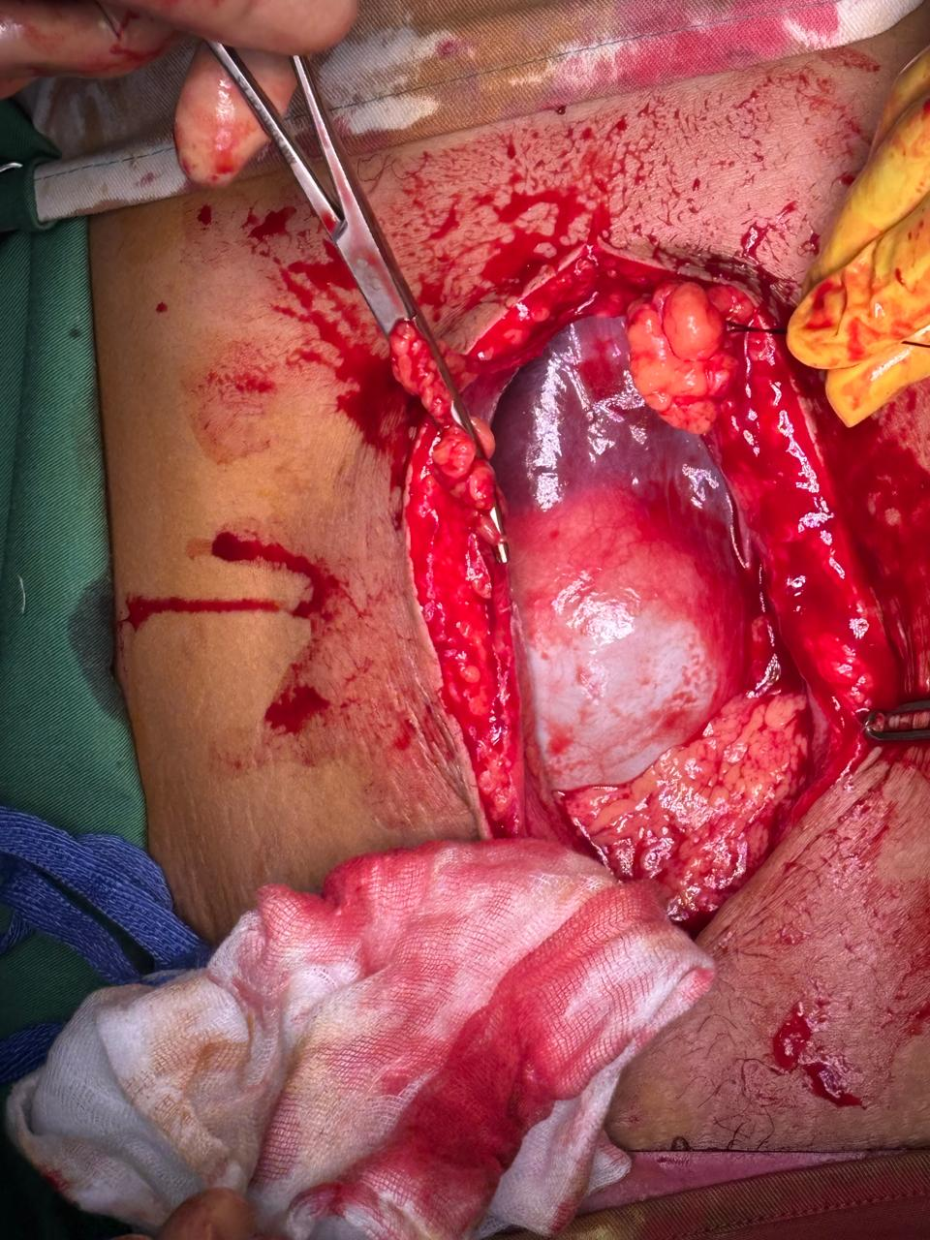
Procedure :

Slide 32
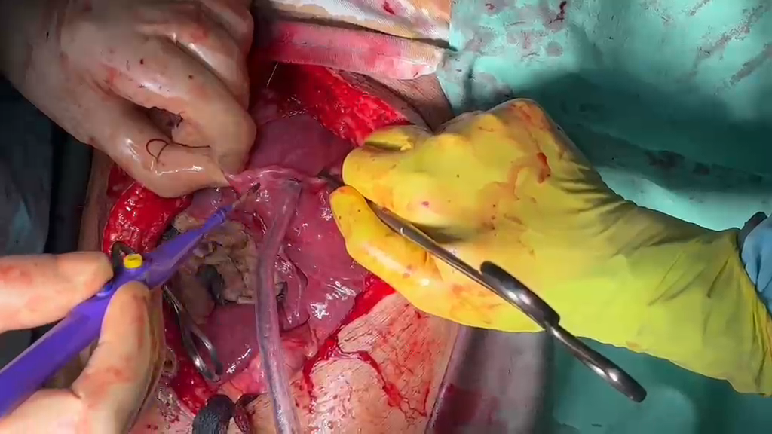

Slide 33
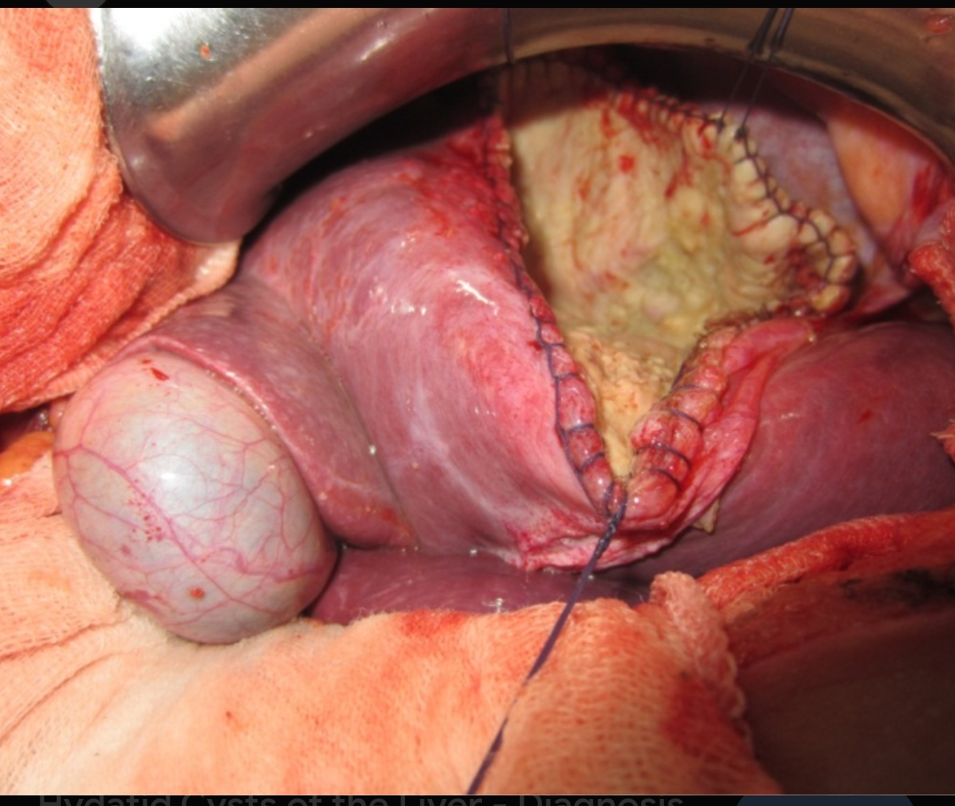

Slide 34
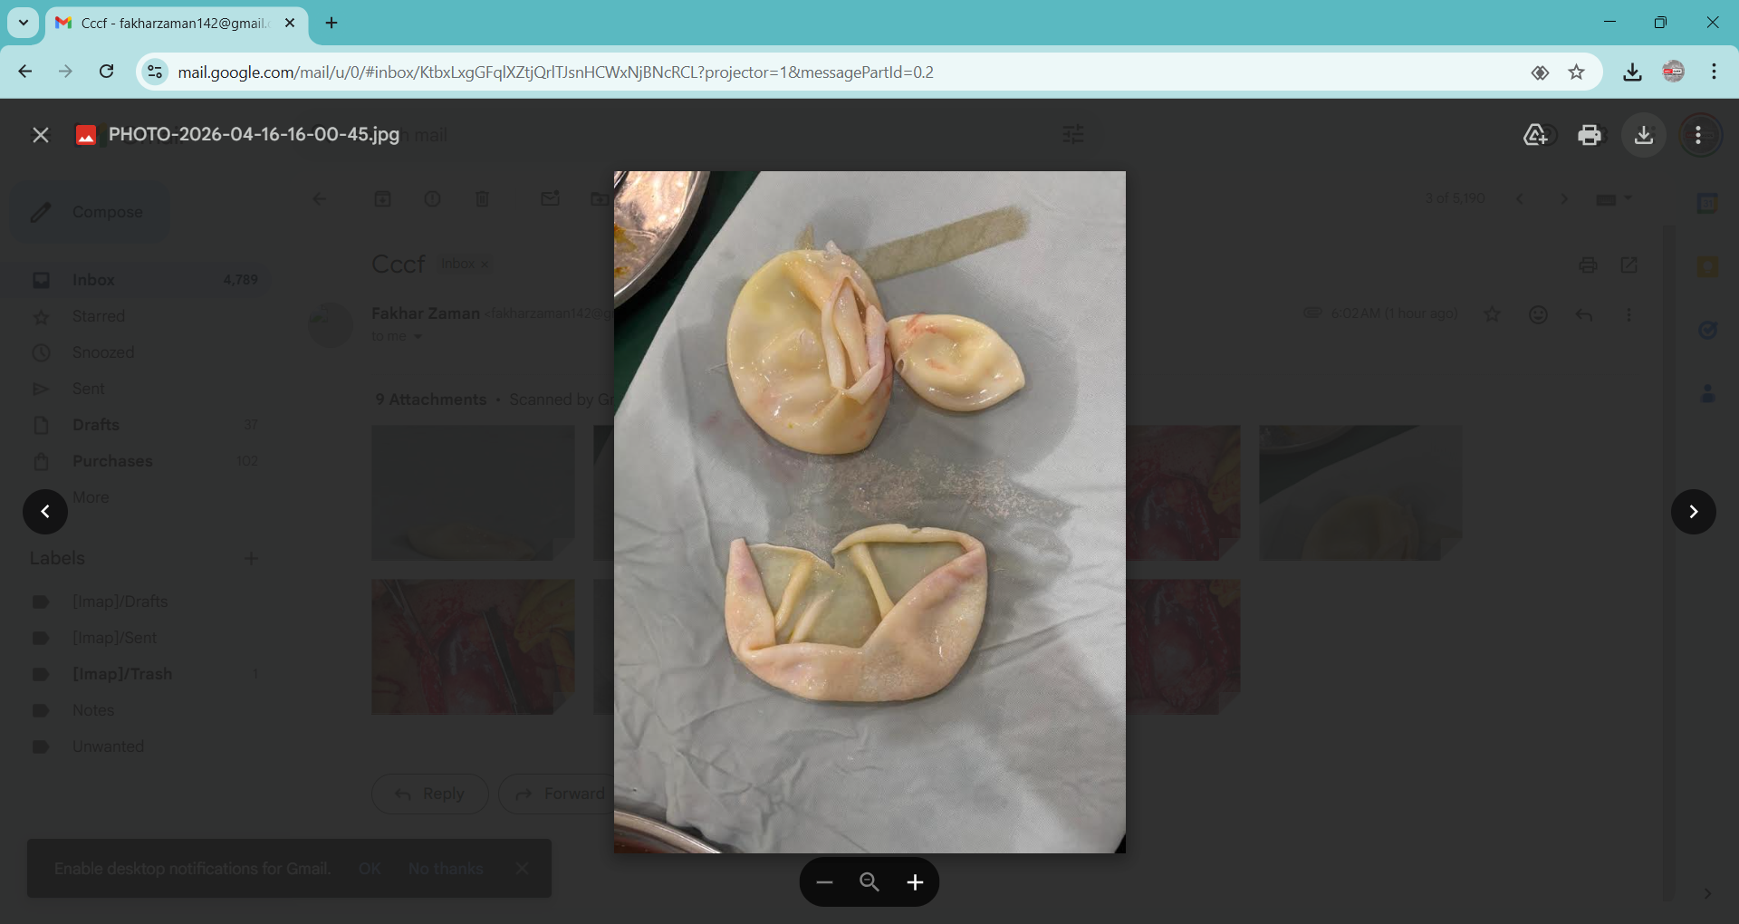
Cysts Removed :

Slide 35
Follow up :
Patient came on follow up on 15/02/2026
No Active complaint
Afebrile
Hemodynamically stable
With Histopathology Report showing HYADIT CYST.

Slide 36
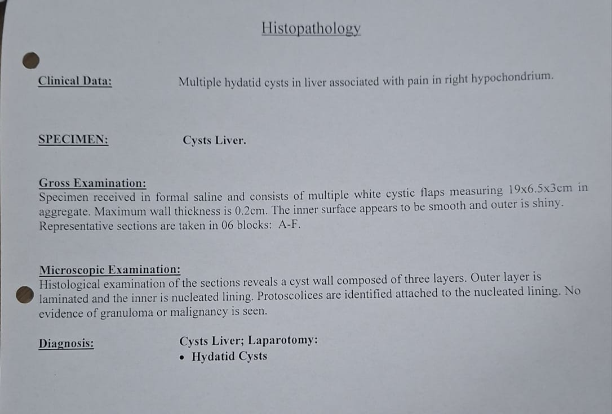
Histopathology :

Slide 37
HYADIT DISEASE
(Literature Review)

Slide 38
Introduction :
Hyadit disease (cystic echinococcosis) is a chronic parasitic zoonosis caused by the larval stage of Echinococcus species.
Most commonly Echinococcus granulosus.
Characterized by formation of fluid-filled cysts in various organs.

Slide 39
Etiology:
Causative Organisms
  Echinococcus granulosus – cystic hyadit disease
  Echinococcus multilocularis – alveolar hyadit disease
  Rare : E. vogeli, E.oligarthrus
Humans are accidental intermediate hosts.

Slide 40
Epidemiology :
Endemic in :
  South Asia ( Pakistan,India )
  Mediterranean region
  Middle East
  Africa & South America
Associated with :
  Sheep farming
  Dog – human close contact

Slide 41
Pathology:
Dog is a definitive host.
Intermediate host – humans, sheep, cattle.
Adult worm (Dog) – reaches small intestine & eggs passed in faeces.
In dog intestine – cyst wall digested allowing protosolices to develop into adult worms.
Spread by : Oral route

Slide 42
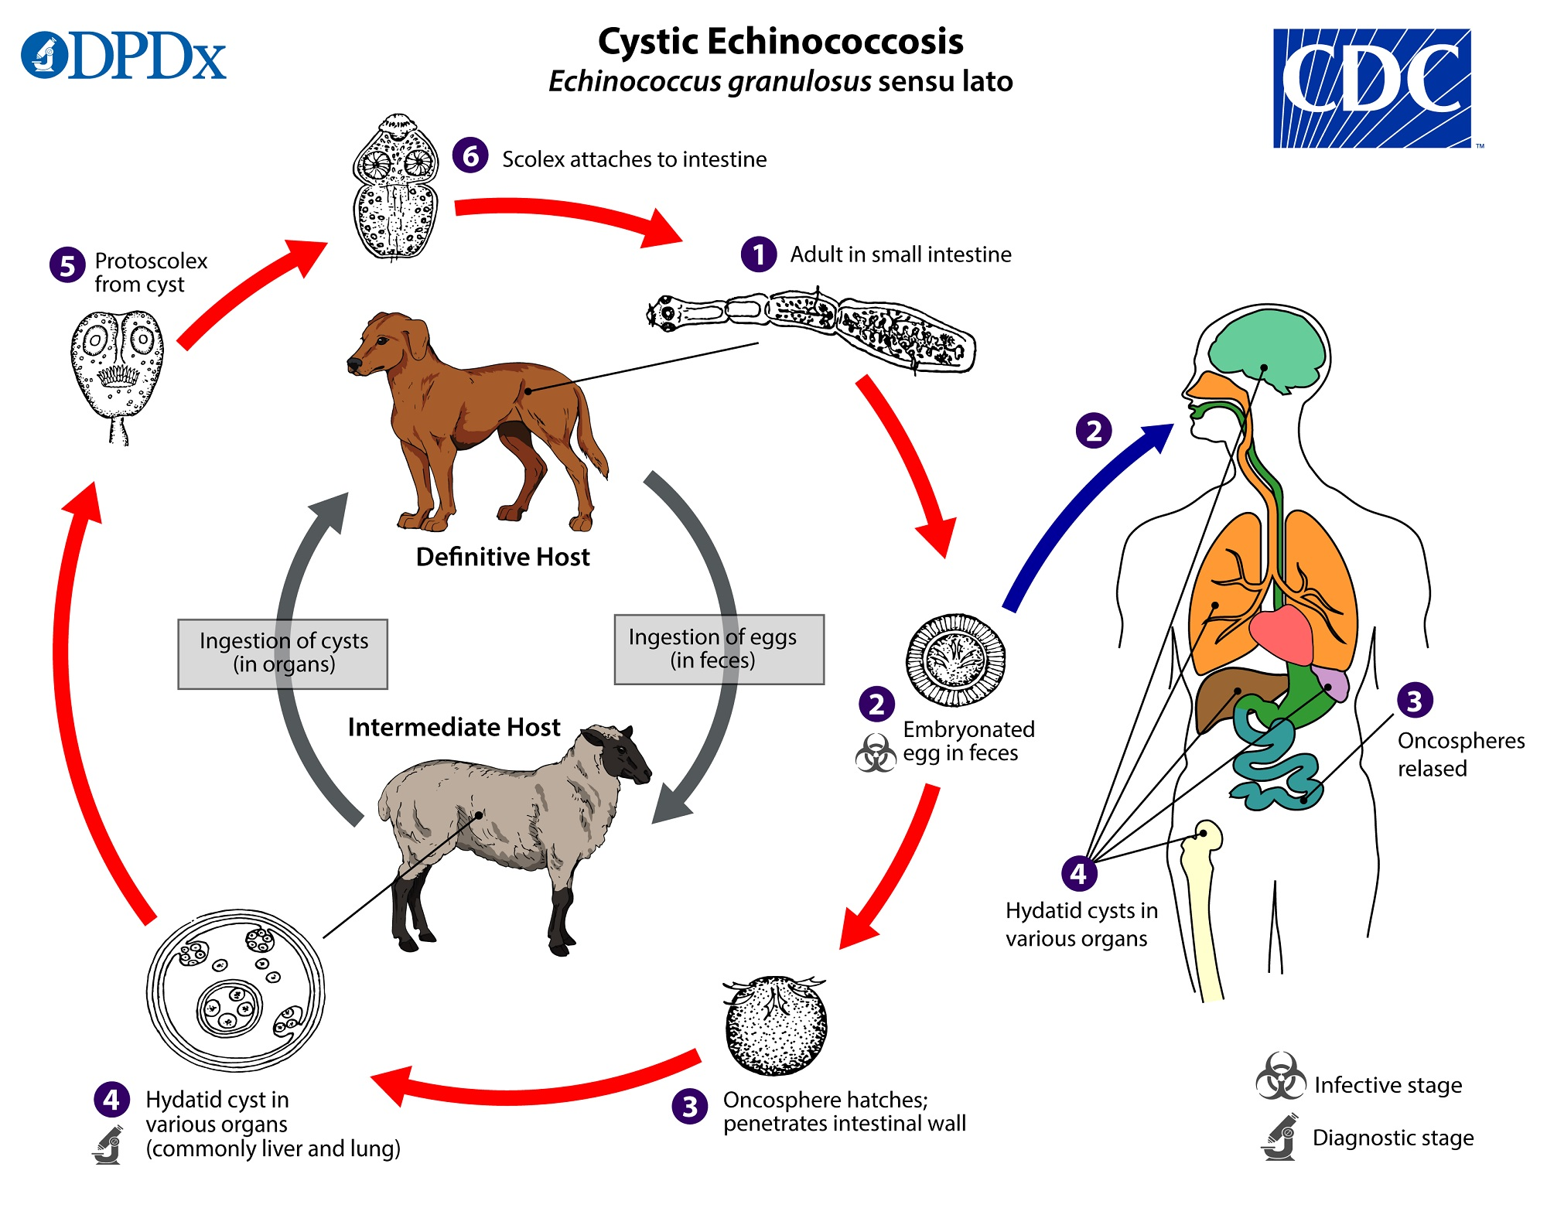
Life Cycle:

Slide 43
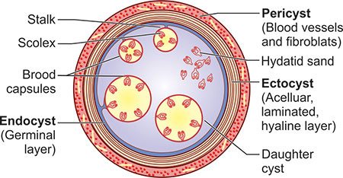
Pathology :
Cyst is characterized by 3Layers.
  Pericyst
  Ectocyst
  Endocyst (germinal layer)

Slide 44
Classification :
Three groups have been recognized:
● Group 1: Active group – cysts larger than 2 cm and often fertile.
● Group 2: Transition group – cysts starting to degenerate and entering a transitional stage because of host resistance or treatment but may contain viable protoscolices.
● Group 3: Inactive group – degenerated, partially or totally calcifed cysts; unlikely to contain viable protoscolices.

Slide 45
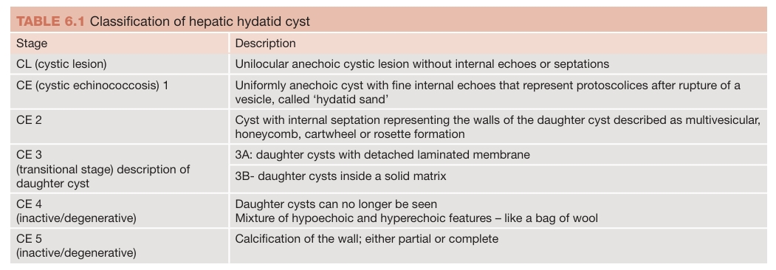
Classification:

Slide 46
Clinical Features:
HEPATIC | PULMONARY | SPLENIC | RENAL | CEREBRAL | BONE
Right upper quadrant pain | Unruptured cyst Cough Chest pain Dyspnea | Left upper quadrant pain | Flank pain | Headache | Chronic pain
Hepatomegaly | Ruptured cyst Sudden cough Hemoptysis | Splenomegaly | Hematuria | Vomiting | Pathological fractures
Palpable mass |  | Plapable mass | Hydatiuria | Raised ICP
Pressure effects |  |  |  | Seizures
Fever with chills |  |  |  | Focal neurological signs

Slide 47
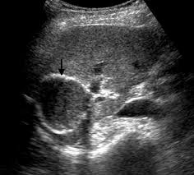
Diagnosis :
CBC (Eosinophilia)
Serology :
  ELISA
  Immunoelectrophoresis
Ultrasound
  best initial test
  Cyst is seen as a well circumscribed swelling
  With budding signs on the cyst membrane
  May contain free floating hyperechogenic
  Hyadit sand.

Slide 48
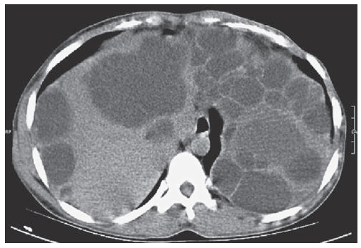
CT Scan :
CT scan is the investigation of choice.
Smooth space occupying lesion with several septa.

Slide 49
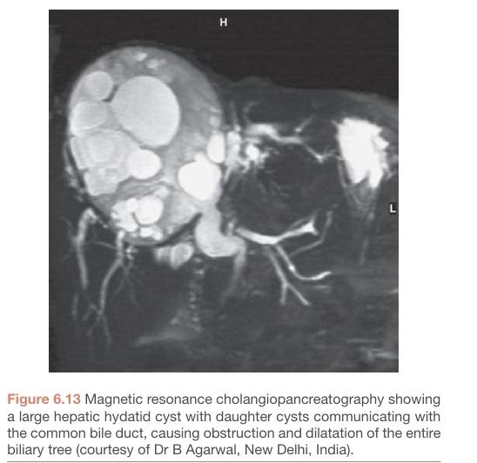
Magnetic Resonance Cholangiopancreatography
(MRCP)

Slide 50
Complications :
Mechanical / Pressure Effects:
  Obstructive jaundice
  Portal hypertension
  Budd chiari syndrome
Infection
Rupture of Cyst
  Intrabiliary rupture
  Intraperitoneal rupture
  Intrathoracic rupture
Anaphylaxis
Calcification
Fistula formation
  (Biliary-enteric fistula)

Slide 51
Treatment options for hepatic hyadit cyst disease:
By a multidisciplinary team of
  Hepatobiliary surgeon
  Physicians
  Intervention radiologist.
Leave asymptomatic and inactive cysts alone – monitor size by ultrasonography.
Treatment option | Description
Medical therapy | Albendazole
PAIR therapy | Puncture , Aspiration, Injection, Re-Aspiration
Open Surgery | Total pericystectomy, Marsupialization, Partial hepatectomy
Laparoscopic surgery | Marsupialization , Peri-cystectomy.

Slide 52
Class | Description | Stage | Suggested practice
CL (cystic lesion) | Unilocular 2. No cyst wall (early stage) : anechoic cystic lesion without internal echoes or septations | Active | PAIR therapy
CE 1 | Unilocular Cyst wall Present (double line sign) Hyadit sand present Fertile | Active | If < 5cm : Albendazole If >5cm : PAIR + Albendazole
CE 2 | Multi-septate honey comb cyst Cyst with internal septations representing wall of daughter cyst i.e : honeycomb, cart-wheel, rosette formation | Active | Surgery + Albendazole
CE 3 | Cyst degeneration starts C3a : cyst with detached/floating membranes (water lilly sign) C3b : A predominantly solid cyst but containing daughter cysts. | Transitional | C3a If < 5cm : Albendazole If >5cm : PAIR + Albendazole C3b Surgery + Albendazole
CE 4 | 1.Cyst with degenerated content 2.Mixture of hypo echoic and hyper echoic features – like a bag of wool 3.No daughter cysts 4.Not fertile | Inactive / degenerative | Wait & Watch
CE 5 | 1. Solid + calcified wall 2. Not complete. | Inactive / degenerative | Wait & Watch

Slide 53
Medical Management:
Drug of Choice :
  Albendazole
  Dose : 10-15mg/kg/day in 2divided doses
  Typical Adult Dose : 400mg twice daily
Regimen :
  28days treatment + 14day gap
  Usually 3-6cycles depending on response
Alternative Drug :
  Mebendazole
  Dose : 40-50mg/kg/day
Role Around Surgery / PAIR
Pre-Operative :
  Albendazole for 2-4 weeks – reduces cyst viability
Post-Operative :
  Continue for 1-3 months – prevents recurrence.

Slide 54
PAIR Therapy:
 | Indications | Contraindications
1 | WHO class CL, CE 1, CE 3a | Inaccessible cysts
2 | Cyst > 5cm in different liver segments | Multiseptate / honeycomb cysts WHO class CE 2
3 | Released cysts / Infected cysts | Calcified cysts (WHO class CE 5)
4 | Inoperable patients / those refusing surgery | Cysts having communication with biliary channels
5 | In pregnant women & children age < 3years. | Hyper echogenic cysts

Slide 55


