Slide 1
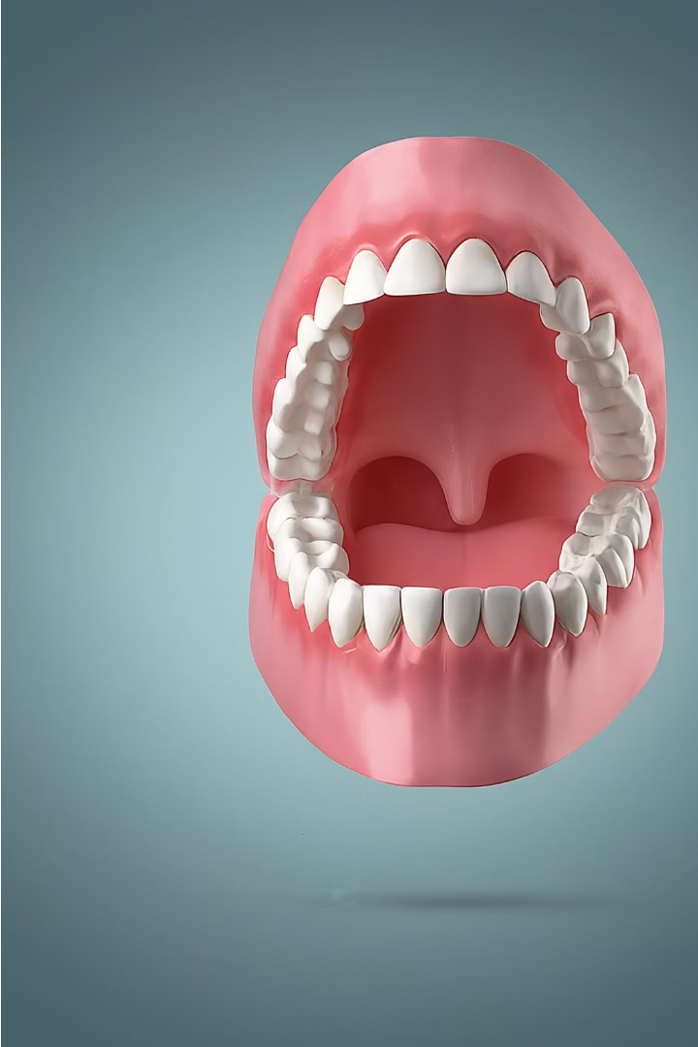

Cancer of Buccal Mucosa
This presentation will provide a comprehensive overview of cancer affecting the buccal mucosa, including its epidemiology, risk factors, clinical presentation, diagnosis, and treatment modalities. We will explore the importance of early detection and the latest advancements in managing this form of oral cancer.
by Prof.Zahid Mahmood

Slide 2
Learning Objectives
1
Understand the epidemiology and risk factors
2
Recognize the clinical presentation
Identify the key demographic and lifestyle factors associated with buccal mucosa cancer.
Explore the common symptoms and signs that may indicate buccal mucosa cancer.
3
Discuss diagnostic approaches
4
Explore treatment modalities
Examine the various diagnostic tools and staging techniques used to evaluate buccal mucosa cancer.
Review the available treatment options, including surgical, radiation, and chemotherapeutic approaches.

Slide 3
Epidemiology and Risk Factors
Epidemiology
Risk Factors
Prevention
Buccal mucosa cancer is a type of oral cancer that affects the inner lining of the cheeks. It is more common in certain regions, such as Southeast Asia, due to cultural practices like betel nut chewing.
Key risk factors include tobacco use, alcohol consumption, chronic irritation, and poor oral hygiene. Genetic predisposition and exposure to certain viruses may also play a role.
Promoting awareness, adopting healthy lifestyle habits, and regular oral cancer screenings can help reduce the risk and enable early detection.

Slide 4
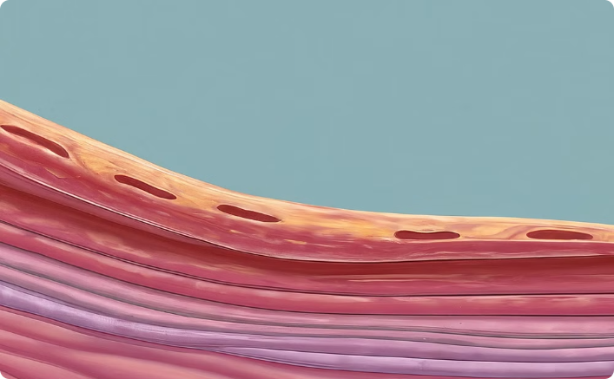
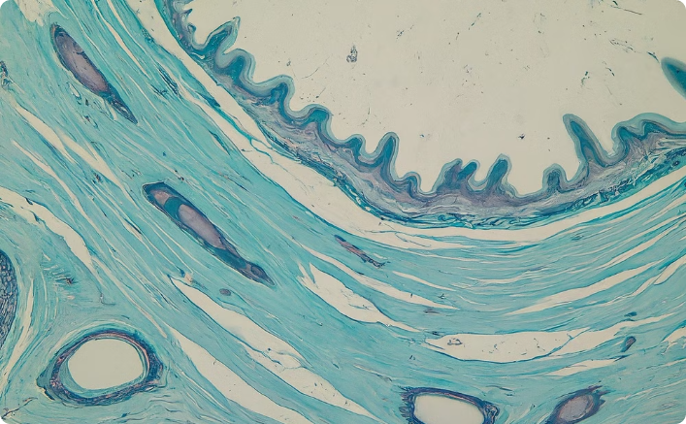
Anatomy and Histology
Anatomical Structure
Histological Features
The buccal mucosa is the inner lining of the cheeks, composed of non-keratinized stratified squamous epithelium and underlying connective tissue.
Histologically, the buccal mucosa is characterized by a thin, moist, and highly vascularized epithelium, which is essential for its protective and sensory functions.

Slide 5
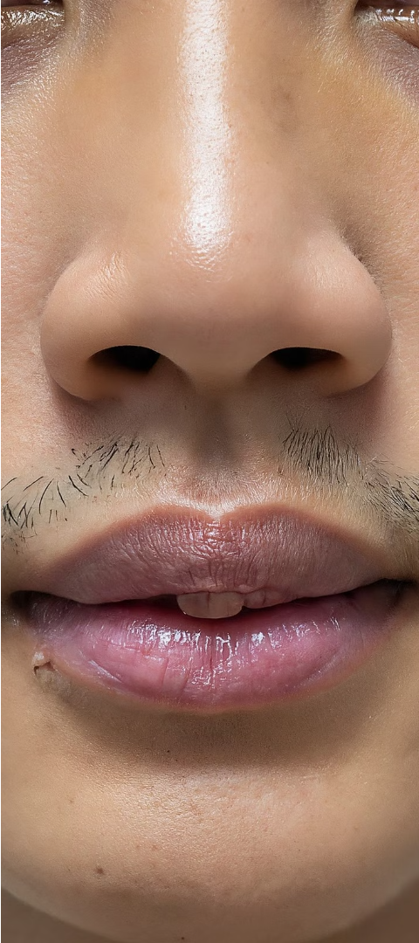
Clinical Presentation
1
Early Stages
In the early stages, buccal mucosa cancer may present as a small, painless, and discolored patch or ulcer on the inner cheek.
2
Progressive Stages
As the cancer progresses, it can cause pain, difficulty swallowing, bleeding, and the formation of a hard, irregular mass or growth.
3
Advanced Stages
In advanced stages, the cancer may invade surrounding tissues, causing facial disfigurement, bone destruction, and potentially, metastasis to nearby lymph nodes.

Slide 6




Diagnosis and Staging
Clinical Examination
Biopsy
Imaging Studies
Staging
A biopsy of the affected area is essential to confirm the diagnosis and determine the histological grade of the cancer.
Imaging techniques, such as CT scans, MRI, and PET scans, are used to assess the extent of the tumor and detect any metastases.
The TNM staging system is used to determine the size of the tumor, involvement of lymph nodes, and presence of distant metastases, which guides treatment planning.
A thorough physical examination, including palpation and visual inspection, is the first step in diagnosing buccal mucosa cancer.

Slide 7
Treatment Modalities
Surgery
Radiation Therapy
Chemotherapy
Surgical excision of the tumor, along with any involved lymph nodes, is the primary treatment approach for early-stage buccal mucosa cancer.
Radiation therapy, either alone or in combination with surgery, is used to treat larger tumors or those that have spread to nearby lymph nodes.
Chemotherapy may be used in advanced or recurrent cases of buccal mucosa cancer, often in combination with radiation therapy or surgery.

Slide 8



Take-Home Message
Early Detection
Multidisciplinary Approach
Preventive Measures
Regular oral cancer screenings are crucial for the early detection of buccal mucosa cancer, which can significantly improve treatment outcomes.
Promoting awareness, encouraging healthy lifestyle habits, and addressing risk factors can help reduce the incidence of buccal mucosa cancer in the community.
A collaborative team of healthcare professionals, including surgeons, radiation oncologists, and medical oncologists, is essential for delivering comprehensive and personalized treatment.

