Slide 1
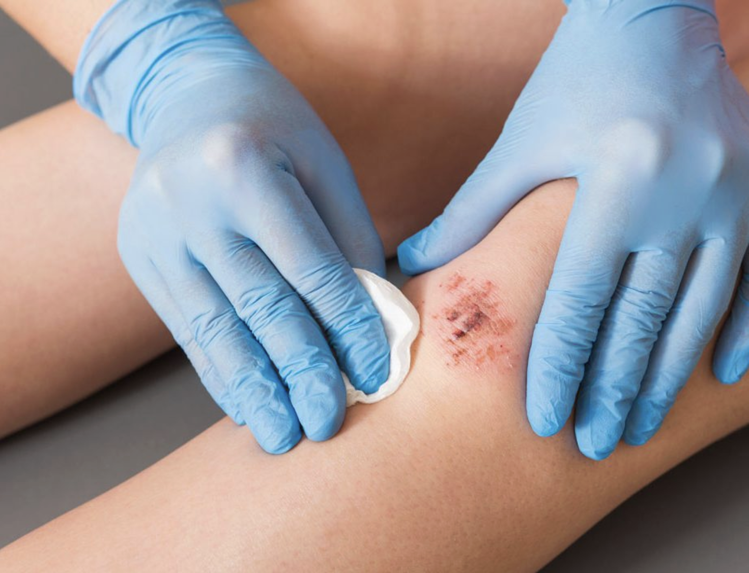
بِسْمِ اللّٰهِ الرَّحْمٰنِ الرَّحِيْمِ
Wound Healing
Prof. Zahid Mahmood

Slide 2
Clinical Scenario
Patient undergoes surgical wound closure today
Wound initially healthy then becomes inflamed
Delayed healing with discharge and infection
What factors influence wound healing process

Slide 3
Learning Outcomes
Define wound healing and its phases
Describe primary and secondary intention healing
Explain role of growth factors cytokines
Identify factors affecting healing outcomes

Slide 4
Definition
Wound healing is tissue repair process
Restores integrity after injury or surgery
Involves cellular and molecular mechanisms
Occurs in orderly sequential phases

Slide 5
Phases Overview
Four phases of wound healing process
Hemostasis
inflammation
proliferation
maturation phases
Overlap occurs between different phases
Each phase essential for normal healing

Slide 6
Hemostasis Phase
Occurs immediately after tissue injury
Platelet aggregation forms fibrin clot
Clot stops bleeding provides scaffold
Growth factors released from platelets

Slide 7
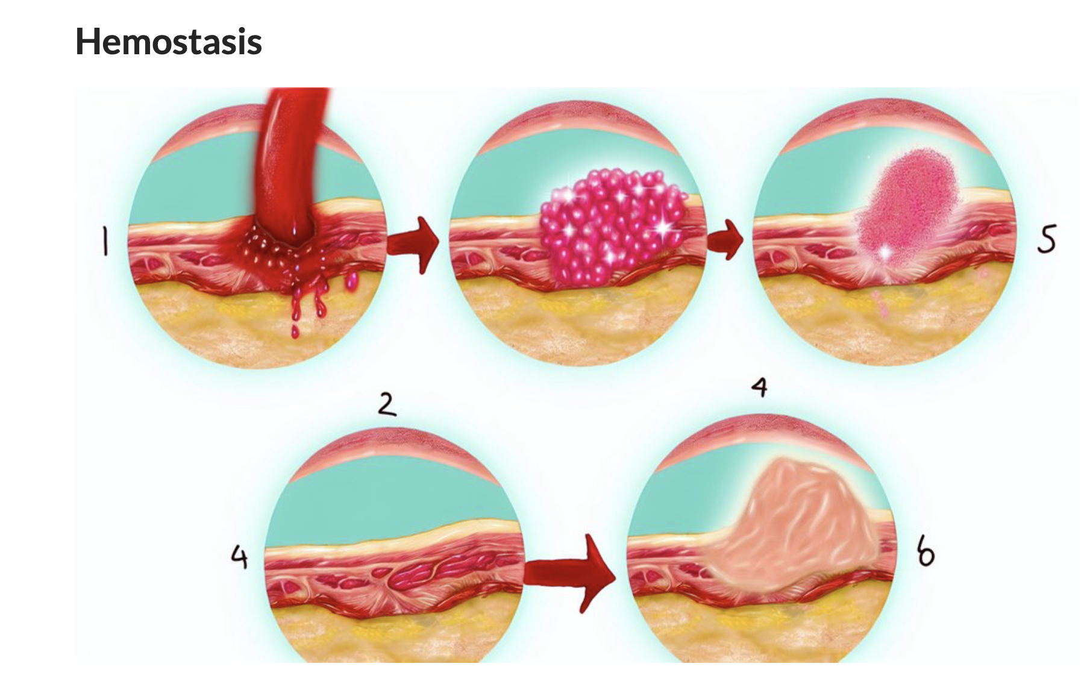

Slide 8
Inflammatory Phase
Lasts approximately three to five days
Neutrophils arrive first then macrophages
Remove debris bacteria necrotic tissue
Cytokines regulate inflammatory response

Slide 9
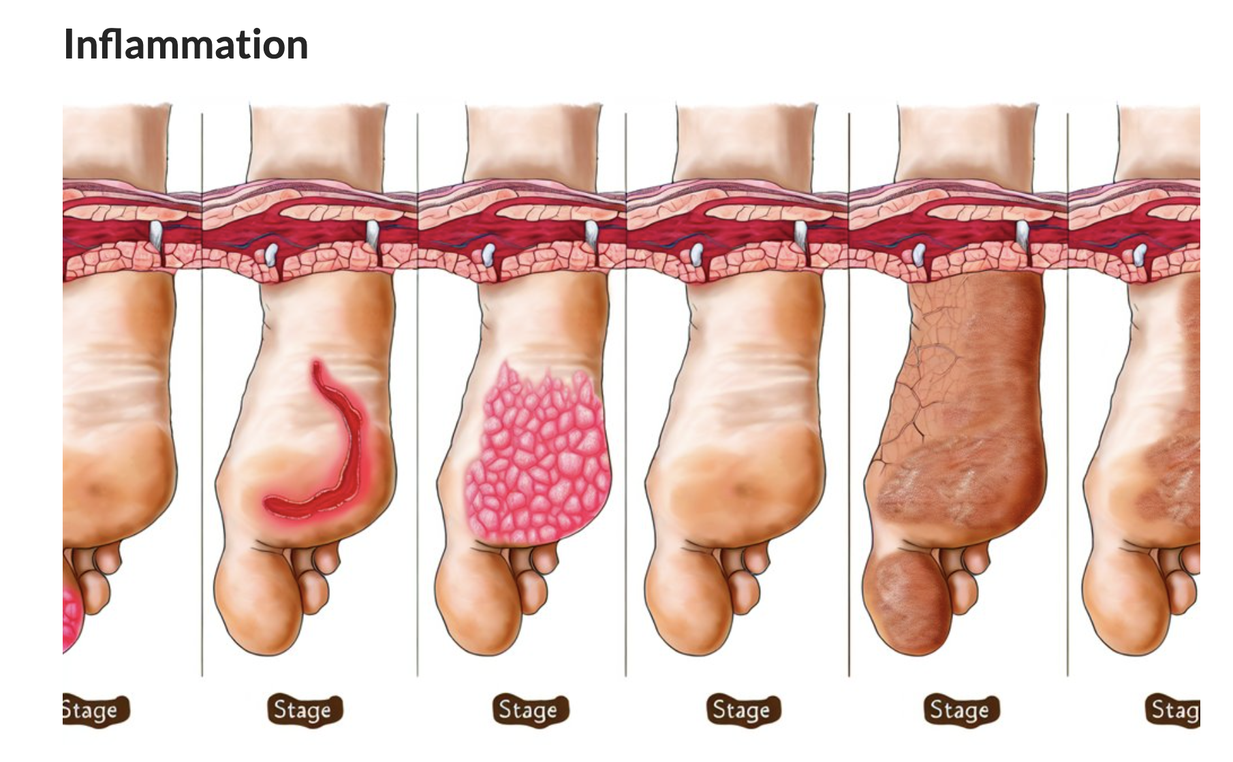

Slide 10
Proliferative Phase
Occurs from day four to weeks
Fibroblasts produce collagen matrix
Angiogenesis forms new blood vessels
Granulation tissue fills wound defect

Slide 11
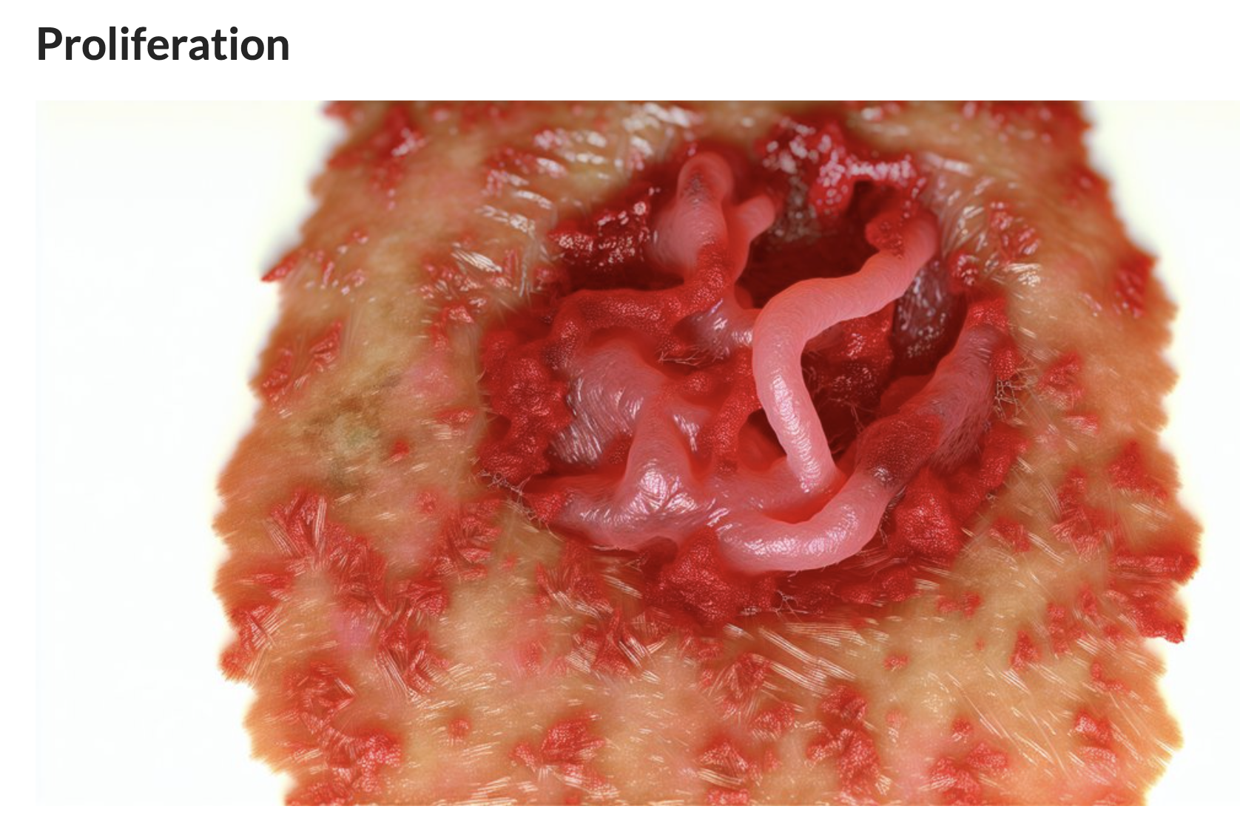

Slide 12
Maturation Phase
Lasts weeks to months after injury
Collagen reorganized strengthened gradually
Type three replaced by type one
Scar gains tensile strength

Slide 13
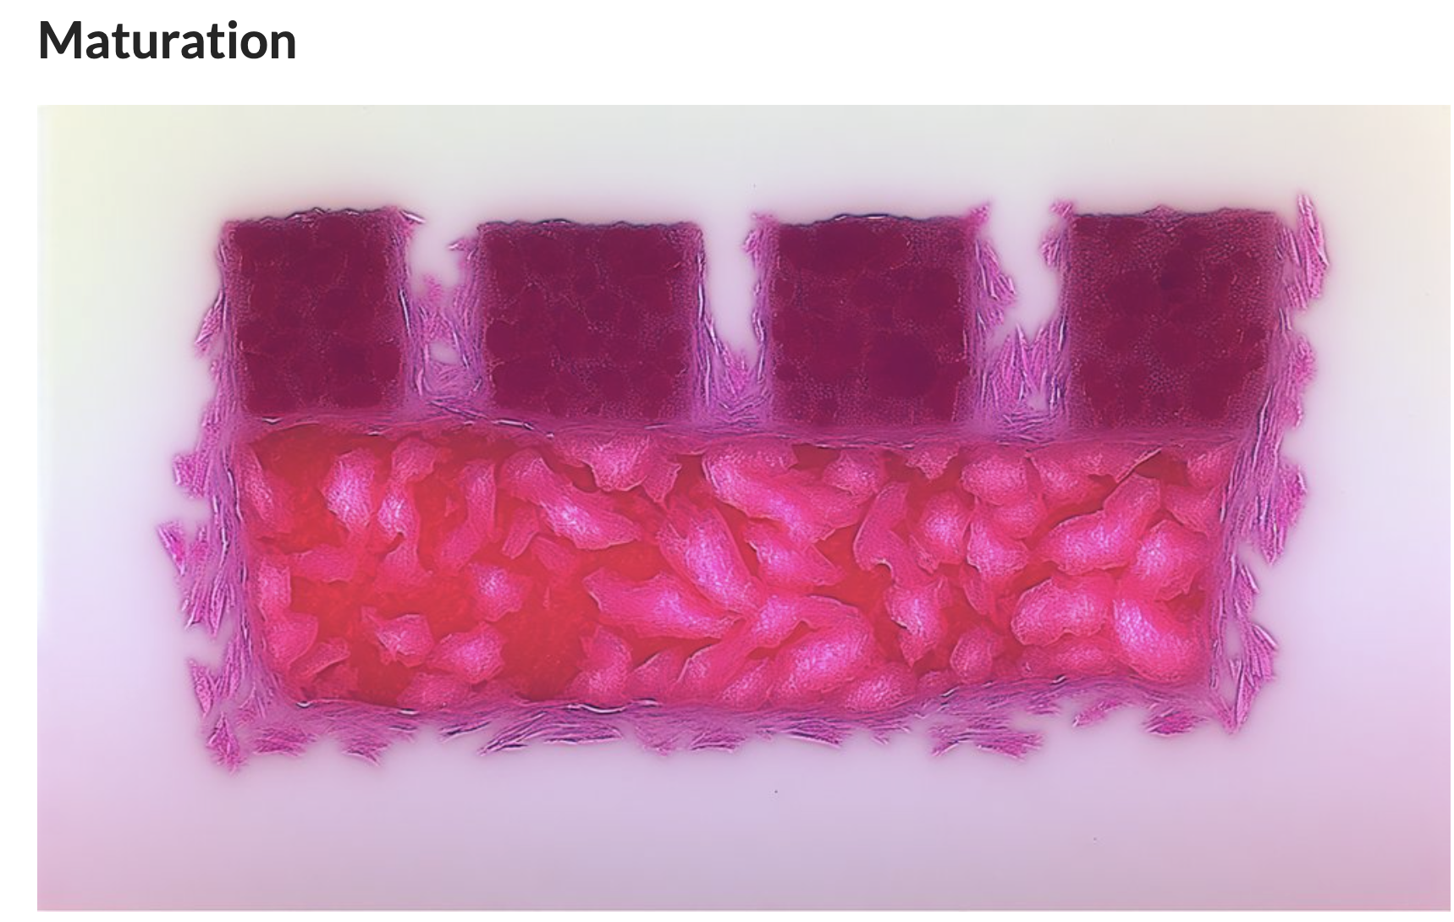

Slide 14
Primary Intention
Occurs in clean surgical wounds
Edges approximated by sutures staples
Minimal tissue loss inflammation
Results minimal scar formation

Slide 15
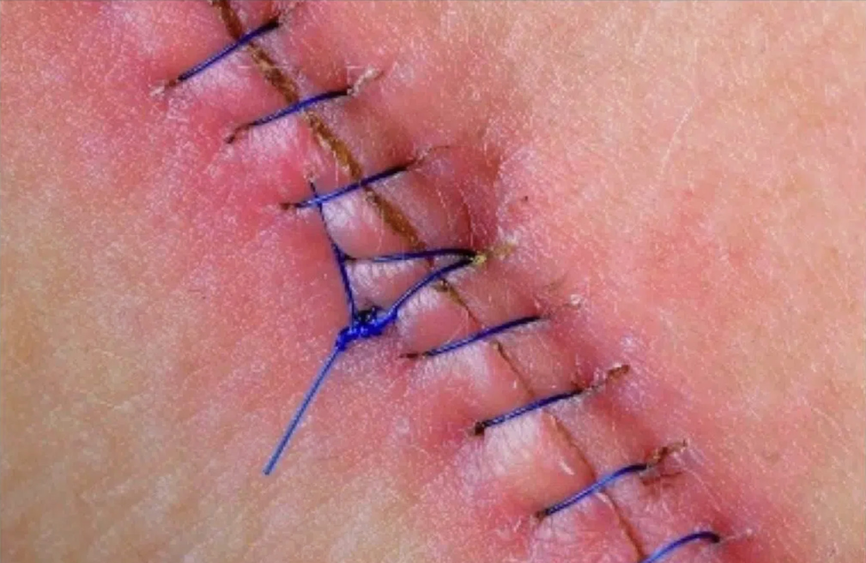

Slide 16
Secondary Intention
Occurs in large contaminated wounds
Edges not approximated initially
Granulation tissue fills wound gradually
Results significant scar formation

Slide 17
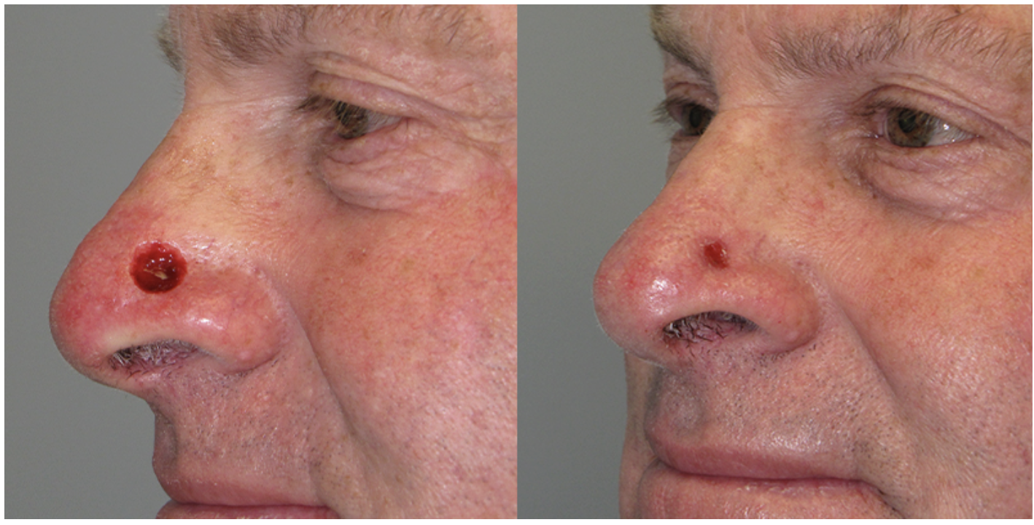

Slide 18
Differences
Primary minimal granulation tissue formation
Secondary extensive granulation tissue formation
Primary faster healing secondary slower
Secondary higher infection scarring risk

Slide 19
Delayed Primary Closure
Also called tertiary intention healing
Wound initially left open
Closed later after infection control
Used in contaminated wounds

Slide 20
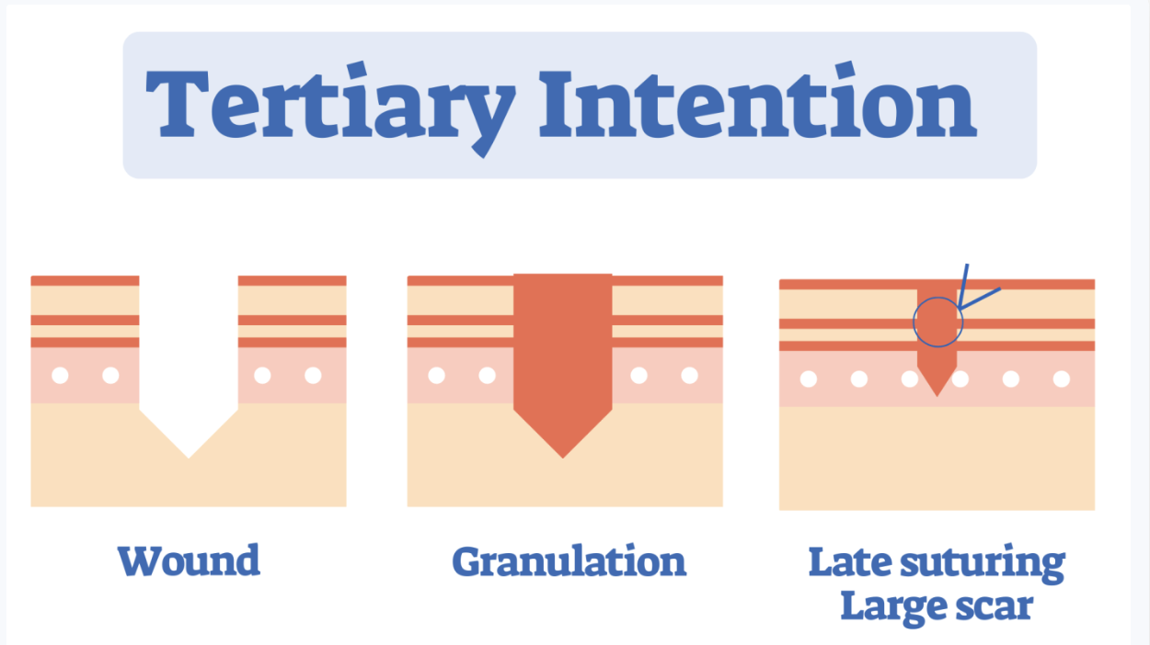

Slide 21
Growth Factors
Proteins regulating cellular proliferation migration
Released platelets macrophages fibroblasts
Act through specific receptors
Essential for coordinated healing

Slide 22
PDGF
Stimulates fibroblast proliferation chemotaxis
Promotes collagen synthesis angiogenesis
Released early during hemostasis
Important in initial healing

Slide 23
TGF Beta
Stimulates collagen matrix production
Inhibits excessive inflammation
Promotes fibroblast differentiation
Important in scar formation

Slide 24
VEGF
Stimulates angiogenesis vessel formation
Increases vascular permeability
Provides oxygen nutrient supply
Critical in proliferative phase

Slide 25
EGF
Promotes epithelial cell proliferation
Accelerates reepithelialization
Important early healing phase
Enhances wound closure

Slide 26
Cytokines
Small proteins mediating inflammation
Include interleukins TNF
Regulate immune cell recruitment
Coordinate healing processes

Slide 27
Factors Affecting
Local infection ischemia foreign bodies
Systemic diabetes malnutrition anemia
Smoking reduces oxygen delivery
Age medications influence healing

Slide 28
Complications
Wound dehiscence separation edges
Hypertrophic scars excessive collagen
Keloid abnormal scar overgrowth
Chronic nonhealing ulcers

Slide 29
Viva Points
Inflammation critical for cleaning
Fibroblasts produce collagen
Type three replaced type one
Infection delays healing

Slide 30
A 22-year-old dental student undergoes an uncomplicated surgical extraction of a horizontally impacted mandibular third molar. Six hours postoperatively, the patient notices significant swelling and a dull ache at the extraction site. On examination, the area is warm and erythematous, which the surgeon explains is a normal physiological response. This initial phase involves a complex interplay of vasoconstriction followed by vasodilation and the migration of neutrophils and macrophages to the site of injury to clear debris and bacteria. Which of the following cells are the first to arrive at the wound site during the early inflammatory phase to provide host defense?
A. Fibroblasts
B. Macrophages
C. Neutrophils
D. Myofibroblasts
E. Endothelial cells
Correct Answer: C. Neutrophils

Slide 31
A patient returns to the clinic 7 days after a biopsy of an oral mucosal lesion. The surgical site is now filling with "granulation tissue," which appears pink, granular, and bleeds easily on contact. The surgeon explains that this tissue is a hallmark of the proliferative phase of healing and is composed of a dense network of new capillaries and a provisional extracellular matrix. During this phase, specialized cells are actively synthesizing Type III collagen, which will later be replaced by the stronger Type I collagen during the remodeling phase. Which cell type is primarily responsible for the synthesis of collagen and the extracellular matrix during the proliferative phase?
A. Keratinocytes
B. Fibroblasts
C. Lymphocytes
D. Osteoblasts
E. Platelets
Correct Answer: B. Fibroblasts

Slide 32
A 25-year-old male presents with a clean-cut laceration on his lower lip following a minor fall. The edges of the wound are sharp and can be easily approximated without tension. The maxillofacial surgeon performs a primary closure using fine 5-0 prolene sutures. The surgeon notes that this method of healing results in minimal scarring and rapid epithelialization because the wound edges are in direct contact. In contrast, an open socket after a tooth extraction must heal by filling the gap with granulation tissue from the bottom up. What is the clinical term for the mechanism of healing where the wound edges are surgically approximated?
A. Healing by secondary intention
B. Healing by tertiary intention (Delayed primary closure)
C. Healing by primary intention
D. Resolution
E. Regeneration
Correct Answer: C. Healing by primary intention

Slide 33
A student is observing a surgery where an incision is made both in the oral mucosa and the overlying facial skin. The surgeon comments that wounds in the oral cavity heal much faster than those on the skin and often with significantly less clinical scarring. This is attributed to the presence of growth factors in the saliva, a more rapid inflammatory response, and the unique phenotype of oral mucosal fibroblasts which behave similarly to fetal fibroblasts. Which of the following factors contributes to the accelerated, "scarless-like" healing observed in the oral mucosa compared to skin?
A. Lower vascularity in the mouth
B. Presence of epidermal growth factor (EGF) in saliva
C. Slower epithelial turnover
D. Increased tension on oral wounds
E. Constant presence of oral bacteria
Correct Answer: B. Presence of epidermal growth factor (EGF) in saliva

Slide 34
During a lecture on wound healing, the Professor explains that cytokines and growth factors act as chemical messengers to coordinate cell behavior. He highlights a specific growth factor that is a potent stimulator of fibroblast activity and collagen production but, if overexpressed, can lead to excessive scarring or keloid formation. This growth factor is released by platelets and macrophages and plays a central role in both the proliferative and remodeling phases of healing. Which growth factor is most closely associated with the promotion of fibrosis and collagen deposition in soft tissue healing?
A. Vascular Endothelial Growth Factor (VEGF)
B. Transforming Growth Factor-beta (TGF-$\beta$)
C. Tumor Necrosis Factor-alpha (TNF-$\alpha$)
D. Insulin-like Growth Factor (IGF)
E. Interferon-gamma
Correct Answer: B. Transforming Growth Factor-beta (TGF-$\beta$)

Slide 35
A patient has a large ulcer on the buccal mucosa that is healing by secondary intention. Over the course of three weeks, the size of the ulcer is visibly decreasing not just by the formation of new tissue, but because the edges of the wound are being "pulled" toward the center. The surgeon explains that this process of "wound contraction" is mediated by a specialized cell type that contains contractile proteins similar to those found in smooth muscle cells. Which cell is primarily responsible for the phenomenon of wound contraction during secondary intention healing?
A. Melanocytes
B. Myofibroblasts
C. Histiocytes
D. Chondrocytes
E. Endothelial cells
Correct Answer: B. Myofibroblasts

Slide 36
A patient suffers a deep laceration that involves the buccinator muscle during a facial injury. The surgeon explains that while skin and mucosa have high regenerative capacities, skeletal muscle healing is more complex. If the basement membrane of the muscle fibers is intact, some regeneration can occur via satellite cells. However, if the injury is extensive, the defect is typically repaired by the formation of a fibrous scar rather than functional muscle fibers, which may lead to some loss of muscle contractility.What is the primary mechanism of repair in skeletal muscle when the injury is extensive and the muscle architecture is destroyed?
A. Complete regeneration of new myocytes
B. Fibrosis and scar formation
C. Hyperplasia of existing muscle fibers
D. Osseous metaplasia
E. Compensatory hypertrophy only
Correct Answer: B. Fibrosis and scar formation

Slide 37
A patient returns for a 6-month follow-up after a major maxillofacial surgery. The surgical scar, which was once red, raised, and firm, has now become pale, flat, and softer. The surgeon explains that the wound has entered the "Remodeling Phase," which can last for up to a year or more. During this phase, the total amount of collagen in the wound does not significantly increase; instead, it is reorganized and cross-linked to increase the tensile strength of the scar. What is the maximum tensile strength a skin scar can typically achieve compared to original, uninjured skin?
A. 100%
B. 50%
C. 80%
D. 20%
E. 10%
Correct Answer: C. 80%

Slide 38
A diabetic patient presents with a dry socket (alveolar osteitis) three days after a dental extraction. The patient is in severe pain, and the socket is filled with foul-smelling debris instead of a healthy blood clot. The surgeon notes that local factors such as poor blood supply, the presence of necrotic tissue, and a high bacterial load have halted the normal healing process. He emphasizes that "debridement" and "irrigation" are necessary to shift the wound back from a chronic inflammatory state to a healing state. Which of the following is considered the most common local cause for the delay of soft tissue healing in the oral cavity?
Vitamin C deficiency
Systemic corticosteroids
Infection and poor oral hygiene
D. Advanced age
E. Anemia
Correct Answer: C. Infection and poor oral hygiene

Slide 39
An elderly patient with a very poor diet (consisting mostly of tea and toast) presents with bleeding gums, loose teeth, and "corkscrew" hairs on the legs. The patient also complains that a small cut on the hand has failed to heal for over a month. The dentist suspects a specific vitamin deficiency that is essential for the hydroxylation of proline and lysine residues during collagen synthesis. Without this vitamin, collagen fibers are weak and unstable, leading to wound dehiscence and capillary fragility. Which vitamin is a mandatory co-factor for the enzymes involved in collagen synthesis and cross-linking?
A. Vitamin A
B. Vitamin D
C. Vitamin C (Ascorbic acid)
D. Vitamin B
E. Vitamin K
Correct Answer: C. Vitamin C (Ascorbic acid)

