Slide 1
Healing and Repair of wounds
بسم الله الرحمن الرحيم
Prof. Zahid Mahmood

Slide 2
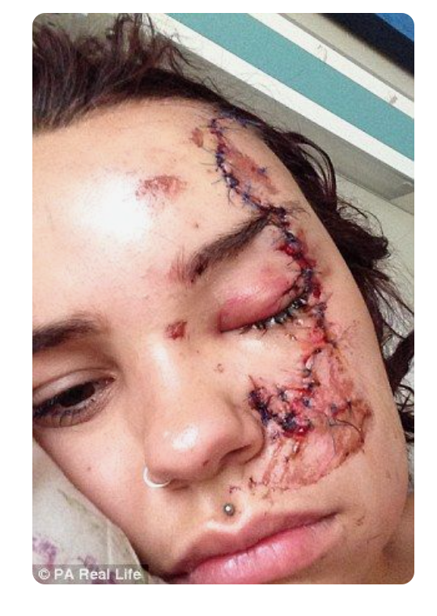

Psychological wounds are more dangerous than Physical Wounds
VS

Slide 3
Learning Objectives
By the end of this lecture, the students will be able to
Describe the normal wound healing mechanism
Describe healing in soft tissue
Describe healing in hard tissue
List factors influencing the healing of the wound
Describe the intentions of healing

Slide 4
Mechanism of Wound Healing
Wound healing is a mechanism whereby the body attempts to restore the integrity of the injured part.
Phases of Healing
The inflammatory phase
The proliferative phase
The remodelling phase (maturing phase)

Slide 5
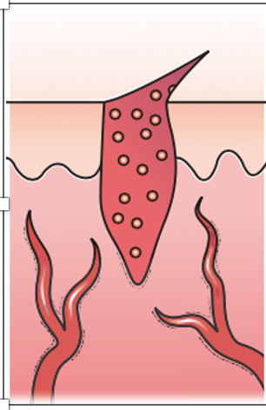
The inflammatory phase
Early inflammatory phase with platelet-enriched blood clot and dilated vessels.

Slide 6
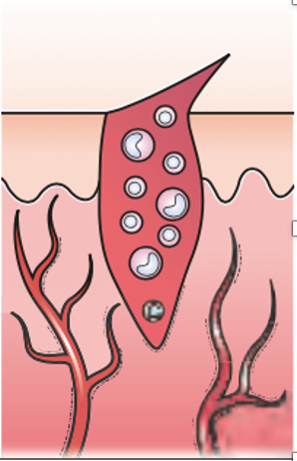
Late inflammatory phase
increased vascularity and increase in polymorpho-nuclear leukocytes and lymphocytes (round cells).

Slide 7
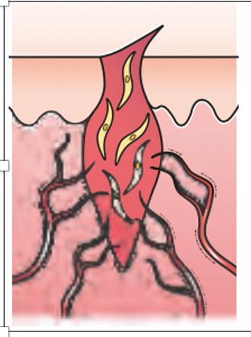
The proliferative phase
Proliferative phase with capillary buds and fibroblasts.
3rd Day 3rd week
fibroblast activity
Production of collagen and ground substance (glycosaminoglycan and proteoglycans)
the growth of new blood vessels as capillary loops (angioneogenesis)
Fibroblasts require vitamin C to produce collagen.

Slide 8
The proliferative phase
The wound tissue formed in the early part of this phase is called granulation tissue.
an increase in the tensile strength of the wound due to increased collagen type III is associated with wound contraction which can considerably reduce the surface area of a wound over the first 3 weeks of healing.

Slide 9
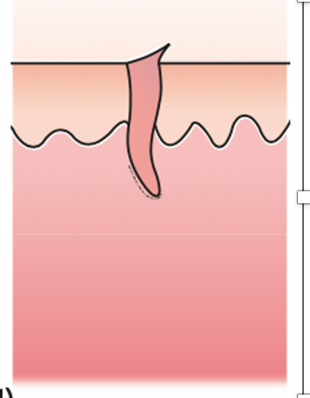
The remodelling phase (maturing phase)
maturation of collagen (type I replacing type III until a ratio of 4:1 is achieved).
There is a realignment of collagen fibres along the lines of tension
decreased wound vascularity
wound contraction due to fibroblast and myofibroblast activity.
This maturation of collagen leads to increased tensile strength in the wound which is maximal at the 12th week post injury and represents approximately 80% of the uninjured skin strength.
Mature contracted scar.

Slide 10
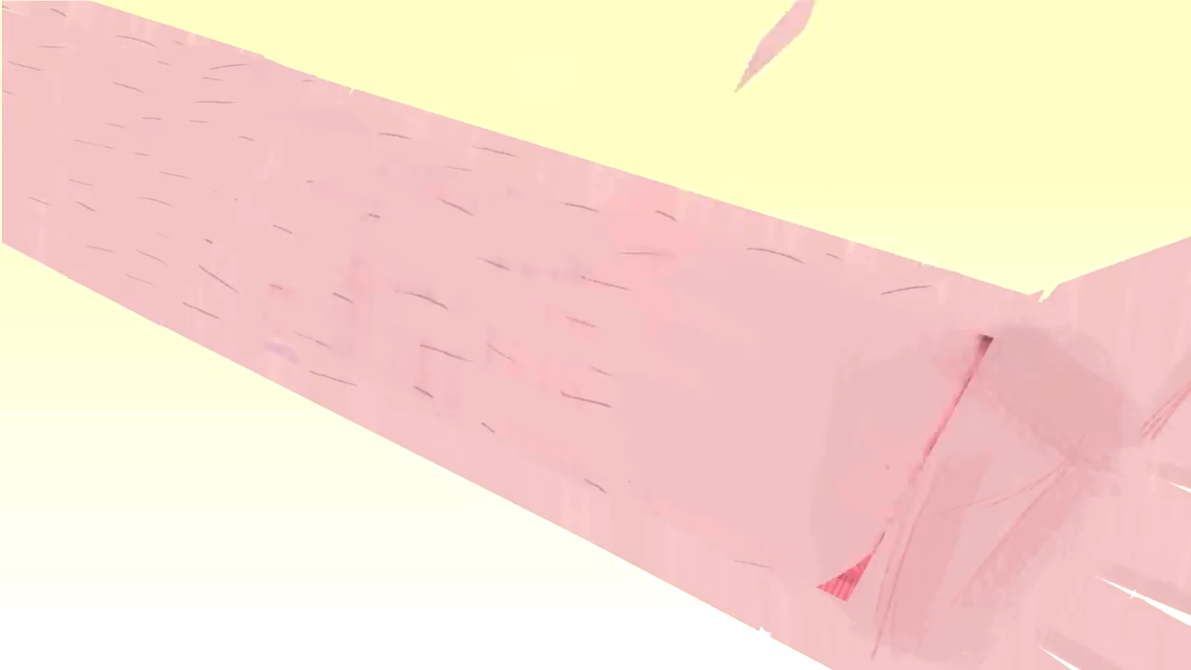
Summary of Stages of wound Healing

Slide 11
NORMAL HEALING IN SPECIFIC TISSUES
Bone
The periosteal and endosteal proliferation leads to the formation of callus
callus is immature bone consisting of osteoid (mineralised by hydroxyapatite and laid down by osteoblasts).
In the remodelling phase, cortical structure and the medullary cavity are restored.
If fracture ends are accurately opposed and rigidly fixed, callus formation is minimal and primary healing occurs.
If a gap exists, then secondary healing may lead to delayed union, non-union or malunion.

Slide 12
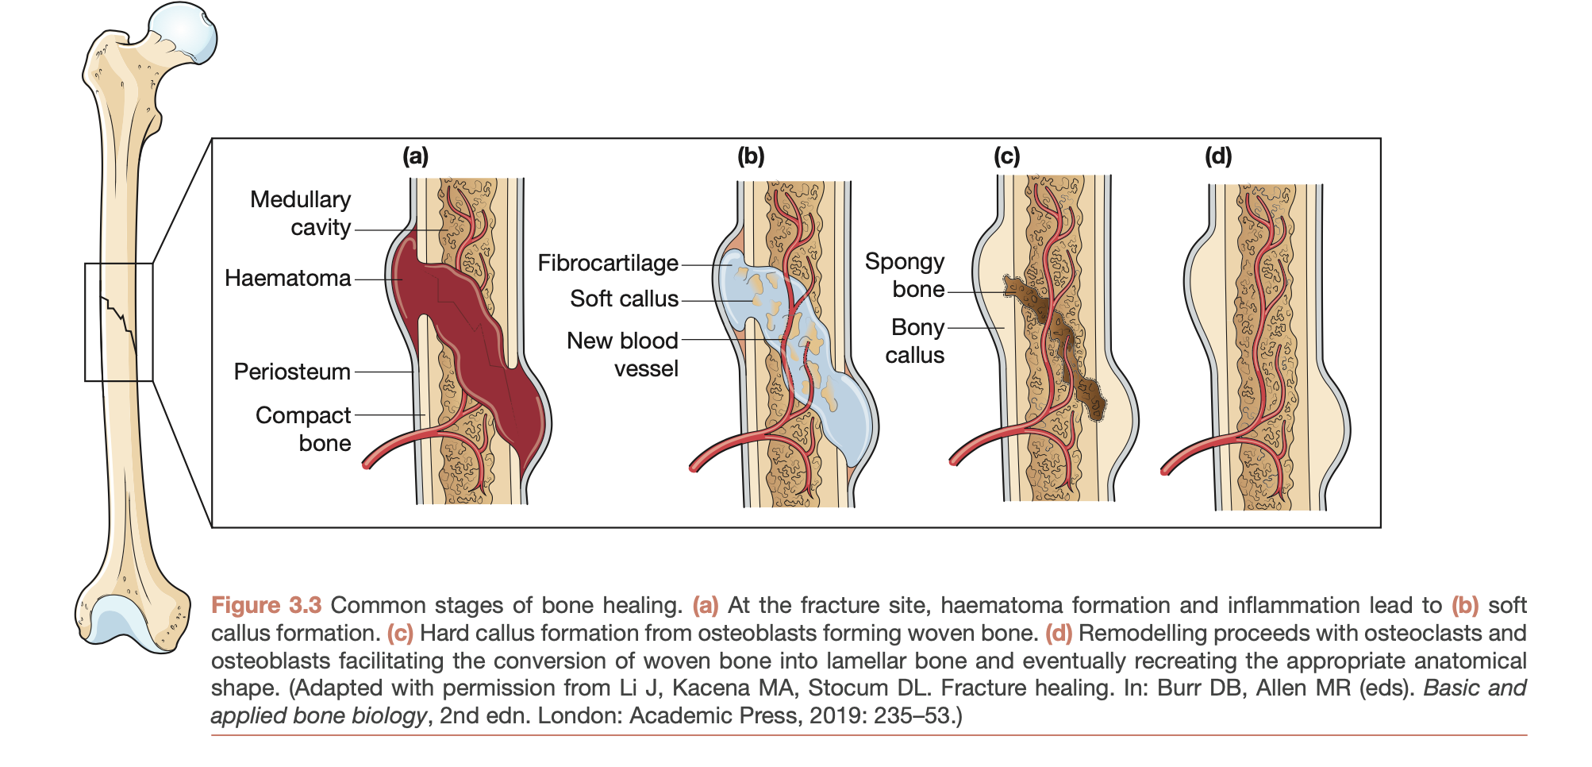

Slide 13
NORMAL HEALING IN SPECIFIC TISSUES
Nerve
Distal to the wound, Wallerian degeneration occurs.
Proximally, the nerve suffers traumatic degeneration as far as the last node of Ranvier.
The regenerating nerve fibres are attracted to their receptors by neurotrophism, which is mediated by growth factors, hormones and other extracellular matrix trophins.
Nerve regeneration is characterised by profuse growth of new nerve fibres which sprout from the cut proximal end.
Overgrowth of these, coupled with poor approximation, may lead to neuroma formation.

Slide 14
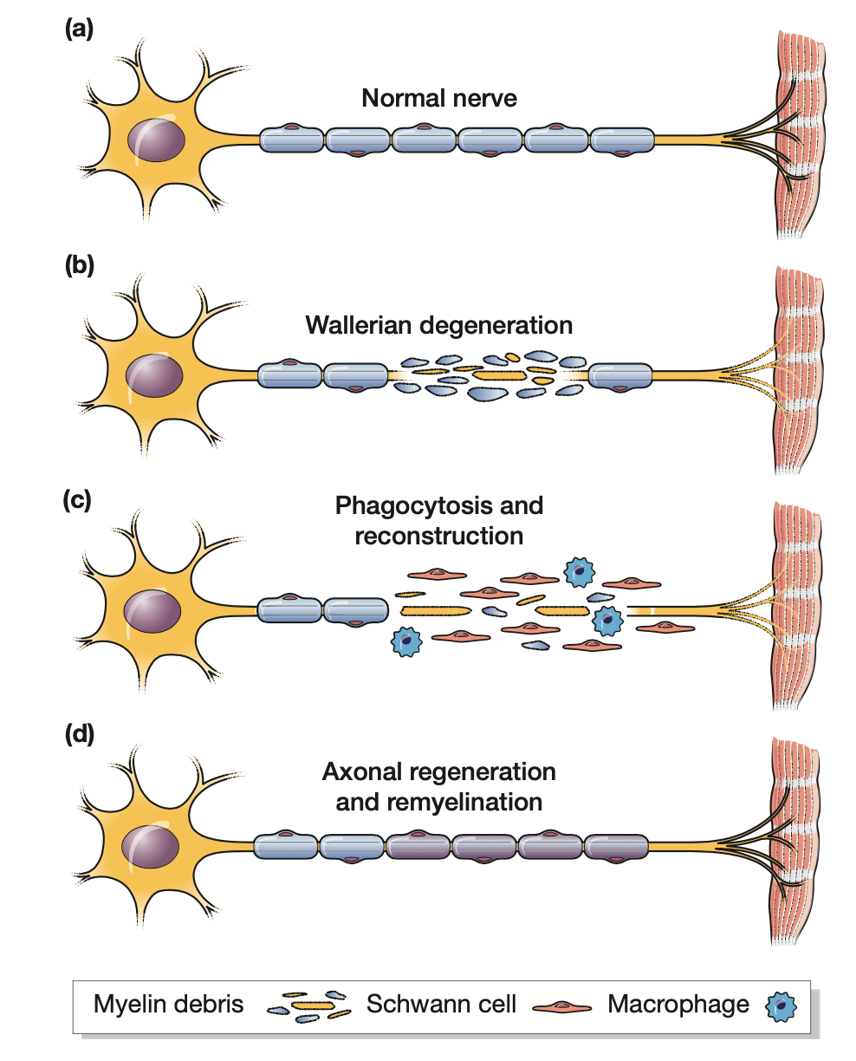

Slide 15
NORMAL HEALING IN SPECIFIC TISSUES
Tendon
Although repair follows the normal pattern of wound healing, there are two main mechanisms whereby nutrients, cells and new vessels reach the severed tendon.
These are intrinsic, which consists of vincular blood flow and synovial diffusion, and extrinsic, which depends on the formation of fibrous adhesions between the tendon and the tendon sheath.
The random nature of the initial collagen produced means that the tendon lacks tensile strength for the first 3–6 weeks.
Active mobilisation prevents adhesions limiting range of motion, but the tendon must be protected by splintage in order to avoid rupture of the repair.

Slide 16
Factors influencing the healing of the wound
Site of wound
Structure involved
Mechanism of wounding
Contamination
Loss of Tissue

Slide 17
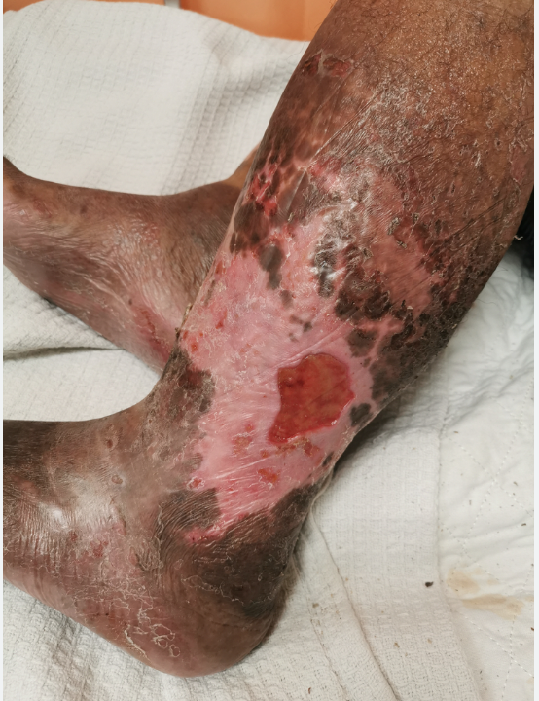
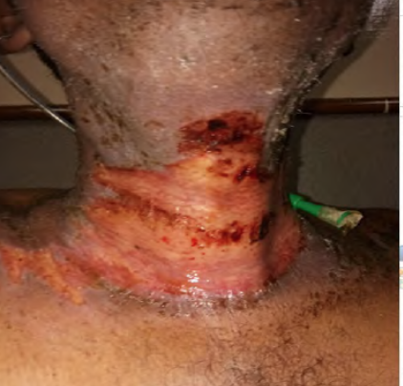
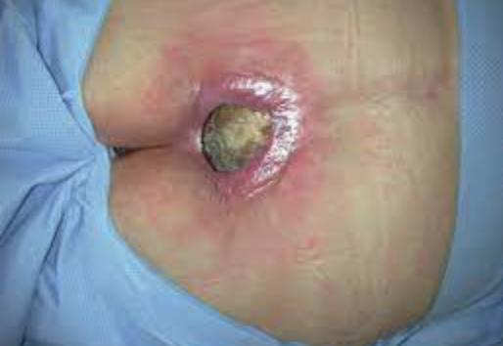
Factors influencing healing of wound
Vascular insufficiency
Previous radiation
Pressure

Slide 18
Factors influencing the healing of the wound
Systemic Factors
Malnutrition ( vitamins, minerals,
Diseases ( Diabetes Mellitus)
Medications ( Steroids, Immunosuppressives )
Immune deficiencies ( chemotherapy, AIDS)
Smoking

Slide 19
A 22-year-old dental student undergoes an uncomplicated surgical extraction of a horizontally impacted mandibular third molar. Six hours postoperatively, the patient notices significant swelling and a dull ache at the extraction site. On examination, the area is warm and erythematous, which the surgeon explains is a normal physiological response. This initial phase involves a complex interplay of vasoconstriction followed by vasodilation and the migration of neutrophils and macrophages to the site of injury to clear debris and bacteria. Which of the following cells are the first to arrive at the wound site during the early inflammatory phase to provide host defense?
A. Fibroblasts
B. Macrophages
C. Neutrophils
D. Myofibroblasts
E. Endothelial cells
Correct Answer: C. Neutrophils

Slide 20
A patient returns to the clinic 7 days after a biopsy of an oral mucosal lesion. The surgical site is now filling with "granulation tissue," which appears pink, granular, and bleeds easily on contact. The surgeon explains that this tissue is a hallmark of the proliferative phase of healing and is composed of a dense network of new capillaries and a provisional extracellular matrix. During this phase, specialized cells are actively synthesizing Type III collagen, which will later be replaced by the stronger Type I collagen during the remodeling phase. Which cell type is primarily responsible for the synthesis of collagen and the extracellular matrix during the proliferative phase?
A. Keratinocytes
B. Fibroblasts
C. Lymphocytes
D. Osteoblasts
E. Platelets
Correct Answer: B. Fibroblasts

Slide 21
A 25-year-old male presents with a clean-cut laceration on his lower lip following a minor fall. The edges of the wound are sharp and can be easily approximated without tension. The maxillofacial surgeon performs a primary closure using fine 5-0 prolene sutures. The surgeon notes that this method of healing results in minimal scarring and rapid epithelialization because the wound edges are in direct contact. In contrast, an open socket after a tooth extraction must heal by filling the gap with granulation tissue from the bottom up. What is the clinical term for the mechanism of healing where the wound edges are surgically approximated?
A. Healing by secondary intention
B. Healing by tertiary intention (Delayed primary closure)
C. Healing by primary intention
D. Resolution
E. Regeneration
Correct Answer: C. Healing by primary intention

Slide 22
A student is observing a surgery where an incision is made both in the oral mucosa and the overlying facial skin. The surgeon comments that wounds in the oral cavity heal much faster than those on the skin and often with significantly less clinical scarring. This is attributed to the presence of growth factors in the saliva, a more rapid inflammatory response, and the unique phenotype of oral mucosal fibroblasts which behave similarly to fetal fibroblasts. Which of the following factors contributes to the accelerated, "scarless-like" healing observed in the oral mucosa compared to skin?
A. Lower vascularity in the mouth
B. Presence of epidermal growth factor (EGF) in saliva
C. Slower epithelial turnover
D. Increased tension on oral wounds
E. Constant presence of oral bacteria
Correct Answer: B. Presence of epidermal growth factor (EGF) in saliva

Slide 23
During a lecture on wound healing, the Professor explains that cytokines and growth factors act as chemical messengers to coordinate cell behavior. He highlights a specific growth factor that is a potent stimulator of fibroblast activity and collagen production but, if overexpressed, can lead to excessive scarring or keloid formation. This growth factor is released by platelets and macrophages and plays a central role in both the proliferative and remodeling phases of healing. Which growth factor is most closely associated with the promotion of fibrosis and collagen deposition in soft tissue healing?
A. Vascular Endothelial Growth Factor (VEGF)
B. Transforming Growth Factor-beta (TGF-$\beta$)
C. Tumor Necrosis Factor-alpha (TNF-$\alpha$)
D. Insulin-like Growth Factor (IGF)
E. Interferon-gamma
Correct Answer: B. Transforming Growth Factor-beta (TGF-$\beta$)

Slide 24
A patient has a large ulcer on the buccal mucosa that is healing by secondary intention. Over the course of three weeks, the size of the ulcer is visibly decreasing not just by the formation of new tissue, but because the edges of the wound are being "pulled" toward the center. The surgeon explains that this process of "wound contraction" is mediated by a specialized cell type that contains contractile proteins similar to those found in smooth muscle cells. Which cell is primarily responsible for the phenomenon of wound contraction during secondary intention healing?
A. Melanocytes
B. Myofibroblasts
C. Histiocytes
D. Chondrocytes
E. Endothelial cells
Correct Answer: B. Myofibroblasts

Slide 25
A patient suffers a deep laceration that involves the buccinator muscle during a facial injury. The surgeon explains that while skin and mucosa have high regenerative capacities, skeletal muscle healing is more complex. If the basement membrane of the muscle fibers is intact, some regeneration can occur via satellite cells. However, if the injury is extensive, the defect is typically repaired by the formation of a fibrous scar rather than functional muscle fibers, which may lead to some loss of muscle contractility.What is the primary mechanism of repair in skeletal muscle when the injury is extensive and the muscle architecture is destroyed?
A. Complete regeneration of new myocytes
B. Fibrosis and scar formation
C. Hyperplasia of existing muscle fibers
D. Osseous metaplasia
E. Compensatory hypertrophy only
Correct Answer: B. Fibrosis and scar formation

Slide 26
A patient returns for a 6-month follow-up after a major maxillofacial surgery. The surgical scar, which was once red, raised, and firm, has now become pale, flat, and softer. The surgeon explains that the wound has entered the "Remodeling Phase," which can last for up to a year or more. During this phase, the total amount of collagen in the wound does not significantly increase; instead, it is reorganized and cross-linked to increase the tensile strength of the scar. What is the maximum tensile strength a skin scar can typically achieve compared to original, uninjured skin?
A. 100%
B. 50%
C. 80%
D. 20%
E. 10%
Correct Answer: C. 80%

Slide 27
A diabetic patient presents with a dry socket (alveolar osteitis) three days after a dental extraction. The patient is in severe pain, and the socket is filled with foul-smelling debris instead of a healthy blood clot. The surgeon notes that local factors such as poor blood supply, the presence of necrotic tissue, and a high bacterial load have halted the normal healing process. He emphasizes that "debridement" and "irrigation" are necessary to shift the wound back from a chronic inflammatory state to a healing state. Which of the following is considered the most common local cause for the delay of soft tissue healing in the oral cavity?
Vitamin C deficiency
Systemic corticosteroids
Infection and poor oral hygiene
D. Advanced age
E. Anemia
Correct Answer: C. Infection and poor oral hygiene

Slide 28
An elderly patient with a very poor diet (consisting mostly of tea and toast) presents with bleeding gums, loose teeth, and "corkscrew" hairs on the legs. The patient also complains that a small cut on the hand has failed to heal for over a month. The dentist suspects a specific vitamin deficiency that is essential for the hydroxylation of proline and lysine residues during collagen synthesis. Without this vitamin, collagen fibers are weak and unstable, leading to wound dehiscence and capillary fragility. Which vitamin is a mandatory co-factor for the enzymes involved in collagen synthesis and cross-linking?
A. Vitamin A
B. Vitamin D
C. Vitamin C (Ascorbic acid)
D. Vitamin B
E. Vitamin K
Correct Answer: C. Vitamin C (Ascorbic acid)

Slide 29
Marks Distribution
3rd Professional BDS (General Surgery)
Prof. Zahid Mahmood

Slide 30
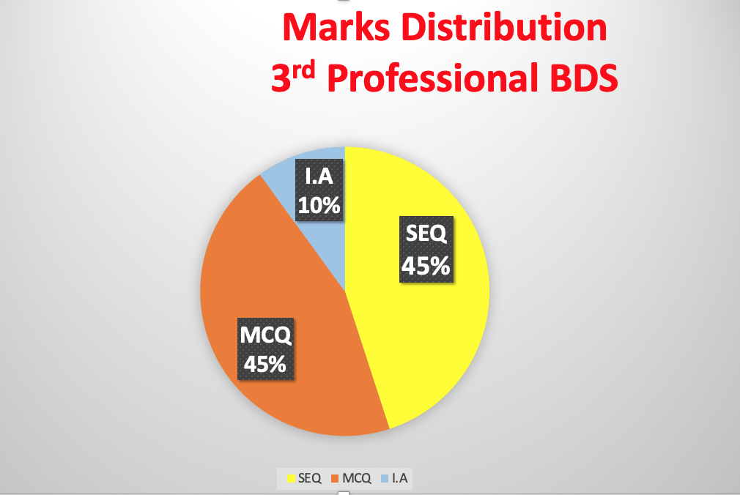
Marks Distribution
3rd Professional BDS (General Surgery)
Theory: 100
SEQ: 15 x3 =45
MCQ: 45 x 1= 45
Internal Assessment = 10

Slide 32
Curriculum for 3rd professional BDS
1) SURGICAL PRNICIPLES (MCQ= 5 SEQs= Nil) Marks=5
2) HEALING and REPAIR of WOUNDS (MCQ= 1 SEQs= Nil) Marks=1
3) SURGICAL INFECTIONS (MCQ= 3 SEQs= 6) Marks=21
4) Trauma Care (MCQ= 8 SEQs= 1) Marks= 11
5) HEMORRHAGE, SHOCK, BURN (MCQ=1 SEQs=Nil) Marks=1
6) ORAL & Maxillofacial Pathology (MCQ=12 SEQs=4) Marks= 24
7) NECK PATHOLOGY (MCQ=13 SEQ= 4 ) Marks= 25
8) DEVELOPMENTAL PATHOLOGY (MCQ=2 SEQ= Nil) Marks= 2

Slide 33
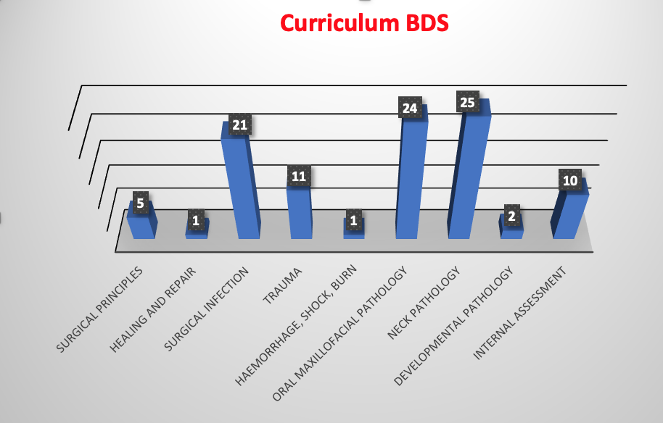

Slide 34
Practical: 100
Short cases 4 = 15x4=60
Internal Examiner= 30 marks
External Examiner=30 marks
OSPE= ( 1 interactive + 9 static stations)=10x3=30marks
internal assessment= 10 marks

Slide 35
Short cases
Wounds
Examination of swelling
Ulcer ,cyst ,fistula ,
Goiter , neck swelling ,
Salivary gland ,
Oral cavity lesions ,
Lipoma, Neurofibroma , sebaceous cyst, Gangrene ,burns ,faciomaxillary trauma )

Slide 36
OSPE for 3rd Year BDS
Interactive (1)
(Counseling)
Tracheostomy
Thyroidectomy
Salivary gland
Neck dissections
Amputation

Slide 37
Static stations
Trauma, Emergency, Facial, Head, Chest, Abdomen (2)
Pre-op Assessment (1)
Diabetic patient
Cardiac patient
Steroid therapy
Hypertension
Chest diseases
Thyrotoxicosis
Post-op complications and care (1)
Wound infection
Fluid and electrolytes
Nasogastric tube, Feeding tube, Endotracheal, tracheostomy

Slide 38
Pain management
Chest care
DVT
Instrument, Tubing
Nasogastric tube, Feeding tube, Endotracheal, tracheostomy (2)
X-rays cervical spine, chest, OPG (2)
Drains, sutures, catheter
Nelton drain, suction drain, corrugated, chest drain,
Silk, proline, vicryl, catgut
Folly’s catheter, central venous line Cather (1)

Slide 39
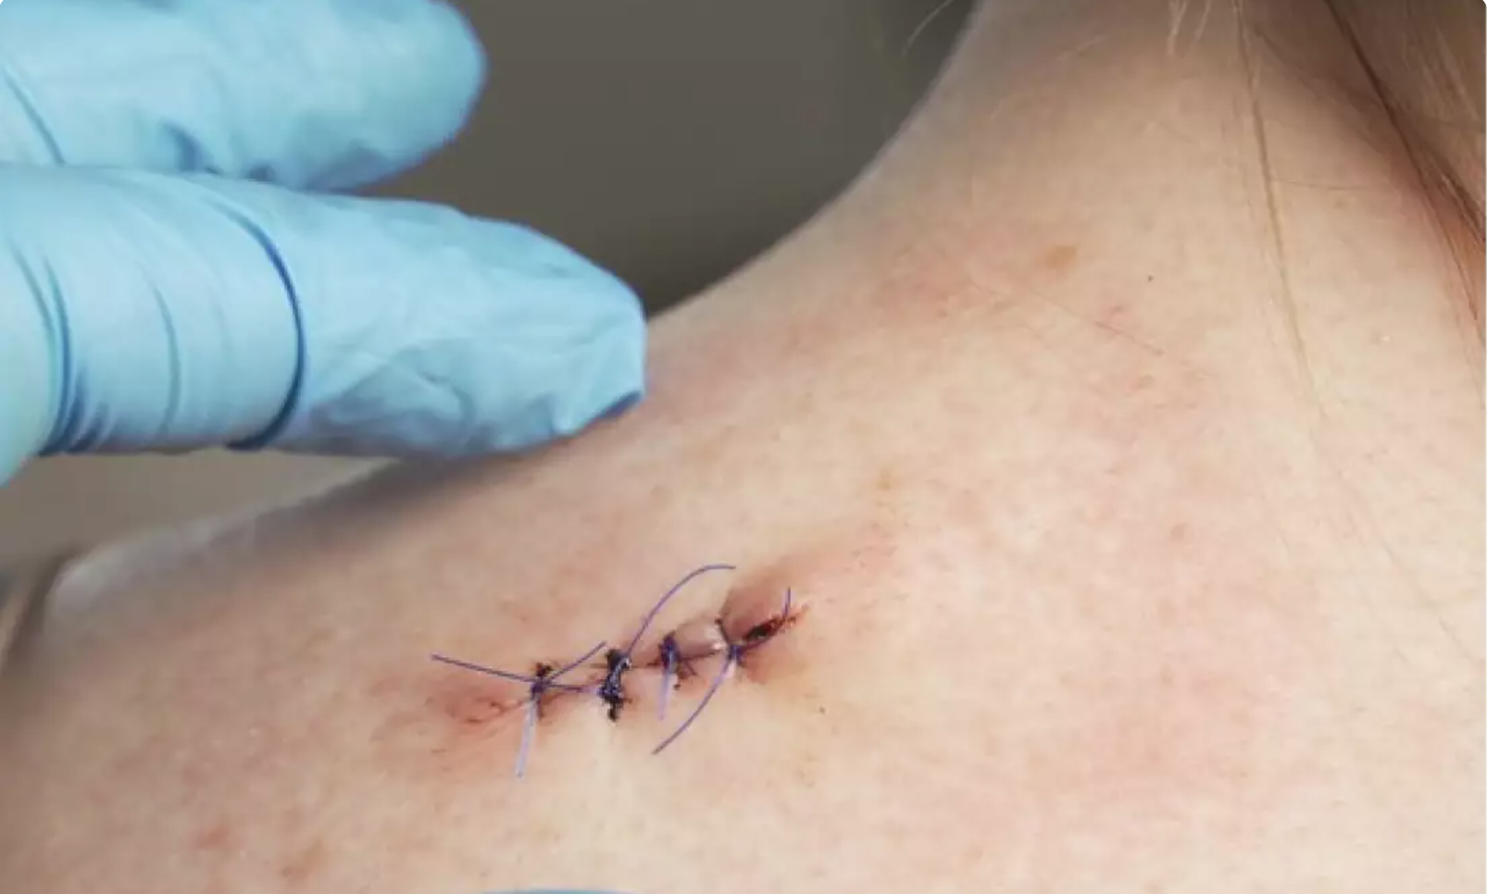
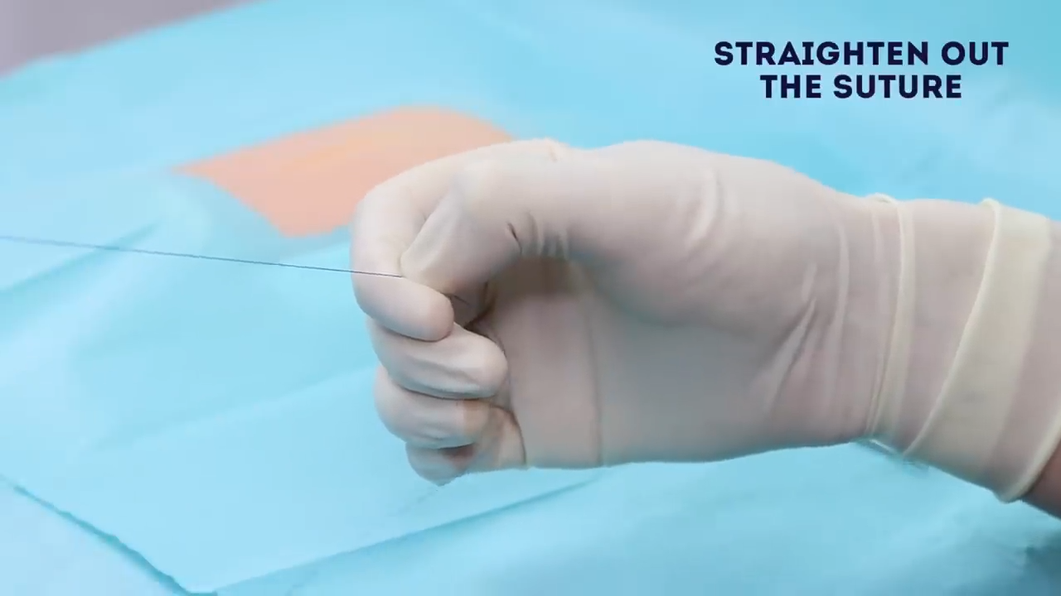
Classification of Wound Closure and Healing
Primary Intention
Wound edges apposed
Normal healing
Minimal Scar

Slide 40
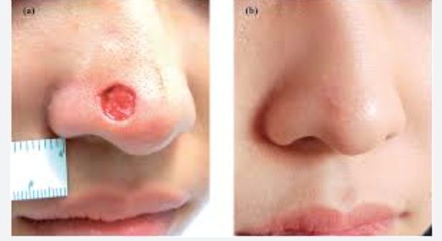
Secondary intention
Wound left open
Heals by granulation, contraction, epithelization
Increased inflammation and proliferation
Poor scar

Slide 41
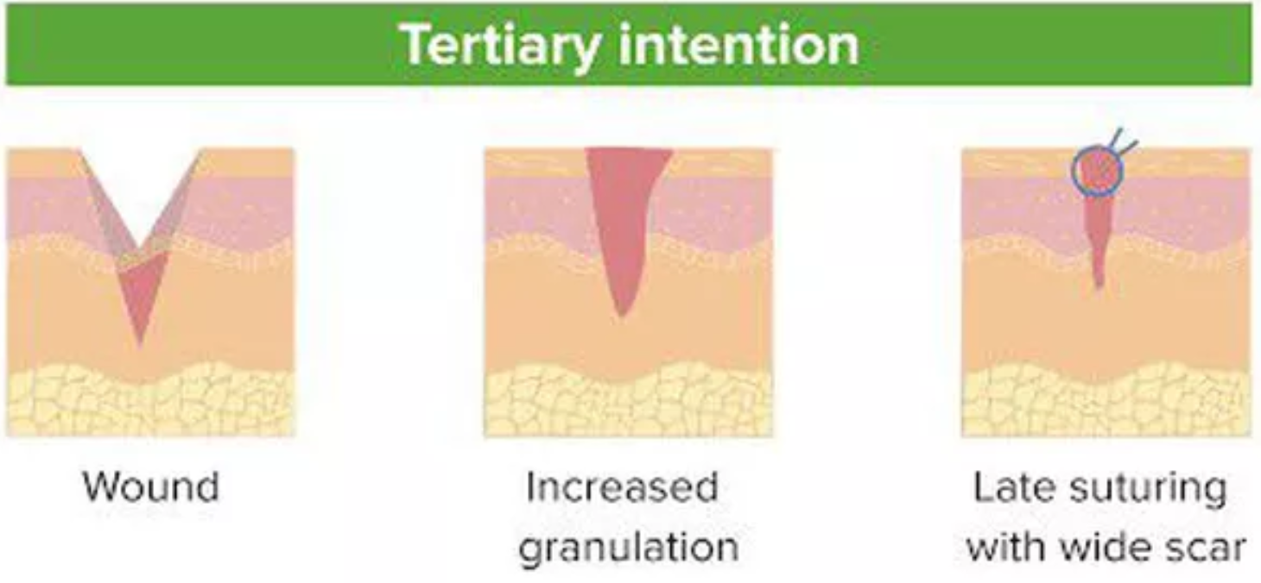
Tertiary intention( Delayed Primary Intention)
The wound was initially left open
Edges later opposed when healing conditions favourable

Slide 43
Marks Distribution
3rd Professional BDS (General Surgery)
Prof. Zahid Mahmood

Slide 44
Marks Distribution
3rd Professional BDS (General Surgery)
Theory: 100
SEQ: 15 x3 =45
MCQ: 45 x 1= 45
Internal Assessment = 10

Slide 46
Curriculum for 3rd professional BDS
1) SURGICAL PRNICIPLES (MCQ= 5 SEQs= Nil) Marks=5
2) HEALING and REPAIR of WOUNDS (MCQ= 1 SEQs= Nil) Marks=1
3) SURGICAL INFECTIONS (MCQ= 3 SEQs= 6) Marks=21
4) Trauma Care (MCQ= 8 SEQs= 1) Marks= 11
5) HEMORRHAGE, SHOCK, BURN (MCQ=1 SEQs=Nil) Marks=1
6) ORAL & Maxillofacial Pathology (MCQ=12 SEQs=4) Marks= 24
7) NECK PATHOLOGY (MCQ=13 SEQ= 4 ) Marks= 25
8) DEVELOPMENTAL PATHOLOGY (MCQ=2 SEQ= Nil) Marks= 2

Slide 48
Practical: 100
Short cases 4 = 15x4=60
Internal Examiner= 30 marks
External Examiner=30 marks
OSPE= ( 1 interactive + 9 static stations)=10x3=30marks
internal assessment= 10 marks

Slide 49
Short cases
Wounds
Examination of swelling
Ulcer ,cyst ,fistula ,
Goiter , neck swelling ,
Salivary gland ,
Oral cavity lesions ,
Lipoma, Neurofibroma , sebaceous cyst, Gangrene ,burns ,faciomaxillary trauma )

Slide 50
OSPE for 3rd Year BDS
Interactive (1)
(Counseling)
Tracheostomy
Thyroidectomy
Salivary gland
Neck dissections
Amputation

Slide 51
Static stations
Trauma, Emergency, Facial, Head, Chest, Abdomen (2)
Pre-op Assessment (1)
Diabetic patient
Cardiac patient
Steroid therapy
Hypertension
Chest diseases
Thyrotoxicosis
Post-op complications and care (1)
Wound infection
Fluid and electrolytes
Nasogastric tube, Feeding tube, Endotracheal, tracheostomy

Slide 52
Pain management
Chest care
DVT
Instrument, Tubing
Nasogastric tube, Feeding tube, Endotracheal, tracheostomy (2)
X-rays cervical spine, chest, OPG (2)
Drains, sutures, catheter
Nelton drain, suction drain, corrugated, chest drain,
Silk, proline, vicryl, catgut
Folly’s catheter, central venous line Cather (1)

