Slide 1
Identifying Appropriate Venous Access Sites
Using Surface Anatomy & Palpation Techniques

Slide 2
Learning Objectives
• Identify major superficial veins for venous access.
• Utilize anatomical landmarks effectively.
• Perform palpation techniques to assess veins.
• Select appropriate venous access sites safely.

Slide 3
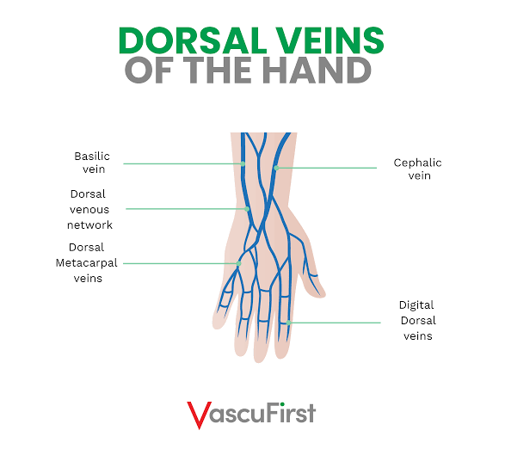
Dorsal Veins of the Hand

Slide 4
Hand Veins – Key Points
• Easily visible and accessible on the dorsal surface.
• Dorsal metacarpal veins commonly used for IV cannulation.
• Best suited for short-term, non-irritating infusions.
• Avoid joints to minimize risk of infiltration.

Slide 5
Hand Veins – Palpation Techniques
• Lower the hand below heart level to encourage venous filling.
• Gently tap or stroke the vein to improve visibility.
• Use the pads of your fingers to feel for soft, bouncy veins.
• Avoid veins that feel hard, ropy, or are pulsatile.

Slide 6
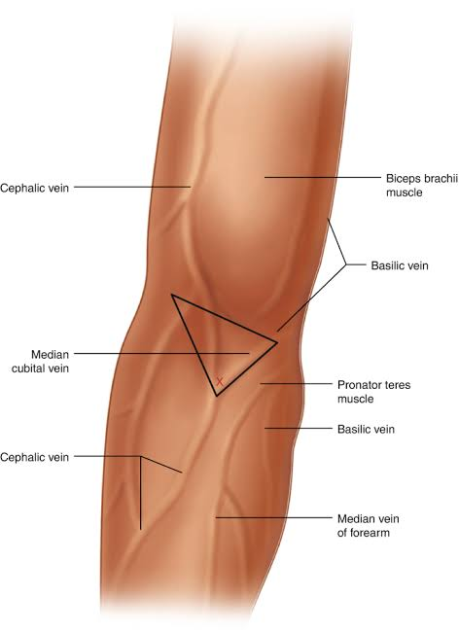
Cubital Fossa Venous Anatomy

Slide 7
Cubital Fossa – Key Points
• Median cubital vein is the most stable and preferred for phlebotomy.
• Cephalic and basilic veins serve as additional access sites.
• Suitable when rapid or large-bore access is required.

Slide 8
Cubital Fossa – Palpation Techniques
• Extend the arm fully to expose veins.
• Palpate for a compressible, non-pulsatile vessel.
• Trace the vein proximally and distally to confirm continuity.

Slide 9
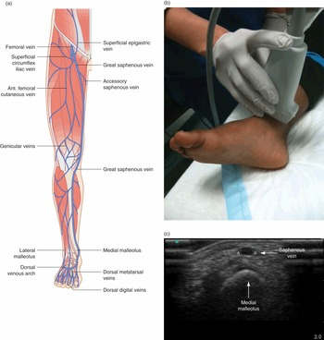
Lower Limb Venous Access

Slide 10
Lower Limb – Key Points
• Great saphenous vein located anterior to the medial malleolus.
• Used when upper limb access is unavailable.
• Ultrasound guidance recommended in difficult cases.

Slide 11
Lower Limb – Palpation Techniques
• Apply light pressure along the vein’s trajectory.
• Elevate the leg slightly to improve venous filling.
• Do not use if redness, warmth, or tenderness suggests DVT.

Slide 12
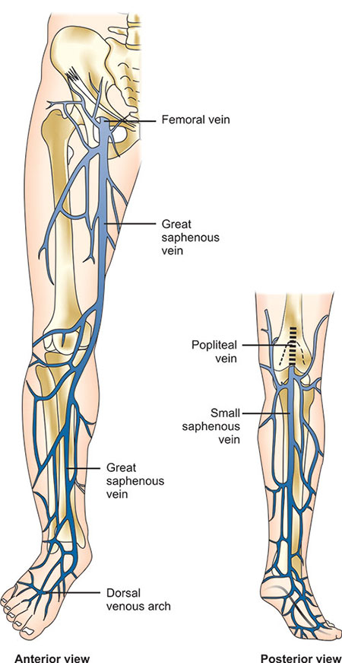
Major Deep Veins of the Lower Limb

Slide 13
Femoral & Popliteal Veins – Key Points
Femoral Vein:
• Located in femoral triangle—large, reliable access site.
• Ideal for emergency and central access when upper limb sites unavailable.
• Lies medial to femoral artery (use artery as landmark).
• Avoid in pelvic trauma or suspected DVT.
Popliteal Vein:
• Found deep in popliteal fossa—less accessible.
• Typically accessed under ultrasound guidance.
• Avoid in cases of knee infection or swelling.

Slide 14
Femoral & Popliteal – Palpation Techniques
Femoral Vein Palpation:
• Locate femoral artery pulse first.
• Vein lies just medial to the artery.
• Palpate gently for a soft, compressible structure.
Popliteal Vein Palpation:
• Ask patient to slightly flex knee to relax posterior tissues.
• Vein is deep and rarely palpable—use ultrasound for accuracy.
• Identify artery pulse; vein lies superficial and slightly lateral.

Slide 15
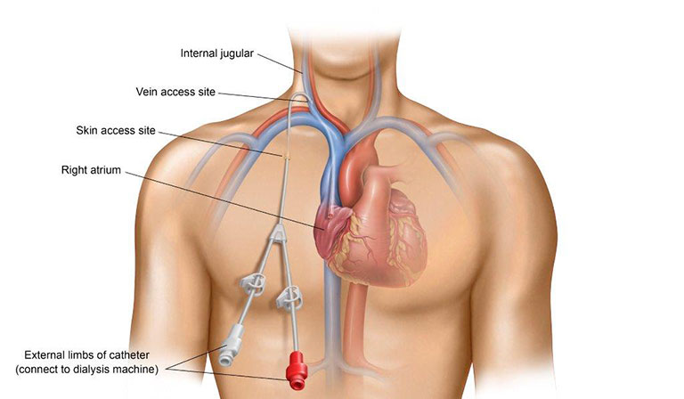
Internal Jugular Vein – Anatomical Landmark

Slide 16
Internal Jugular Vein – Key Points
• Preferred central venous access site due to straight path to SVC.
• Lies lateral to carotid artery within carotid sheath.
• Commonly accessed at apex of the triangle formed by clavicular & sternal heads of SCM.
• Lower infection risk compared to femoral access.

Slide 17
Internal Jugular – Palpation Techniques
• Identify the two heads of the sternocleidomastoid (SCM) muscle.
• The IJV lies between these heads—slightly lateral.
• Palpate carotid artery first; **never insert needle over the artery**.
• The IJV is non-pulsatile and compressible—use ultrasound for safety.

