Slide 1
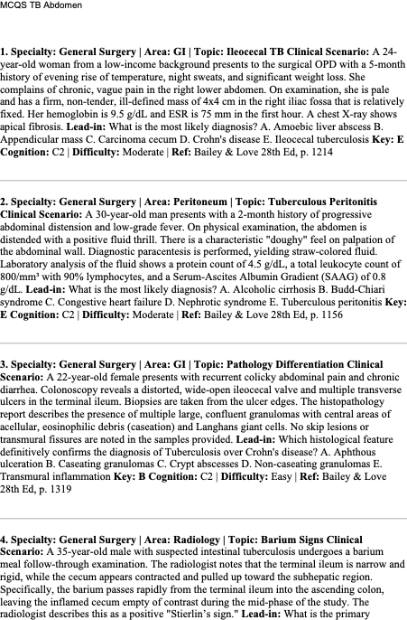
MCQ 1 – Ileocecal TB
A 24-year-old woman with evening fever, night sweats, weight loss and RIF mass.
Most likely diagnosis?
A. Amoebic liver abscess
B. Appendicular mass
C. Carcinoma cecum
D. Crohn's disease
E. Ileocecal tuberculosis
Answer: E

Slide 2
MCQ 2 – Tuberculous Peritonitis
30-year-old man with abdominal distension, fever and doughy abdomen.
Ascitic protein 4.5 g/dL, lymphocytes 90%, SAAG 0.8.
Diagnosis?
A. Alcoholic cirrhosis
B. Budd-Chiari syndrome
C. CHF
D. Nephrotic syndrome
E. Tuberculous peritonitis
Answer: E

Slide 3
MCQ 3 – TB vs Crohn
Histology showing granulomas with caseation.
Which confirms TB?
A. Aphthous ulceration
B. Caseating granulomas
C. Crypt abscess
D. Non‑caseating granulomas
E. Transmural inflammation
Answer: B

Slide 4
MCQ 4 – Stierlin Sign
Barium study shows rapid emptying of cecum.
Cause?
A. Adhesions
B. Fibrotic stricture
C. Hyperirritability of cecum
D. Malignant infiltration
E. Paralytic ileus
Answer: C

Slide 5
MCQ 5 – TB Perforation
Patient with TB abdomen develops pneumoperitoneum.
Most common perforation site?
A. Ascending colon
B. Duodenum
C. Ileum
D. Jejunum
E. Stomach
Answer: C

Slide 6
MCQ 6 – Stricture Surgery
Multiple short intestinal strictures (2–3 cm).
Best surgery?
A. Bypass
B. Heineke‑Mikulicz strictureplasty
C. Right hemicolectomy
D. Resection
E. Proctocolectomy
Answer: B

Slide 7
MCQ 7 – Morphological Type
Most common type of ileocecal TB?
A. Ascitic
B. Encephaloid
C. Hyperplastic
D. Plastic
E. Ulcerative
Answer: C

Slide 8
MCQ 8 – Ascitic Marker
Best marker for TB ascites?
A. ADA
B. ALP
C. Amylase
D. CEA
E. LDH
Answer: A

Slide 9
MCQ 9 – Long Stricture
Single 12 cm ileal stricture.
Best surgery?
A. Finney strictureplasty
B. Heineke‑Mikulicz
C. Bypass
D. Ileostomy
E. Resection
Answer: A

Slide 10
MCQ 10 – TB vs Cancer
CT feature favoring TB?
A. Ascites
B. Enhancement
C. Cecal thickening
D. Ileal narrowing
E. Necrotic lymph nodes
Answer: E

