Slide 1
بِسْمِ اللَّهِ الرَّحْمَٰنِ الرَّحِيمِ
In the name of Allah, the Most Gracious, the Most Merciful

Slide 2
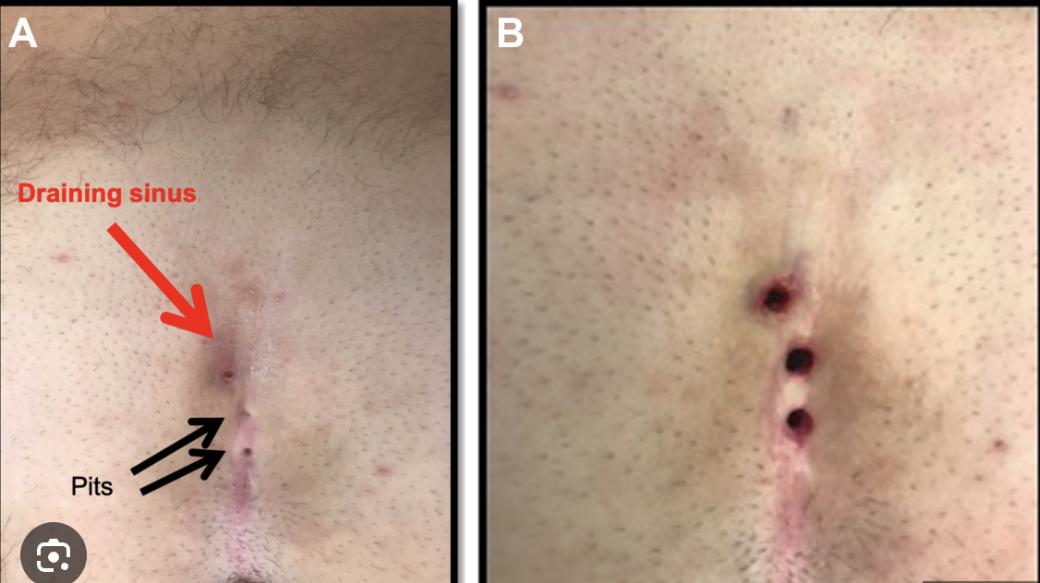
PILONIDAL SINUS
Prof. Zahid Mahmood

Slide 3
Did You Know?
"Pilonidal" = Latin: pilus (hair) + nidus (nest)
Literally a "nest of hair" under your skin!
Barbers get it between their fingers!
More common than appendicitis in young men
Called "Jeep Rider's Disease" in World War II

Slide 4


Slide 5
Learning Outcomes
Define pilonidal sinus and its anatomy
Describe aetiology and pathogenesis
Identify clinical features and diagnosis
Outline management options
Discuss surgical techniques and complications

Slide 6
What Is Pilonidal Sinus?
Condition in natal cleft overlying coccyx
One or more midline skin openings (pits)
Fibrous track lined by granulation tissue
Contains loose hair within the lumen
Track communicates with subcutaneous cavity

Slide 7
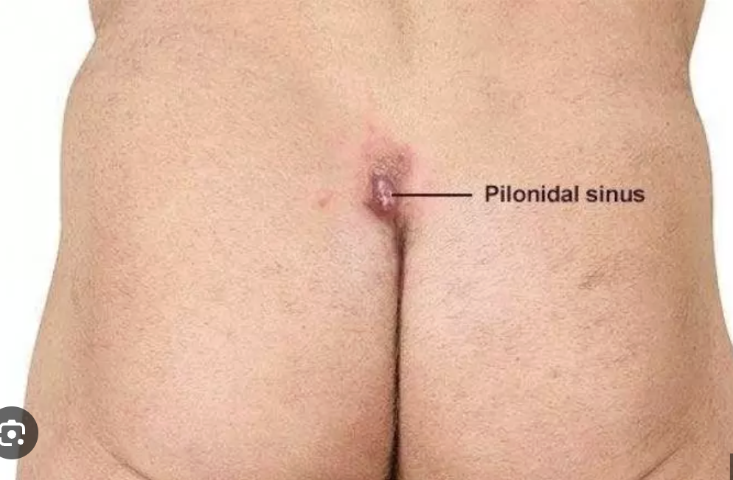

Slide 8
Anatomy & Location
Located in sacrococcygeal natal cleft
Between sacrococcygeal joint and coccyx tip
Primary pits: strictly in the midline
Secondary tracts spread laterally
Secondary openings: discharging granulation tissue

Slide 9
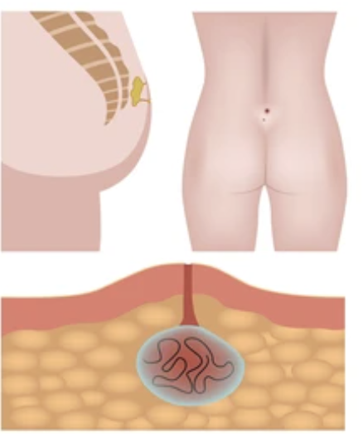

Slide 10
Aetiology — Acquired Theory
Most accepted theory: acquired, not congenital
Buttock friction + shearing forces involved
Shed hairs drill through midline skin
Hair follicle infection allows hair entry
Suction from buttock movement pulls hair in

Slide 11
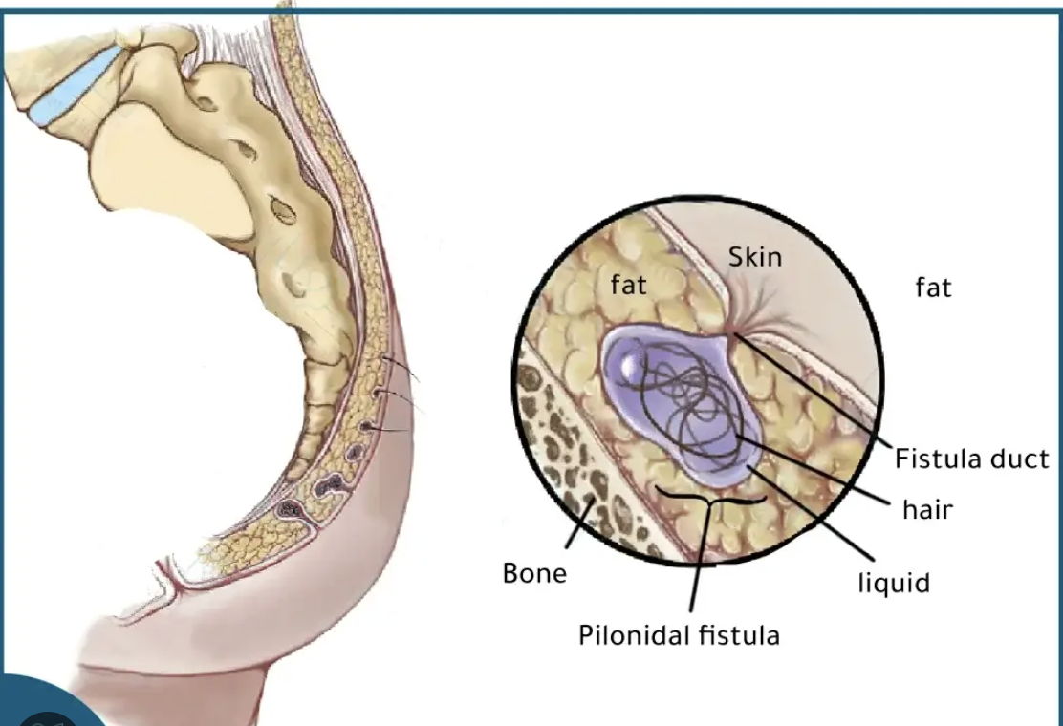

Slide 12
Evidence — Acquired Origin
Interdigital sinus: occupational disease of barbers
Age of onset older than congenital lesions
Hair follicles absent in sinus walls
Hair tips point toward blind sinus end
Disease mainly affects hirsute young men

Slide 13
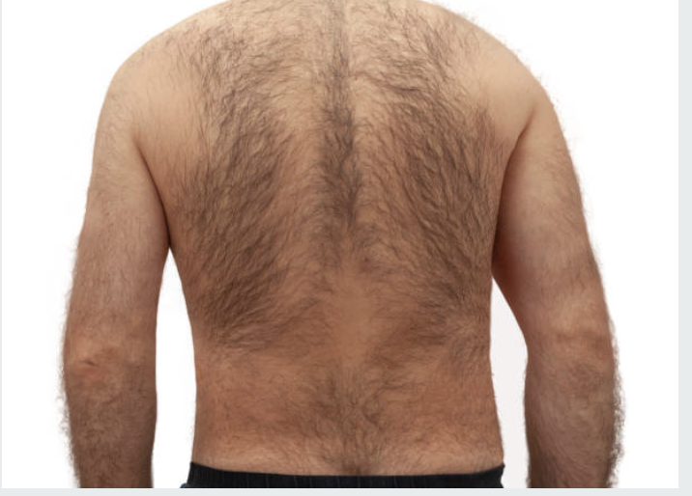

Slide 14
Epidemiology
Males >> Females (much more common)
Typically after puberty to 4th decade
Dark-haired individuals more affected
Obese, sedentary individuals at higher risk
Rare in children and over 40 years

Slide 15
Clinical Features
Intermittent pain at base of spine
Swelling and discharge in natal cleft
History of repeated abscesses
Abscesses burst spontaneously or incised
Minimal constitutional symptoms

Slide 16
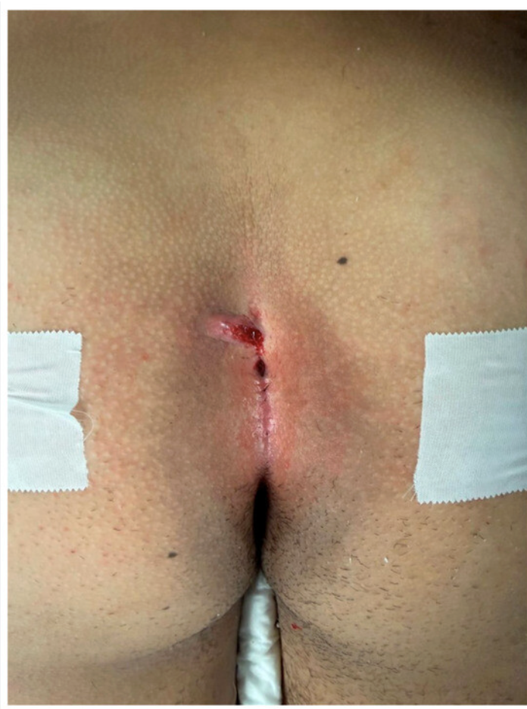

Slide 17
Examination Findings
Midline pit(s): sacrococcygeal to coccyx tip
Tuft of hair protruding from pit
Lateral secondary openings may be present
Tender induration in the natal cleft
Purulent discharge on pressure

Slide 18
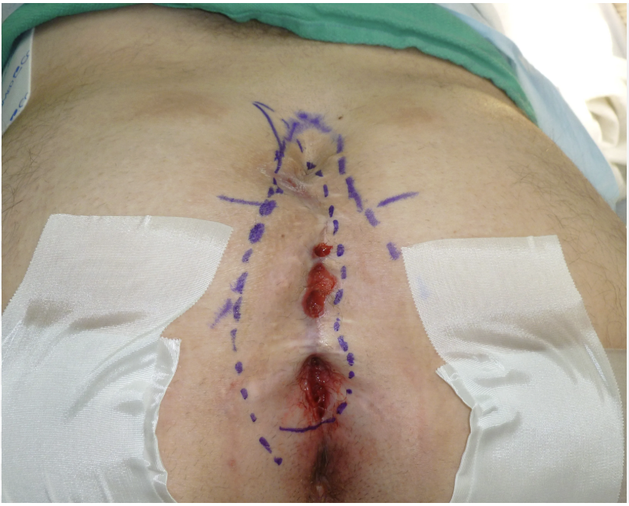

Slide 19
Differential Diagnosis
Anal fistula (sinus caudal to pits)
Hidradenitis suppurativa (lateral drainage)
Perianal abscess or fistula
Osteomyelitis with draining sinuses
Tuberculosis or actinomycosis (rare)

Slide 20
Pilonidal Sinus vs Anal Fistula
Feature | Pilonidal Sinus | Anal Fistula
Location | Natal cleft, midline | Perianal region
Opening | Midline pits above anus | External opening near anus
Content | Hair-containing track | No hair, lined by epithelium
Relation to gut | No relation to gut | Communicates with anal canal

Slide 21
Conservative Treatment
Natural history: regresses over time
Hygiene: remove hair, keep area clean
Regular hair exfoliation of the region
Silver nitrate cauterisation of tracks
Laser coagulation for less complex disease

Slide 22
Acute Abscess: Treatment
Drain through small longitudinal incision
Incision placed OFF the midline
Thorough curettage of granulation tissue
Remove all hair from cavity
May result in complete resolution

Slide 23
Surgical Treatment — Options
Lay open all tracks ± marsupialisation
Excise all tracks with primary closure
Excise + off-midline flap closure
Bascom's procedure (lateral approach)
Limberg flap / Karydakis procedure

Slide 24
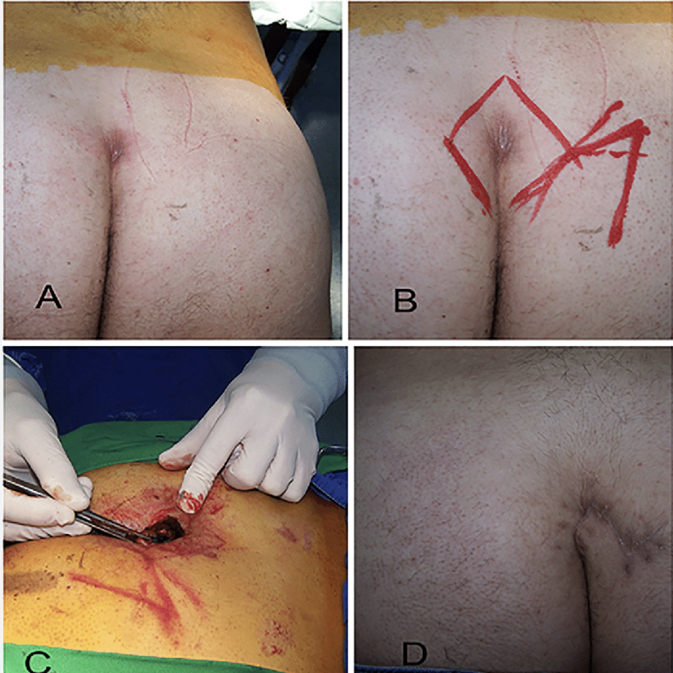

Slide 25
Off-Midline Techniques
Karydakis: off-midline excision + flap
Limberg: rhomboid excision + rotational flap
Bascom: lateral incision, curette cavity
Bascom: excise + close midline pits
Lateral wound left open to heal secondarily

Slide 26
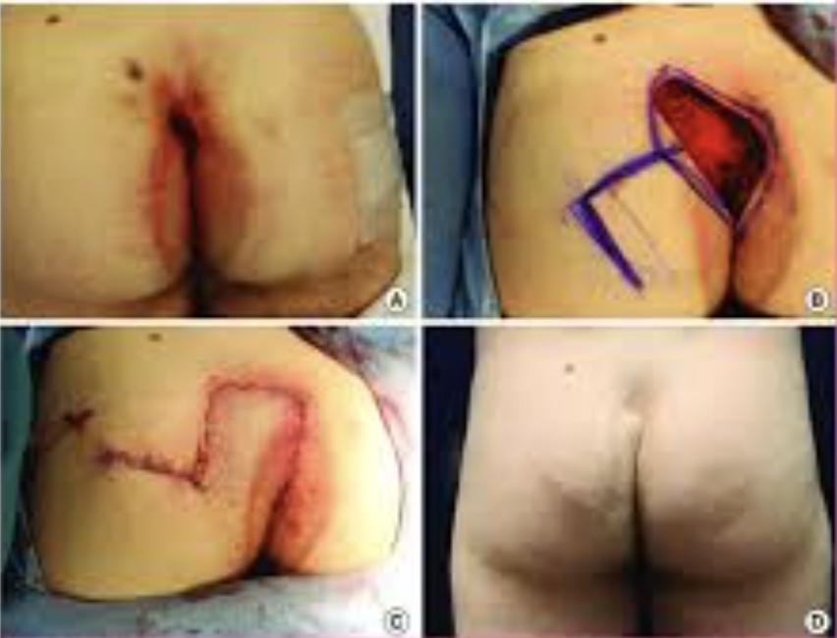

Slide 27
Healing & Recurrence: Key Facts
Open healing: lower recurrence, slower healing
Primary closure: faster healing, higher recurrence
Off-midline closure: best recurrence rates
Midline closure: higher recurrence rate
Postop hair removal is essential always

Slide 28
Complications
Recurrence: most common complication
Wound infection and poor healing
Chronic discharging sinus formation
Squamous cell carcinoma: rare, chronic cases
Flap failure after reconstructive procedures

Slide 29
Take Home Message
Pilonidal sinus is an ACQUIRED disease
Young hirsute men most commonly affected
Drain acute abscess OFF the midline
Off-midline closure gives best results
Hair removal prevents recurrence always

Slide 30
Q1. Which statement best defines pilonidal sinus?
A. Congenital midline cyst of sacrum
B. Midline pits with hair-containing fibrous track
C. Fistula between anal canal and skin
D. Abscess of apocrine sweat glands
E. Perianal haematoma with infection
Key: B

Slide 31
Q2. Pilonidal sinus most commonly affects which group?
A. Elderly females over 60 years
B. Young children under 10 years
C. Hirsute young men after puberty
D. Post-menopausal women
E. Infants with spina bifida
Key: C

Slide 32
Q3. Interdigital pilonidal sinus is most common in?
A. Surgeons during operations
B. Hairdressers as occupational disease
C. Farmers doing physical labour
D. Nurses from frequent washing
E. Athletes from friction injury
Key: B

Slide 33
Q4. Primary sinus pits are located strictly in the?
A. Lateral buttock crease
B. Perineal body region
C. Midline natal cleft
D. Left gluteal fold
E. Perianal skin at 6 o'clock
Key: C

Slide 34
Q5. An acute pilonidal abscess should be drained by?
A. Midline incision over abscess
B. Cruciate incision in natal cleft
C. Small off-midline longitudinal incision
D. Wide excision with primary closure
E. Needle aspiration under ultrasound
Key: C

Slide 35
Q6. Which of the following supports acquired theory of pilonidal sinus?
A. Hair follicles seen in sinus walls
B. Disease present since childhood
C. Condition appears after puberty
D. Equal incidence in males and females
E. Congenital embryonic remnant found
Key: C

Slide 36
Q7. Karydakis procedure for pilonidal sinus involves?
A. Wide midline excision, open wound
B. Off-midline excision and flap closure
C. Rhomboid excision with rotation flap
D. Lateral incision and sinus curettage
E. Laser ablation of sinus tracts
Key: B

Slide 37
Q8. Which closure gives lowest recurrence rate?
A. Midline primary closure technique
B. Open wound healing technique
C. Off-midline closure technique
D. Z-plasty midline closure only
E. Split-thickness skin graft closure
Key: C

Slide 38
Q9. Carcinoma arising in pilonidal disease is?
A. Very common complication
B. Always adenocarcinoma type
C. Exceedingly rare occurrence
D. Present in 10% of cases
E. Usually basal cell carcinoma
Key: C

Slide 39
Q10. Most important step to prevent recurrence after surgery?
A. Prophylactic antibiotics for 6 months
B. Strict hair removal from wound area
C. Daily wound packing with gauze
D. Immobilisation in bed for 2 weeks
E. Laser hair removal of entire back
Key: B

Slide 40
Thank You
Moral Lesson for a Surgeon
Even a small sinus can ruin a life
Treat the cause, not just the symptom
A good surgeon prevents recurrence
Attention to detail defines excellence

