Slide 1
بِسْمِ اللّٰهِ الرَّحْمٰنِ الرَّحِيْم

Slide 2
OSTEOMYELITIS
of the Jaws
"A bone that forgets how to heal — inflamed, infected, and fighting back"
Prof. Dr. Zahid Mahmood
Professor of Surgery

Slide 3
🎯 Learning Objectives
By the end of this lecture, you will be able to:
Define osteomyelitis and classify its types
Distinguish acute from chronic and suppurative from non-suppurative forms
1
5
Describe the pathophysiology of jaw osteomyelitis
Select appropriate investigations including OPG and CT
2
6
Identify predisposing and causative factors
Outline medical and surgical management
3
7
Enumerate clinical and radiological features
Recognize complications and prevention strategies
4
8

Slide 4
📖 Introduction & Definition
OSTEOMYELITIS = Inflammation of bone marrow (osteon + myelos + itis) extending to compact bone and periosteum, caused predominantly by infection.
Common Site
Why Mandible?
Mandible (80–90%) > Maxilla
Thick cortex, poor blood supply, dense bone
Common Cause
Peak Age
Odontogenic infection (periapical abscess)
Any age; children & elderly more susceptible
Sex
Key Risk Factor
Males > Females (more dental disease/trauma)
Diabetes, immunosuppression, radiation
⭐ KEY FACT: Mandible's dense cortical bone limits collateral blood supply — once infection establishes, it spreads rapidly through the medullary cavity.

Slide 5
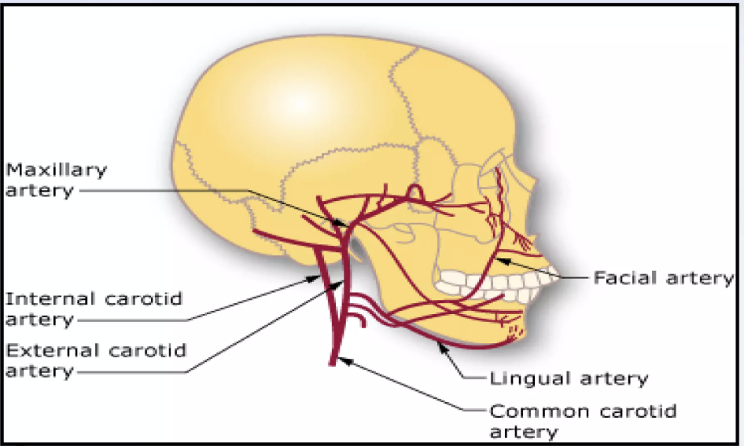
🦷 Relevant Anatomy of the Jaw
Mandible: densely corticated bone with limited collateral vasculature
Blood supply: inferior alveolar artery (main) + periosteal vessels
Periosteum: stripped early in infection → avascular necrosis → sequestrum
Mandible body & angle: poorest blood supply = most vulnerable regions
Maxilla: rich cancellous bone + multiple vascular anastomoses → less susceptible
Maxillary sinus proximity complicates maxillary osteomyelitis
Lingual plate perforation → sublingual / submandibular space involvement
[ Insert: Diagram of
mandible blood supply
& vascular territories ]
⭐ EXAM PEARL: Loss of periosteal blood supply → osteonecrosis → sequestrum formation (hallmark of chronic osteomyelitis)

Slide 6
⚠️ Etiology & Predisposing Factors
Odontogenic Sources
Non-Odontogenic Sources
Periapical abscess (most common)
Periodontal disease
Infected tooth socket
Pericoronal abscess (wisdom tooth)
Failed root canal treatment
Compound fractures of jaw
Haematogenous spread (children)
Infected orthopedic hardware
Contiguous spread from sinusitis
Radiation injury (MRONJ)
Local Predisposing Factors
Systemic Risk Factors
Previous irradiation to jaw
Bisphosphonate therapy (BRONJ)
Paget's disease of bone
Osteopetrosis
Fibrous dysplasia
Diabetes mellitus (commonest)
Immunosuppression / HIV
Malnutrition / anaemia
Sickle cell disease
Alcohol / smoking

Slide 7
📊 Classification of Osteomyelitis
Type | Onset | Features | Management
Acute Suppurative | < 1 month | Pain, swelling, pus, fever, trismus, Vincent's sign | IV antibiotics + I&D
Chronic Suppurative | > 1 month | Sequestrum, fistula, draining sinus, dull pain | Sequestrectomy + long antibiotics
Chronic Focal Sclerosing | Months–years | Condensing osteitis; dense bone around apex; young | Usually observation only
Chronic Diffuse Sclerosing | Long-standing | Widespread sclerosis, cyclical pain, older patients | Long antibiotics ± Hyperbaric O2
Garre's OM (Proliferative Periostitis) | Children/adolescents | Bony expansion; onion-skin X-ray; no pus | Remove causative tooth → resolves
MRONJ / BRONJ | Post-bisphosphonate or radiation | Exposed necrotic bone > 8 weeks; no healing | Conservative + surgery (refractory)

Slide 8
🧬 Pathophysiology
Entry of Bacteria
Medullary Inflammation
1
2
Via periapical abscess, socket, fracture, or haematogenous spread
Acute inflammatory response → oedema → rising intraosseous pressure
Vascular Compromise
Cortical Spread
3
4
Pressure on vessels → ischaemia → necrosis of bone marrow
Pus tracks through Volkmann's canals → periosteum stripped → cortical necrosis
Sequestrum Formation
Chronic Phase
5
6
Dead avascular bone = SEQUESTRUM; reactive new bone shell = INVOLUCRUM
Draining sinuses (cloacae), persistent infection, or resolution with treatment
Prof. Dr. Zahid Mahmood | Osteomyelitis of the Jaws | BDS Lecture

Slide 9
🩺 Clinical Features — Acute Osteomyelitis
🔥
Fever & Systemic Upset
High fever (38–40°C), malaise, leukocytosis, raised ESR and CRP
😣
Severe Throbbing Pain
Deep, boring pain over affected jaw; exquisite tenderness on palpation
😮
Trismus & Swelling
Difficulty opening mouth; facial swelling; indurated overlying skin/mucosa
🦷
Tooth Loosening
Affected teeth become loose and tender to percussion; may extrude from socket
💧
Suppuration
Pus discharge from gingival sulcus; foul odour; fluctuant swelling
😶
Vincent's Sign
Numbness of lower lip/chin — inferior alveolar nerve compression (PATHOGNOMONIC)
⭐ EXAM TIP: Vincent's sign = lower lip/chin numbness = pathognomonic of mandibular osteomyelitis (inferior alveolar nerve compression).

Slide 10
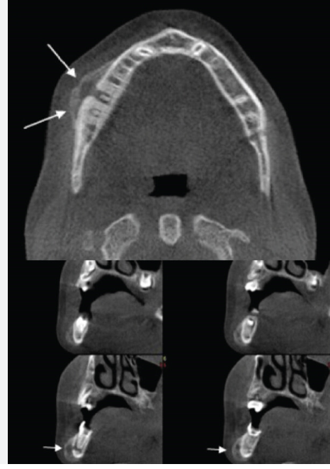
🕐 Clinical Features — Chronic Osteomyelitis
CHRONIC SUPPURATIVE
GARRE'S OSTEOMYELITIS
Dull, persistent aching pain (may be intermittent)
Intra-oral or extra-oral draining sinuses / fistulae
Sequestrum: dead bone visible or palpable in wound
Involucrum: surrounding reactive periosteal bone shell
Cloacae: openings in involucrum through which pus drains
Hard, woody jaw swelling; pathological fracture (severe)
Children / adolescents (< 20 years)
Unilateral bony hard expansion of mandible
Low-grade infection — usually near carious molar
No pus, no fistula, no sequestrum
X-ray: 'onion-skin' periosteal layering (PATHOGNOMONIC)
Treatment: remove causative tooth → resolves completely
Prof. Dr. Zahid Mahmood | Osteomyelitis of the Jaws | BDS Lecture

Slide 11
🧪 Investigations
🔬
OPG (Orthopantomograph)
🔬
CBCT / CT Scan
First-line; wide view of both jaws; available everywhere
Best for extent of disease and cortical destruction
Moth-eaten bone, sequestrum, periosteal reaction — changes lag 2 weeks behind symptoms
3D assessment; plans sequestrectomy; detects early changes missed on OPG
🔬
Plain X-ray (Lateral oblique jaw)
🔬
MRI
Supplements OPG; quick bedside screening
Best for soft tissue & marrow involvement
Bone destruction, pathological fracture assessment
Early oedema in medullary space; soft tissue spread; no radiation
🔬
Bone Scan (Tc-99m)
🔬
Labs: CBC, ESR, CRP, Culture
Nuclear medicine; detects early active disease
Systemic infection markers
Increased uptake in acute OM before X-ray changes appear
Leukocytosis, raised ESR/CRP; pus and bone biopsy culture + sensitivity essential
Prof. Dr. Zahid Mahmood | Osteomyelitis of the Jaws | BDS Lecture

Slide 12
📡 Radiological Features — High Yield
Stage / Type | X-ray / OPG Finding | Clinical Meaning
Acute (< 2 weeks) | Normal X-ray initially | 30–50% bone loss needed before radiological changes appear
Acute (> 2 weeks) | 'Moth-eaten' bone — irregular radiolucency | Medullary bone destruction by spreading infection
Chronic Suppurative | Sequestrum — dense radiopaque fragment within lucency | Dead avascular bone surrounded by pus
Chronic Suppurative | Involucrum — shell of reactive periosteal new bone | Periosteal reaction containing the sequestrum
Garre's OM | 'Onion-skin' periosteal lamination — cortical expansion | Periosteal reactive layering (pathognomonic in young)
Diffuse Sclerosing | Widespread irregular sclerosis of mandible | Cotton-wool or ground-glass dense appearance
Pathological Fracture | Fracture line through diseased bone | Late complication of neglected osteomyelitis

Slide 13
🔀 Differential Diagnosis
Condition | Key Distinguishing Feature | Radiology
Periapical abscess | Localised; no systemic upset; no loose adjacent teeth; no Vincent's sign | Periapical lucency only
Infected odontogenic cyst | Unilocular lucency; corticated margin; no marrow involvement | Well-defined lucency
Fibrous dysplasia | Ground-glass; painless expansion; no infection signs; young | Diffuse ground-glass
Osteosarcoma | Hard painless swelling; sun-ray periosteal reaction; rapid growth; no fever | Sun-burst periosteal
MRONJ / BRONJ | History of bisphosphonates/radiation; exposed necrotic bone; chronic history | May mimic chronic OM
Actinomycosis of jaw | Sulphur granules in pus; woody hard; sinus tracts; responds to penicillin | Multilocular destruction
Burkitt's lymphoma (child) | Floating teeth; massive expansion; rapid growth; no pus; African child | Moth-eaten bone

Slide 14
💊 Management Overview — Flowchart
Patient with jaw osteomyelitis
Assess: Clinical + OPG/CT + Labs + Culture
Medical
Surgical — Acute Phase
Chronic Phase
High-dose IV antibiotics
(Penicillin + Metronidazole)
Analgesics & hydration
Treat underlying cause
Control blood sugar
Airway monitoring
Remove causative tooth
Incision & drainage
Cortical trephination
(decompress medullary pus)
Wound irrigation/debridement
Sequestrectomy
Saucerisation
Decortication
Bone grafting
Hyperbaric O2 (MRONJ)
Jaw resection (rare)
Prof. Dr. Zahid Mahmood | Osteomyelitis of the Jaws | BDS Lecture

Slide 15
💉 Antibiotic Therapy — Practical Guide
Setting | First-Line Antibiotic | Alternative | Duration
Acute OM (mild) | Amoxicillin/Clavulanate 625 mg TDS PO | Clindamycin 300 mg TDS PO | 4–6 weeks
Acute OM (severe/IV) | Benzylpenicillin 1.2g QDS IV + Metronidazole 500 mg TDS IV | Clindamycin 600 mg TDS IV | IV 2 wks then PO 4 wks
Chronic OM | Clindamycin 300–450 mg QDS PO (excellent bone penetration) | Rifampicin combination (biofilm-active) | 6–12 weeks minimum
MRONJ / Radiation OM | Amoxicillin/Clav + Metronidazole | Doxycycline (anti-collagenase) | Long-term; culture-guided
Penicillin allergy | Clindamycin 300–600 mg TDS/QDS | Erythromycin + Metronidazole | As above per stage

Slide 16
⚔️ Surgical Management — Procedures
🦷
Remove Causative Tooth
Acute
🔪
Incision & Drainage
Acute
First step — opens drainage and removes nidus of infection; allows spontaneous drainage
Intra- or extra-oral I&D; decompress abscess; pack open; irrigate with saline/antiseptic
🦴
Cortical Trephination
Acute/refractory
🪓
Sequestrectomy
Chronic
Drill holes through cortex to decompress medullary pus; relieves throbbing pain rapidly
Removal of sequestrum once demarcated; curette surrounding granulation tissue; culture
🫙
Saucerisation / Decortication
Chronic diffuse
🧬
Bone Graft / Jaw Resection
Severe / MRONJ
Remove infected/necrotic cortex; saucer shape improves blood supply; chronic diffuse OM
Segmental resection for extensive OM; later reconstruct with bone graft or free fibula flap

Slide 17
🚨 Complications of Untreated Osteomyelitis
💔
Pathological Fracture
HIGH
😷
Deep Space Infection
CRITICAL
Bone weakened by necrosis fractures with minimal trauma; requires fixation + OM treatment
Spread to masticator, sublingual, submandibular spaces → Ludwig's angina (life-threatening)
🎗️
Orocutaneous Fistula
MED
🦷
Growth Disturbance (Children)
MED
Chronic draining sinuses connecting diseased bone to skin or oral mucosa; disfiguring
Condyle involvement → facial asymmetry and micrognathia in growing children
😶
Permanent Nerve Damage
MED
📈
Malignant Transformation
HIGH
Inferior alveolar nerve → permanent lower lip numbness; severe: anaesthesia dolorosa
Rare — longstanding chronic OM may undergo squamous cell carcinoma transformation (Marjolin's)

Slide 18
💊 Special Entity: MRONJ / BRONJ
MRONJ = Medication-Related Osteonecrosis of the Jaw
(bisphosphonates, denosumab, antiangiogenics → avascular jaw necrosis without radiation)
AAOMS DIAGNOSTIC CRITERIA:
1. Current or previous treatment with antiresorptive or antiangiogenic agents
2. Exposed bone / bone that can be probed through fistula in maxillofacial region
3. Persisting for > 8 weeks
4. No history of radiation therapy to jaws or obvious metastatic disease
Stage 0
Stage 1
Stage 2
Stage 3
No exposed bone; non-specific symptoms only; radiological changes
Exposed bone; no infection; asymptomatic
Exposed bone + infection; pain, redness, swelling, pus
Exposed bone + fracture/fistula/osteolysis to border/sinus involvement

Slide 19
📋 Clinical Case Scenario
📖 CASE VIGNETTE
A 55-year-old male with poorly controlled diabetes presents with 3 weeks of deep boring pain in the right mandible, high fever, and right cheek swelling. He had a lower right molar extracted 1 month ago. On examination: trismus (2.5 cm), tender right submandibular swelling, loose adjacent teeth, numbness of right lower lip, and pus discharging from the socket. Blood glucose: 16 mmol/L.
Q1: Most likely diagnosis?
Answer: Acute osteomyelitis of the right mandible (odontogenic — post-extraction)
Q2: Which sign is present and its significance?
Answer: Vincent's sign (lower lip numbness) — inferior alveolar nerve compression; pathognomonic of mandibular OM
Q3: Most important predisposing factor?
Answer: Poorly controlled diabetes mellitus — impaired neutrophil function and poor wound healing
Q4: Outline immediate management.
Answer: Admit → IV Benzylpenicillin + Metronidazole → control blood glucose → I&D → OPG/CT → culture → surgical debridement
Prof. Dr. Zahid Mahmood | Osteomyelitis of the Jaws | BDS Lecture

Slide 20
🎓 Viva Questions & OSCE Points
🎤 Common Viva Questions
📝 OSCE Station Tips
1. Define osteomyelitis. Why mandible > maxilla?
2. What is Vincent's sign and its significance?
3. Differentiate sequestrum from involucrum from cloaca.
4. What is Garre's osteomyelitis? Who is affected?
5. Why do X-ray changes lag in acute OM?
6. What is the pathognomonic X-ray sign of Garre's OM?
7. Name the antibiotic of choice for chronic OM.
8. What is MRONJ? State AAOMS criteria.
9. List complications of untreated osteomyelitis.
10. Manage OM in a diabetic patient.
• Identify moth-eaten bone on OPG and describe findings
• Identify onion-skin pattern — Garre's OM
• Identify exposed necrotic bone (MRONJ) in clinical photo
• Prescribe: Benzylpenicillin + Metronidazole IV doses
• Diagram: label sequestrum, involucrum, cloaca
• Demonstrate bimanual palpation of submandibular region
• Short case: differential of moth-eaten bone on OPG
• State AAOMS staging of MRONJ (Stage 0–3)
Prof. Dr. Zahid Mahmood | Osteomyelitis of the Jaws | BDS Lecture

Slide 21
📝 MCQ Revision Questions
Q1. The most common cause of osteomyelitis of the mandible is:
Answer: B
A. Haematogenous spread | B. Periapical abscess (odontogenic) | C. Compound mandibular fracture | D. Actinomycosis
Q2. Vincent's sign in osteomyelitis refers to:
Answer: B
A. Trismus | B. Numbness of lower lip/chin | C. Pus from gingival sulcus | D. Pathological fracture
Q3. Onion-skin periosteal reaction on OPG is characteristic of:
Answer: C
A. Chronic suppurative OM | B. Osteosarcoma | C. Garre's osteomyelitis | D. MRONJ
Q4. Antibiotic with best bone penetration for chronic osteomyelitis:
Answer: C
A. Amoxicillin | B. Tetracycline | C. Clindamycin | D. Erythromycin
Prof. Dr. Zahid Mahmood | Osteomyelitis of the Jaws | BDS Lecture

Slide 22
⭐ Key Take-Home Messages
Mandible is affected in 80–90% of jaw OM due to dense cortex and limited collateral blood supply from inferior alveolar artery.
Vincent's sign = lower lip/chin numbness = inferior alveolar nerve compression = PATHOGNOMONIC of mandibular osteomyelitis.
01
02
X-ray changes lag 10–14 days in acute OM. Treat clinically. CT and bone scan detect earlier disease than plain X-ray.
Sequestrum = dead avascular bone. Involucrum = periosteal new bone shell. Cloaca = openings for pus drainage.
03
04
Garre's OM = onion-skin periosteal pattern in children. Remove the causative tooth → resolves completely.
MRONJ: exposed bone > 8 weeks + antiresorptive drug history. Prevention = dental clearance BEFORE starting bisphosphonates.
05
06
Prof. Dr. Zahid Mahmood | Osteomyelitis of the Jaws | BDS Lecture

Slide 23
Thank You
شکریہ — جَزَاکَ اللّٰہُ خَیْرًا
Prof. Dr. Zahid Mahmood
Professor of Surgery — LMDC
Visiting Surgeon: Hameed Latif Hospital (6–8 PM) | Ghurki Trust Teaching Hospital (Tue/Thu 9 AM–1 PM)
📞 03004130159 | 🌐 professorzahid.com
"A tooth saved early prevents a bone lost later"

