Slide 1



Introduction to Protozoal Infections
Protozoal infections are caused by single-celled eukaryotic organisms that can inhabit various parts of the human body, including the gastrointestinal tract, bloodstream, and tissues. These infections can have significant implications in surgical practice, leading to complications and affecting patient outcomes.
by Prof.Zahid Mahmood

Slide 2

Importance of Protozoal Infections in Surgical Practice
1
Increased Risk of Complications
2
Impact on Wound Healing
Certain protozoal infections, such as amebiasis, can directly affect wound healing processes, potentially leading to delayed recovery or even surgical site breakdown.
Protozoal infections can compromise the immune system, leading to a higher risk of surgical site infections and other postoperative complications.
3
Diagnostic Challenges
Protozoal infections can be difficult to diagnose, as they may present with non-specific symptoms, making it crucial for surgeons to have a high index of suspicion.

Slide 3
Common Protozoal Infections: Giardiasis, Amoebiasis, Malaria
Giardiasis
Amoebiasis
Malaria
Caused by the protozoan Giardia lamblia, this infection primarily affects the small intestine, leading to diarrhea, abdominal pain, and malabsorption.
Caused by the protozoan Entamoeba histolytica, this infection can lead to dysentery, liver abscesses, and potentially life-threatening complications.
Caused by Plasmodium parasites, this infection primarily affects the liver and red blood cells, leading to fever, chills, and potentially severe complications.

Slide 4
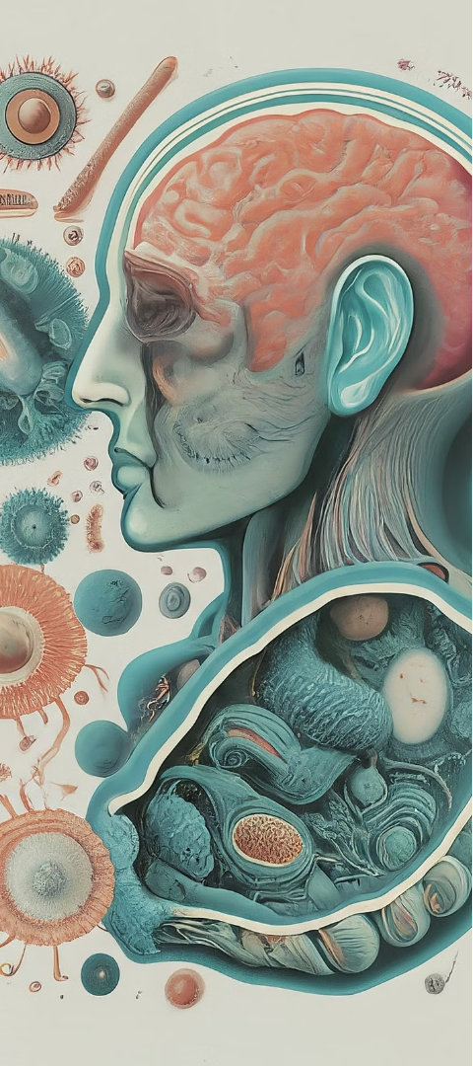
Pathogenesis and Clinical Manifestations
1
Infection and Invasion
Protozoal parasites gain entry into the human body through various routes, such as ingestion, insect bites, or direct contact, and then invade specific tissues or organs.
2
Immune Response
The body's immune system attempts to combat the protozoal infection, leading to inflammation and tissue damage, which can contribute to clinical symptoms.
3
Systemic Effects
Depending on the type of protozoa, the infection can lead to a wide range of systemic effects, such as gastrointestinal, hepatic, or neurological manifestations.

Slide 5




Diagnostic Approaches
Clinical Presentation
Analyzing the patient's symptoms and medical history can provide valuable clues for diagnostic suspicion.
Laboratory Tests
Microscopic examination of stool samples, blood smears, or other clinical specimens can help identify the specific protozoan parasite.
Imaging Techniques
Imaging modalities, such as ultrasonography or CT scans, can detect organ-specific manifestations, like liver abscesses in amoebiasis.

Slide 6
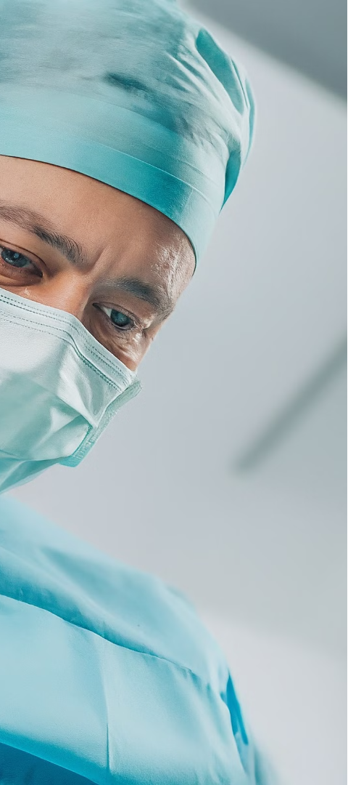
Surgical Implications and Management
Preoperative Considerations
Perioperative Management
Identifying and treating any active protozoal infections prior to surgery can help reduce the risk of complications and promote better surgical outcomes.
Appropriate antiprotozoal medications, along with supportive care, may be necessary to manage protozoal infections during the surgical process.
Postoperative Complications
Surgeons should be vigilant for any signs of protozoal-related complications, such as delayed wound healing or organ abscesses, and address them promptly.

Slide 7



Prevention and Control Strategies
Improved Hygiene
Vector Control
Vaccination
Practicing good hand hygiene and maintaining proper sanitation can help reduce the risk of transmitting protozoal infections.
Implementing measures to control insect vectors, such as mosquitoes for malaria, can prevent the transmission of protozoal infections.
Vaccines, where available, can provide protection against certain protozoal infections, reducing the burden of disease.

Slide 8


Conclusion and Key Takeaways
Protozoal infections can have significant implications in surgical practice, leading to increased risks of complications, delayed wound healing, and diagnostic challenges. Awareness of common protozoal infections, their pathogenesis, and appropriate management strategies is crucial for surgeons to provide optimal care and improve patient outcomes.

