Slide 1

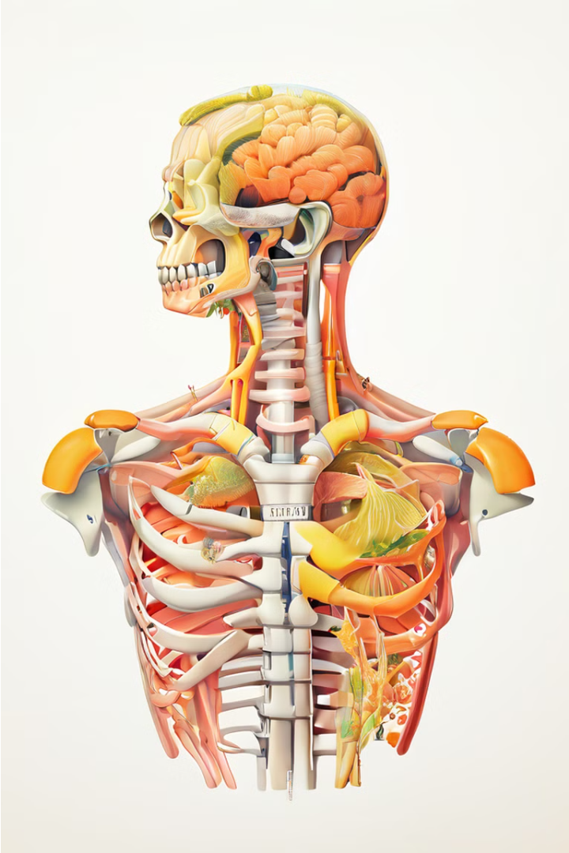

Introduction to Neck Dissections
Neck dissections are a crucial surgical procedure in the management of head and neck cancers. This presentation will provide a comprehensive overview of the anatomy, key landmarks, and essential structures involved in neck dissections. By understanding these concepts, medical students can develop the necessary skills to perform safe and effective neck surgeries.
by Prof.Zahid Mahmood

Slide 2
Anatomy of the Neck
The neck is a complex region, containing essential structures such as the thyroid gland, larynx, pharynx, and numerous blood vessels and nerves. Mastering the intricate anatomy of the neck is vital for successful neck dissections and avoiding critical complications.
Layers of the Neck
Lymphatic System
The neck is divided into distinct anatomical layers, including the superficial fascia, platysma muscle, and deep cervical fascia. Understanding these layers is crucial for safe surgical access.
The lymphatic drainage of the neck plays a significant role in the spread of head and neck cancers. Thorough examination of the lymph nodes is a critical component of neck dissections.
1
2
3
Vital Structures
Key structures in the neck include the carotid arteries, jugular veins, brachial plexus, and cranial nerves. Careful identification and preservation of these structures is essential during dissection.

Slide 3
Surgical Landmarks and Incisions
Identifying key anatomical landmarks is essential for planning the appropriate surgical approach and incisions during neck dissections. Precise incisions allow for optimal exposure and access to the target structures.
Landmarks
Incisions
Surgical Techniques
Important landmarks include the sternocleidomastoid muscle, carotid artery, and cricoid cartilage. These serve as guides for locating deeper structures and planning the surgical approach.
Common incisions used in neck dissections include the hockey-stick, apron, and extended apron incisions. The choice of incision depends on the specific surgical goals and the extent of the dissection required.
Neck dissections often involve techniques such as sharp dissection, blunt dissection, and electrocautery to carefully separate and expose the target structures. Meticulous surgical technique is crucial to minimize complications.

Slide 4
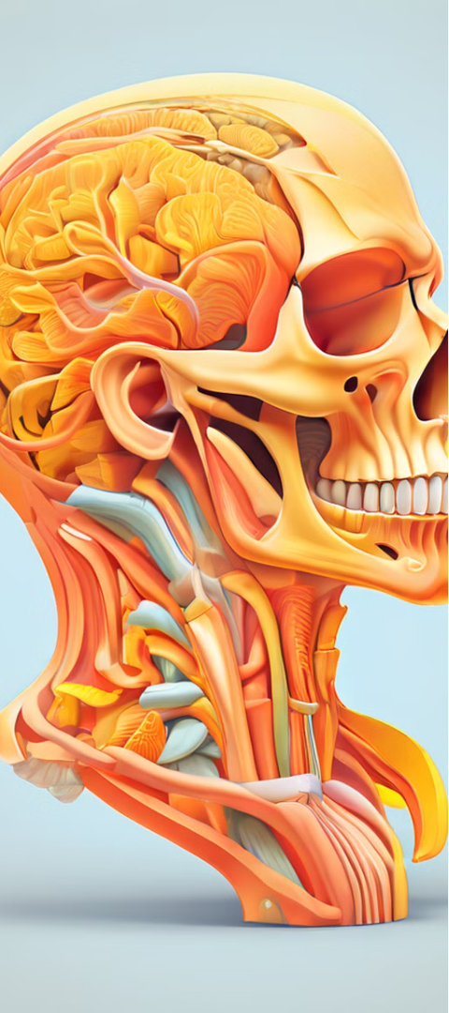
Superficial Structures of the Neck
The superficial structures of the neck include the skin, subcutaneous tissue, platysma muscle, and sternocleidomastoid muscle. Understanding the anatomy and surgical relevance of these structures is essential for safe and effective neck dissections.
1
Skin and Subcutaneous Tissue
2
Platysma Muscle
The platysma muscle is a thin, sheet-like muscle that covers the anterior and lateral aspects of the neck. It must be identified and divided during neck dissections.
The skin and subcutaneous tissue of the neck must be carefully incised and dissected to access the deeper structures.
3
Sternocleidomastoid Muscle
The sternocleidomastoid muscle is a landmark structure that serves as a guide to the deeper neurovascular structures in the neck.

Slide 5
Deep Structures of the Neck
The deep structures of the neck, including the carotid sheath, thyroid gland, and larynx, are critical to identify and preserve during neck dissections. Meticulous dissection and careful handling of these structures are essential to avoid serious complications.
Carotid Sheath
Thyroid Gland
The carotid sheath contains the carotid artery, internal jugular vein, and vagus nerve. Careful dissection is required to isolate and protect these vital structures.
The thyroid gland is a highly vascular structure that must be identified and carefully separated from the surrounding tissues during neck dissections.
Larynx and Pharynx
Nerves and Muscles
The larynx and pharynx are delicate structures that must be meticulously dissected and preserved to maintain the patient's ability to swallow and speak.
Cranial nerves, such as the spinal accessory nerve and the recurrent laryngeal nerve, as well as the infrahyoid muscles, must be identified and protected during neck dissections.

Slide 6




Lymph Nodes and Lymphatic Drainage
The lymphatic system plays a crucial role in the spread of head and neck cancers, making the thorough examination and dissection of lymph nodes an essential component of neck dissections.
Levels of the Neck
Neck lymph nodes are organized into distinct levels, each with its own clinical significance in terms of cancer staging and treatment.
Lymphatic Drainage
Understanding the complex lymphatic drainage patterns of the neck is critical for identifying and removing all potentially involved lymph nodes.
Surgical Approach
Neck dissections may involve selective, modified radical, or radical approaches, depending on the extent of lymph node involvement and the specific clinical scenario.

Slide 7


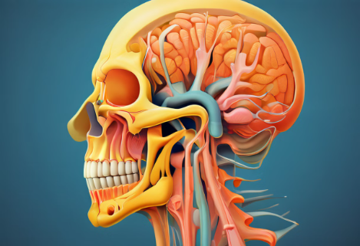
Cranial Nerves and their Importance
The cranial nerves that traverse the neck region are critical structures that must be identified and preserved during neck dissections to avoid serious complications, such as paralysis or sensory deficits.
Spinal Accessory Nerve
Vagus Nerve
The spinal accessory nerve (CN XI) controls the sternocleidomastoid and trapezius muscles, and must be carefully dissected and preserved.
The vagus nerve (CN X) provides innervation to the pharynx, larynx, and other vital structures, and must be identified and protected.
Recurrent Laryngeal Nerve
The recurrent laryngeal branch of the vagus nerve controls the laryngeal muscles, and its preservation is crucial to maintain the patient's voice and swallowing function.
Other Cranial Nerves
Additional cranial nerves, such as the hypoglossal nerve (CN XII) and the glossopharyngeal nerve (CN IX), may also be encountered and must be carefully identified and preserved.

Slide 8
Conclusion and Key Takeaways
In conclusion, neck dissections are a complex and critical surgical procedure that require a thorough understanding of the neck's anatomy, key landmarks, and essential structures. By mastering these concepts, medical students can develop the necessary skills to perform safe and effective neck surgeries, ultimately improving patient outcomes.
Comprehensive Anatomy Knowledge
Detailed understanding of the superficial and deep structures of the neck is essential for successful neck dissections.
Identification of Surgical Landmarks
Recognizing key anatomical landmarks is crucial for planning appropriate surgical approaches and incisions.
Preservation of Critical Structures
Meticulous dissection and careful handling of vital structures, such as nerves and blood vessels, are critical to avoid serious complications.
Thorough Lymph Node Evaluation
Comprehensive examination and dissection of the lymphatic system is a vital component of neck dissections for cancer management.

