Slide 1
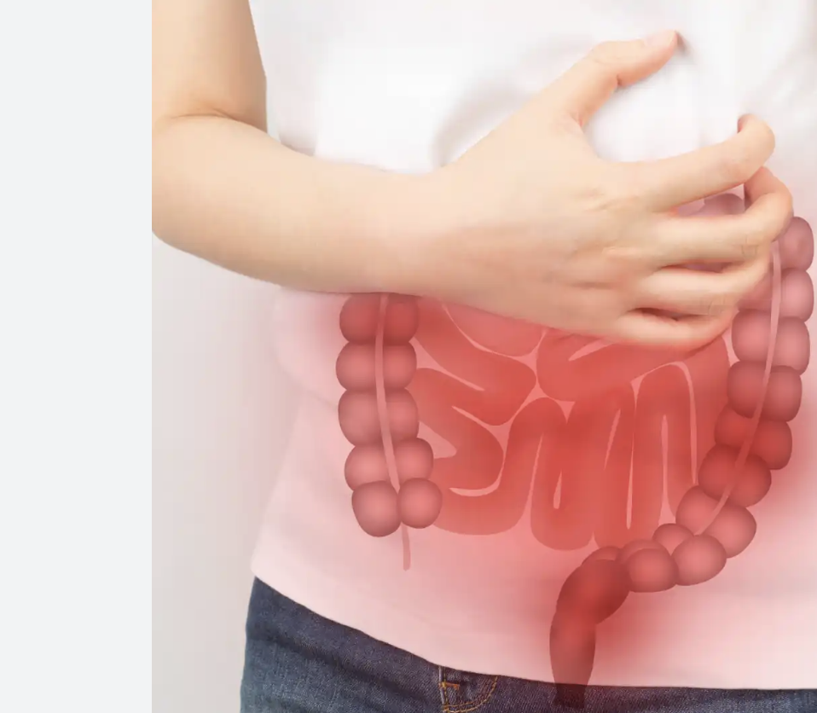

Slide 2
Intestinal Obstruction
بسم الله الرحمن الرحيم
Prof. Zahid Mahmood

Slide 3
Guess Diagnosis
A 55-year-old male presents with abdominal pain
Vomiting and abdominal distension for two days
No passage of stool or flatus reported
What is your provisional diagnosis
Intestinal Obstruction

Slide 4
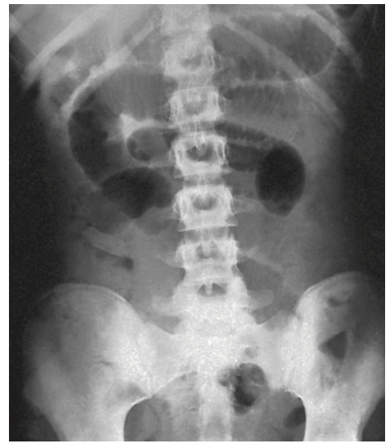
Distended Loops

Slide 5
Learning Outcomes
Understand types of intestinal obstruction clearly
Recognize causes and pathophysiology mechanisms
Identify clinical features and complications early
Outline principles of management and surgery

Slide 6
Definition
Intestinal obstruction is impaired passage of contents
May be mechanical or functional in origin
Leads to accumulation of gas and fluids
Results in distension and systemic effects

Slide 7
Classification
Dynamic obstruction involves active peristalsis present
Adynamic obstruction lacks effective bowel motility
Dynamic may be acute or chronic type
Adynamic includes ileus and pseudo-obstruction

Slide 8
Causes of Dynamic Obstruction
Intraluminal causes include Faecal impaction, bezoars
Intramural causes include strictures and malignancy
Extramural causes include adhesions and hernia
Volvulus and intussusception also important

Slide 9
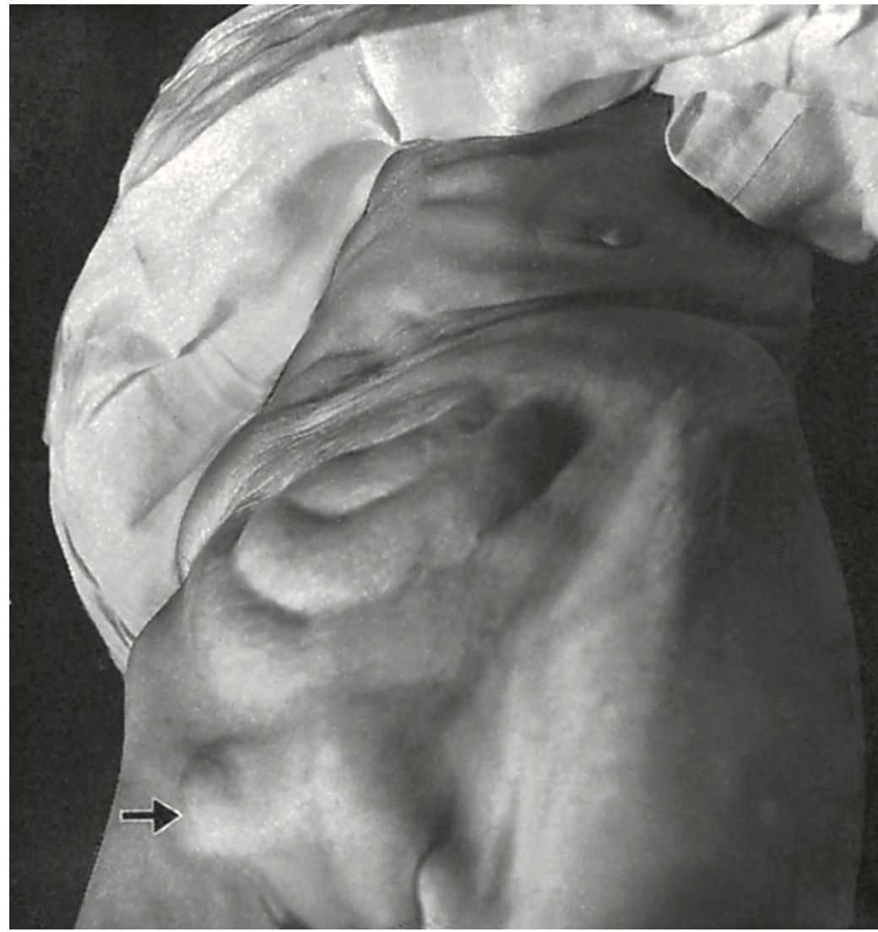

Slide 10
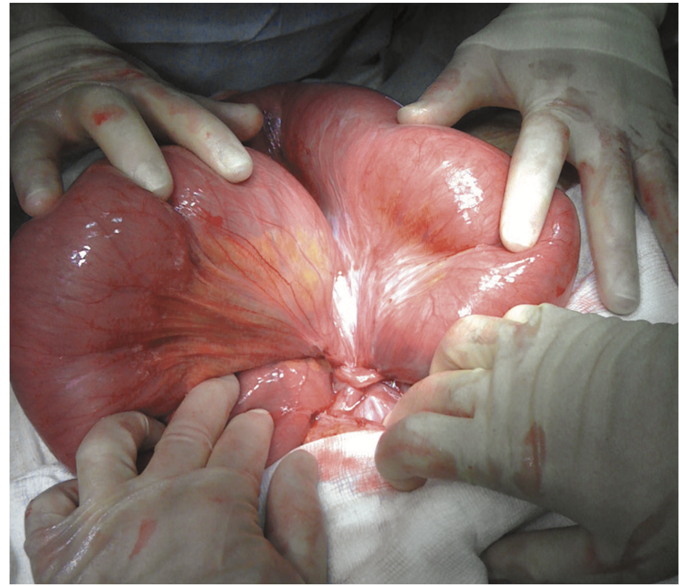

Slide 11
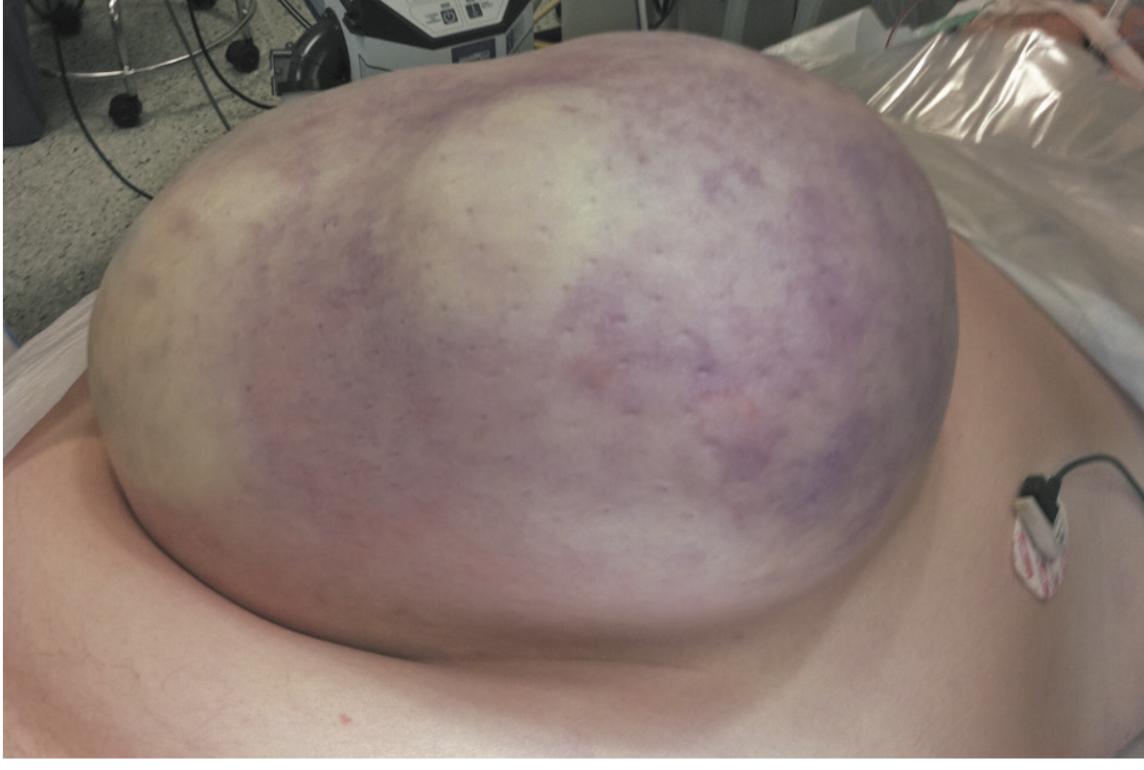

Slide 12
Causes of Adynamic Obstruction
Paralytic ileus common after abdominal surgery
Electrolyte imbalance may reduce bowel motility
Peritonitis and sepsis also important causes
Pseudo-obstruction mimics mechanical obstruction clinically

Slide 13
Pathophysiology
Proximal bowel dilates due to accumulation
Distal bowel collapses after emptying
Initial peristalsis increases to overcome obstruction
Later bowel becomes paralysed and flaccid

Slide 14
Gas and Fluid Changes
Gas mainly nitrogen and hydrogen sulphide
Fluid includes gastric, biliary, pancreatic secretions
Fluid sequestration leads to dehydration
Electrolyte imbalance worsens clinical condition

Slide 15
Strangulation
Blood supply becomes compromised causing ischemia
Venous obstruction occurs before arterial compromise
Leads to necrosis and perforation
Life-threatening surgical emergency condition

Slide 16
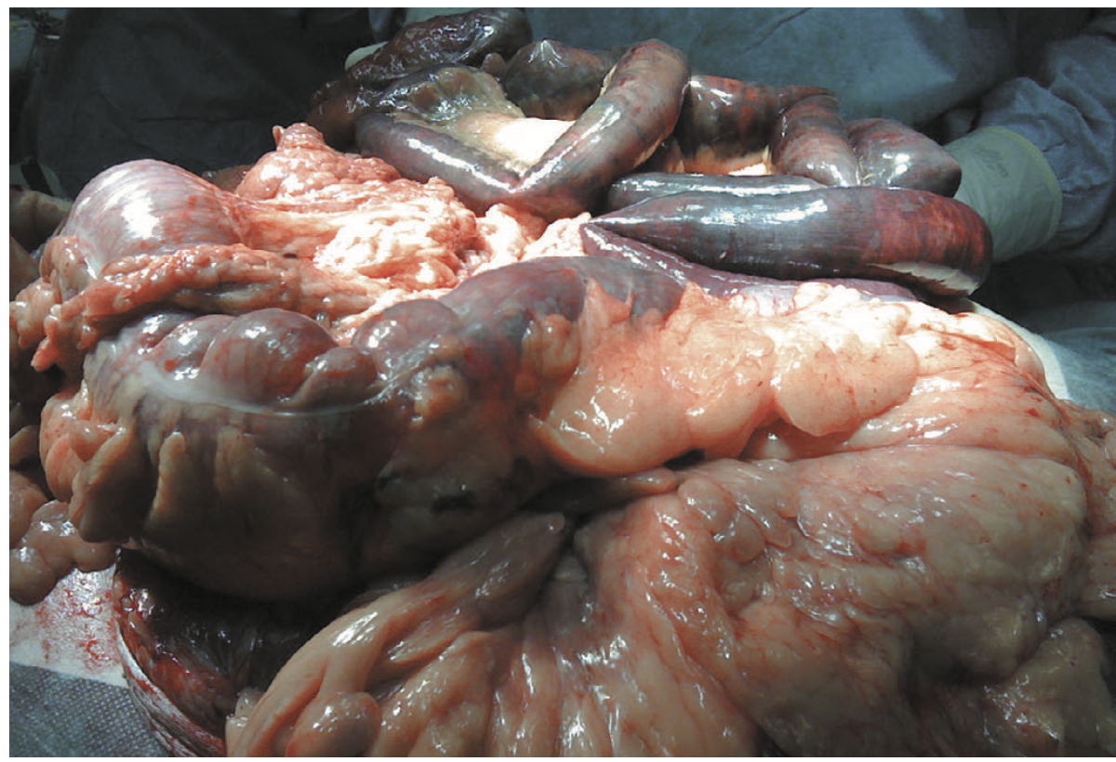

Slide 17
Causes of Strangulation
Hernial orifices cause direct bowel compression
Adhesions and bands also major contributors
Volvulus interrupts mesenteric blood flow
Closed-loop obstruction increases intraluminal pressure

Slide 18
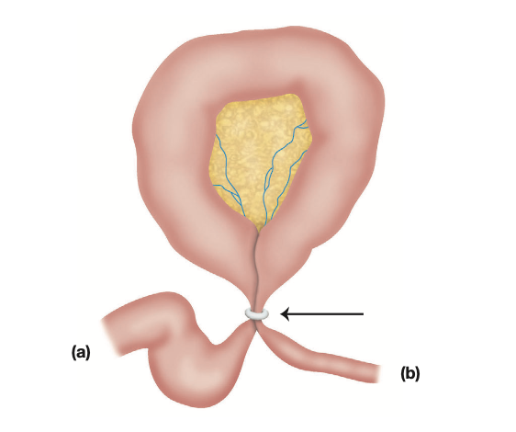
Closed Loop Obstruction
Bowel obstructed at two points simultaneously
Distension confined to isolated bowel segment
Rapid increase in intraluminal pressure occurs
High risk of ischemia and perforation

Slide 19
Adhesions
Postoperative adhesions commonest cause worldwide
Form due to peritoneal irritation and fibrin
May be flimsy or dense fibrous
Usually involve lower small bowel

Slide 20
Prevention of Adhesions
Gentle
Gentle tissue handling during surgery essential
Minimize
Minimize contact with gauze and foreign material
Wash
Wash peritoneal cavity with saline solution
Cover
Cover raw peritoneal surfaces carefully

Slide 21
Intussusception
Proximal bowel invaginates into distal segment
Common in children, rare in adults
Lead point often present in adults
May cause obstruction and ischemia

Slide 22
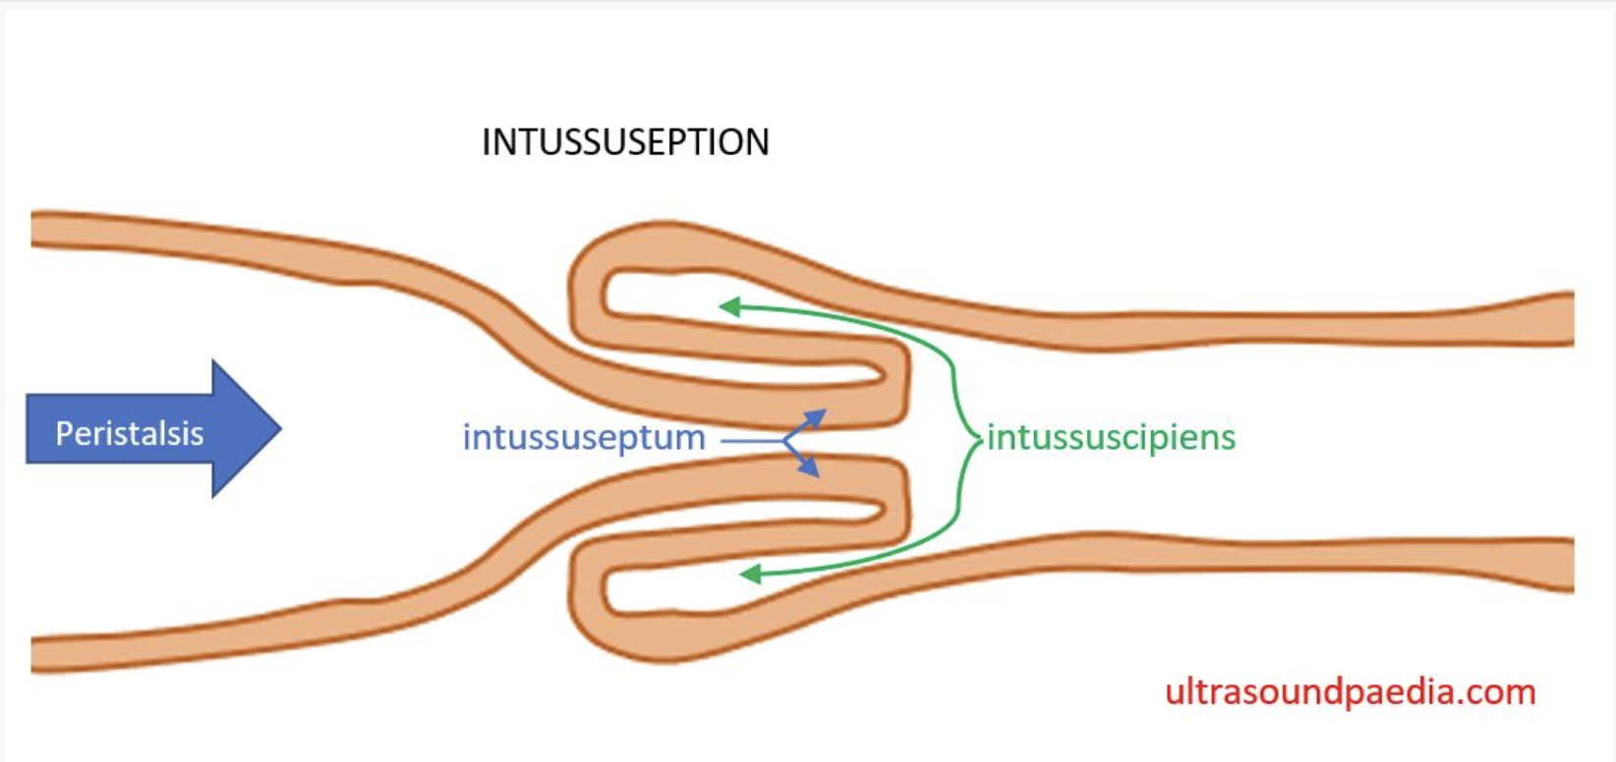

Slide 23
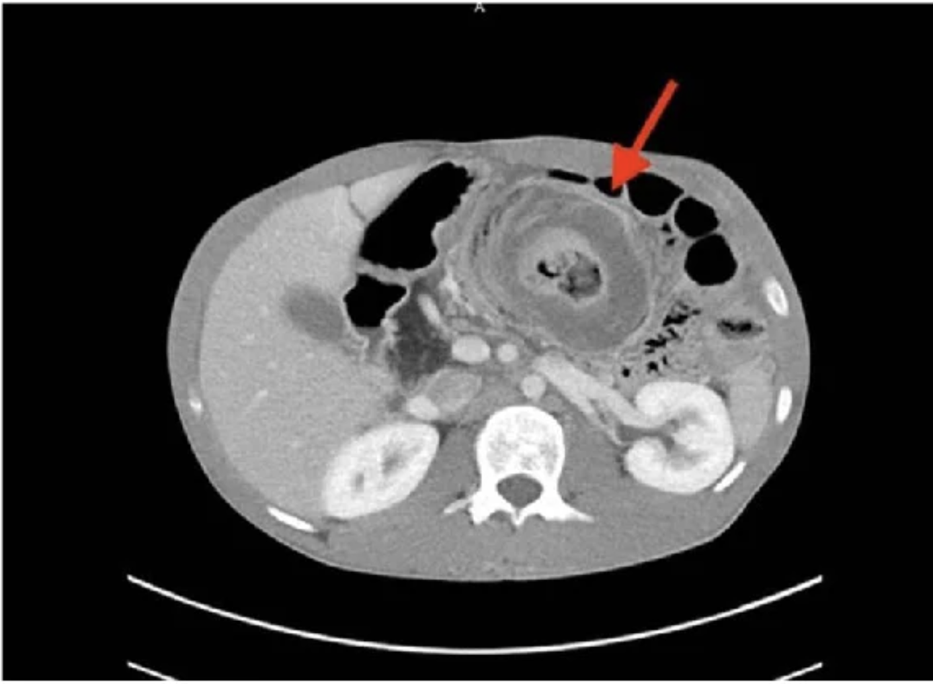
Target Sign

Slide 24
Volvulus
Twisting of bowel around mesentery occurs
Leads to obstruction and vascular compromise
Common sites sigmoid colon and caecum
Sigmoid volvulus common in elderly patients

Slide 25
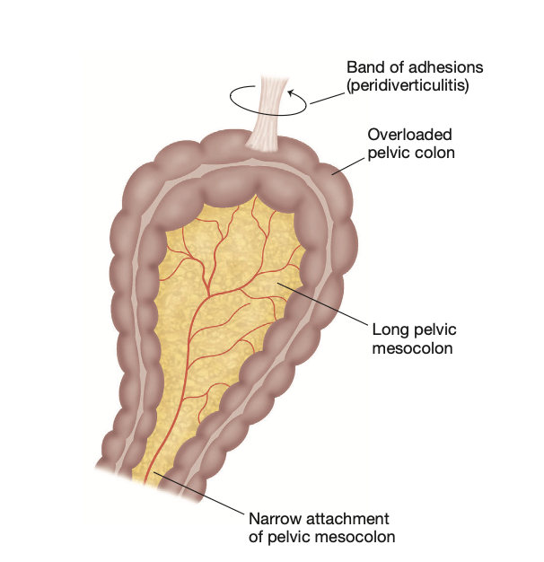

Slide 26
Cardinal Features
Abdominal pain is colicky in nature
Vomiting occurs depending on obstruction level
Distension varies with site of obstruction
Absolute constipation is key diagnostic feature

Slide 27
Small vs Large Bowel Obstruction
Small bowel vomiting occurs early and severe
Large bowel distension more prominent early
Pain more severe in small bowel obstruction
Vomiting late in large bowel obstruction

Slide 28
Pain Characteristics
Colicky pain due to peristaltic contractions
Becomes constant with bowel distension
Severe continuous pain suggests strangulation
Pain location depends on obstruction site

Slide 29
Vomiting Features
Early vomiting in proximal obstruction cases
Late vomiting in distal obstruction cases
Feculent vomiting indicates advanced obstruction
Leads to dehydration and electrolyte imbalance

Slide 30
Distension and Constipation
Distension more in distal obstruction cases
Visible peristalsis may be seen clinically
Absolute constipation indicates complete obstruction
Partial obstruction may still pass flatus

Slide 31
Dehydration
Dry tongue and sunken eyes present
Reduced urine output indicates severity
Raised urea and hematocrit observed
Fluid loss due to vomiting and sequestration

Slide 32
Strangulation Signs
Severe continuous abdominal pain present
Localized tenderness with guarding observed
Shock indicates advanced ischemia
Requires urgent surgical intervention

Slide 33
Examination Findings
High-pitched bowel sounds heard initially
Later bowel sounds become absent
Check all hernial orifices carefully
Look for abdominal tenderness and rigidity

Slide 34
X-ray Findings
Dilated bowel loops seen on radiograph
Jejunum shows valvulae conniventes pattern
Colon shows haustral markings irregular
Multiple fluid levels indicate obstruction

Slide 35
CT Scan Role
Most accurate imaging modality currently
Identifies level and cause of obstruction
Helps detect ischemia and complications
Guides decision for surgical intervention

Slide 36
Initial Management
Nasogastric tube for decompression inserted
Fluid resuscitation with saline or Hartmann’s
Correct electrolyte imbalance promptly
Monitor urine output and vital signs

Slide 37
Indications for Surgery
Strangulation requires immediate surgical intervention
Obstructed hernia needs urgent operation
Failure of conservative treatment indicates surgery
Closed-loop obstruction always requires surgery

Slide 38
Surgical Principles
Relieve obstruction and restore bowel continuity
Assess bowel viability carefully intraoperatively
Resect non-viable bowel segments promptly
Prevent further complications and recurrence

Slide 39
Adhesive Obstruction Management
Initial
Initial conservative treatment with NG decompression
Continue
Continue observation up to seventy-two hours
Operate
Operate if no improvement or deterioration
Divide
Divide only causative adhesions carefully

Slide 40
Summary
Pain, vomiting, distension, constipation key features
Strangulation is surgical emergency always
Adhesions most common cause worldwide
Early diagnosis improves patient outcomes significantly

Slide 41
A 35-year-old otherwise healthy woman presents with acute onset colicky abdominal pain and vomiting. CT confirms caecal volvulus. The on-call registrar plans colonoscopic decompression as first-line treatment.
Which statement best describes the management of caecal volvulus compared to sigmoid volvulus?
A. Caecal volvulus responds better to colonoscopic decompression than sigmoid volvulus
B. Both are managed identically with colonoscopic decompression
C. Caecal volvulus: endoscopic decompression is often unsuccessful and causes treatment delay — urgent surgery is preferred
D. Caecal volvulus is managed with a flatus tube for 2–5 days
E. Caecal volvulus requires Hartmann's procedure in all cases
Key c

