Slide 1
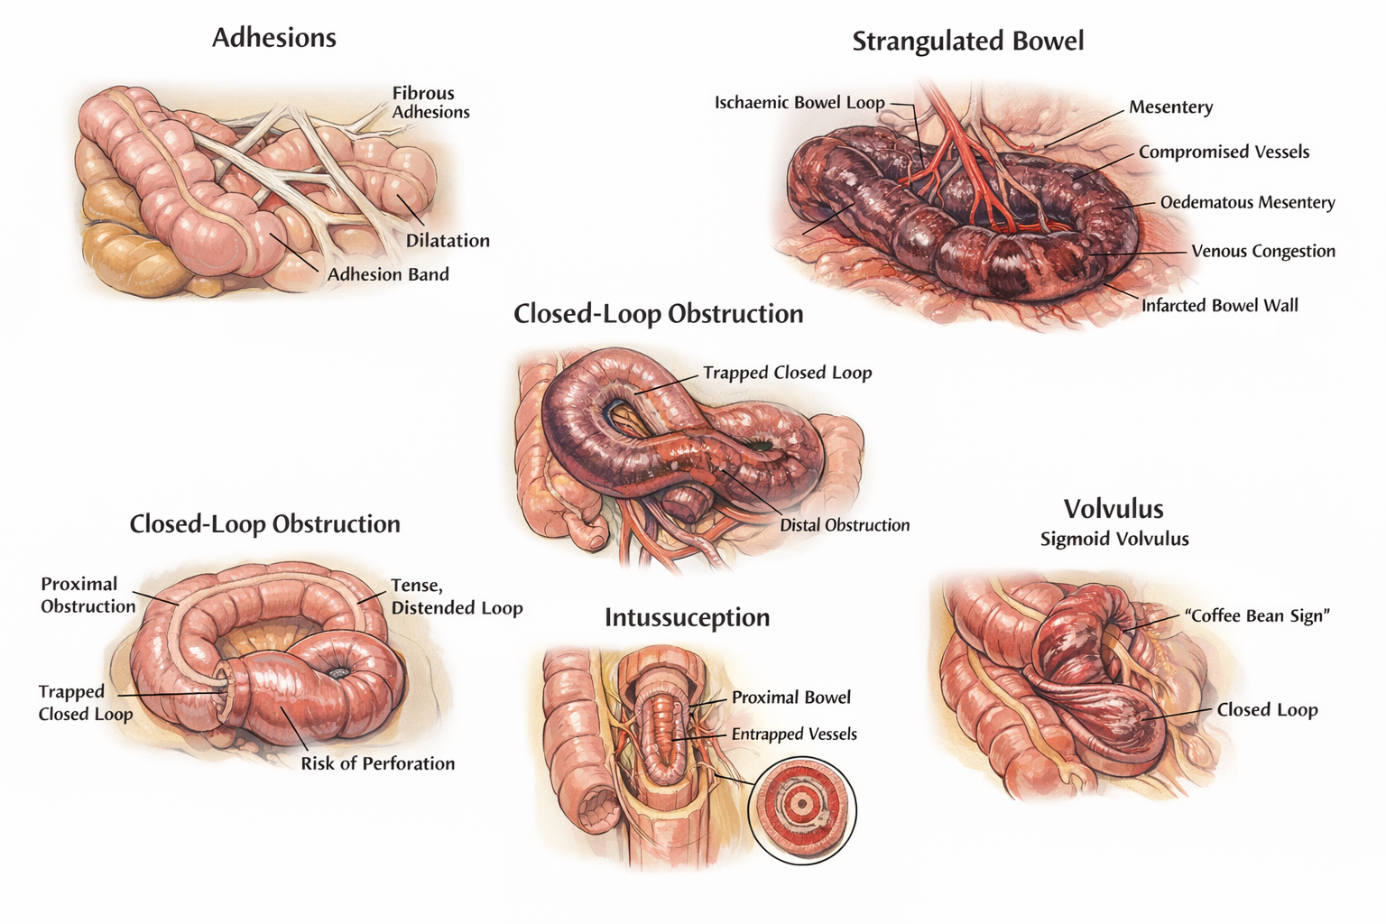
Key Surgical Diagrams: Intestinal Obstruction

