Slide 1

INTESTINAL OBSTRUCTION
Prof. Zahid Mahmood

Slide 2
⚡ CLINICAL SCENARIO
The Surgical Emergency
?
  60yr male — post-appendicectomy scar
  Colicky central pain since early morning
  Profuse vomiting; not passed flatus
  AXR: dilated central small bowel loops
  What is your diagnosis & management?
Most common cause of SBO?
ADHESIONS (40%)

Slide 3
DEFINITION & CLASSIFICATION
DYNAMIC (MECHANICAL OBSTRUCTION)
  Peristalsis works against a physical blockage
  Types: intraluminal, intramural, extramural
  Adhesions 40% SBO; risk of strangulation
ADYNAMIC (FUNCTIONAL OBSTRUCTION)
  No physical block — peristalsis is absent
  Paralytic ileus: post-op, sepsis, metabolic
  Pseudo-obstruction = Ogilvie's syndrome

Slide 4
AETIOLOGY — SBO vs LBO 📊
SMALL BOWEL OBSTRUCTION
LARGE BOWEL OBSTRUCTION
CAUSE | FREQ
Adhesions & Bands | 40%
External Hernia | 12%
Crohn's / Inflammatory | 15%
Carcinoma | 15%
Faecal Impaction | 8%
Pseudo-obstruction | 5%
Miscellaneous | 5%
CAUSE | NOTES
Carcinoma (~60%) | Most common
Diverticular Disease | Stricture
Sigmoid Volvulus | Elderly
Pseudo-obstruction | Ogilvie's
Faecal Impaction | Elderly
Hernia / Other | Rare
⭐ Adhesions = #1 SBO | Carcinoma = #1 LBO | Both carry strangulation risk

Slide 5
PATHOPHYSIOLOGY — MECHANICAL OBSTRUCTION
  Proximal dilates; distal empties
  Gas = 90% N₂ + H₂S (bacteria)
  Untreated → strangulation
FLUID / 24 HOURS
Source | Volume
Saliva | 500 mL
Bile | 500 mL
Pancreatic | 500 mL
Gastric | 1,000 mL
Intestinal | ~4,500 mL
TOTAL | ~7 Litres
DEHYDRATION CAUSES: ↓ oral intake • defective absorption • vomiting • bowel sequestration • peritoneal transudation

Slide 6
PATHOPHYSIOLOGY — PROGRESSION FLOWCHART 🔄
CONSEQUENCES
• Dehydration & shock
• Electrolyte imbalance
• Bowel ischaemia
• Bacterial translocation
• Systemic sepsis
• Multi-organ failure
Mechanical Obstruction
KEY FACTS
• N₂ = 90% bowel gas
• Venous before arterial
• Caecum highest risk
• Closed-loop = danger
• Reperfusion injury
• No colic in ileus
Proximal Dilation + Gas Accumulation
Fluid Sequestration + Bacterial Growth
Dehydration + Electrolyte Imbalance
Raised Intraluminal Pressure
Strangulation → Gangrene → Peritonitis

Slide 7
STRANGULATION — SURGICAL EMERGENCY ⚠️
CAUSES
CLINICAL FEATURES
• Constant pain — opiates don't help
• Tenderness + rigidity + peritonism
• Shock: tachycardia + hypotension
• Pyrexia + ↑WBC + ↑LDH/amylase
  Hernial orifices — direct wall pressure
  Adhesions / bands; volvulus; intussusception
  Closed-loop — raised intraluminal pressure
SEQUENCE OF EVENTS
Venous block → ↑ capillary pressure
→ Arterial impairment → Infarction
→ Gangrene → Sepsis → Death
⭐ EXAM PEARL
Diagnosis is primarily CLINICAL.
NEVER delay surgery to wait for CT.

Slide 8
SPECIAL TYPES OF MECHANICAL OBSTRUCTION 📋
ADHESIONS
HERNIA
Post-op; 40% SBO; divide culprit band only
External orifice; Richter's = partial wall
VOLVULUS
INTUSSUSCEPTION
Axial rotation; sigmoid most common adult
Proximal into distal; ileocolic 77%
GALLSTONE ILEUS
CLOSED LOOP
Elderly; Rigler's triad; 60 cm from ICV
Both ends blocked; caecum perforates

Slide 9
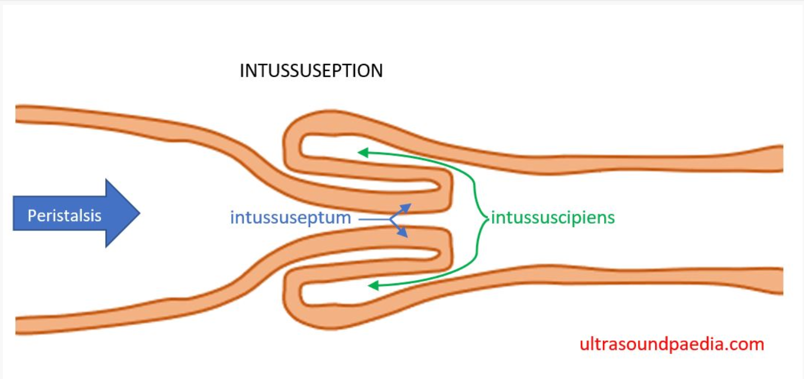
INTUSSUSCEPTION
  Proximal invaginates into distal segment
  Peak: 5–10 months; 90% idiopathic
  Redcurrant jelly stool = late sign
TREATMENT: Air/barium enema >70% success • Contraindicated: peritonitis/shock/lead point • Surgery if reduction fails • Recurrence up to 10%

Slide 10
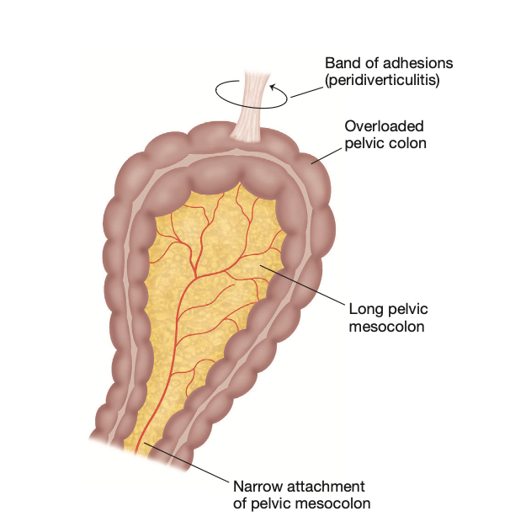
VOLVULUS — AXIAL ROTATION
  Sigmoid: most common adult volvulus
  >360° torsion = mesenteric occlusion
  Sigmoidoscopy + flatus tube first
TYPE | POPULATION | TREATMENT
Volvulus Neonatorum | Neonates | Emergency surgery (malrotation)
Sigmoid Volvulus | Elderly | Sigmoidoscopy → elective resection
Caecal Volvulus | 4th–5th decade | Resection or caecopexy

Slide 11
CLINICAL FEATURES — THE CARDINAL QUARTET
1. PAIN
Sudden; colicky; central (SBO) or lower abdomen. Constant pain = strangulation.
2. VOMITING
Earlier the higher the obstruction. Profuse in high SBO. Late = faeculent.
3. DISTENSION
Greater the more distal the level. Visible peristalsis in thin patients.
4. ABSOLUTE CONSTIPATION
Neither faeces nor flatus passed. Cardinal sign of complete obstruction.

Slide 12
HIGH SBO vs LOW SBO vs LARGE BOWEL 📊
FEATURE | HIGH SBO | LOW SBO | LARGE BOWEL
Pain | Epigastric; early | Central; colicky | Lower abdomen; mild
Vomiting | Early & profuse | Moderate; later | Very late
Distension | Minimal | Central; prominent | Peripheral; marked
Constipation | Late feature | Present | Early; absolute
Dehydration | Rapid; severe | Moderate | Less severe
AXR finding | Few central loops | Multiple ladders | Peripheral colon gas

Slide 13
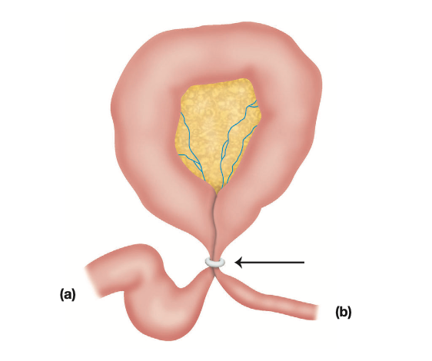
CLINICAL FEATURES OF STRANGULATION
  Constant pain — opiates don't relieve
  Shock + rigidity + skin discolouration
  CLINICAL diagnosis — CT must not delay
⭐ PEARLS: Venous before arterial • ↑K⁺ + ↑amylase + ↑LDH = suggestive • Persistent pain = presume strangulation • CT must NOT delay surgery

Slide 14
INVESTIGATIONS
BLOOD INVESTIGATIONS
  FBC: leukocytosis = strangulation / sepsis
  U&E: ↑urea; electrolyte imbalance (↓K⁺)
  ↑Amylase + ↑LDH = strangulation markers
IMAGING INVESTIGATIONS
  Plain AXR supine: first-line in all cases
  CT abdomen: gold standard; identifies cause
  ⚠️ Barium follow-through CONTRAINDICATED

Slide 15
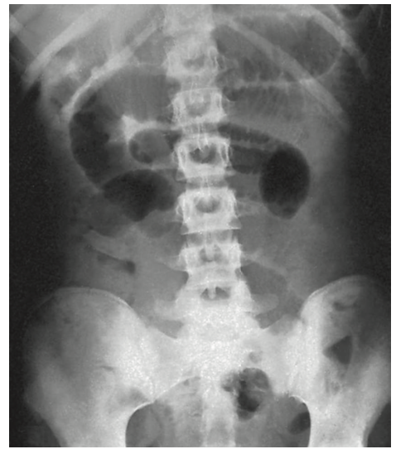
RADIOLOGICAL FEATURES — PLAIN X-RAY 🔬
STRUCTURE | RADIOLOGICAL APPEARANCE
Jejunum | Valvulae conniventes; full-width; concertina
Ileum | Featureless; central; transverse; no markings
Caecum | Rounded gas shadow — right iliac fossa
Colon | Haustral folds; peripheral; irregular spacing
Sigmoid Volvulus | Coffee bean / omega loop / inverted-U
Gallstone Ileus | Rigler's triad: SBO + pneumobilia + stone

Slide 16
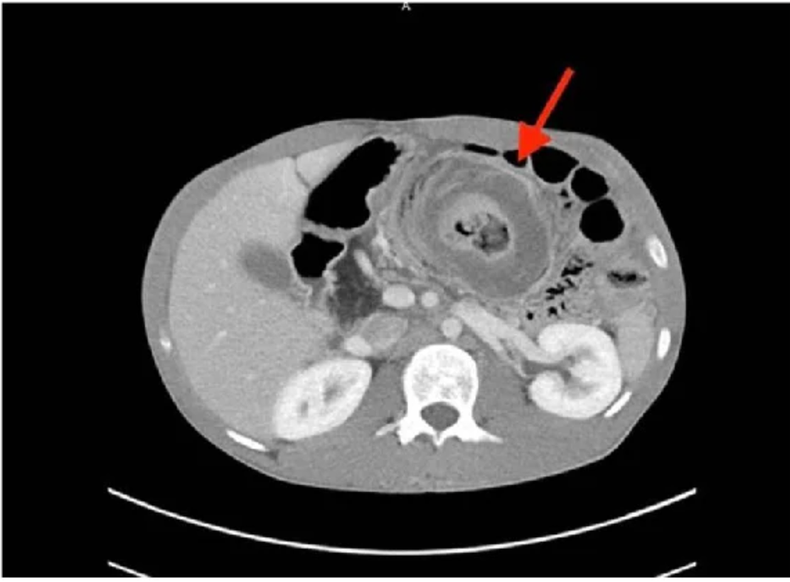
CT ABDOMEN — GOLD STANDARD INVESTIGATION
  Identifies site, level and cause
  ↓ Enhancement → strangulation likely
  NEVER delay surgery to wait for CT
CT SIGN | INTERPRETATION
↓ Bowel wall enhancement | ↑ Probability of strangulation
Absent mesenteric oedema | ↓ Probability of strangulation
Pneumatosis intestinalis | Advanced ischaemia / necrosis

Slide 17
MANAGEMENT — THREE PILLARS
1. RESUSCITATE
IV Hartmann's/Saline • Correct K⁺ & Na⁺ • Catheter + urine output • Analgesia + O₂
2. DECOMPRESS
Nasogastric tube (Salem/Ryle's) • Free drainage + 4-hourly aspiration • Essential BEFORE anaesthesia
3. RELIEVE CAUSE
Conservative (adhesions) max 72h • Surgery if strangulation • Assess viability; resect necrotic bowel

Slide 18
MANAGEMENT ALGORITHM 🔄
SUSPECTED INTESTINAL OBSTRUCTION
Resuscitate: IV fluids + NGT + catheter + O₂
Imaging: AXR first → CT Abdomen
STRANGULATION / HERNIA / CLOSED LOOP?
YES ↓
NO ↓
EMERGENCY
SURGERY
CONSERVATIVE
max 72 hours
Assess viability: colour • sheen • peristalsis • mesenteric pulsation | Resect non-viable bowel

Slide 19
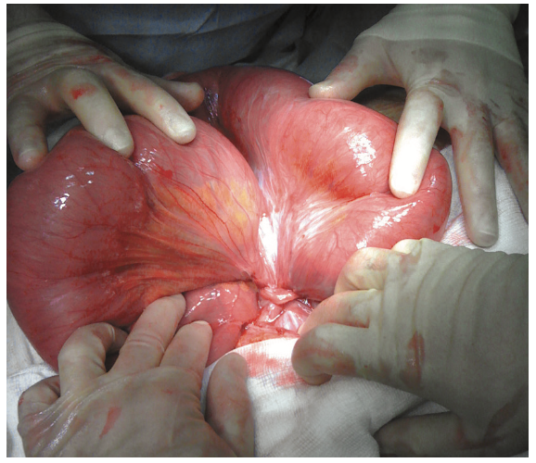
TREATMENT OF ADHESIVE SBO
  IV fluids + NGT; conservative max 72h
  Water-soluble contrast: Rx + diagnostic
  Divide only the causative adhesion
PREVENTION: Good surgical technique • Saline peritoneal lavage • Minimise gauze contact • Cover raw surfaces • Laparoscopic surgery reduces adhesion risk

Slide 20
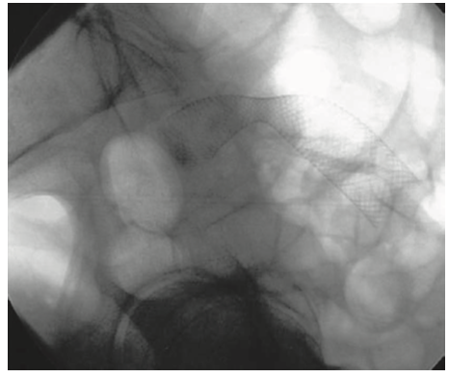
TREATMENT OF LARGE BOWEL OBSTRUCTION
  Right colon → emergency hemicolectomy
  Left colon → Hartmann's procedure
  Metal stent: palliation / bridge
SITE OF LESION | RECOMMENDED TREATMENT
Caecum / Ascending | Emergency right hemicolectomy + anastomosis
Splenic flexure | Extended right hemicolectomy + anastomosis
Left colon / Rectosigmoid | Resection ± Hartmann's procedure
Palliative / Unfit | Self-expanding metal stent (80–90%)

Slide 21
SURGICAL ASSESSMENT — BOWEL VIABILITY 📋
  Assess viability AFTER relieving obstruction
  Doubtful: hot packs × 10 min; reassess
  Uncertain → resect (unless short bowel risk)
  Second-look laparotomy at 24–48h if needed
PARAMETER | VIABLE BOWEL ✅ | NON-VIABLE BOWEL ❌
Colour | Pink — lightens on compression | Dark — remains unchanged
Appearance | Shiny and glistening | Dull and lustreless
Wall tone | Firm; intact muscle | Flabby, thin, friable
Peristalsis | Present; stimulable | Absent — no movement

Slide 22
ADYNAMIC OBSTRUCTION
PARALYTIC ILEUS
  Causes: post-op, sepsis, metabolic, reflex
  Normal if resolves within 72 h post-operatively
  Silent abdomen; no colic; NGT + IV fluids
OGILVIE'S PSEUDO-OBSTRUCTION
  Acute colonic dilation; no mechanical cause
  Caecal distension → risk of perforation
  Colonoscopic decompression first-line Rx

Slide 23
COMPLICATIONS
DISEASE COMPLICATIONS | TREATMENT / SURGICAL COMPLICATIONS
Dehydration & electrolyte loss | Wound infection / anastomotic leak
Strangulation & bowel gangrene | Short bowel syndrome
Intestinal perforation & peritonitis | Recurrent adhesive SBO
Septicaemia & multi-organ failure | Stoma complications
Hypovolaemic shock | Reperfusion injury post-ischaemia
Respiratory embarrassment | Port-site hernia (~2%)

Slide 24
⭐ HIGH-YIELD EXAM PEARLS
TOPIC | KEY FACT / VIVA ANSWER
Most common SBO cause | Adhesions (40%)
Most common LBO cause | Carcinoma (~60%)
Rigler's Triad | SBO + Pneumobilia + Ectopic stone shadow
Intussusception peak age | 5–10 months; ileocolic = 77%
Sigmoid volvulus Rx | Sigmoidoscopy + flatus tube first
Conservative SBO limit | Maximum 72 hours
Strangulation diagnosis | Primarily CLINICAL — CT must not delay surgery
Hartmann's procedure | Resection + end colostomy + close rectal stump
Water-soluble contrast | Sensitivity 96% / Specificity 98%

Slide 25
SUMMARY
  Classify: Dynamic (mechanical) vs Adynamic
  Cardinal quartet: pain, distension, vomiting, constipation
  Strangulation = emergency; diagnose clinically
  CT abdomen = gold standard; never delay surgery
  Resuscitate; assess viability at operation

