Slide 1
Inflammatory Bowel Diseases
بسم الله الرحمن الرحيم
Prof. Zahid Mahmood

Slide 2
Guess Diagnosis
A 24-year-old woman presents to the surgical OPD with a 3-month history of bloody diarrhea and tenesmus. Rigid sigmoidoscopy shows hyperemic mucosa that bleeds on touch. A mucosal biopsy is performed.
Ulcerative Colitis

Slide 3
Learning Outcomes
Differentiate Ulcerative Colitis and Crohn’s
  Recognize urgent surgical indications early
  List essential diagnostic investigations clearly
  Explain restorative proctocolectomy principles

Slide 4
Definition of IBD
Chronic relapsing immune-mediated intestinal inflammation
  Common in young adult population
  Ulcerative Colitis affects colonic mucosa
  Crohn’s affects entire gastrointestinal tract

Slide 5
Epidemiology in Pakistan
Increasing incidence in urban populations
  Bimodal age distribution documented worldwide
  Equal gender distribution in UC
  Genetic predisposition plays significant role

Slide 6
Ulcerative Colitis Pathology
Inflammation limited to mucosa layer
  Rectum almost always initially involved
  Disease spreads proximally continuously
  Crypt abscesses characteristic histological feature

Slide 7
Crohn’s Disease Pathology
Transmural inflammation affects entire wall
  Skip lesions alternate healthy mucosa
  Deep fissures create cobblestone appearance
  Non-caseating granulomas diagnostic hallmark

Slide 8
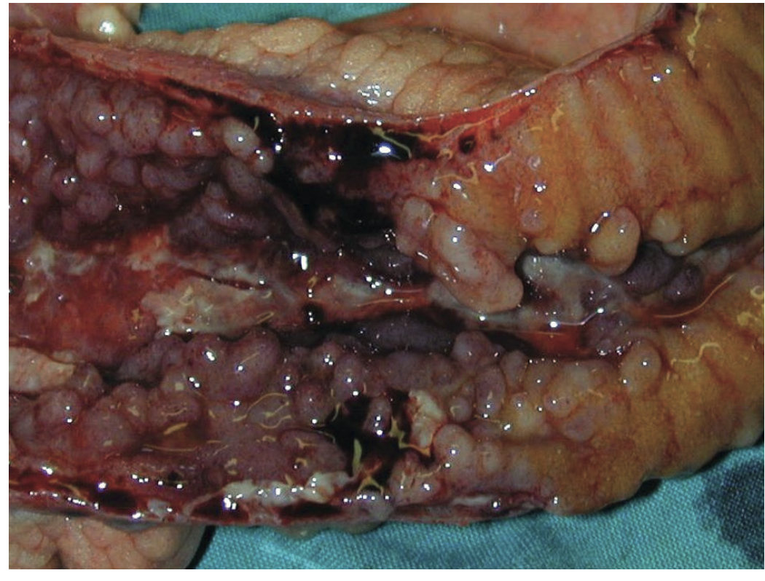
Crohn’s disease of the terminal ileum illustrating longitudinal ulceration and cobblestone mucosa.

Slide 9
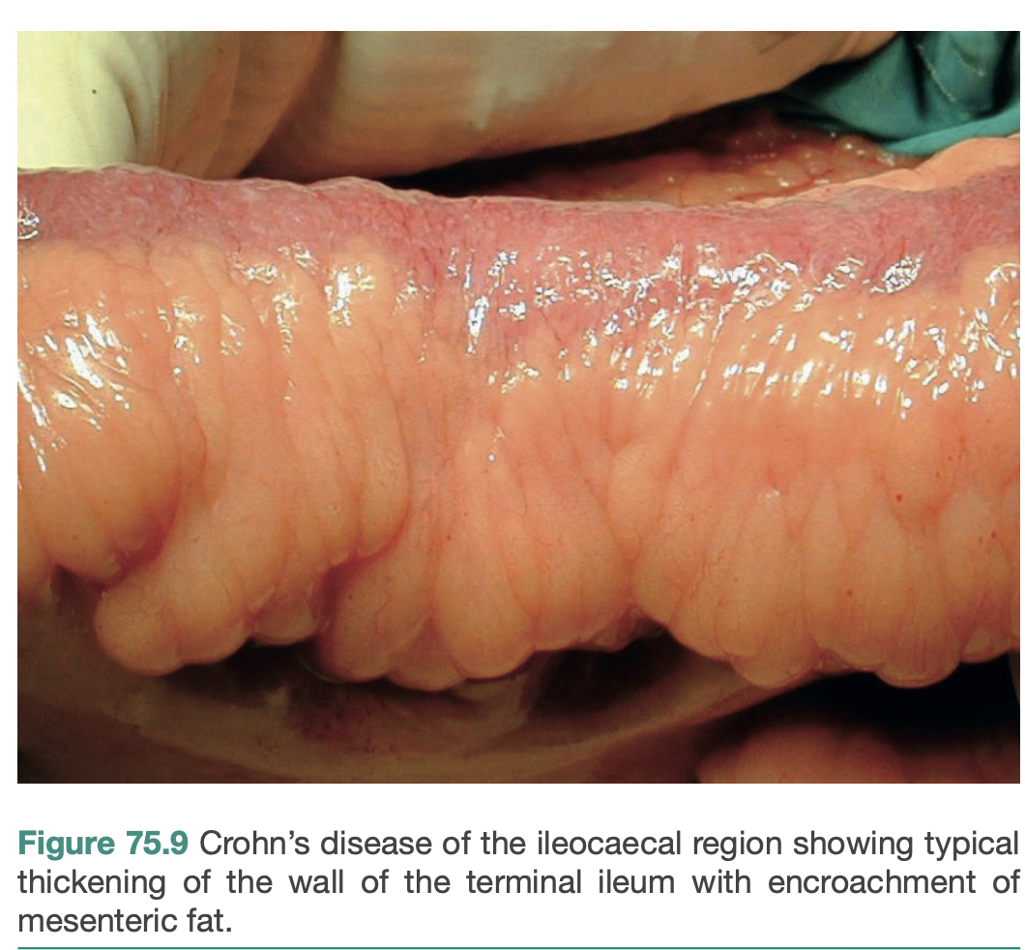

Slide 10
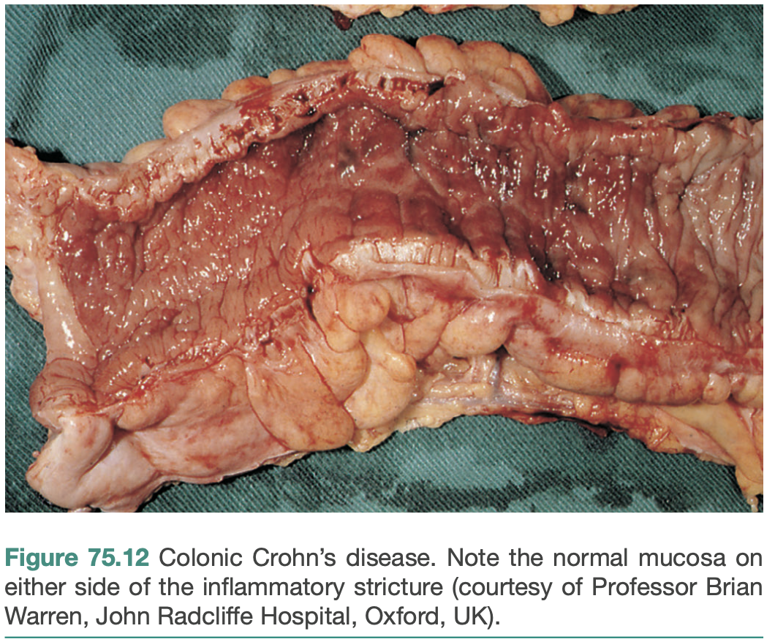

Slide 11
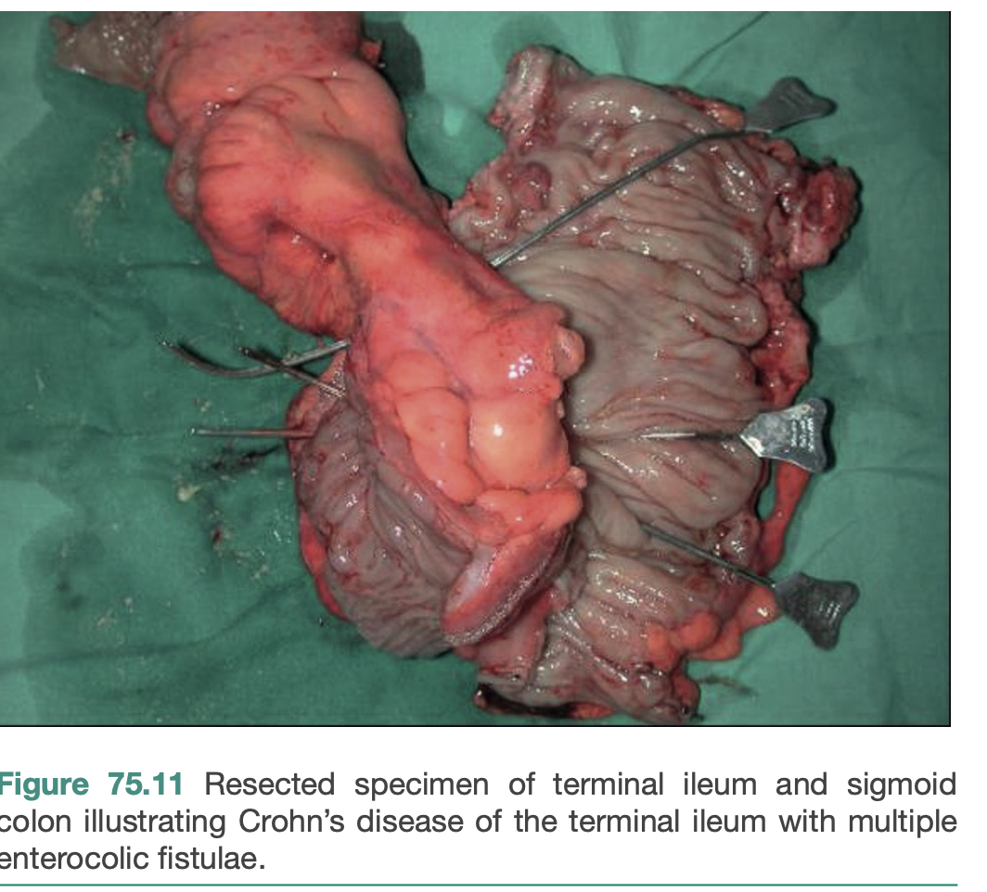

Slide 12
Morphological Changes
Bowel wall thickening common Crohn’s
  Mesenteric fat wrapping characteristic feature
  UC causes thin friable mucosa
  Pseudo polyps represent regenerating mucosa islands

Slide 13
Ulcerative Colitis Symptoms
Bloody diarrhea hallmark presentation
  Tenesmus indicates rectal involvement
  Colicky pain precedes defecation
  Urgency causes faecal incontinence episodes

Slide 14
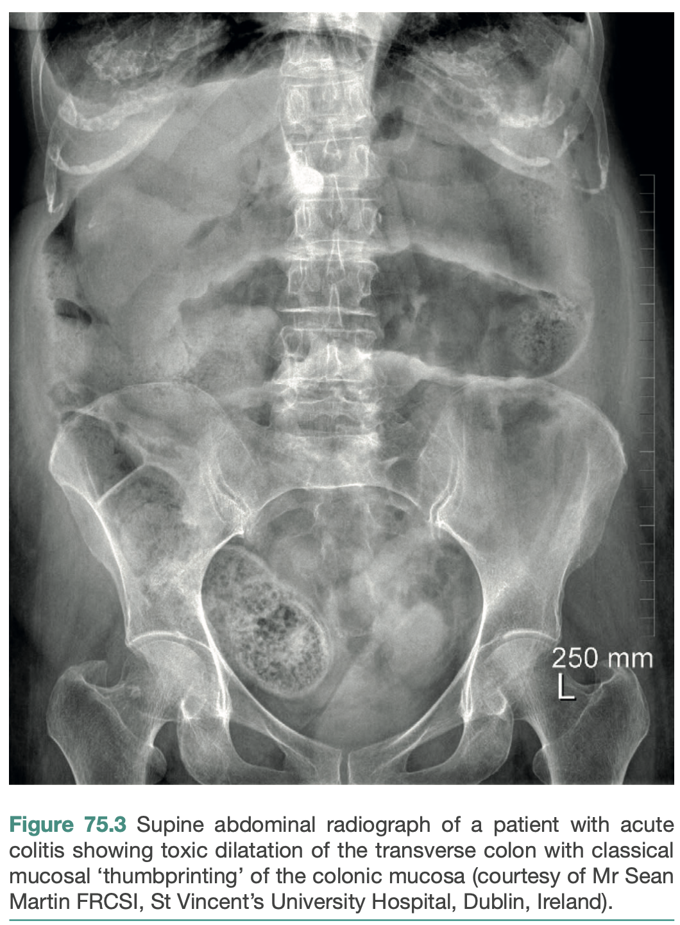

Slide 15
Crohn’s Disease Symptoms
Chronic abdominal pain watery diarrhea
  Right iliac fossa mass common
  Malabsorption leads significant weight loss
  Perianal disease precedes intestinal symptoms

Slide 16
Extraintestinal Manifestations
Primary sclerosing cholangitis liver involvement
  Ankylosing spondylitis axial skeleton disease
  Pyoderma gangrenosum painful skin ulcers
  Uveitis causes painful blurred vision

Slide 17
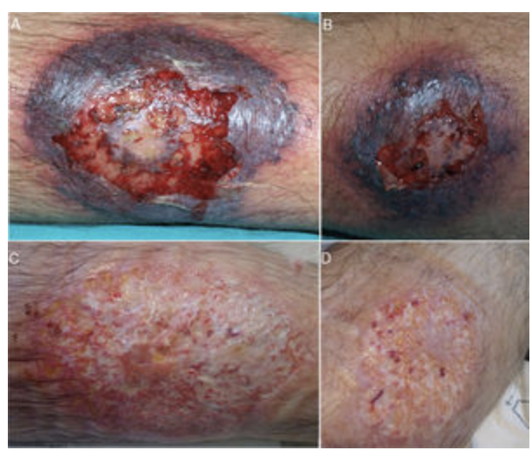

Slide 18
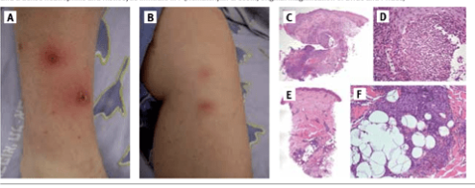

Slide 19
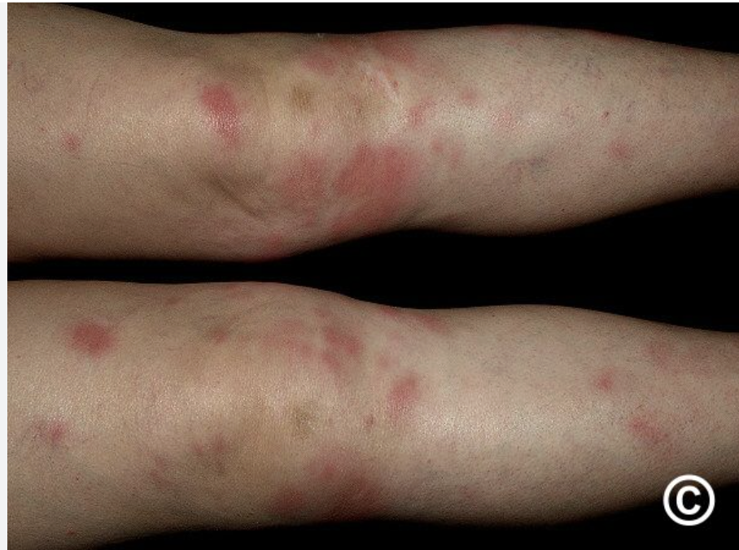

Slide 20
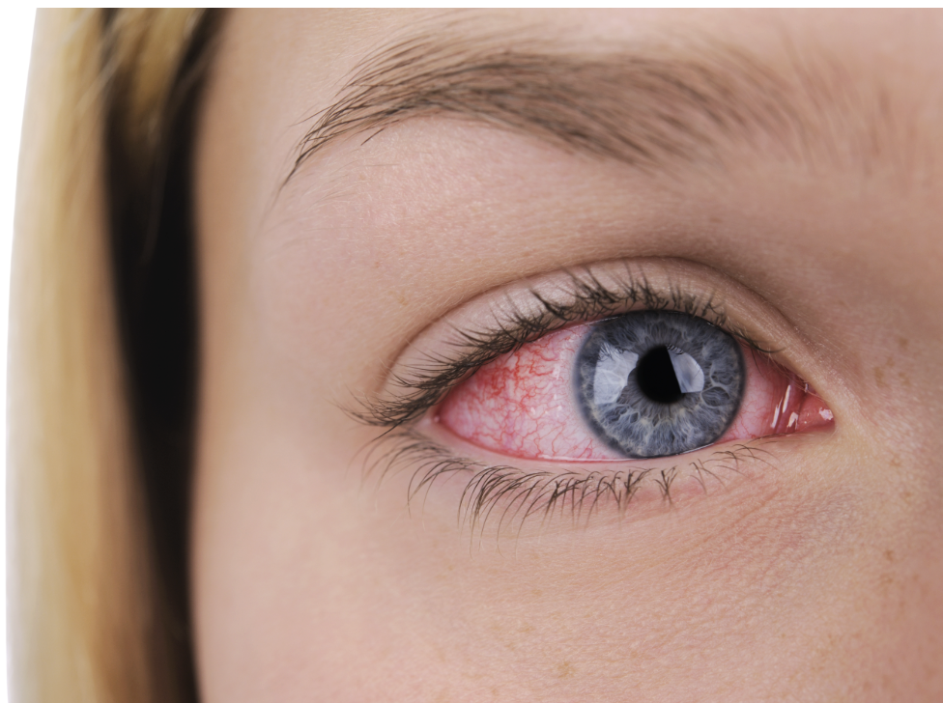

Slide 21
Laboratory Workup
Anaemia detected on blood count
  Elevated C-reactive protein indicates activity
  Low albumin reflects protein loss
  Faecal calprotectin sensitive inflammation marker

Slide 22
Endoscopy – Ulcerative Colitis
Continuous inflammation from rectum proximally
  Loss vascular pattern mucosal friability
  Rectal biopsy mandatory for diagnosis
  Surveillance colonoscopy prevents malignancy

Slide 23
Endoscopy – Crohn’s Disease
Aphthous ulcers earliest finding
  Cobblestone appearance advanced disease
  Terminal ileum intubation mandatory
  Strictures prevent complete colonoscopy

Slide 24
Radiology – Basic Imaging
Abdominal radiograph detects perforation
  Toxic megacolon dilated colon loops
  Thumbprinting indicates severe oedema
  Lead-pipe colon barium enema

Slide 25
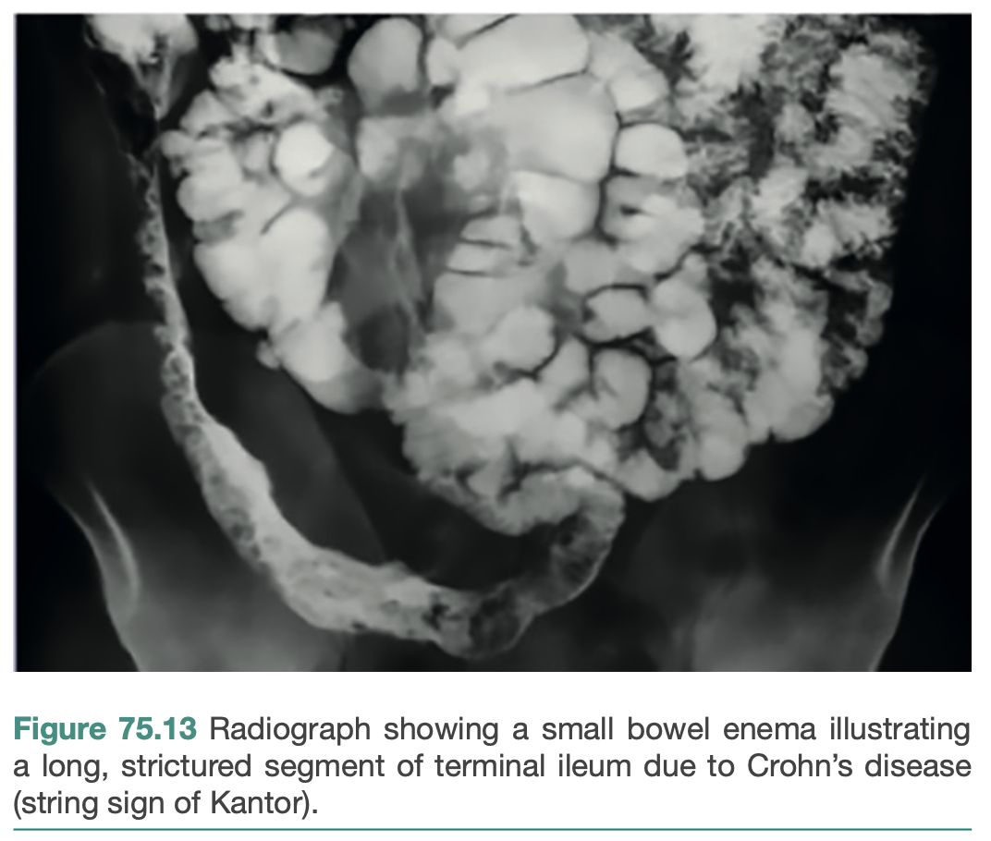

Slide 26
Advanced Imaging
CT enterorrhaphy detects small strictures
  MRI pelvis evaluates perianal fistulae
  Ultrasound detects intraabdominal abscess
  Capsule endoscopy identifies occult ulcers

Slide 27
Indications for UC Surgery
Toxic megacolon medical therapy failure
  Perforation absolute surgical indication
  Massive haemorrhage requires colectomy
  High-grade dysplasia suggests malignancy

Slide 28
Emergency UC Surgery
Subtotal colectomy end ileostomy preferred
  Rectal stump usually retained
  Safe procedure in sepsis
  Avoid primary anastomosis emergency

Slide 29
Elective UC Surgery
Proctocolectomy permanent ileostomy curative
  Restorative proctocolectomy ileal pouch
  J-pouch commonest configuration
  Meticulous pelvic nerve preservation

Slide 31
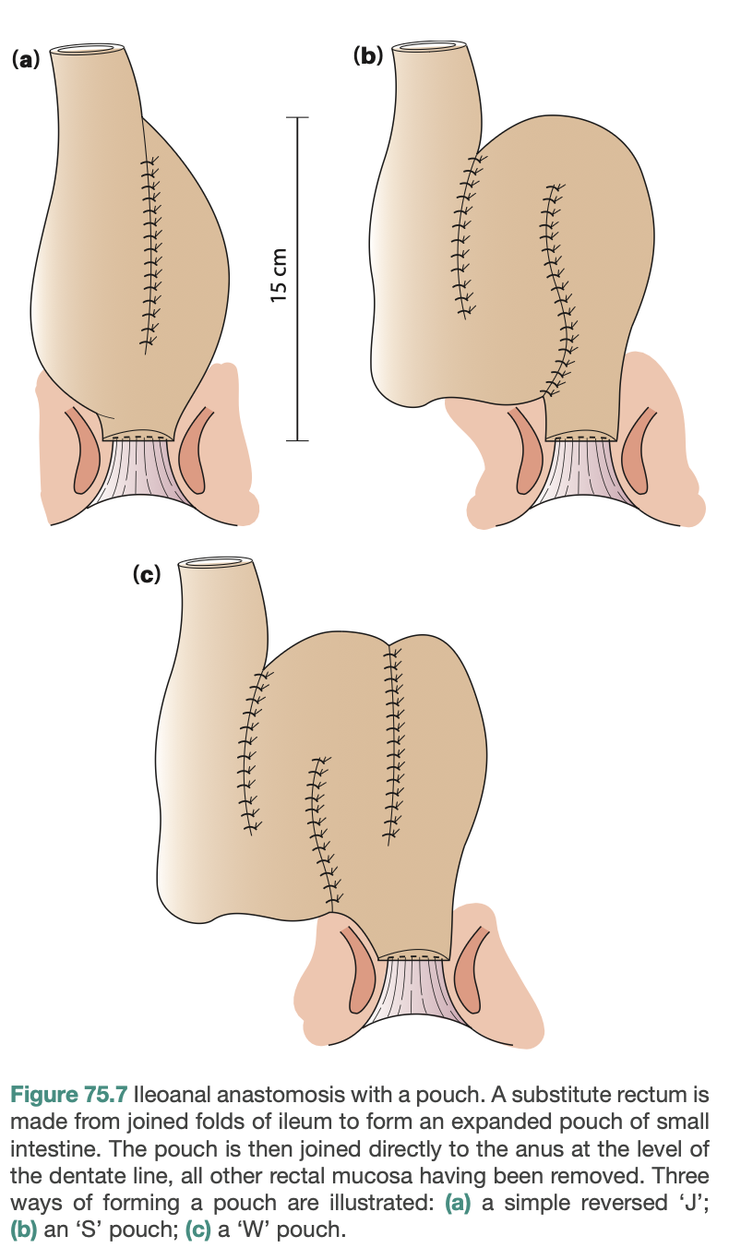

Slide 32
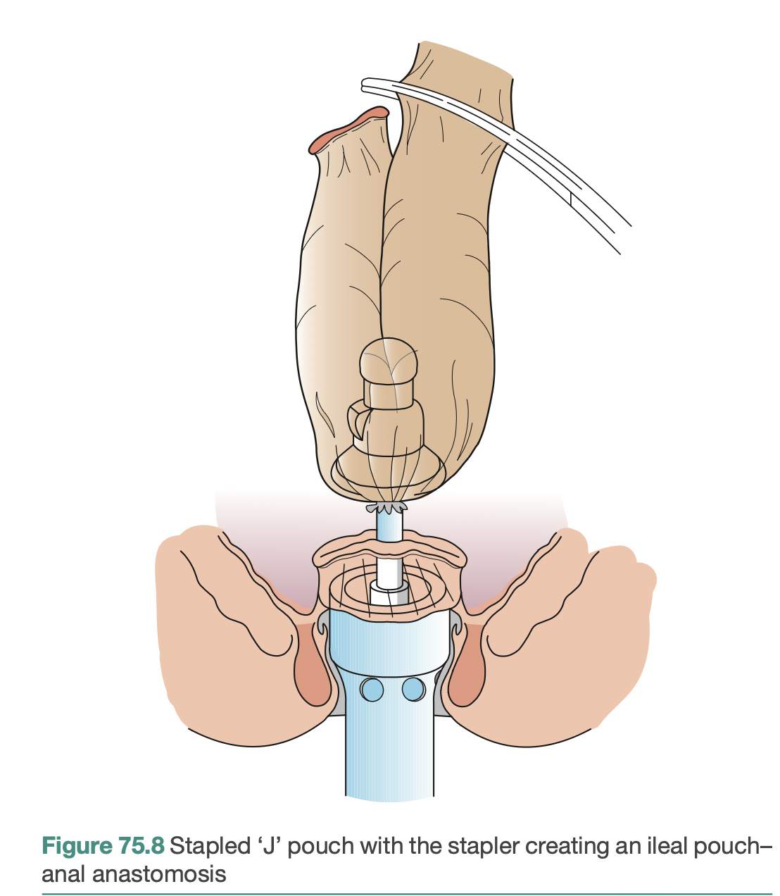

Slide 33
Crohn’s Surgical Indications
Surgery not curative disease
  Operate only for complications
  Internal fistulae causing symptoms
  Persistent obstruction despite therapy

Slide 34
Crohn’s Surgical Principles
Preserve maximum bowel length
  Resect only diseased segments
  Wide margins unnecessary here
  Strictureplasty prevents short bowel

Slide 35
Strictureplasty Techniques
Heineke-Mikulicz short strictures
  Finney technique longer segments
  Incise longitudinal close transverse
  Prevents short bowel syndrome

Slide 36
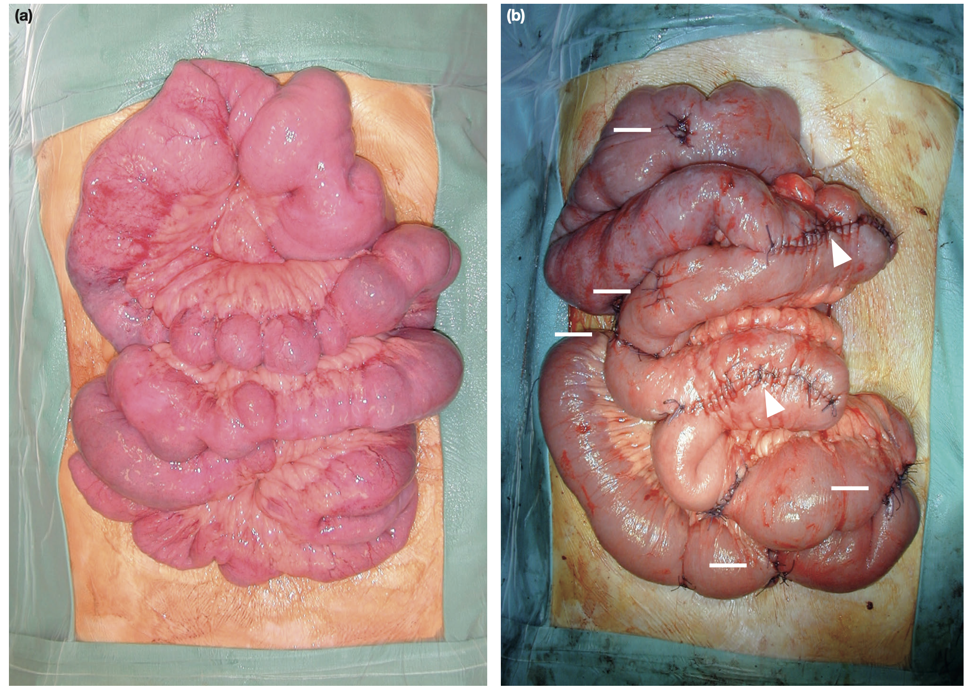

Slide 37
Perianal Crohn’s Management
Drain sepsis insert silastic seton
  Avoid simple fistulectomy procedure
  Infliximab helps fistula closure
  Proctectomy severe rectal destruction

Slide 38
Tropical Differentials
Intestinal tuberculosis mimics Crohn’s
  Ileocecal involvement common tuberculosis
  Exclude amoebic colitis initially
  Typhoid perforation emergency differential

Slide 39
Other Differentials
Infective colitis acute onset
  Ischemic colitis elderly patients
  Diverticulitis left lower pain
  Radiation proctitis post pelvic therapy

Slide 40
Acute Complications
Fulminant colitis bowel necrosis
  Transmural perforation pneumoperitoneum
  Severe haemorrhage urgent intervention
  Portal pyaemia pelvic sepsis

Slide 41
Chronic Complications
Bowel strictures chronic obstruction
  Enterocutaneous fistulae skin breakdown
  Amyloidosis progressive renal failure
  Gallstones bile salt malabsorption

Slide 42
Colorectal Cancer Risk
Risk increases eight years
  Pancolitis higher risk proctitis
  Annual surveillance colonoscopy mandatory
  High-grade dysplasia prophylactic colectomy

Slide 43
Stoma Management
Ileostomy requires specialized care
  High output electrolyte depletion
  Parastomal hernia late complication
  Reversal depends clinical stability

Slide 44
Pouchitis
Common complication after J-pouch
  Frequency pelvic pain symptoms
  Diagnosed via pouch endoscopy
  Responds to metronidazole therapy

Slide 45
Short Bowel Syndrome
Multiple resections Crohn’s disease
  Severe diarrhea malnutrition
  Requires long-term parenteral nutrition
  Transplantation last therapeutic option

Slide 46
Viva Pearls – UC
Total proctocolectomy curative
  Backwash ileitis may occur
  Avoid steroids preoperatively
  Smoking protective association

Slide 47
Viva Pearls – Crohn’s
Mouth to anus involvement
  Smoking worsens disease prognosis
  Perianal fistula first manifestation
  Recurrence at anastomosis common

Slide 48
Multi-Disciplinary Team
Surgeons, gastroenterologists, radiologists collaborate
  Nutritionists optimize preoperative status
  Psychologists support chronic illness
  Nurses manage stomas biologics

Slide 49
Future Trends
Biologics reduce surgery rates
  Laparoscopy current gold standard
  Robotic surgery improves precision
  Microbiota transplant research ongoing

Slide 50
Final Summary
Early diagnosis prevents complications
  Timely surgery improves outcomes
  Individualized treatment best strategy
  Lifelong follow-up essential

Slide 51
1. A 24-year-old male presents with a 6-month history of diarrhea, weight loss, and a painful mass in the right iliac fossa. Colonoscopy reveals skip lesions and a "cobblestone" appearance. What is the most likely diagnosis?
A. Abdominal Tuberculosis
B. Amoebic Liver Abscess
C. Appendicular Mass
D. Crohn's Disease
E. Ulcerative Colitis
Key: D

Slide 52
2. A 30-year-old female with known Ulcerative Colitis for 10 years presents with high-grade fever, abdominal distension, and severe tenderness. An X-ray shows a colonic diameter of 8 cm. What is the next best step in management?
A. Barium Enema study
B. Emergency Total Proctocolectomy
C. Intravenous Hydrocortisone administration
D. Loop Ileostomy formation
E. Permanent End Sigmoid Colostomy
Key: B

Slide 53
3. A patient diagnosed with Crohn's disease is found to have a 4 cm fibrous stricture in the mid-jejunum causing intermittent obstruction. What is the preferred surgical procedure?
A. Anterior Resection
B. Ileocolectomy
C. Left Hemicolectomy
D. Panproctocolectomy
E. Strictureplasty
Key: E

Slide 54
4. A 20-year-old male presents with recurrent perianal discharge and multiple external openings around the anus. Examination reveals deep oral ulcers. Which investigation is most specific for this suspected condition?
A. Abdominal Ultrasound
B. Biopsy showing Granulomas
C. Carinal Angle measurement
D. Serum Albumin levels
E. White Cell Count
Key: B

Slide 55
5. A 28-year-old female with Ulcerative Colitis undergoes a restorative proctocolectomy. Which of the following is the most common long-term functional complication?
A. Gallstones
B. Nephrolithiasis
C. Pouchitis
D. Small bowel volvulus
E. Vitamin B12 deficiency
Key: C

Slide 56
6. A 22-year-old male with a 5-year history of Crohn's disease presents with a 2-day history of vomiting and absolute constipation. X-ray shows dilated small bowel loops. What is the most likely cause?
A. Adhesion formation
B. Fibrotic stricture
C. Intussusception
D. Malignant transformation
E. Paralytic ileus
Key: B

Slide 57
7. A patient with Ulcerative Colitis is being monitored for disease activity. Which non-invasive test is most useful for detecting an impending flare-up?
A. Barium swallow
B. Fecal calprotectin
C. Serum amylase
D. Urea breath test
E. White cell count
Key: B

Slide 58
8. During a viva, you are asked which feature most strongly suggests Crohn's disease over Ulcerative Colitis on a biopsy specimen. Which is it?
A. Crypt abscess
B. Goblet cell depletion
C. Mucosal friability
D. Non-caseating granuloma
E. Superficial ulceration
Key: D

Slide 59
9. A 29-year-old woman with Ulcerative Colitis presents with a heart rate of 120 bpm, temperature of 101°F, and a dilated colon of 7.5 cm on X-ray. What is the diagnosis?
A. Amoebic colitis
B. Hirschsprung's disease
C. Ischemic colitis
D. Sigmoid volvulus
E. Toxic megacolon
Key: E

Slide 60
10. Which surgical procedure is considered the "gold standard" elective surgery for a 25-year-old patient with Ulcerative Colitis who wishes to avoid a permanent stoma?
A. Abdominoperineal resection
B. Hartmann's procedure
C. Ileal pouch-anal anastomosis
D. Right hemicolectomy
E. Subtotal colectomy
Key: C

Slide 61
11. A 24-year-old woman presents to the surgical OPD with a 3-month history of bloody diarrhea and tenesmus. Rigid sigmoidoscopy shows hyperemic mucosa that bleeds on touch. A mucosal biopsy is performed. What is the most likely histological finding?
A. Crypt abscesses
B. Fissuring ulcers
C. Non-caseating granulomas
D. Skip lesions
E. Transmural inflammation
Key: A

Slide 62
12: A 30-year-old man presents with chronic abdominal pain, weight loss, and watery diarrhea. Colonoscopy reveals areas of normal-looking mucosa interspersed with deep linear ulcers in the ascending colon.
What is the most characteristic macroscopic feature of this condition?
A. Continuous involvement
B. Lead-pipe appearance
C. Mucosal friability
D. Pseudopolyps
E. Skip lesions
Key: E

Slide 63
13. A 45-year-old man with long-standing Ulcerative Colitis presents with jaundice and generalized pruritus. Laboratory tests show a cholestatic pattern of liver enzymes. What is the most likely associated condition?
A. Amoebic liver abscess
B. Cholelithiasis
C. Hepatocellular carcinoma
D. Hydatid cyst
E. Primary sclerosing cholangitis
Key: E

Slide 64
14. A 22-year-old woman undergoes surgery for suspected appendicitis. Intraoperatively, the appendix is normal, but the terminal ileum is thickened and "fat wrapping" is noted on the mesenteric border.
What is the most likely diagnosis?
A. Abdominal Tuberculosis
B. Carcinoid tumor
C. Crohn's disease
D. Meckel's diverticulitis
E. Ulcerative colitis
Key: C

Slide 65
15. A 28-year-old man with a 5-year history of IBD is found to have inflammation strictly limited to the rectum. He complains of mucus discharge and tenesmus but no systemic symptoms.
What is the correct term for this distribution?
A. Backwash ileitis
B. Left-sided colitis
C. Pancolitis
D. Proctitis
E. Regional enteritis
Key: D

Slide 66
16. A 35-year-old woman with known Ulcerative Colitis presents with 8 bloody stools per day, a pulse rate of 110 bpm, and a temperature of 38.5°C. Her haemoglobin is 9 g/dL.
According to Truelove and Witts criteria, how is her disease categorized?
A. Fulminant
B. Indeterminate
C. Mild
D. Moderate
E. Severe
Key: E

Slide 67
17. A 40-year-old man admitted for acute severe colitis develops sudden abdominal distension and severe pain. A plain abdominal radiograph shows a transverse colon diameter of 8 cm with mucosal thumbprinting.
What is the most appropriate next step in management?
A. Barium enema
B. Colonoscopy
C. Emergency surgery
D. Intravenous antibiotics
E. Total parenteral nutrition
Key: C

Slide 68
18. A patient with fulminant colitis is being monitored. The clinical team notices a sudden decrease in stool frequency despite increasing abdominal pain and tachycardia.
What does this clinical change most likely indicate?
A. Clinical remission
B. Impending perforation
C. Resolution of inflammation
D. Response to steroids
E. Small bowel obstruction
Key: B

Slide 69
19. A 25-year-old woman is hospitalized with her first attack of acute severe colitis. She is started on intensive medical therapy including intravenous steroids.
What is the expected remission rate with this treatment?
A. 10%
B. 30%
C. 50%
D. 70%
E. 90%
Key: D

Slide 70
20. A patient on long-term high-dose steroids for IBD is suspected of having a colonic perforation.
Why might the diagnosis be clinically challenging in this patient?
A. Perforation is retroperitoneal
B. Radiographs are always normal
C. Steroids mask physical signs
D. Steroids prevent pain
E. Symptoms are usually mild
Key: C

Slide 71
21. A 50-year-old man has had pan-ulcerative colitis for 20 years. He is currently in clinical remission.
What is his approximate risk of developing colorectal cancer at this stage?
A. 1%
B. 5%
C. 10-15%
D. 30%
E. 50%
Key: C

Slide 72
22. A 32-year-old woman with pancolitis of 12 years' duration is referred for cancer screening.
What is the most appropriate screening method?
A. Annual CT scan
B. Barium enema every 2 years
C. Carcinoembryonic antigen (CEA) levels
D. Colonoscopy with chromoendoscopy
E. Faecal occult blood test
Key: D

Slide 73
23. A 26-year-old man with acute bloody diarrhea is suspected of having Ulcerative Colitis. A stool specimen is sent for analysis.
Which organism must be excluded as it mimics acute severe UC?
A. Campylobacter
B. Clostridium botulinum
C. Escherichia coli
D. Helicobacter pylori
E. Staphylococcus aureus
Key: A

Slide 74
24. A patient is admitted with a severe acute flare of Ulcerative Colitis.
Which investigation is generally contraindicated in this setting due to the high risk of perforation?
A. Abdominal Ultrasound
B. CT enterography
C. Full colonoscopy
D. Rigid sigmoidoscopy
E. Supine abdominal X-ray
Key: C

Slide 75
25. A surgical registrar is assessing a patient’s response to treatment for Ulcerative Colitis to decide on the need for surgery.
Which scoring system is most widely used to measure disease progression or response?
A. APACHE II
B. Child-Pugh
C. Glasgow Coma Scale
D. Mayo score
E. Rockall score
Key: D

Slide 76
26. A 29-year-old man with refractory acute severe colitis is scheduled for emergency surgery.
What is the safest surgical procedure in this emergency situation?
A. Abdominoperineal resection
B. Left hemicolectomy
C. Proctocolectomy with J-pouch
D. Right hemicolectomy
E. Subtotal colectomy and end-ileostomy
Key: E

Slide 77
27. During an emergency subtotal colectomy for toxic megacolon, the junior resident suggests performing a concurrent proctectomy.
Why is proctectomy generally avoided in the emergency setting?
A. High risk of fecal incontinence
B. Increased risk of pelvic nerve injury
C. Pelvic dissection is easier later
D. Proctectomy is never needed in UC
E. Rectum is always healthy in UC
Key: B

Slide 78
28. An 18-year-old student with Ulcerative Colitis is finding it difficult to maintain remission without high doses of steroids, which have caused significant weight gain and moon face.
What is this specific indication for surgery called?
A. Acute severe disease
B. Fulminating disease
C. Growth retardation
D. Neoplastic change
E. Steroid-dependent disease
Key: E

Slide 79
29. A 22-year-old woman has fully recovered from an emergency subtotal colectomy. She now wants to undergo restorative surgery to avoid a permanent stoma.
What is the most common elective restorative procedure?
A. Abdominoperineal resection
B. Hartmann’s procedure
C. Ileal pouch-anal anastomosis (IPAA)
D. Ileorectal anastomosis
E. Permanent end-ileostomy
Key: C

Slide 80
30. A newly diagnosed 20-year-old patient with Ulcerative Colitis asks about the likelihood of needing surgery in the future.
What is the approximate lifetime risk of colectomy for a patient with UC?
A. 5%
B. 20%
C. 40%
D. 60%
E. 80%
Key: B

Slide 81
31. A surgeon is planning an elective operation for a patient with Crohn's disease of the small bowel.
What is the primary principle of surgical management in Crohn’s disease?
A. Cure the disease permanently
B. Perform wide resection margins
C. Preserve as much bowel as possible
D. Remove the entire colon
E. Resect all skip lesions
Key: C

Slide 82
32. A patient with long-standing Crohn's disease presents with signs of intestinal obstruction.
What is a common indication for elective surgery in this patient?
A. Fibrotic strictures
B. Frequent watery stools
C. Mild abdominal pain
D. Mucus in stool
E. Sudden bloody diarrhea
Key: A

Slide 83
33. A patient is found to have an isolated segment of diseased colon. The multidisciplinary team is discussing resection.
For which condition is a segmental colectomy a recognized elective option?
A. Backwash ileitis
B. Crohn’s colitis
C. Indeterminate colitis
D. Pancolitis
E. Ulcerative colitis
Key: B

Slide 84
34. A malnourished patient with IBD is being prepared for elective surgery.
In which situation is nutritional optimization unlikely to be successful until the primary issue is addressed?
A. Anemia
B. Presence of active infection
C. Steroid dependence
D. Vitamin deficiency
E. Weight loss
Key: B

Slide 85
35. A patient is being prepared for a subtotal colectomy and is anxious about the stoma.
Which member of the MDT should be introduced early to provide specialized support and counseling?
A. Clinical psychologist
B. Interventional radiologist
C. Pathologist
D. Stoma therapist
E. Surgical registrar
Key: D

