Slide 1
بسم الله الرحمن الرحيم
Stoma
Prof. Zahid Mahmood

Slide 2
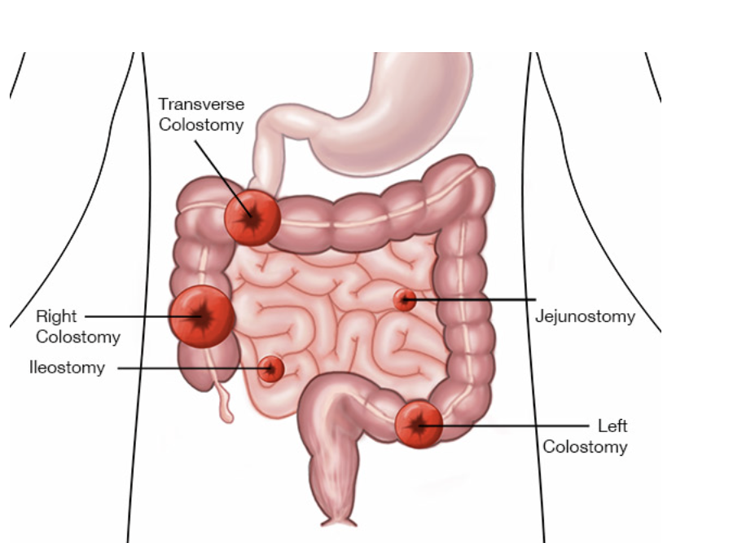

Slide 3
Learning Outcomes
Define stoma and anatomical basis
Classify stomas by type mechanism temporality
Explain indications and surgical techniques
Identify complications and management principles

Slide 4
Definition
Surgically created opening hollow organ skin
Allows diversion intestinal contents
Mucosal surface pink moist appearance
No pain due absence somatic innervation

Slide 5
Classification
Colostomy ileostomy jejunostomy types
End loop double barrel split varieties
Temporary permanent emergency elective categories
Location RIF LIF abdominal quadrants

Slide 6
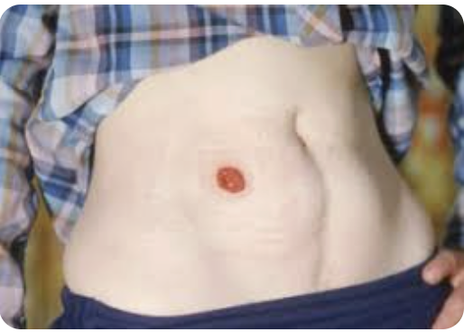
Ileostomy
Located right iliac fossa abdomen
Spouted two to three centimeters above
Liquid high volume enzyme rich output
Used inflammatory bowel disease protection

Slide 7
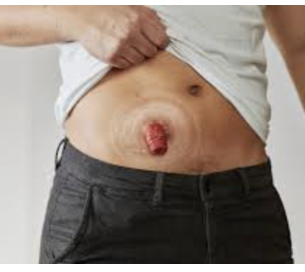
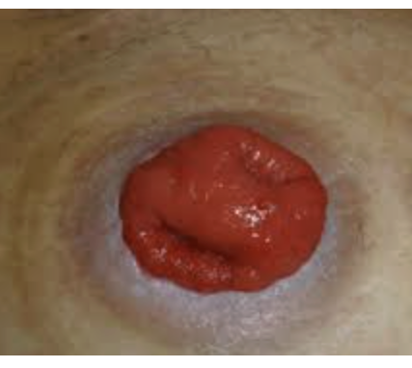
Ileostomy

Slide 8
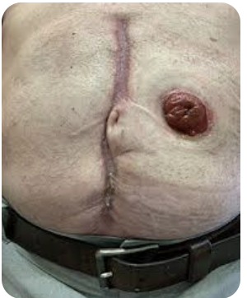
Colostomy
Located left iliac fossa abdomen
Flush with skin surface typically
Formed stool output more controlled
Used cancer diverticulitis obstruction cases

Slide 9
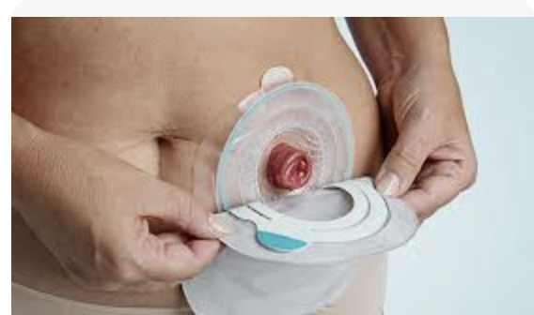
Colostomy Bag

Slide 10
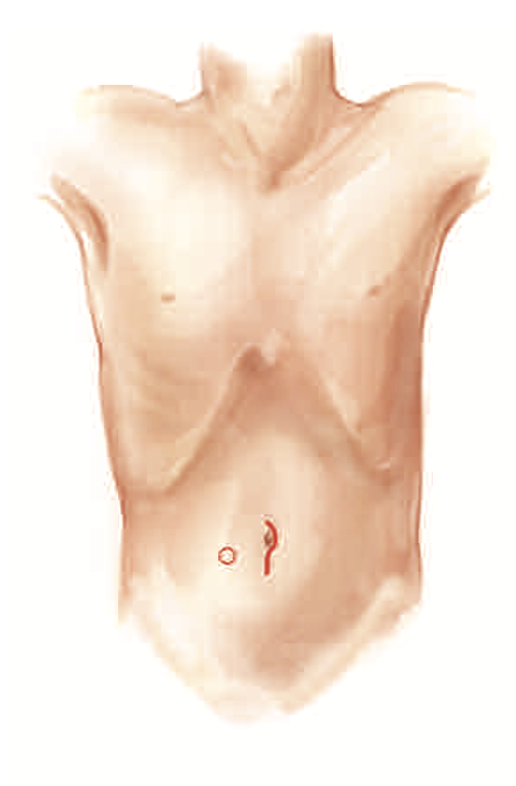
Preoperative Siting
Place within rectus muscle reduces hernia
Away from scars creases prominences areas
Visible to patient for self care
Mark standing sitting lying positions

Slide 11
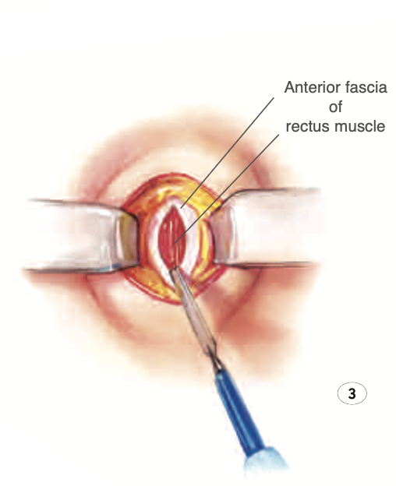
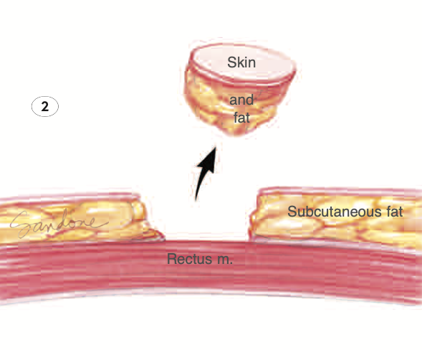
Surgical Technique
Excise skin disc create trephine opening
Split rectus muscle avoid excision
Deliver bowel without tension twist
Evert mucosa form spout Brooke technique

Slide 12
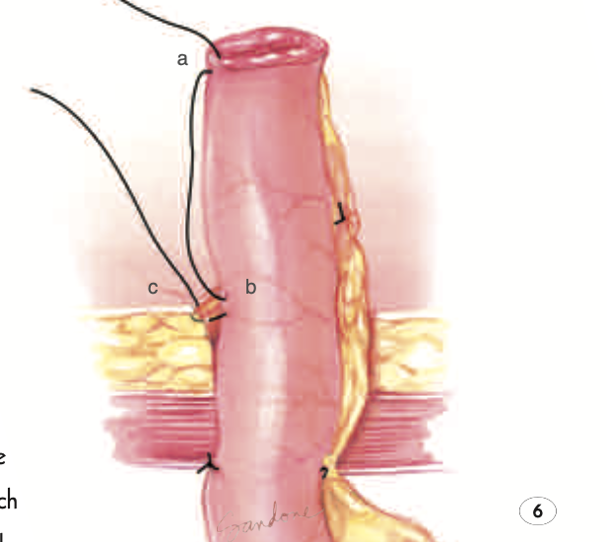
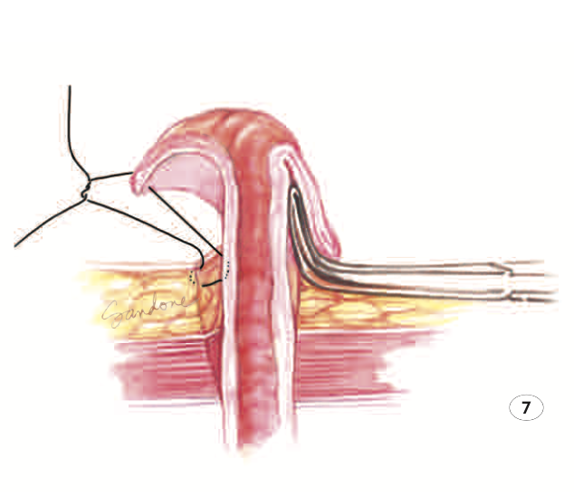

Slide 13
Early Complications
Ischemia necrosis urgent surgical intervention
Retraction causes leakage skin excoriation
Mucocutaneous separation wound dehiscence occurs
High output leads dehydration electrolyte imbalance

Slide 14
Late Complications
Parastomal hernia most common complication
Prolapse more common loop stomas
Stenosis narrowing causes obstructed output
Skin excoriation due leakage irritation

Slide 15
Stoma Care
Use one piece two piece appliances
Drainable bags ileostomy closed colostomy
Skin barriers prevent irritation breakdown
Educate patient before hospital discharge

Slide 16
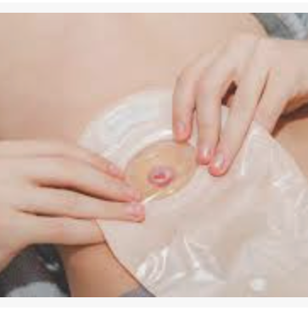
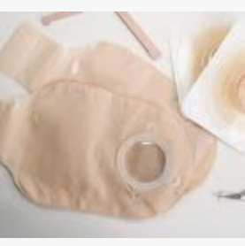
Care

Slide 17
Reversal
Performed after eight to twelve weeks
Ensure distal bowel patency intact
Patient medically fit nutritionally optimized
Risk leak obstruction infection present

Slide 18
Summary
Stomas lifesaving procedures require expertise
Proper siting reduces complications significantly
Ileostomy spouted colostomy flush distinction
Patient education essential quality life

Slide 19
Clinical Scenario
Postoperative patient develops wound discharge
Feculent fluid drains abdominal incision site
Patient has fever dehydration imbalance
What is diagnosis and management

Slide 20
A 52-year-old man underwent emergency laparotomy for small bowel obstruction 10 days ago. On day 8, he developed wound discharge of greenish fluid with a feculent odor. Output is approximately 400 mL/24 hours. He is pyrexial (38.2°C) with tachycardia. What is the most likely diagnosis?

Slide 21
Learning Outcomes
Define enterocutaneous fistula clearly
Classify fistula based on output
Explain pathophysiology clinical features
Outline investigations and management

Slide 22
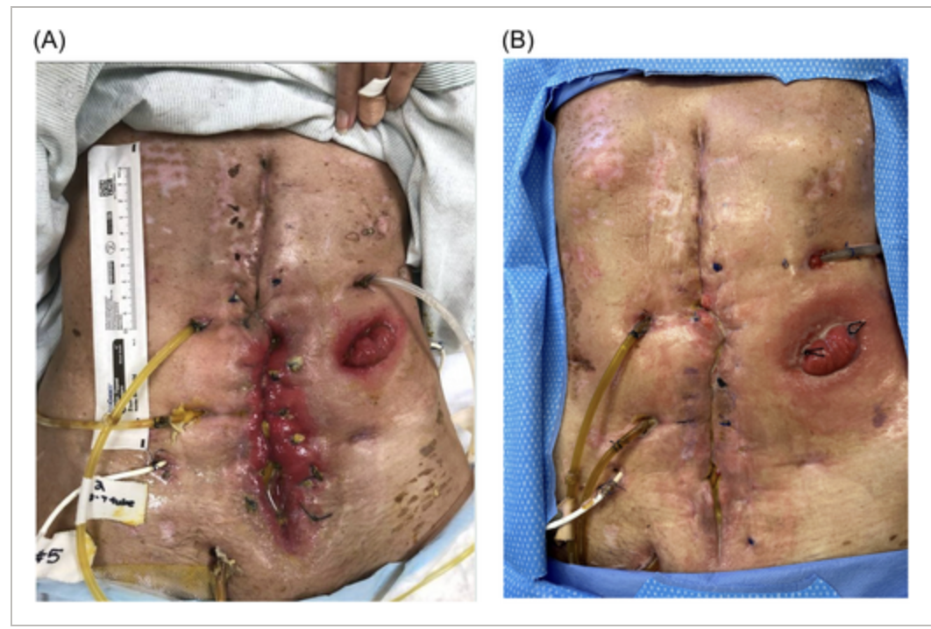

Slide 23
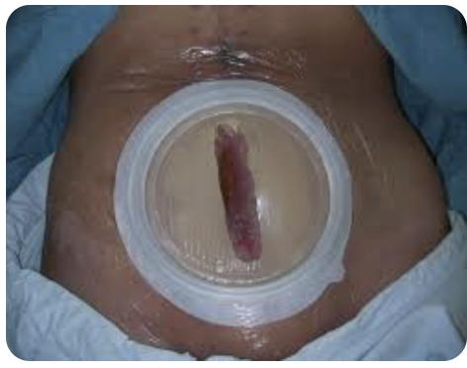

Slide 24
Definition
Abnormal communication bowel and skin
Allows leakage intestinal contents externally
Fecal fistula involves distal bowel
Output varies with anatomical origin

Slide 25
Classification
Low output less than two hundred
Moderate output two to five hundred
High output greater than five hundred
Simple complex based on abscess

Slide 26
Etiology
Postoperative cause most common seventy percent
Anastomotic leak frequent mechanism
Crohn disease common nonoperative cause
Radiation malignancy infection also causes

Slide 27
FRIENDS
F. Foreign body
R. Radiations
I. infections
E. Epithelization
N. Neoplasia
D. Distal obstruction
S. Specific Infections Tb Actinomycosis Crohns

Slide 28
Pathophysiology Diagram
Bowel disruption occurs
Abscess formation develops
Track forms toward skin
Epithelialization prevents closure

Slide 29
Systemic Effects
Fluid loss leads dehydration hypovolemia
Malnutrition due protein loss ongoing
Sepsis major cause mortality patients
Immune suppression worsens outcomes

Slide 30
Clinical Features
Feculent discharge from wound site
Skin excoriation around fistula opening
Fever tachycardia systemic sepsis signs
Weight loss malnutrition common findings

Slide 31
SNAP Approach
Sepsis control drainage antibiotics
Nutrition support essential healing
Anatomy defined by imaging
Procedure planned after optimization

Slide 32
Investigations
Blood tests show infection imbalance
Electrolytes reveal sodium potassium losses
Albumin indicates nutritional status
CRP elevated inflammatory activity

Slide 33
Imaging Overview
CT scan identifies abscess tract
Fistulography shows communication
Endoscopy detects pathology
Defines anatomy before surgery

Slide 34
Medical Management
Fluid resuscitation correct dehydration
Antibiotics treat sepsis effectively
Octreotide reduces fistula output
Skin care prevents complications

Slide 35
Nutrition
Enteral feeding preferred if possible
TPN used if bowel inaccessible
Protein increased for healing
Maintain albumin above three grams

Slide 36
Surgical Management
Indicated if fistula fails closure
Resection with anastomosis performed
Adhesiolysis before fistula excision
Delay surgery until optimized

Slide 37
Viva Points
Most fistulas postoperative origin
Closure occurs within six weeks
Sepsis leading cause mortality
FRIEND mnemonic predicts nonclosure

Slide 38
A 58-year-old man underwent emergency Hartmann's procedure for perforated sigmoid diverticulitis 3 days ago. The end-colostomy in the left iliac fossa appears dark purple to black in colour. The patient is haemodynamically stable. What is the most likely complication?
Stoma prolapse
B) Stoma ischaemia
C) Stoma retraction
D) Parastomal hernia
E) Normal appearance for day 3
Key B

Slide 39
A 45-year-old woman with an end-ileostomy in the right iliac fossa (formed 8 months ago) complains of difficulty with appliance adherence and frequent leakage causing severe skin excoriation around the stoma. Examination shows the stoma is flush with the skin level. What is the most likely complication?
A) Stoma stenosis
B) Stoma prolapse
C) Stoma retraction
D) Parastomal hernia
E) Stoma ischaemia
C) Stoma retraction

Slide 40
A 62-year-old man with a permanent end-colostomy presents 18 months post-surgery with a bulge around the stoma. The bulge increases with coughing and straining. The stoma functions normally. What is the most likely diagnosis?
A) Stoma prolapse
B) Parastomal hernia
C) Stoma stenosis
D) Rectus sheath haematoma
E) Stoma granuloma
B) Parastomal hernia

Slide 41
A 55-year-old woman presents 3 years after formation of loop ileostomy with increasing length of protruding bowel through the stoma opening. She reports the bowel protrudes 8-10 cm and is difficult to reduce. The bowel appears viable and pink. What is the most appropriate initial management?
A) Emergency laparotomy
B) Manual reduction and observation
C) Urgent stoma revision
D) Application of sugar to reduce oedema
E) No treatment needed if viable
B) Manual reduction and observation

Slide 42
A 52-year-old man underwent emergency laparotomy for small bowel obstruction 10 days ago. On day 8, he developed wound discharge of greenish fluid with a feculent odor. Output is approximately 400 mL/24 hours. He is pyrexial (38.2°C) with tachycardia. What is the most likely diagnosis?
A) Wound infection with seroma
B) Postoperative enterocutaneous fistula
C) Anastomotic leak with peritonitis
D) Rectus sheath abscess
E) Normal postoperative wound drainage
B) Postoperative enterocutaneous fistula

Slide 43
A 62-year-old man with high-output enterocutaneous fistula (proximal jejunum) is being managed conservatively. Blood tests show: Na+ 126 mmol/L, K+ 2.6 mmol/L, Mg2+ 0.4 mmol/L, albumin 22 g/L. What is the MOST important immediate intervention?
A) Start octreotide infusion
B) Emergency surgical closure
C) Intravenous fluid and aggressive electrolyte replacement
D) Increase oral fluid intake
E) Start total parenteral nutrition
C) Intravenous fluid and aggressive electrolyte replacement

