Slide 1
بِسْمِ اللَّهِ الرَّحْمَٰنِ الرَّحِيمِ

Slide 2
Prof. Dr. Zahid Mahmood
Professor of Surgery, Lahore Medical and Dental College
CYST
1

Slide 3
Learning Outcomes
Define a cyst and a pseudocyst
Classify cysts by origin and cause
Describe clinical features of cystic swellings
Outline management of common surgical cysts
2

Slide 4
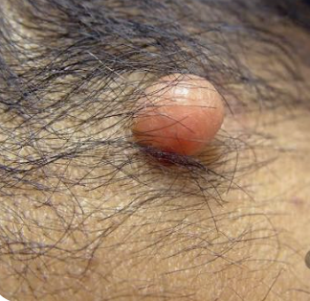
Definition of a Cyst
Abnormal sac containing fluid or semisolid material
Lined internally by epithelium or endothelium
Enclosed by a fibrous connective tissue wall
Can occur in almost any body tissue
3

Slide 5
Structure of a True Cyst
Outer fibrous capsule gives structural support
Inner epithelial or endothelial lining present
Central cavity filled with fluid or debris
Lining cells secrete or absorb cyst contents
4

Slide 6
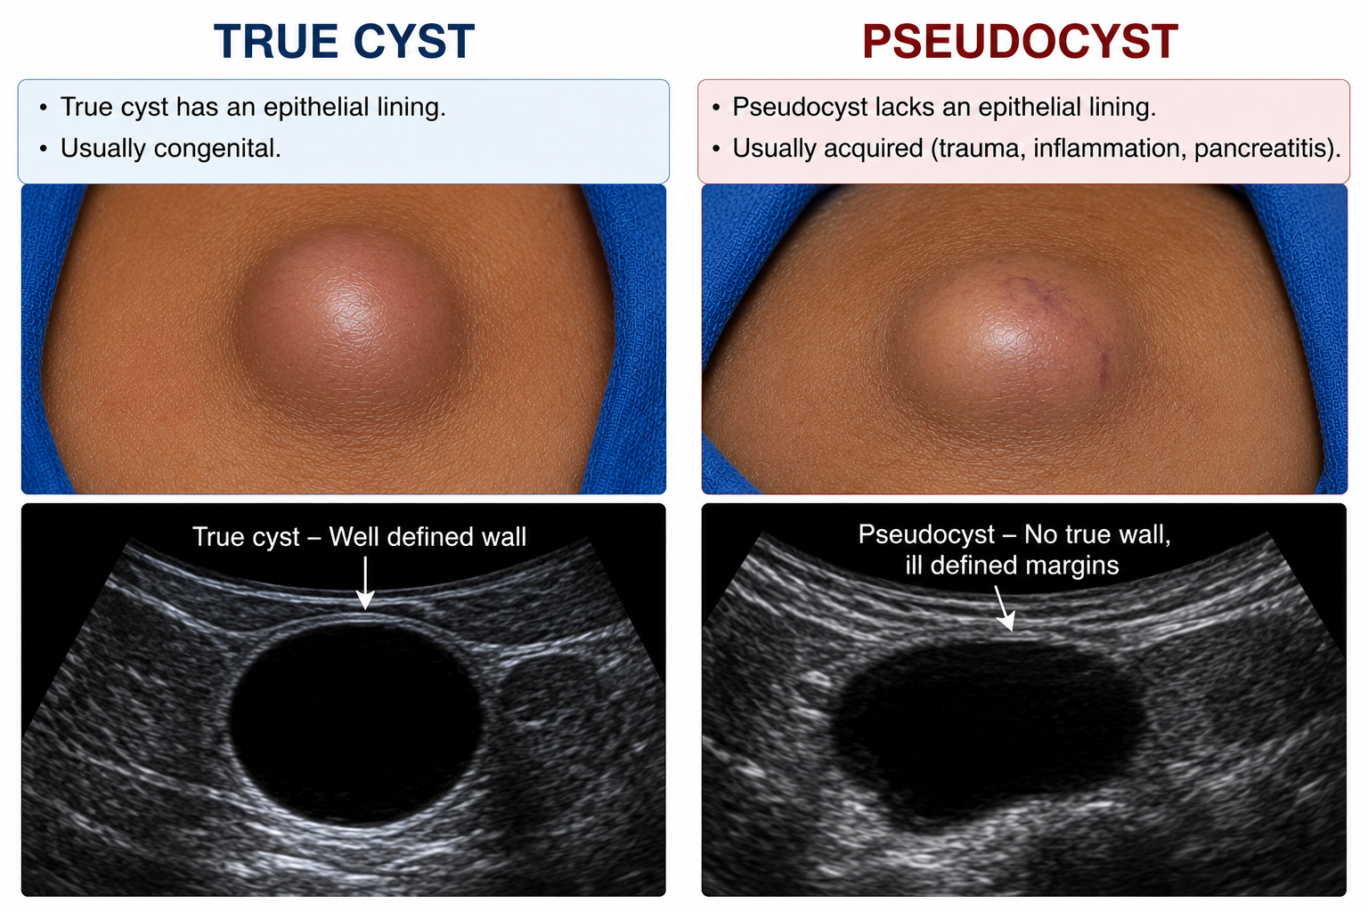
True Cyst vs Pseudocyst
True cyst always has an epithelial lining
Pseudocyst lacks any true epithelial lining
Pseudocyst wall is made of fibrous tissue
Example: a pancreatic pseudocyst after acute pancreatitis
5

Slide 7
Classification of Cysts
Congenital cysts are present since birth
Acquired cysts develop later during life
Acquired types: retention, exudation, implantation, parasitic
Neoplastic and degenerative cysts complete the list
6

Slide 8
Congenital Cysts: Overview
Result from abnormal embryological development
Common examples: dermoid, branchial, thyroglossal cysts
Cystic hygroma is also a congenital lesion
Often noticed early in childhood
7

Slide 9
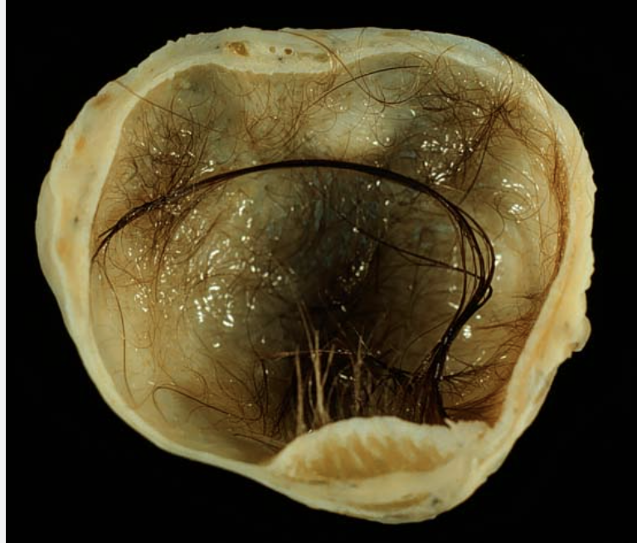
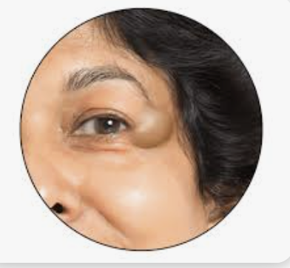
Dermoid Cyst
Congenital inclusion cyst along embryonic fusion lines
Contains skin appendages: hair, sebum, sometimes teeth
Common sites: face, scalp, neck, ovary
Treated by complete surgical excision
8

Slide 10
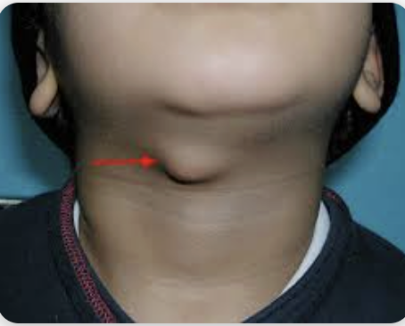
Thyroglossal Cyst
Arises from remnants of the thyroglossal duct
Found in the midline of the neck
Characteristically moves upward on tongue protrusion
Treated with Sistrunk's operation
9

Slide 11
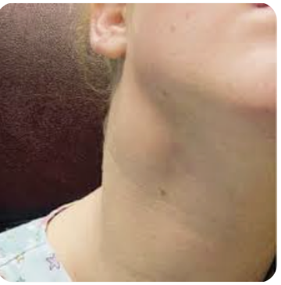
Branchial Cyst
Develops from branchial cleft remnants
Found along anterior border of sternocleidomastoid muscle
Typically presents in young adults
Managed by complete surgical excision
10

Slide 12
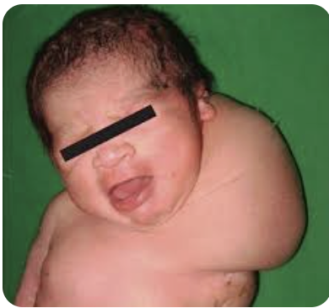
Cystic Hygroma
Congenital malformation of lymphatic vessels
Commonly found in the posterior triangle of neck
Soft, fluctuant, and brilliantly transilluminant swelling
Treated with sclerotherapy or surgical excision
11

Slide 13
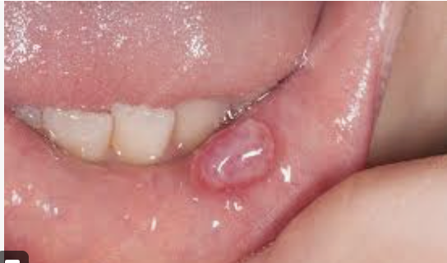
Acquired Cysts: Overview
Retention cysts follow a blocked gland duct
Exudation cysts collect fluid, e.g. hydrocele
Implantation cysts trap epithelium after injury
Parasitic and neoplastic cysts are also acquired
Prof. Dr. Zahid Mahmood | Surgery | BDS Lecture: Cyst
12

Slide 14
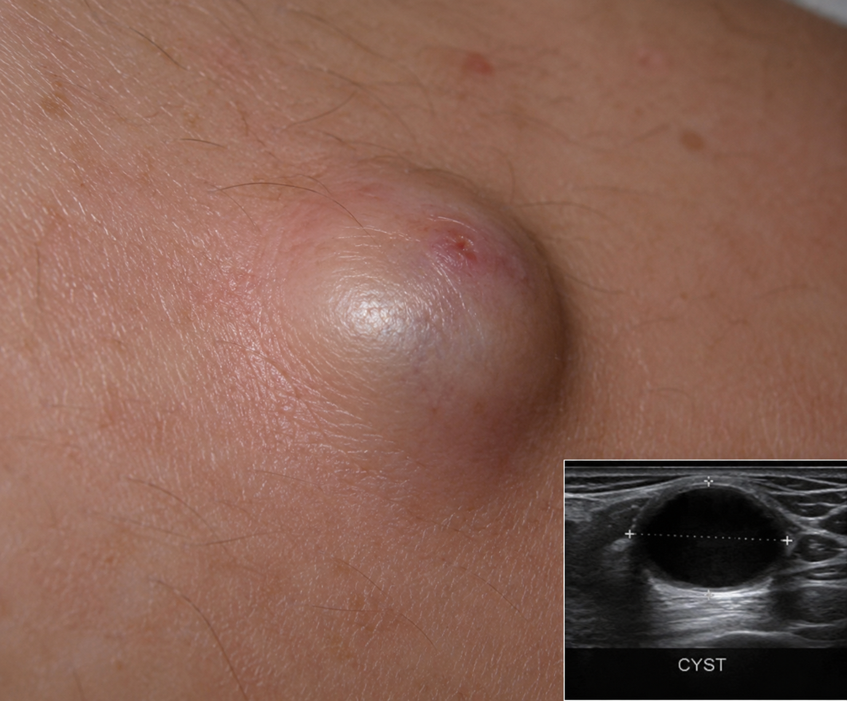
Sebaceous (Epidermoid) Cyst
Caused by a blocked sebaceous gland duct
Common on the scalp, face, and back
Contains cheesy, foul-smelling sebaceous material
Treated by complete surgical excision
13

Slide 15
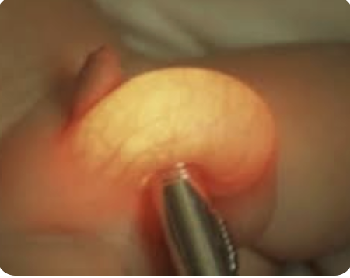
Exudation Cyst: Hydrocele
Fluid accumulates within the tunica vaginalis
Presents as a painless scrotal swelling
Brilliantly transilluminant on clinical examination
Managed by hydrocelectomy when symptomatic
14

Slide 16
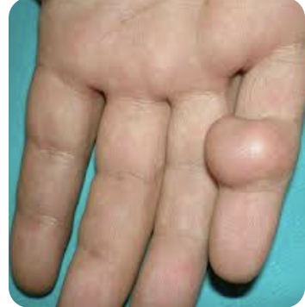
Implantation Cyst
Surface epithelium implanted into deeper tissue
Usually follows a penetrating injury or surgery
Common on fingers, palms, and soles
Treated with simple surgical excision
15

Slide 17
Parasitic Cyst: Hydatid Disease
Caused by the Echinococcus granulosus tapeworm
Most commonly affects the liver and lungs
Diagnosed using ultrasound and serological tests
Treated with surgery plus albendazole therapy
16

Slide 18
Neoplastic Cyst
Arises from a cystic tumour formation
Example: cystadenoma of the ovary
May occasionally undergo malignant transformation
Requires careful histopathological evaluation
17

Slide 19
Clinical Features of a Cyst
Usually a painless, slow-growing swelling
Smooth surface with well-defined edges
Soft to firm consistency, fluctuant on palpation
Becomes tender and red if infected
18

Slide 20
Examination of a Cystic Swelling
Inspect the site, size, and surface
Palpate for fluctuation, consistency, and tenderness
Test for transillumination if superficial and tense
Check fixity to skin and deeper structures
19

Slide 21
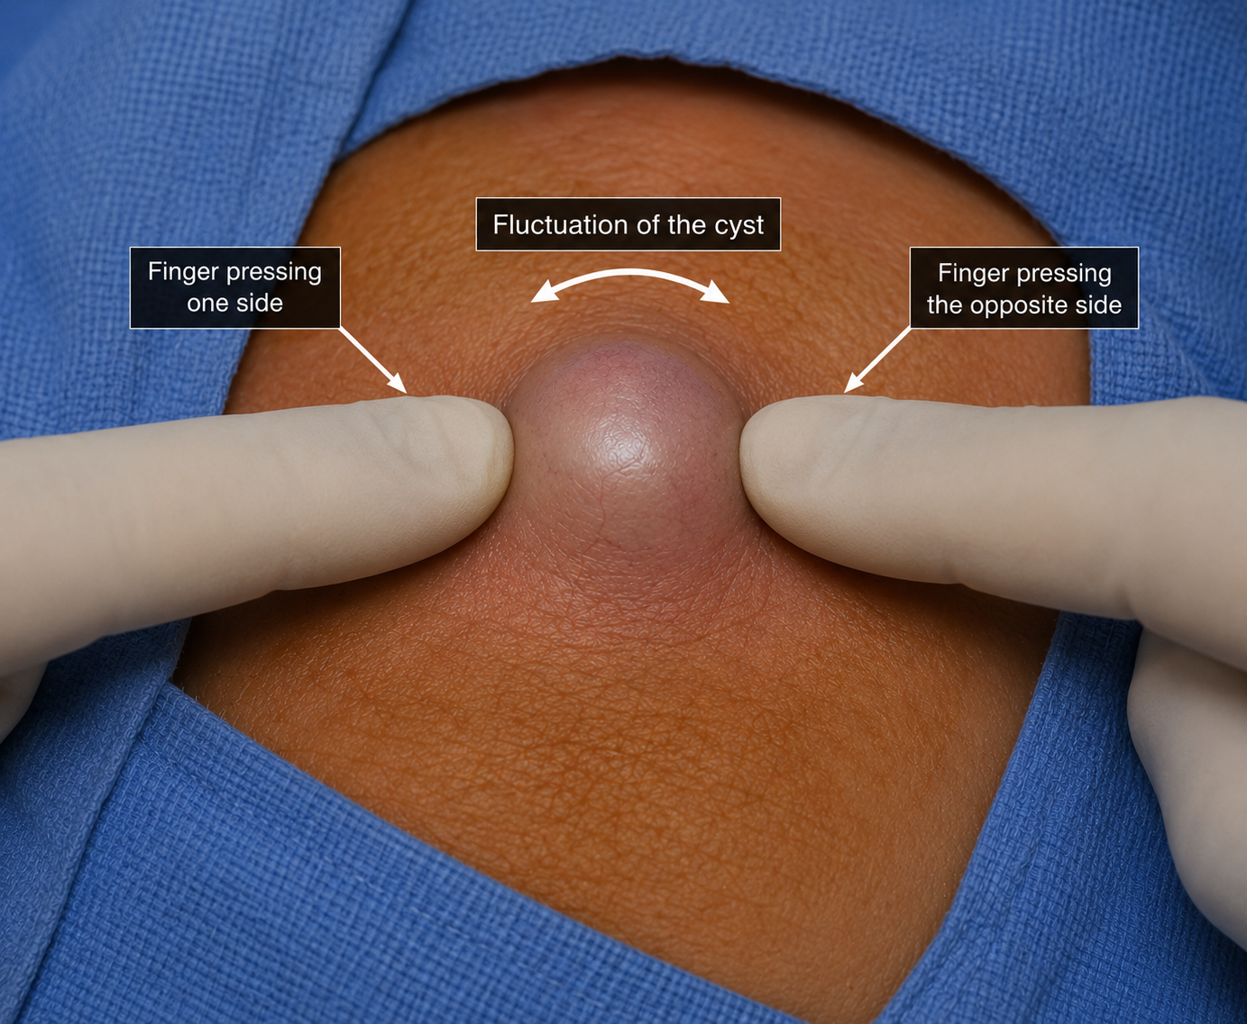
Fluctuation Test
Confirms the presence of fluid content
Performed using Paget's two-finger method
Positive in almost all true cysts
Helps differentiate a cyst from a solid mass
20

Slide 22
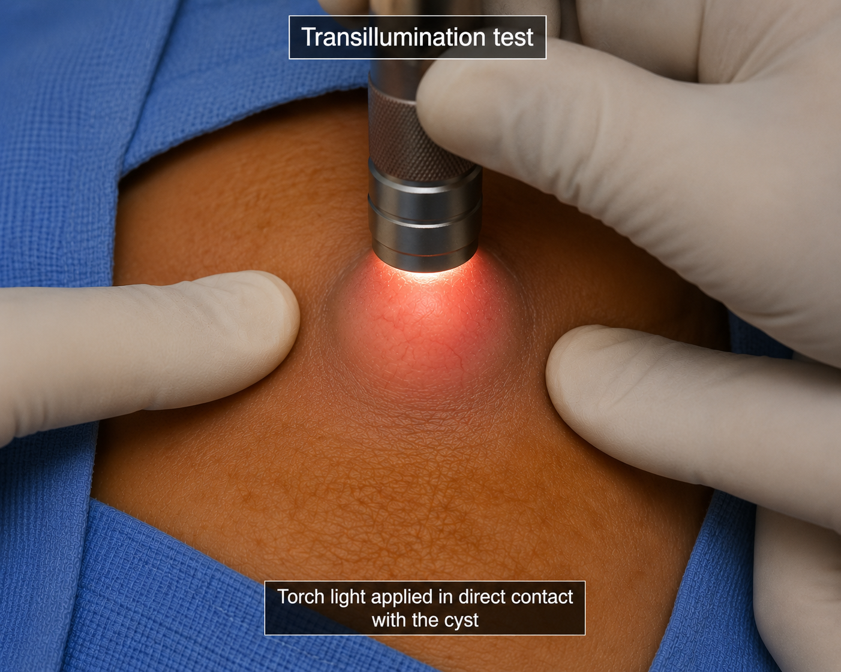
Transillumination Test
Light is passed through the swelling in darkness
Positive in clear, fluid-filled cysts
Hydrocele and cystic hygroma are classically positive
Negative in solid or blood-filled lesions
21

Slide 23
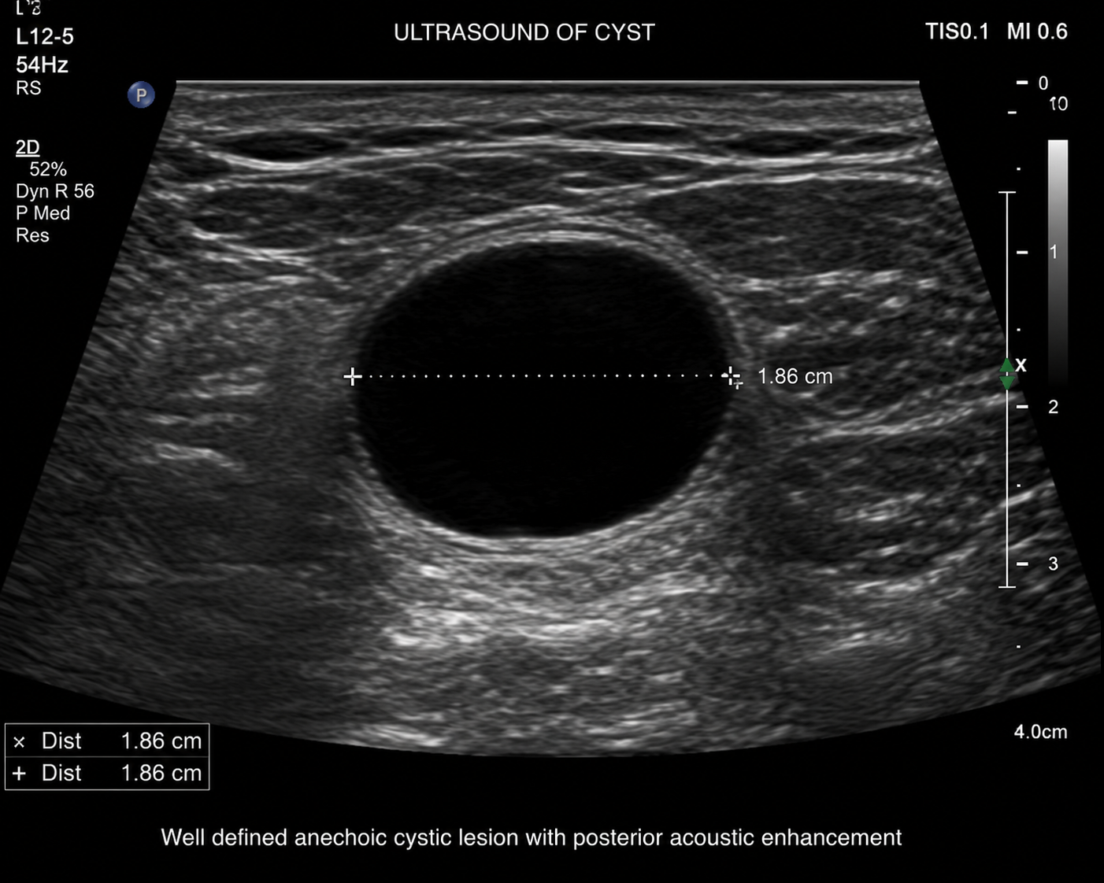
Investigations
Ultrasound confirms cystic versus solid nature
FNAC allows analysis of cyst fluid content
CT or MRI used for deep-seated cysts
Serology is useful for suspected parasitic cysts
22

Slide 24
Complications of Cysts
Infection may lead to abscess formation
Haemorrhage can occur into the cyst cavity
Rupture causes surrounding tissue inflammation
Rare malignant change in long-standing cysts
23

Slide 25
Principles of Management
Small, asymptomatic cysts may simply be observed
Complete surgical excision is the definitive treatment
Marsupialization is used for large pancreatic pseudocysts
Treating the underlying cause prevents recurrence
24

Slide 26
Summary
Cyst: a fluid-filled sac with epithelial lining
Classified as congenital, acquired, or neoplastic
Diagnosed clinically and confirmed with imaging
Treated mainly by complete surgical excision
25

Slide 27
Quick Recap Quiz
1. Which test confirms a fluid-filled swelling?
2. Name a congenital cyst found in the midline neck.
3. Which organism causes hydatid cyst disease?
4. What is the definitive treatment for a sebaceous cyst?
26

Slide 28
Q1. A 25-year-old man presents with a smooth swelling on the right side of his neck, at the junction of the upper and middle thirds of the sternomastoid muscle. It is soft, fluctuant and transilluminates. He has had it for 2 years. What is the most likely diagnosis?
A. Thyroglossal cyst
B. Branchial cyst
C. Cystic hygroma
D. Sebaceous cyst
E. Lymph node abscess
Key: B

Slide 29
Q2. A 10-year-old boy has a midline neck swelling since birth. On examination, the swelling moves upward when he swallows and also when he protrudes his tongue. There is no tenderness. What is the most likely diagnosis?
A. Branchial cyst
B. Lipoma of neck
C. Thyroglossal duct cyst
D. Lymph node enlargement
E. Dermoid cyst
Key: C

Slide 30
Q3. A neonate is born with a large, soft, bilateral neck swelling. On examination it is soft, partially compressible, and when a torch is placed against it, it glows brilliantly. It increases in size when the baby cries. What is the diagnosis?
A. Branchial cyst
B. Thyroglossal cyst
C. Cystic hygroma
D. Thyroid goitre
E. Lymph node cyst
Key: C

Slide 31
Q4. A 30-year-old woman has a small swelling on her scalp present for 5 years. On examination there is a 2 cm smooth, mobile swelling with a small dark spot in the centre. It is non-tender. What is the MOST characteristic feature of this cyst?
A. Brilliant transillumination
B. Movement on swallowing
C. Central punctum
D. Turbid fluid on aspiration
E. Attachment to deep fascia
Key: C

Slide 32
Q5. A surgeon excises a sebaceous cyst but leaves behind a small piece of its wall. Six months later the patient returns with a new swelling at the same site. What is the most likely reason for recurrence?
A. Inadequate antibiotic cover given
B. Failure to excise the cyst wall completely
C. Incision made in the wrong direction
D. Cyst was infected at time of surgery
E. Patient had underlying diabetes mellitus
Key: B

Slide 33
Q6. A 20-year-old female presents with a soft swelling beneath her chin in the midline. She was previously treated for a discharging sinus in the neck. Ultrasound confirms a cystic lesion. Surgery must include which of the following?
A. Excision of cyst only
B. Total thyroidectomy with cyst
C. Removal of body of hyoid bone
D. Drainage and marsupialisation
E. Aspiration and sclerotherapy only
Key: C

Slide 34
Q7. A 28-year-old woman notices a lump on the dorsum of her right wrist for 3 months. It is smooth, soft and brilliantly transilluminates. It occasionally causes discomfort on gripping. What is the most common treatment option offered first?
A. Wide local excision with margins
B. Incision and drainage of cyst
C. Aspiration or surgical excision
D. Sclerotherapy injection
E. Radiotherapy to the wrist
Key: C

Slide 35
Q8. A 45-year-old man with a 3-year history of a painless neck lump presents to a surgeon. The surgeon suspects a branchial cyst but the patient is 47 years old. What is the most important next step before surgical excision?
A. CT chest to look for lung metastasis
B. Exclude malignancy — necrotic lymph node
C. Prescribe antibiotics for 6 weeks first
D. Immediate surgical excision under GA
E. Wait and watch for 6 more months
Key: B

Slide 36
Q9. A pathology specimen shows a cyst containing hair, teeth and sebaceous material. The cyst wall is lined by all three germ layers. The specimen was removed from the ovary of a 22-year-old female. What type of cyst is this?
A. Retention cyst
B. Implantation dermoid
C. Branchial cyst
D. Teratomatous dermoid (teratoma)
E. Parasitic hydatid cyst
Key: D

Slide 37
Q10. A surgeon is examining a patient with a 2 cm swelling on the outer corner of the right eye present since childhood. It is smooth, non-tender and mobile. It does not transilluminate. It arises at an embryonic fusion line. What type of cyst is this?
A. Sebaceous cyst
B. Congenital dermoid cyst
C. Implantation dermoid
D. Branchial cyst
E. Cystic hygroma
Key: B

Slide 38
Thank You
Moral Lesson for a Surgeon
Not every swelling is cancer — but never assume
Incomplete excision today means operation again tomorrow
Observe carefully — a moving lump is a telling lump
In surgery, thoroughness is the mark of excellence

Slide 39

“To heal is a gift; to understand disease is the trust that makes healing possible.”
Thank You
Prof. Dr. Zahid Mahmood
Professor of Surgery, Lahore Medical and Dental College
Contact: 0300-4130159
WhatsApp Channel: whatsapp.com/channel/0029VbBCHkr65yDCqesAB739
Prof. Dr. Zahid Mahmood | Surgery | BDS Lecture: Cyst
27

