Slide 1
بِسْمِ اللّٰهِ الرَّحْمٰنِ الرَّحِيْمِ

Slide 2
Condylomata Acuminata, AIN & Anal Malignancies
Prof. Zahid Mahmood

Slide 3
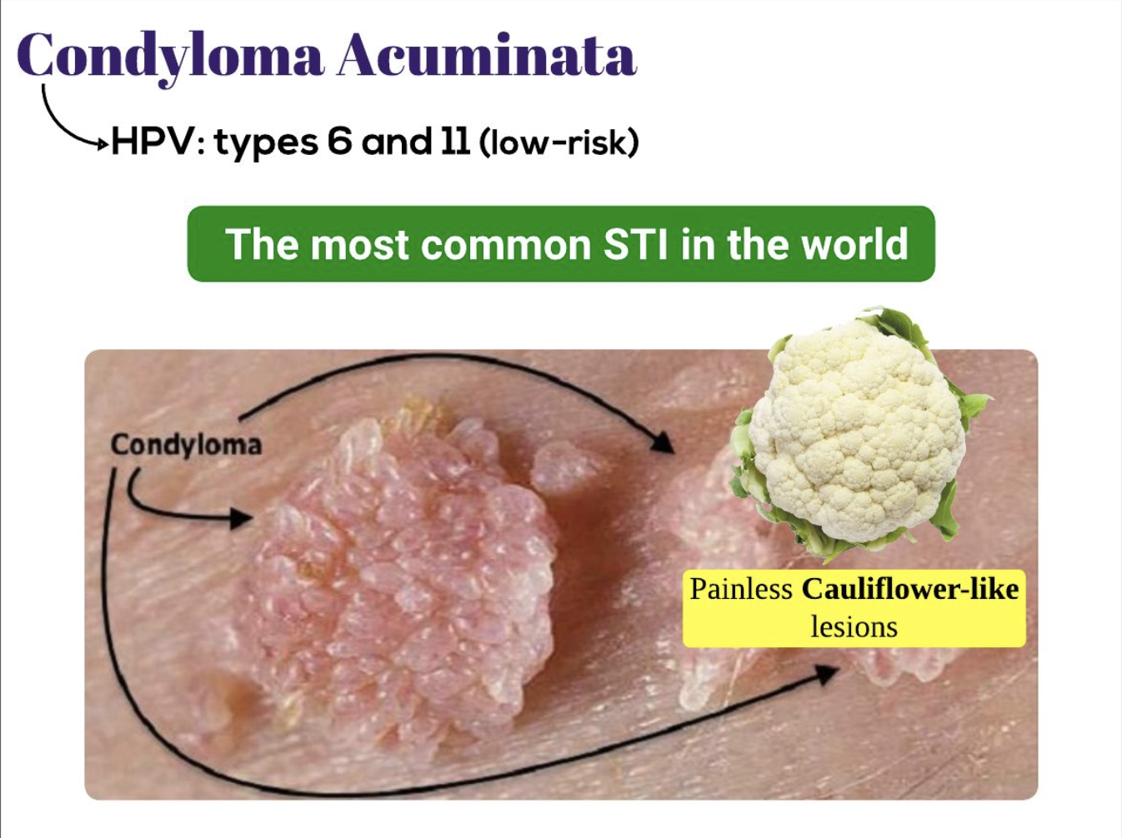

Slide 4
Learning Outcomes
Describe etiology & epidemiology of anal warts & HPV-related lesions
Recognize clinical features of Condylomata, AIN, and anal malignancy
Outline diagnostic approaches and key investigations
Discuss complications including dysplasia and carcinoma
Summarize latest management strategies

Slide 5
Clinical Scenario
A 35-year-old male, known case of HIV infection on antiretroviral therapy, presents to the surgical outpatient department with a 6-month history of perianal discomfort, intense pruritus, and intermittent bleeding per rectum. He also reports noticing multiple small growths around his anal margin which have gradually increased in size and number. The lesions occasionally become painful, especially during defecation, and stain his undergarments with blood.

Slide 6
On examination, there are multiple coalescent verrucous lesions carpeting the entire anal margin and extending into the anal canal, consistent with extensive Condylomata acuminata. The lesions are friable, bleed on touch, and some show superficial ulceration. No inguinal lymphadenopathy is palpable. Digital rectal examination reveals thickening of the anal canal mucosa, though no obvious deep mass is felt.

Slide 7
Given his HIV-positive status, immunosuppression, and extensive perianal warty growths, the patient is at significant risk for anal intraepithelial neoplasia (AIN) and squamous cell carcinoma (SCC) of the anal canal.

Slide 8
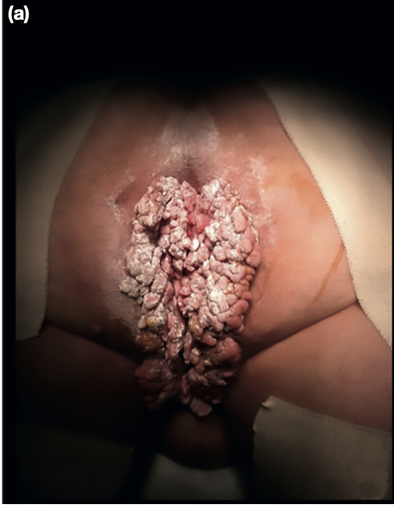

Slide 9
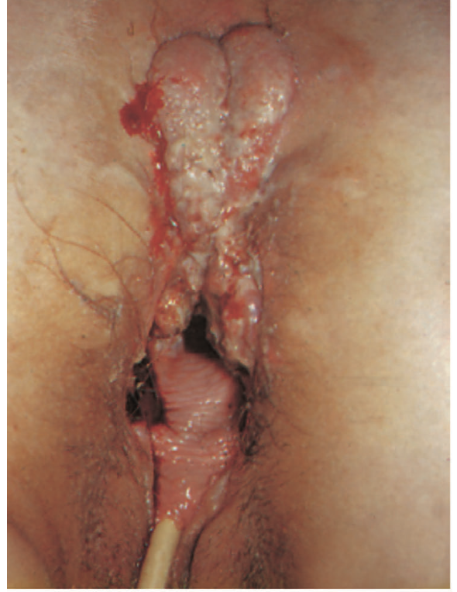

Slide 10
Introduction
HPV is major etiological factor (>170 subtypes).
Oncogenic subtypes: 16, 18, 31, 33.
Field change phenomenon: virus affects squamous epithelium.
Associated with VIN, CIN, SCC.

Slide 11
Epidemiology
Rising incidence in last 30 years.
Common in HIV+ and immunocompromised individuals.
Associated with anal intercourse, cervical/vulval dysplasia in women.
Anal malignancy: <2% of colorectal cancers.

Slide 12
Clinical Features: Condylomata
Often asymptomatic.
Symptoms: pruritus, discharge, bleeding, pain.
Early: small pinkish-white perianal warts.
Late: coalescent lesions, giant condyloma (Buschke–Löwenstein).

Slide 13
Diagnosis
Aceto-whitening with acetic acid.
Biopsy confirms diagnosis, rules out dysplasia/carcinoma.
Screen genitalia/perineum for field change.
Anal cytology in high-risk groups.

Slide 14
Anal Intraepithelial Neoplasia (AIN)
HPV-related dysplastic lesion.
Subtypes 6 & 11: warts/early AIN.
Subtypes 16 & 18: >75% of anal cancers.
Classification: AIN I, AIN II, AIN III.

Slide 15
Clinical Features: AIN
Often asymptomatic, found on histology.
Symptoms: pruritus, pain, bleeding, discharge.
Lesions: flat/raised, irregular pigmentation.
AIN III → carcinoma risk ~10% at 5 years.

Slide 16
Investigations
Examination under anaesthesia + biopsy (mapping 8–12).
Anal colposcopy with acetic acid & Lugol’s iodine.
MRI, CT, PET-CT for staging.
Yearly cervical smear in women with AIN.

Slide 17
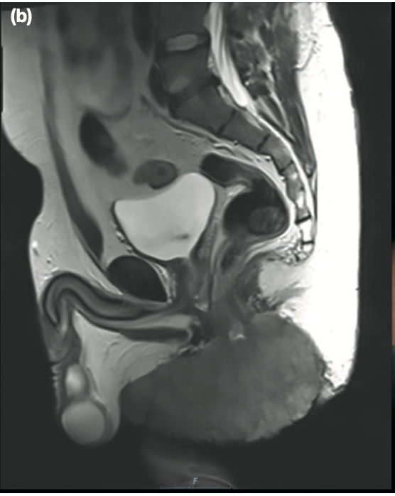

Slide 18
Complications
Progression from AIN → carcinoma.
Recurrent warts due to field change.
Anal stenosis after extensive excision.
Malignant transformation (HPV 16/18 related).

Slide 19
Management
Condylomata: Podophyllin topical, surgical excision.
AIN: <30% excised, >30% observed or topical (Imiquimod, retinoids).
Anal cancer: Chemoradiotherapy (Nigro protocol).
Surgery (APR, pelvic exenteration) for salvage.

Slide 20
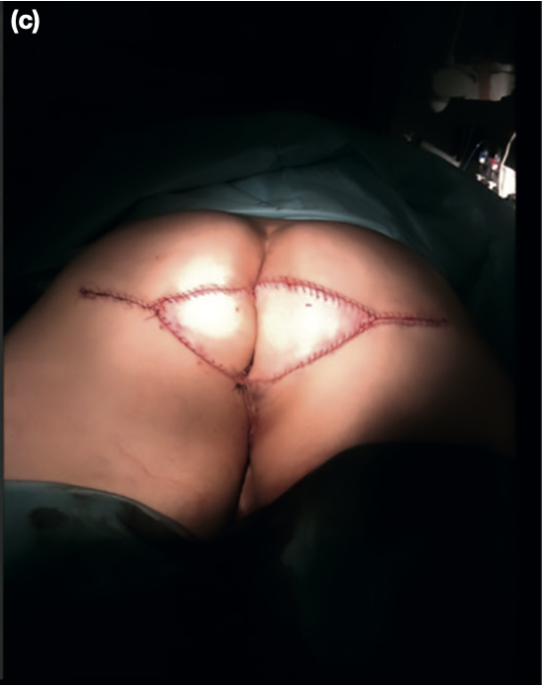

Slide 21
Latest Advances
HPV vaccination reduces incidence.
PET-CT for staging & nodal assessment.
Topical imiquimod, oral retinoids for dysplasia regression.
ACT trials: personalized treatment protocols.

Slide 22
Management – Staging Investigations
MRI pelvis → assesses local extent & sphincter involvement
CT chest/abdomen/pelvis → distant staging
PET-CT → helpful in equivocal inguinal node assessment

Slide 23
Management – Standard of Care
Historically: Abdominoperineal resection (APR) was primary treatment
Since 1970s: Chemoradiotherapy (Nigro protocol) became standard
UKCCCR ACT I: Chemoradiation > Radiotherapy alone
ACT II: Mitomycin + 5-FU vs Cisplatin + 5-FU → similar outcomes
Preferred: Mitomycin + 5-FU (shorter infusion, better tolerated)

Slide 24
Management – Current Trials
ACT III–V: Investigating personalized protocols
Local excision for small tumors
Combination of excision and radiotherapy regimes
Aim: More tailored and less mutilating treatments

Slide 25
Management – Role of Surgery
Indications: residual tumor, recurrence, complications (fistula, incontinence)
APR as salvage procedure after failed chemoradiation
Pelvic exenteration for extensive disease
Often requires myocutaneous flap reconstruction

Slide 26
Management – Lymph Nodes
Inguinal nodes may be reactive or malignant
Histology/cytology mandatory for confirmation
Positive nodes: treated with chemoradiotherapy
Radical groin dissection: high morbidity, limited role

