Slide 1



Introduction to Cleft Lip and Palate
Cleft lip and palate are common congenital birth defects that occur when the lip or palate (roof of the mouth) do not form properly during fetal development. This can lead to functional and aesthetic challenges, but with proper treatment, individuals with clefts can live healthy, fulfilling lives.
by Prof.Zahid Mahmood

Slide 2
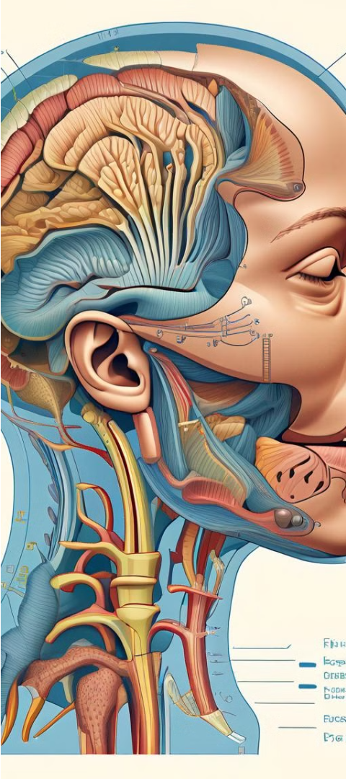
Anatomy and Embryology
1
Lip Formation
The lips form between the 4th and 7th weeks of pregnancy when the medial nasal and maxillary processes fuse. Clefts occur when this fusion fails to complete.
2
Palate Formation
The palate develops between the 6th and 12th weeks. The two palatal shelves grow towards each other and fuse, creating the roof of the mouth. Clefts occur when this fusion is incomplete.
3
Complex Process
Cleft lip and palate involve a complex interplay of genetic and environmental factors that disrupt normal facial development. Understanding the anatomy is key to effective treatment.

Slide 3
Types of Cleft Lip and Palate
Cleft Lip
Cleft Palate
Combined Clefts
A partial or complete gap in the upper lip, ranging from a small notch to a complete separation extending into the nose.
An opening or split in the roof of the mouth, which can involve the hard palate (bony front), soft palate (muscular back), or both.
A cleft that includes both the lip and palate, often the most complex type requiring coordinated, staged surgical repair.

Slide 4
Epidemiology and Risk Factors
1
Incidence
2
Genetic Factors
Cleft lip and/or palate occur in about 1 in 700 live births worldwide, with variations across ethnicities and geographic regions.
Specific genetic mutations and chromosomal abnormalities can increase the risk of cleft lip and palate.
3
Environmental Factors
4
Associated Conditions
Maternal exposure to toxins, medications, infections, and nutritional deficiencies during pregnancy can also contribute to the development of clefts.
Cleft lip and palate can occur as part of broader genetic syndromes or in isolation as an independent birth defect.

Slide 5
Clinical Presentation and Diagnosis
Physical Exam
Feeding Challenges
Clefts are usually visible at birth, allowing for early diagnosis and treatment planning. A thorough physical exam can assess the extent of the defect.
Infants with cleft palate may have difficulty sucking and swallowing, requiring specialized feeding techniques and equipment.
Imaging Studies
Multidisciplinary Care
Ultrasound, CT, and MRI scans can provide detailed information about the anatomy and severity of the cleft to guide surgical planning.
A team of specialists, including plastic surgeons, oral/maxillofacial surgeons, pediatricians, speech therapists, and social workers, collaborates to provide comprehensive care.

Slide 6



Principles of Surgical Management
Timing
Techniques
Multidisciplinary Approach
Cleft lip repair is typically performed at 3-6 months, and cleft palate repair at 6-12 months to optimize functional and aesthetic outcomes.
Specialized surgical techniques, such as Millard's rotation-advancement for cleft lip and von Langenbeck's for cleft palate, are used to close the defect.
A collaborative team of surgeons, dentists, speech therapists, and other specialists work together to provide comprehensive, coordinated care.

Slide 7




Timing and Techniques of Cleft Lip and Palate Repair
Cleft Lip Repair
Cleft Palate Repair
Surgical Techniques
Multidisciplinary Care
Performed at 3-6 months to optimize appearance and function.
Performed at 6-12 months to allow for proper speech development.
Using specialized methods like Millard's rotation-advancement and von Langenbeck's palate repair.
Collaboration between surgeons, dentists, speech therapists, and other specialists.

Slide 8
Complications and Long-Term Outcomes
Complications
Feeding difficulties, speech and language delays, dental and orthodontic issues, hearing problems, and psychosocial challenges.
Long-Term Outcomes
With comprehensive, multidisciplinary care, individuals with cleft lip and palate can lead healthy, fulfilling lives with good speech, appearance, and social integration.

