Slide 1
بِسْمِ اللّٰهِ الرَّحْمٰنِ الرَّحِيْم
CIRCUMCISION
Indications, Techniques & Complications
Prof. Dr. Zahid Mahmood
Professor of Surgery
Lahore Medical & Dental College
Hameed Latif Hospital | Ghurki Trust Teaching Hospital
MBBS Students | General Surgery
Prof. Dr. Zahid Mahmood | LMDC | Hameed Latif Hospital | Ghurki Trust Teaching Hospital | 03004130159

Slide 2
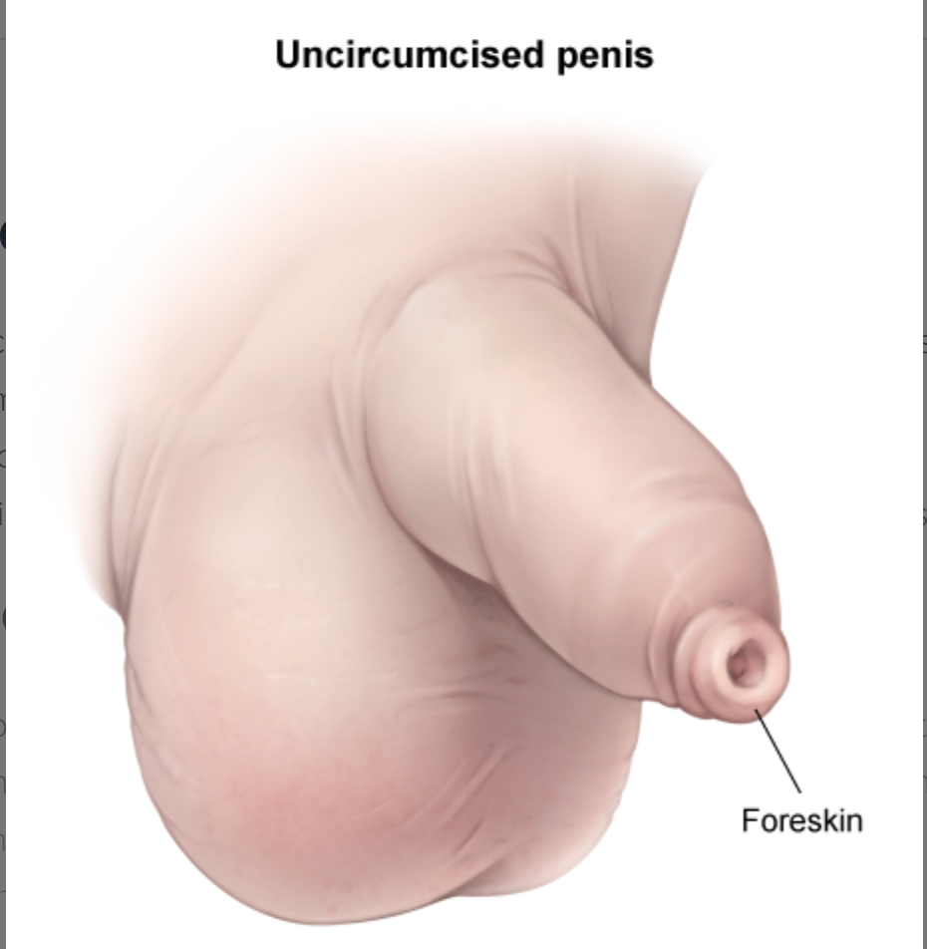
Definition
Surgical removal of the prepuce (foreskin)
Prepuce = skin covering the glans penis
Most common elective surgical procedure worldwide
Performed for medical, religious and cultural reasons

Slide 3
Applied Anatomy — Prepuce
Foreskin has inner and outer layer
Inner layer adheres to glans at birth
Preputial adhesions separate by age 3–5
Foreskin fully retractile by late childhood
[ Diagram: prepuce layers and anatomy ]
Prof. Dr. Zahid Mahmood | LMDC | Hameed Latif Hospital | Ghurki Trust Teaching Hospital | 03004130159

Slide 4
Normal Foreskin Development
Foreskin non-retractile at birth — normal
90% retractile by age 3 years
99% retractile by age 17 years
Physiological phimosis — do not force retract
[ Graph: foreskin retractility by age ]
Prof. Dr. Zahid Mahmood | LMDC | Hameed Latif Hospital | Ghurki Trust Teaching Hospital | 03004130159

Slide 5
Medical Indications — Absolute
Pathological phimosis — scarred foreskin
Balanitis xerotica obliterans (BXO)
Recurrent balanitis — infection of glans
Paraphimosis — non-reducible retracted foreskin
[ Image: pathological phimosis ]
Prof. Dr. Zahid Mahmood | LMDC | Hameed Latif Hospital | Ghurki Trust Teaching Hospital | 03004130159

Slide 6
Medical Indications — Relative
Recurrent urinary tract infections in boys
Vesicoureteric reflux with recurrent UTI
HIV prevention — evidence-based
Penile cancer prevention — reduced risk
[ Infographic: relative indications list ]
Prof. Dr. Zahid Mahmood | LMDC | Hameed Latif Hospital | Ghurki Trust Teaching Hospital | 03004130159

Slide 7
Religious Indication
Obligatory in Islam — Sunnah practice
Obligatory in Judaism — performed day 8
Performed by millions worldwide annually
Most common reason for circumcision globally
[ Image: religious context of circumcision ]
Prof. Dr. Zahid Mahmood | LMDC | Hameed Latif Hospital | Ghurki Trust Teaching Hospital | 03004130159

Slide 8
Phimosis — Definition
Inability to retract foreskin over glans
Physiological — normal in young boys
Pathological — due to scarring or BXO
Only pathological phimosis needs surgery
[ Diagram: phimosis — tight foreskin ring ]
Prof. Dr. Zahid Mahmood | LMDC | Hameed Latif Hospital | Ghurki Trust Teaching Hospital | 03004130159

Slide 9
Balanitis Xerotica Obliterans (BXO)
Chronic inflammatory skin condition
Foreskin becomes white, scarred and rigid
Meatus can also become stenosed
Circumcision is the only curative treatment
[ Image: BXO appearance — white scar tissue ]
Prof. Dr. Zahid Mahmood | LMDC | Hameed Latif Hospital | Ghurki Trust Teaching Hospital | 03004130159

Slide 10
Paraphimosis
Retracted foreskin trapped behind glans
Foreskin cannot be reduced forward
Oedema and ischaemia of glans develops
Surgical emergency — reduce or dorsal slit
[ Image: paraphimosis clinical appearance ]
Prof. Dr. Zahid Mahmood | LMDC | Hameed Latif Hospital | Ghurki Trust Teaching Hospital | 03004130159

Slide 11
Paraphimosis — Management
Manual reduction first — squeeze glans
Ice and compression reduce oedema
Dorsal slit if manual reduction fails
Elective circumcision after acute episode
[ Diagram: manual reduction technique ]
Prof. Dr. Zahid Mahmood | LMDC | Hameed Latif Hospital | Ghurki Trust Teaching Hospital | 03004130159

Slide 12
Balanitis — Recurrent
Inflammation of glans and foreskin
Usually due to poor hygiene under foreskin
Three or more episodes — consider circumcision
Swab and treat infection first
[ Image: balanitis — red inflamed glans ]
Prof. Dr. Zahid Mahmood | LMDC | Hameed Latif Hospital | Ghurki Trust Teaching Hospital | 03004130159

Slide 13
Contraindications to Circumcision
Hypospadias — foreskin needed for repair
Chordee requiring surgical correction
Buried penis — may worsen appearance
Bleeding disorder — correct first
[ Warning diagram: contraindications list ]
Prof. Dr. Zahid Mahmood | LMDC | Hameed Latif Hospital | Ghurki Trust Teaching Hospital | 03004130159

Slide 14
Pre-Operative Assessment
Confirm medical or religious indication
Exclude hypospadias before listing
Check bleeding history and clotting screen
Obtain informed consent from parents
[ Diagram: pre-operative checklist ]
Prof. Dr. Zahid Mahmood | LMDC | Hameed Latif Hospital | Ghurki Trust Teaching Hospital | 03004130159

Slide 15
Anaesthesia
General anaesthesia — children
Local anaesthesia — adults or neonates
Penile ring block — most common technique
Dorsal nerve block also used
[ Diagram: penile ring block technique ]
Prof. Dr. Zahid Mahmood | LMDC | Hameed Latif Hospital | Ghurki Trust Teaching Hospital | 03004130159

Slide 16
Surgical Techniques — Overview
1. Dorsal slit method
2. Sleeve resection technique
3. Forceps-guided method
4. Plastibell device — neonates
[ Diagram: four circumcision techniques ]
Prof. Dr. Zahid Mahmood | LMDC | Hameed Latif Hospital | Ghurki Trust Teaching Hospital | 03004130159

Slide 17
Sleeve Resection Technique
Most common technique in older children
Mark inner and outer skin incision lines
Remove foreskin sleeve between two incisions
Suture inner and outer skin layers together
[ Diagram: sleeve resection steps ]
Prof. Dr. Zahid Mahmood | LMDC | Hameed Latif Hospital | Ghurki Trust Teaching Hospital | 03004130159

Slide 18
Dorsal Slit Method
Emergency use — paraphimosis or tight foreskin
Single incision along dorsum of foreskin
Releases tight preputial ring immediately
Not cosmetically ideal — formal repair later
[ Diagram: dorsal slit procedure ]
Prof. Dr. Zahid Mahmood | LMDC | Hameed Latif Hospital | Ghurki Trust Teaching Hospital | 03004130159

Slide 19
Plastibell Device — Neonates
Plastic ring placed under foreskin
Ligature tied over foreskin onto groove
Foreskin falls off in 5–7 days
Simple, safe, used for religious neonatal cases
[ Image: Plastibell device and application ]
Prof. Dr. Zahid Mahmood | LMDC | Hameed Latif Hospital | Ghurki Trust Teaching Hospital | 03004130159

Slide 20
Steps of Circumcision — Summary
Retract foreskin — assess anatomy
Mark incision lines — inner and outer
Excise foreskin — haemostasis
Approximate skin edges — absorbable sutures
[ Operative diagram: circumcision steps ]
Prof. Dr. Zahid Mahmood | LMDC | Hameed Latif Hospital | Ghurki Trust Teaching Hospital | 03004130159

Slide 21
Intraoperative Care
Identify and protect frenular artery
Ensure meatus is normal before excising
Avoid removing too much inner skin
Bipolar diathermy for haemostasis
[ Diagram: frenular artery and anatomy ]
Prof. Dr. Zahid Mahmood | LMDC | Hameed Latif Hospital | Ghurki Trust Teaching Hospital | 03004130159

Slide 22
Post-Operative Care
Paraffin gauze dressing applied
Analgesics — paracetamol and ibuprofen
Avoid tight underwear for one week
Return if bleeding, swelling or fever
[ Image: post-circumcision dressing ]
Prof. Dr. Zahid Mahmood | LMDC | Hameed Latif Hospital | Ghurki Trust Teaching Hospital | 03004130159

Slide 23
Early Complications
Bleeding — most common early complication
Haematoma — blood collection under skin
Infection — redness, discharge, fever
Urinary retention — swelling of meatus
[ Diagram: early complications list ]
Prof. Dr. Zahid Mahmood | LMDC | Hameed Latif Hospital | Ghurki Trust Teaching Hospital | 03004130159

Slide 24
Late Complications
Meatal stenosis — narrowed urinary opening
Skin bridge — adhesion between shaft and glans
Inclusion cyst — buried smegma
Inadequate or excessive skin removal
[ Diagram: late complications illustrated ]
Prof. Dr. Zahid Mahmood | LMDC | Hameed Latif Hospital | Ghurki Trust Teaching Hospital | 03004130159

Slide 25
Meatal Stenosis
Narrowing of urinary meatus after circumcision
Presents with poor stream or deflected stream
Caused by meatitis — inflammation post-op
Treatment: meatotomy or meatoplasty
[ Diagram: meatal stenosis and meatotomy ]
Prof. Dr. Zahid Mahmood | LMDC | Hameed Latif Hospital | Ghurki Trust Teaching Hospital | 03004130159

Slide 26
Serious Complications — Rare
Penile amputation — catastrophic error
Necrotising fasciitis — rapidly fatal
Urethrocutaneous fistula — rare
Death — very rare, from anaesthesia or sepsis
[ Infographic: rare but serious complication list ]
Prof. Dr. Zahid Mahmood | LMDC | Hameed Latif Hospital | Ghurki Trust Teaching Hospital | 03004130159

Slide 27
Benefits of Circumcision
Prevents phimosis and paraphimosis
Reduces urinary tract infections by 10 times
Reduces HIV transmission risk by 50–60%
Virtually eliminates penile cancer risk
[ Infographic: 4 evidence-based benefits ]
Prof. Dr. Zahid Mahmood | LMDC | Hameed Latif Hospital | Ghurki Trust Teaching Hospital | 03004130159

Slide 28
Risks vs Benefits
Complication rate: 0.2–0.6% overall
Benefits greatest with medical indication
Routine neonatal — debated in Western countries
In Islam — Sunnah benefit beyond medicine
[ Diagram: risk vs benefit balance scale ]
Prof. Dr. Zahid Mahmood | LMDC | Hameed Latif Hospital | Ghurki Trust Teaching Hospital | 03004130159

Slide 29
Adult Circumcision
Same indications as in children
Local anaesthesia preferred in adults
Recovery takes 2–3 weeks
Sexual intercourse after 4–6 weeks
[ Diagram: adult circumcision technique ]
Prof. Dr. Zahid Mahmood | LMDC | Hameed Latif Hospital | Ghurki Trust Teaching Hospital | 03004130159

Slide 30
Circumcision in Diabetes
Recurrent balanitis common in diabetics
Poor glycaemic control delays wound healing
Control blood sugar before surgery
Higher infection risk — antibiotic cover
[ Diagram: diabetes and penile hygiene ]
Prof. Dr. Zahid Mahmood | LMDC | Hameed Latif Hospital | Ghurki Trust Teaching Hospital | 03004130159

Slide 31
Topical Steroid Alternative
Betamethasone 0.05% cream applied twice daily
Apply to tight foreskin for 4–6 weeks
Loosens foreskin in 70–80% of cases
First-line for physiological phimosis
[ Image: topical steroid application technique ]
Prof. Dr. Zahid Mahmood | LMDC | Hameed Latif Hospital | Ghurki Trust Teaching Hospital | 03004130159

Slide 32
Preputioplasty
Widens the foreskin without removing it
Preserves the foreskin — patient preference
Dorsal slit and transverse closure
Alternative to circumcision for phimosis
[ Diagram: preputioplasty technique ]
Prof. Dr. Zahid Mahmood | LMDC | Hameed Latif Hospital | Ghurki Trust Teaching Hospital | 03004130159

Slide 33
Clinical Case 1
Boy, 8 years, recurrent tight foreskin
Cannot retract — white scarring visible
Diagnosis: BXO — pathological phimosis
Treatment: circumcision — only curative option
[ Image: BXO — white scarred foreskin ]
Prof. Dr. Zahid Mahmood | LMDC | Hameed Latif Hospital | Ghurki Trust Teaching Hospital | 03004130159

Slide 34
Clinical Case 2
Man, 45 years, foreskin stuck behind glans
Oedematous swollen glans, cannot reduce
Diagnosis: paraphimosis
Management: manual reduction then elective circumcision
[ Image: paraphimosis reduction technique ]
Prof. Dr. Zahid Mahmood | LMDC | Hameed Latif Hospital | Ghurki Trust Teaching Hospital | 03004130159

Slide 35
MCQs — Questions 1 to 4
Q1: Most common early complication? — Bleeding
Q2: BXO — treatment of choice? — Circumcision
Q3: Absolute contraindication? — Hypospadias
Q4: Late complication of circumcision? — Meatal stenosis
[ MCQ answer card ]
Prof. Dr. Zahid Mahmood | LMDC | Hameed Latif Hospital | Ghurki Trust Teaching Hospital | 03004130159

Slide 36
MCQs — Questions 5 to 8
Q5: Paraphimosis — first step? — Manual reduction
Q6: Foreskin retractile in 90% by? — Age 3 years
Q7: Neonatal technique? — Plastibell device
Q8: Topical treatment for phimosis? — Betamethasone cream
[ MCQ answer card ]
Prof. Dr. Zahid Mahmood | LMDC | Hameed Latif Hospital | Ghurki Trust Teaching Hospital | 03004130159

Slide 37
Viva Questions
Define phimosis — types and management
What are the absolute contraindications?
Describe sleeve resection technique
What is BXO and how is it treated?
[ Viva question card ]
Prof. Dr. Zahid Mahmood | LMDC | Hameed Latif Hospital | Ghurki Trust Teaching Hospital | 03004130159

Slide 38
High-Yield Exam Points
Never circumcise hypospadias — key exam rule
BXO — only curative treatment is circumcision
Paraphimosis — emergency, reduce first
Physiological phimosis — normal until age 3
[ Summary: 4 must-know exam facts ]
Prof. Dr. Zahid Mahmood | LMDC | Hameed Latif Hospital | Ghurki Trust Teaching Hospital | 03004130159

Slide 39
References
Bailey & Love — 27th Edition
Sabiston Textbook of Surgery — 21st Ed
EAU Guidelines — Male Sexual Health 2023
Schwartz Principles of Surgery — 11th Ed
[ Textbook covers ]
Prof. Dr. Zahid Mahmood | LMDC | Hameed Latif Hospital | Ghurki Trust Teaching Hospital | 03004130159

Slide 40
جزاک اللہ خیراً
Thank You
Prof. Dr. Zahid Mahmood
Professor of Surgery — LMDC
Hameed Latif Hospital (6–8 PM, Mon–Sat)
Ghurki Trust Hospital (Tue & Thu, 9AM–1PM)
📞 03004130159
professorzahid.com
Prof. Dr. Zahid Mahmood | LMDC | Hameed Latif Hospital | Ghurki Trust Teaching Hospital | 03004130159

