Slide 1
بِسْمِ اللّٰهِ الرَّحْمٰنِ الرَّحِيْمِ
Acute Appendecitis
Prof. Zahid Mahmood

Slide 2
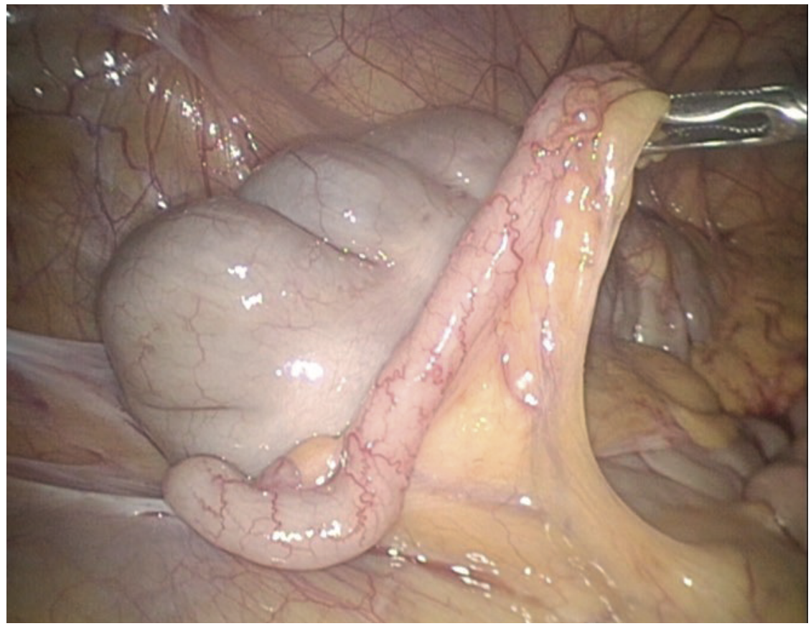

Slide 3
Learning Objectives
Understand anatomy
Explain etiology
Recognize clinical features
Outline management

Slide 4
Introduction
Most common acute abdomen
Young adults common
Clinical diagnosis key
Frequent emergency surgery

Slide 5
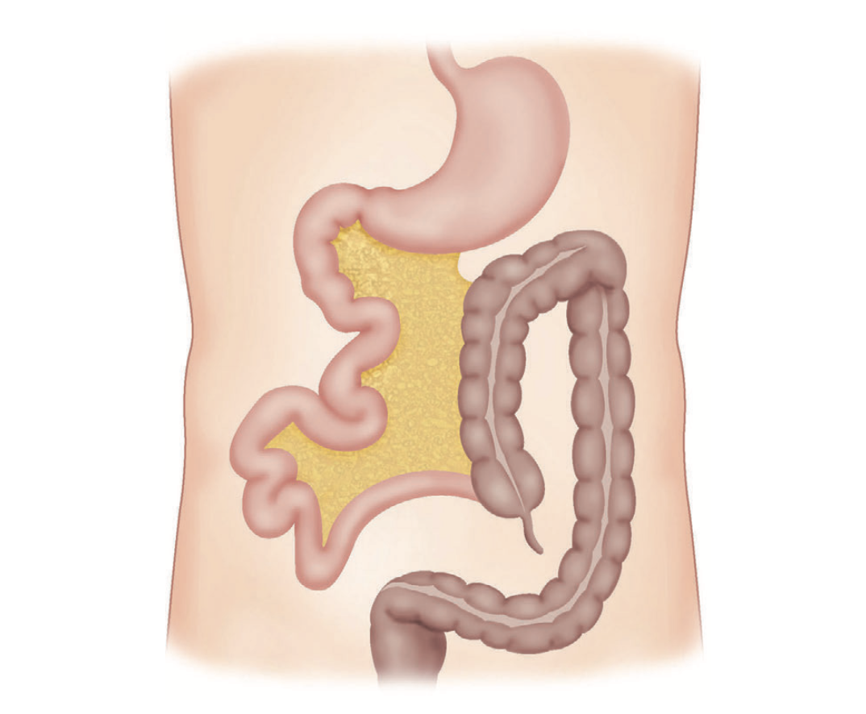
Anatomy
Blind muscular tube
From caecum
Length 7–10 cm
Variable position

Slide 6
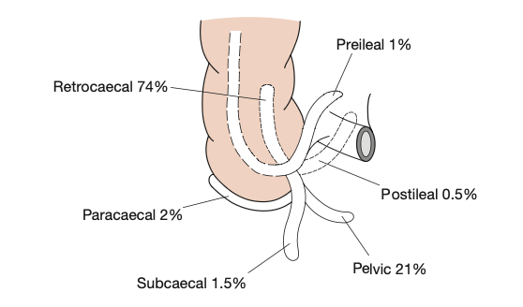
Positions
Retrocaecal common
Pelvic
Subcaecal
Paracaecal

Slide 7
Blood Supply
Appendicular artery
Ileocolic branch
End artery
Thrombosis → gangrene

Slide 8
Lymphatics
Ileocaecal nodes
Multiple channels
Spread infection
Inflammation role

Slide 9
Microscopy
Columnar epithelium
Lymphoid tissue
Narrow lumen
Crypts present

Slide 10
Epidemiology
Teens peak
Rare infants
Declines age
Male predominance

Slide 11
Aetiology
Luminal obstruction
Faecolith common
Mixed infection
Low fiber diet

Slide 12
Obstruction Causes
Faecolith
Hyperplasia
Tumor
Parasites

Slide 13
Pathogenesis
Obstruction
Pressure increase
Venous block
Ischemia

Slide 14
Progression
Inflammation
Bacterial invasion
Gangrene
Perforation

Slide 15
Complications
Peritonitis
Abscess
Phlegmon
Sepsis

Slide 16
History
Periumbilical pain
Shift to RIF
Anorexia
Vomiting

Slide 17
Pain
Visceral → somatic
Localized RIF
Movement worsens
Progressive

Slide 18
Symptoms
Nausea
Fever
Anorexia
Malaise

Slide 19
Signs
RIF tenderness
Guarding
Rebound
Pyrexia

Slide 20
Special Signs
McBurney
Rovsing
Psoas
Obturator

Slide 21
Atypical
Elderly vague
Children delay
Pelvic suprapubic
Retrocaecal silent

Slide 22
Differential
Gastroenteritis
Ureteric colic
Crohn’s
Pancreatitis

Slide 23
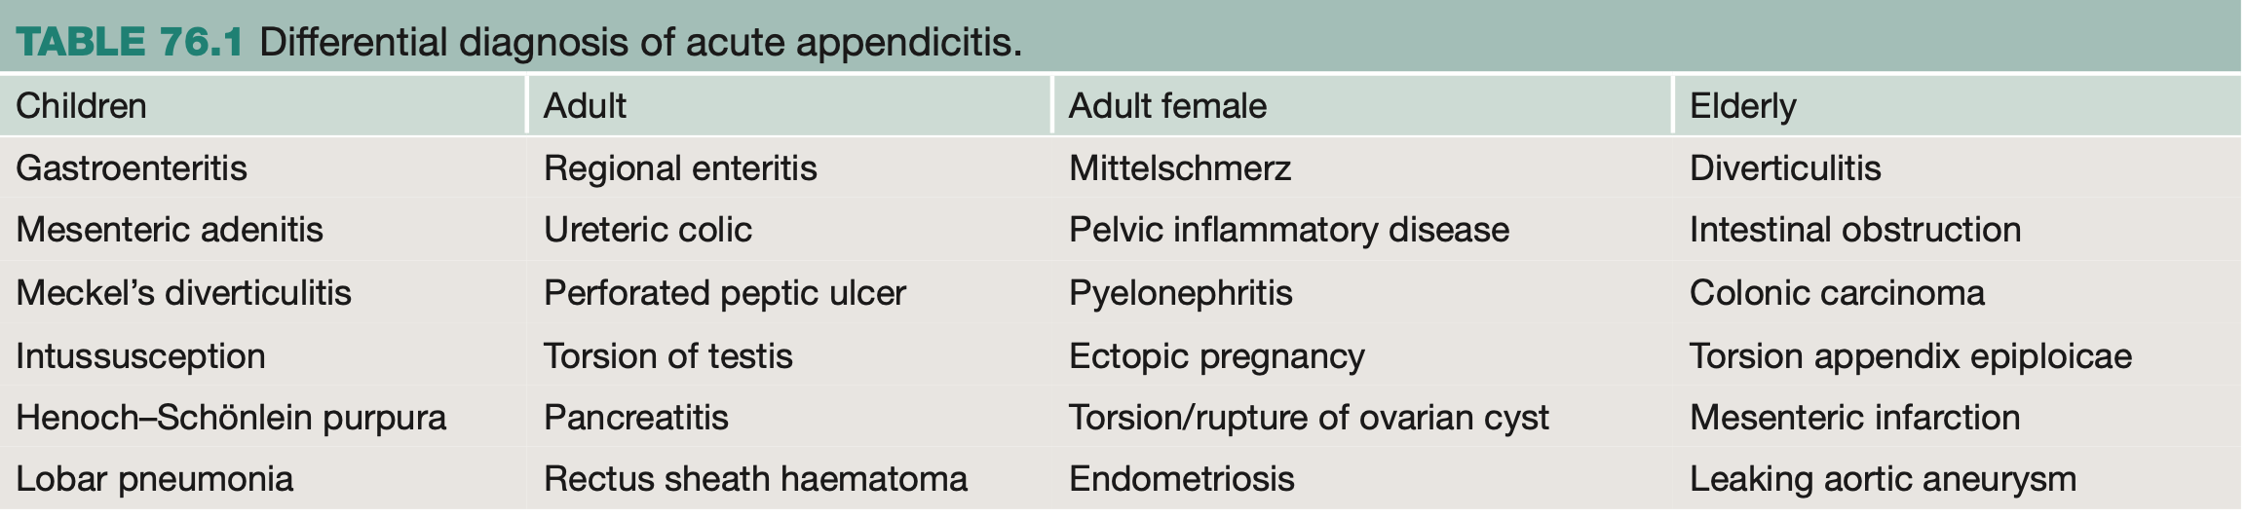

Slide 24
Female Differentiate
PID
Ectopic
Ovarian cyst
Mittelschmerz

Slide 25
Elderly Differentiate
Diverticulitis
Carcinoma
Obstruction
Ischemia

Slide 26
Investigations
Clinical primary
CBC
Urinalysis
CRP

Slide 27
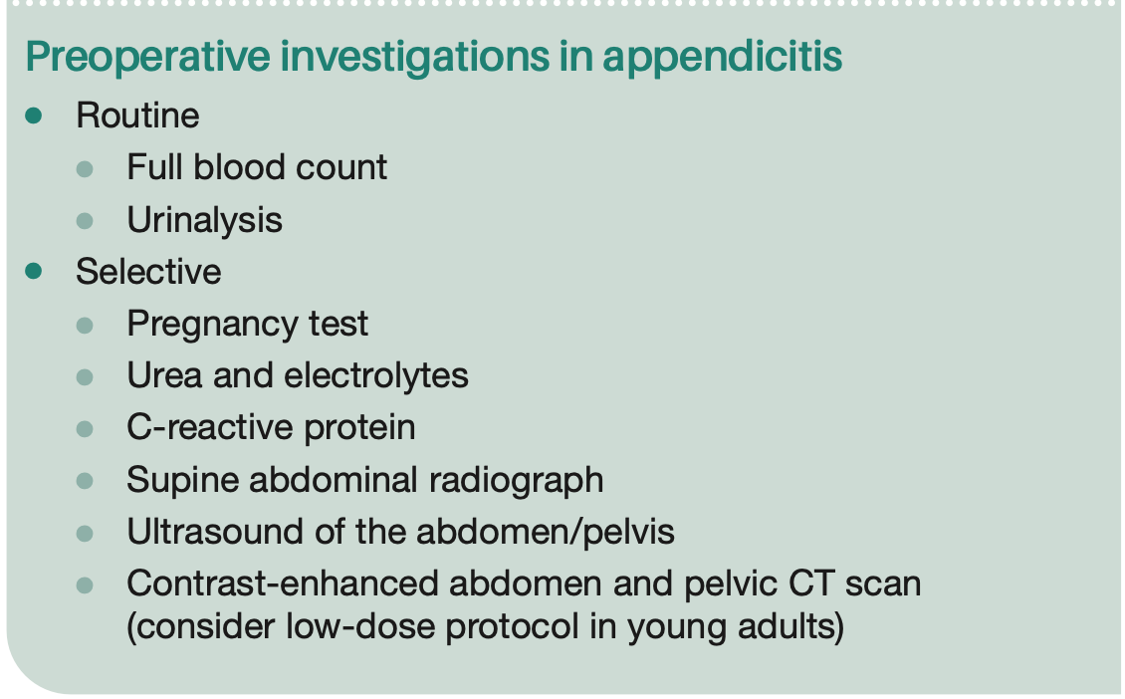

Slide 28
Alvarado
Score ≥7 likely
5–6 imaging
Clinical tool
Widely used

Slide 29
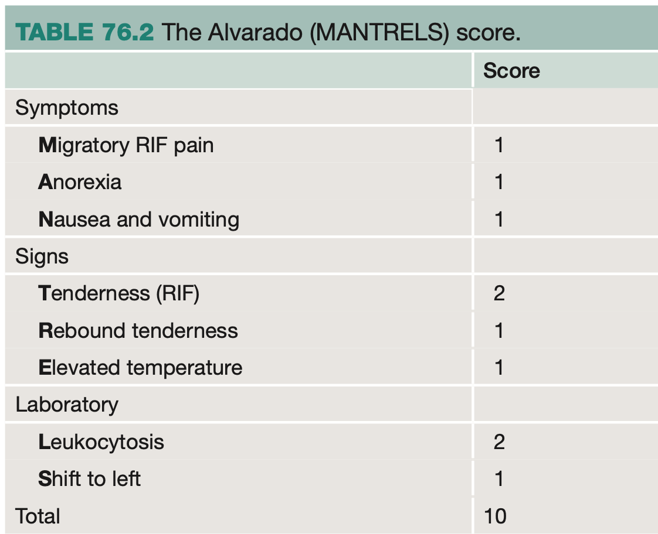

Slide 30
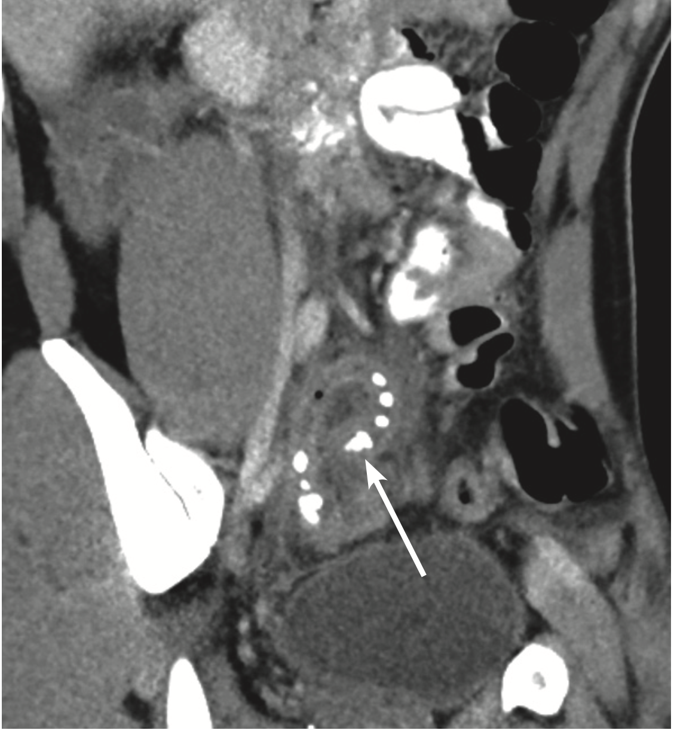
Imaging
US children
CT gold standard
95% accuracy
Detect complications

Slide 31
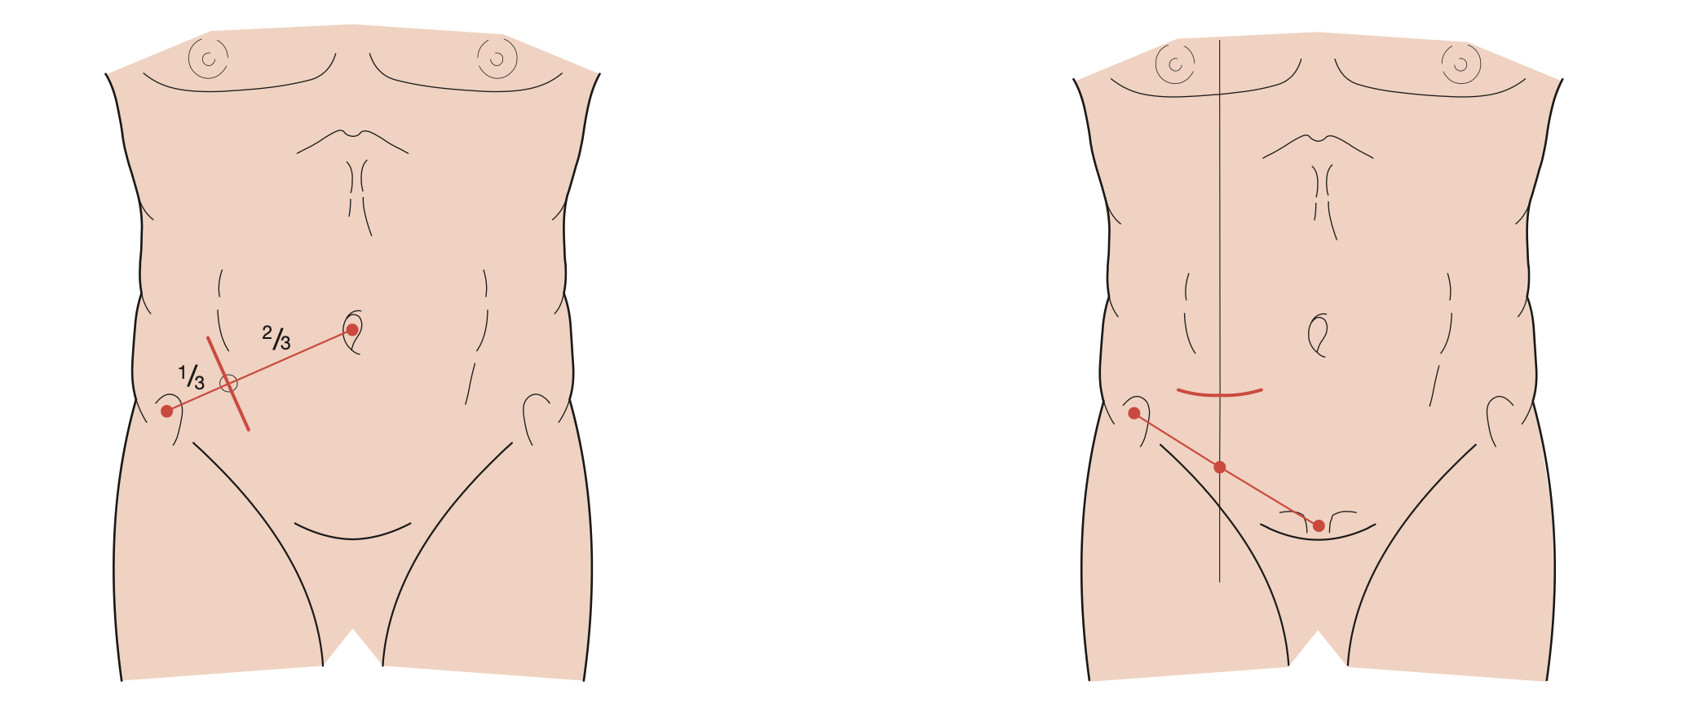
Treatment
Appendicectomy
Early intervention
Resuscitation
Antibiotics

Slide 32
Conservative
Uncomplicated
IV antibiotics
85% success
Recurrence

Slide 33
Appendix Mass
Ochsner regimen
Conservative
Monitor
Operate if worse

Slide 34
Indications
Deterioration
Peritonitis
Failure
Complications

Slide 35
Surgery
Open
Laparoscopic
Preferred lap
Faster recovery

Slide 36
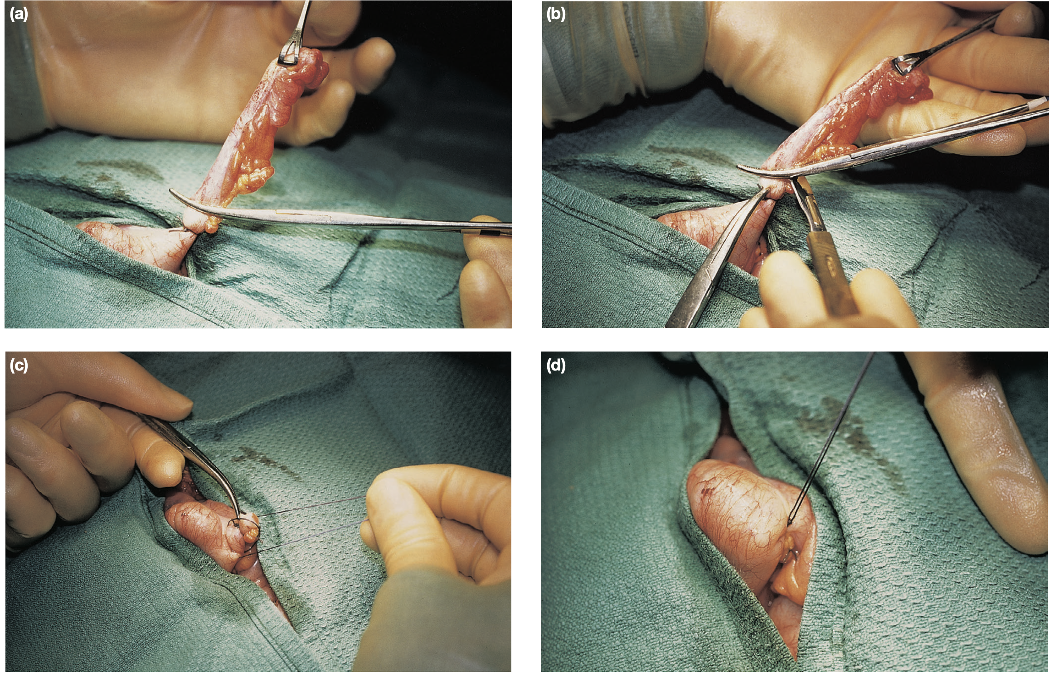

Slide 37
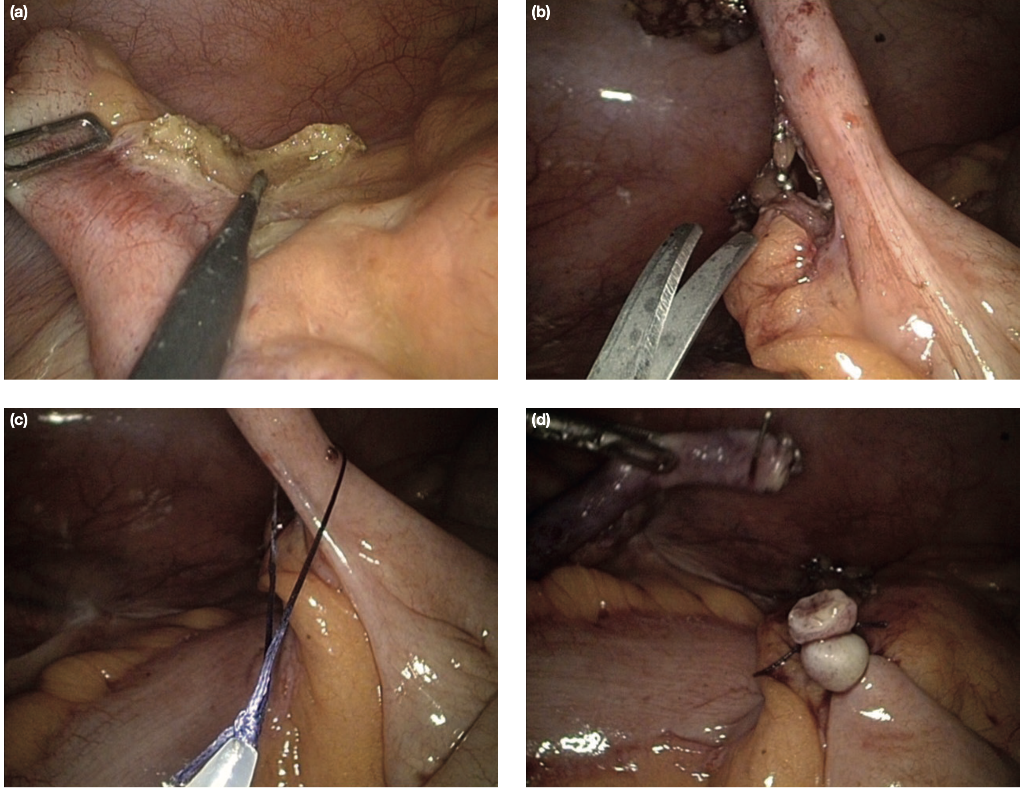

Slide 38
Incisions
McBurney
Lanz
Rutherford
Midline

Slide 39
Post-op
Infection
Abscess
Ileus
Adhesions

Slide 40
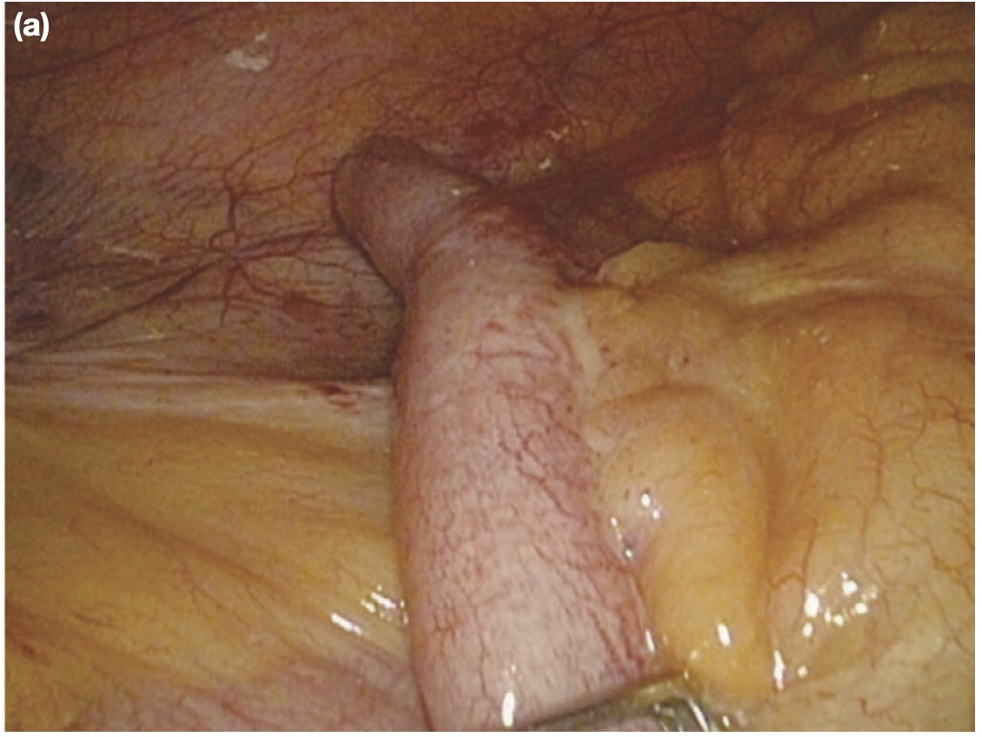

Slide 41
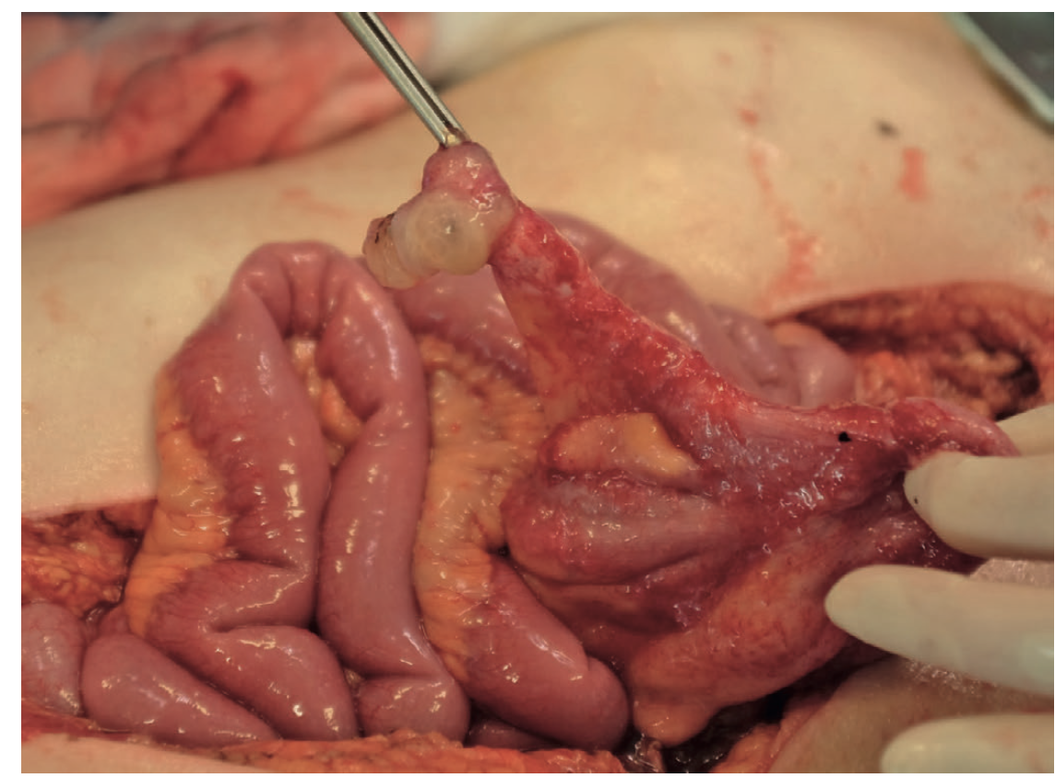

Slide 42
Serious
Peritonitis
Sepsis
Pyaemia
Fistula

Slide 43
