Slide 1
بِسْمِ اللّٰهِ الرَّحْمٰنِ الرَّحِيْمِ
Prof. Zahid Mahmood

Slide 2
The Abdominal Wall: Anatomy, Pathology & Hernias

Slide 3
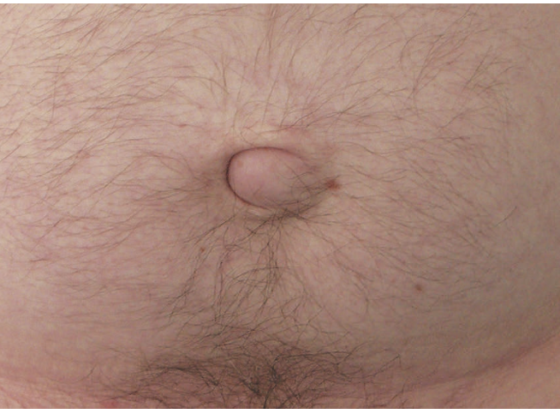
Paraumbilical Hernia

Slide 4
Learning Outcomes
Describe abdominal wall anatomy & areas of weakness
Classify abdominal wall hernias & their causes
Explain pathophysiology & complications of hernia
Outline diagnostic methods for hernia detection
Discuss management principles & mesh technology

Slide 5
Clinical Scenario
50-year-old obese male with groin bulge; reduces on lying; pain on straining
What are the likely diagnoses and red flags?
How will you examine and investigate?

Slide 6
Abdominal Wall – Basic Anatomy
Skin/Subcutaneous
External Oblique
Internal Oblique
Transversus
Peritoneum
Components: muscles, bones, fascia; function: protection + mobility
Roof: diaphragm (negative thoracic vs positive abdominal pressure)
Floor: pelvis & perineum (risk of pelvic organ prolapse)

Slide 7
Muscle Arrangement & Weak Areas
Posterior wall strong (vertebrae, ribs, pelvis) – rare lumbar hernias
Lateral wall: 3 crisscross muscle layers → strength + flexibility
Anterior: rectus abdominis; Linea alba is potential weak point (umbilical/epigastric)

Slide 8
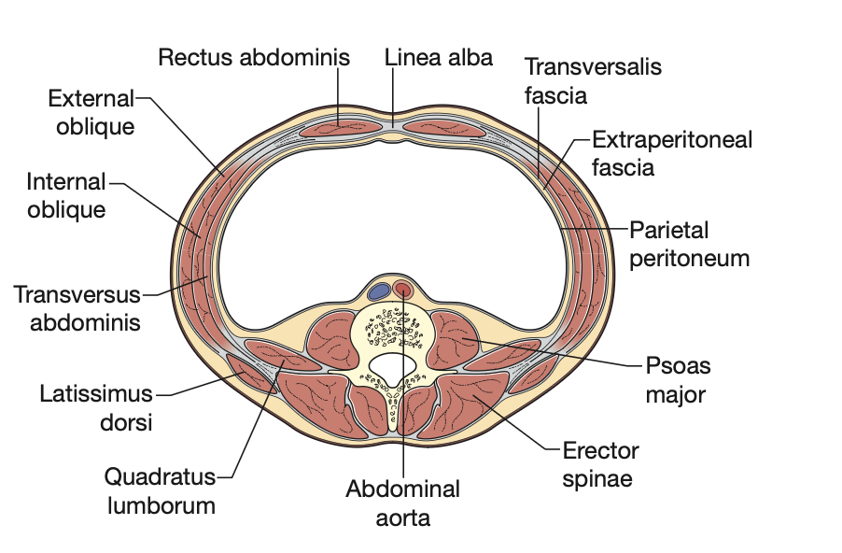

Slide 9
Divarication of Recti (Not a Hernia)
Linea alba stretches; recti separate
Common: upper abdomen of overweight men; postpartum women (below umbilicus)
Usually cosmetic; repair only for cosmesis

Slide 10
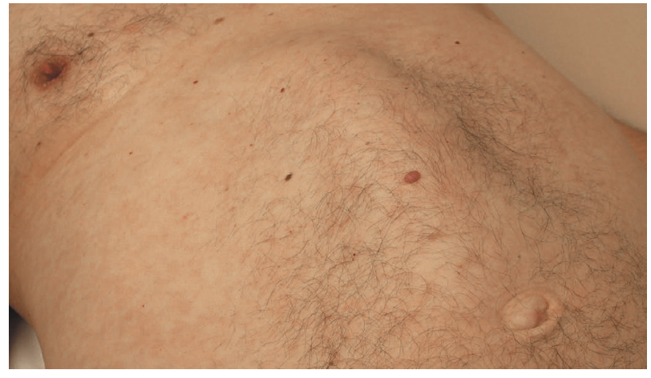

Slide 11
What is a Hernia?
Abnormal protrusion through a weakness in abdominal wall
May lack peritoneal sac (small epigastric hernias)
Common sites: inguinal, femoral, umbilical, epigastric, incisional, traumatic

Slide 12
Causes of Abdominal Wall Herniation
Natural weakness: lumbar triangles; inguinal canal; umbilicus; femoral canal; hiatus
Developmental failure: patent processus vaginalis → indirect inguinal hernia
Congenital defects: Morgagni, Bochdalek, some umbilical hernias
Acquired: incisional (10% after laparotomy), port-site (≈1%), blunt trauma

Slide 13
Risk Factors & Collagen Biology
‘Collagen disease’ hypothesis: imbalance of collagen types → weakness
Associations: aortic aneurysm, Ehlers–Danlos; smoking impairs collagen maturation
Elderly: degenerative muscles/fascia; surgical closure technique matters

Slide 14
Pathophysiology of Hernia
Defect
Two components: DEFECT + CONTENT
Small rigid neck → incarceration → obstruction → strangulation → infarction
Sliding hernia, interstitial hernia concepts
Hernia sac/Content
Incarceration
Strangulation
Infarction

Slide 15
Types by Complexity
Occult · Reducible · Irreducible · Incarcerated · Strangulated · Infarcted
Pain, tenderness, skin changes = high risk; emergency in strangulation

Slide 16
Richter’s Hernia
Only part of bowel wall enters the defect → may lack obstruction
High risk of necrosis & perforation; diagnostic delay common (femoral hernia)

Slide 17
Clinical History & Presentation
Lump/bulge ± reducibility; heavy ache; sharp pains suggest neck pinching
Ask: spontaneous vs assisted reduction, obstruction symptoms
Primary vs recurrent vs incisional hernia affects approach

Slide 18
Examination for Hernia
Inspect & palpate: supine then standing; Valsalva/cough impulse
Check reducibility; skin colour; tenderness
Always examine contralateral groin; note prior scars/repairs

Slide 19
Investigations
Clinical exam is primary; imaging when uncertain or complex
Ultrasound: low-cost, dynamic; operator dependent
CT: complex ventral/incisional; plan reconstruction; rule out other pathology
MRI: sportsman’s groin with pain; Laparoscopy: detect occult defects

Slide 20
Management Principles
Not all hernias need repair; assess risk & symptoms
Always repair femoral hernias; symptomatic/irreducible → repair
Elderly asymptomatic inguinal: watchful waiting reasonable
Acute painful irreducible hernia → urgent surgery

Slide 21
Surgical Approach – General Steps
Reduce contents; excise/close sac (if present)
Close defect when feasible; protect traversing structures
Reinforce repair with mesh (tension-free)
Open vs laparoscopic approaches
Reduce contents
Deal with sac
Close defect
Mesh reinforcement

Slide 22
Mesh in Hernia Repair – Concepts
Uses: bridge, plug (less used), augment
Complications: meshoma, migration, erosion, fistula, infection
Prefer lightweight, large-pore synthetic meshes to reduce fibrosis/contracture

Slide 23
Mesh Types & Placement Planes
Synthetic: Polypropylene, Polyester, PTFE; Biological: dermis/pericardium/submucosa
Tissue-separating meshes for intraperitoneal use (adhesion-minimizing surfaces)
Placement: Onlay · Inlay (avoid) · Sublay/Retromuscular · Extraperitoneal · Intraperitoneal
Onlay
Sublay
Extraperitoneal
Intraperitoneal

Slide 24
Take-Home Message
Hernias arise from anatomical/developmental/acquired weaknesses
Small neck ⇒ higher risk of incarceration/strangulation
Diagnosis is clinical; image when uncertain/complex
Repair symptomatic/femoral/irreducible; consider watchful waiting in select cases
Mesh reinforcement is standard; prefer lightweight, large-pore meshes; avoid intraperitoneal when possible

